Slide 1
WELCOME
To The
Project Presentation ON
Fast Bite(Fast Food)
Designed & Developed by Rahul .R. Nishad
Guided by
Asst.Prof.: GaneshKumar R. Narayankar
Shankar Narayan College

Slide 2
Introduction
In the world of this fastes growing Social Media platform the two most famous things is Food & Traveling .
After long lockdown people also miss the street foods or fast foods of their favourite places and can go for the same without thinking of time.
This has made restaurants open their eyes as well and now one can find an array of healthy menus in the restaurants .
- The web application is know as “Fast Bite ‘’ is about the Fast
Foods and Beverages with recipes all ingredients needed is here and many more option plus also with the nearby Restaurants, and famous
Street food, location.

Slide 3
Proposed System
The purpose of the Online Fast Food System is to automate the existing manual system with the help of this web application and full-fledged software, fulfilling user and their requirements, so that their valuable data/information can be stored for a long period with easy accessing and manipulation of a the same.

Slide 4
Main Objective to Project
-The main objective of the Project on the Fast Bite is to manage details of Food Items, Categories, Saved to Cart,Customers Order, and Confirm Order. It manages all the information about Food items,Payments, Confirm orders, Fast Food & Beverages items.
-The project is totally built at the administrative end and thus only the administrator is guaranteed the access.
- The purpose of the project is to build an web application program to reduce the manual work for managing the Food Items, Categories, Payment, and Customers. It tracks all the details about the Customer, Order, and Confirms Order.

Slide 5
Module Of The Project
Login Module : Used for managing the login details
Users Module: Used for managing the users of the system.
Increase Level of Visibility & Information –- You can have your Favourite fast Food Menu card customized, to present comprehensive information on each and every dish & beverages you mentioned – like the ingredients used,recipes, calorie count, etc.
Provide Customer Opinion –-Through the Fast Bite menu card web app you and the user can understand important things like which of the promotional features are being viewed the most by customers, which dishes are getting more popular, etc. They can collect and sort answers to provide you with some very essential information related to your business.

Slide 6
Advantages
Fast food is cheap.
It saves time.
There are healthy options too.
There are a plethora of choices.
Fast food tastes good.
Order at your place.

Slide 7
Disadvantages
More Shopping at the Grocery Store.
Have to Clean Up Afterwards.
3-No Enthusiasm for Cooking.
4-Lack of Cooking Skills.
5-Practical Limitations.
6-Restaurants Are Great for Your Social Life
7-Restaurants Can Provide Inspiration.
8-Buying Ingredients Can Be Costly

Slide 8
System Requirement
Windows requirements->: Windows 8 or later 64-bit
Processor-> : Intel Pentium 4 or later
Memory -> : 2 GB minimum, 4 GB recommended
Screen resolution -> : 1280x1024 or larger
Application window size -> : 1024x680 or larger
Internet connection -> : Required
Front-end :
-HTML 5
-CSS version :CSS3
-JavaScript Version :ES2015

Slide 9
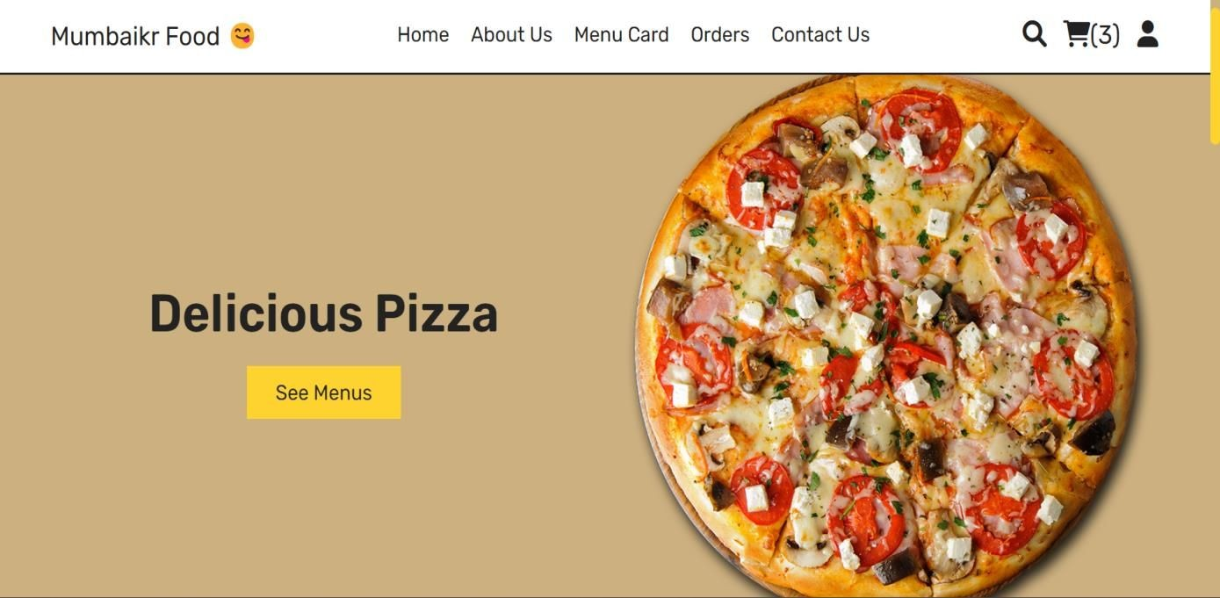
Screenshot & Report Layout

Slide 10

Screenshots & Report Layout

Slide 11
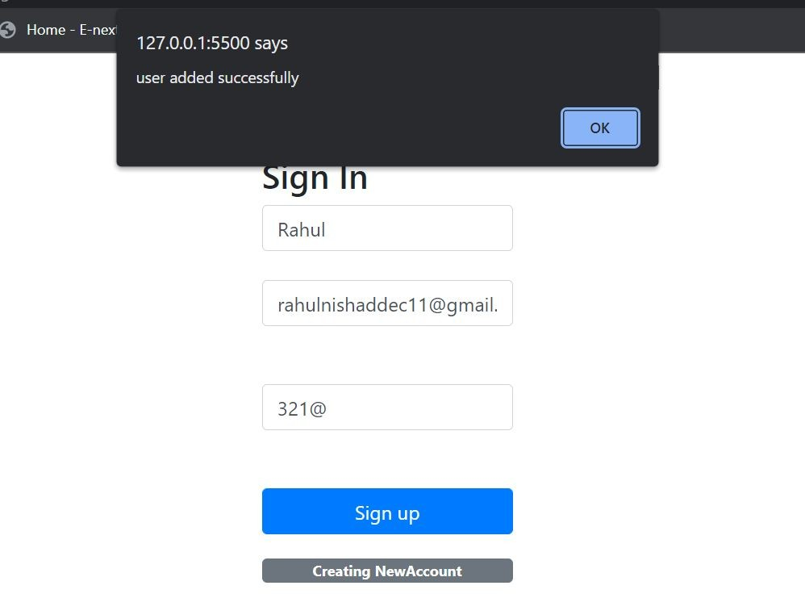
Screenshots & Report Layout

Slide 12
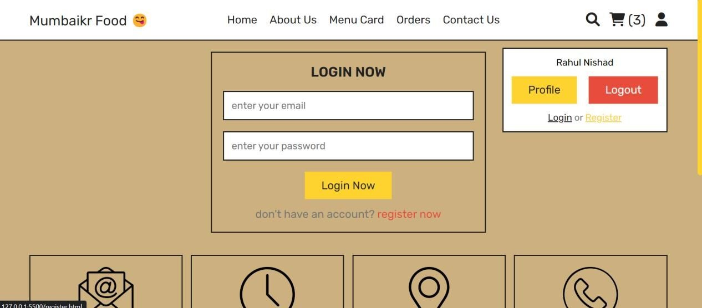
Screenshot & Report Layout

Slide 13
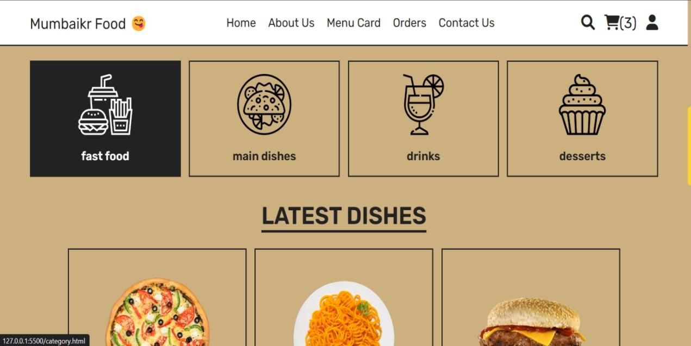
Screenshots & Report Layout

Slide 14
Future Enhancement
–In future, I will add an PHP ( Hypertext Preprocessor) server-side scripting language that many devs use for web development.
–I’ll be Providing delivery system at the customer door steps by Drone systems.
–Their will be all over cultural foods and their recipes and most trending features.
User can make changes on this web application and much more

Slide 15
Conclusion
–To summarize, this was thoroughly enjoy a ble assignment, giving ample opportunity to consolidate m y learning into a viable web application.
–While selecting this project, I realized the problems faced during recording attendance manually. This web
application will help to learn and order easily and quickly by this project .
–The Dishes , account ,contents , review gets stored directly in the database.
From this project, I have Learned how an website/web application is developed. I have realized this long path is very extensive and requires a lot of work .

Slide 16
Thank You

