Slide 1
Team Name
Formula 4

Slide 2
Team name and member details
EY Techathon 2: #iSolve4aBillion Challenge
1. | Rahul Mayekar
2. | Swati Sahai
3. | Sai Ranjani Chandrashekar
4. | Chandramohan Chauhan
Welingkar Institute of Management, Mumbai.
PGDM 21-23.
Problem statement: Bringing transparency in carbon credit calculation
Page 2

Slide 3
Problem statement
EY Techathon 2: #iSolve4aBillion Challenge
Carbon footprint may be defined as “the amount of gaseous emissions that are relevant to climate change
(gases with greenhouse effect) and associated with human production or consumption activities.
Carbon footprint is measured in carbon dioxide equivalent (CO2e)
Carbon credit is calculated manually by gathering data and vetting it. Since the manual processes are
prone to tampering at any stage and also time consuming, We are suggesting to use block chain technology , to automate the calculation of carbon credits- by implementing smart contracts that would verify
carbon emissions in every stage of the project.
Why blockchain?
A blockchain is a distributed database that is shared among the nodes of a computer network
All committed transactions are stored in a chain of blocks. We can use block chains like Ethereum, that offers a decentralized
virtual machine to handle smart contracts, which are like digital contracts that control users’ digital assets, formulating the participants’ rights and obligations
Page 3

Slide 4
Our focus
EY Techathon 2: #iSolve4aBillion Challenge
We will be automating the calculation of carbon footprint using the block chain technology that will help in calculating the carbon credit.
We calculate Carbon footprint from end to end activities of a corporate- example a manufacturing activity wherein we consider calculating the carbon footprint right from sourcing of raw materials, manufacturing activity, packaging, recycling of usage of plastic/ any other raw material if any that will result in positive credits, till delivery.
We will be generating a certificate- which have an identification information on the non-fungible token and using that cannot be replaced by another token or manipulated.
This NFT can be used by the vetting agencies to transparently audit them.

Slide 5
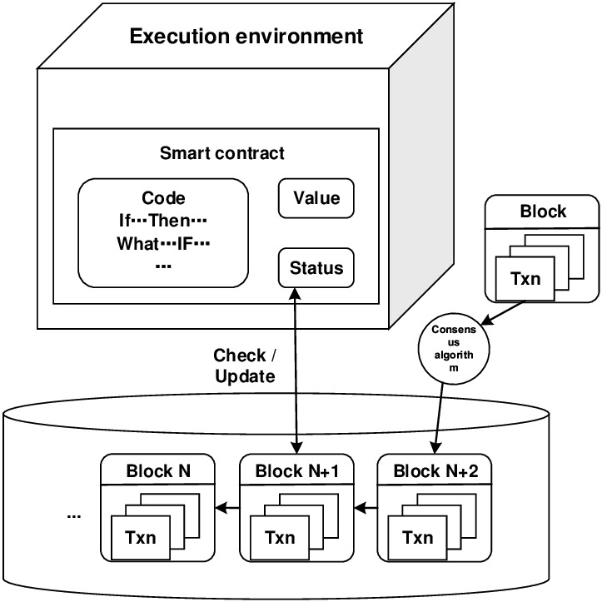
Solution
EY Techathon 2: #iSolve4aBillion Challenge
Frameworks/tools/technologies stacks used
Blockchain – Ethereum Blockchain, Solidity, Vyper
Web Application – HTML, python and Flask
Page 4

Slide 6
Steps involved
EY Techathon 2: #iSolve4aBillion Challenge
Input from the user on various process listed
Processes considered for calculating carbon footprint:
Sourcing of raw materials- vehicular emissions (by various mode of transport (Land, water, Air)
Manufacturing process- emissions
Electricity consumption
Warehousing and storage if any (example- cold storage, etc)
Transportation- delivery by various mode of transport (Land, water, Air)
Page 8

Slide 7
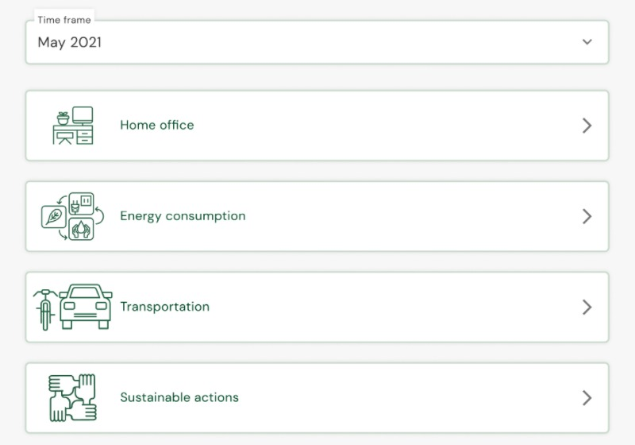
Model output
EY Techathon 2: #iSolve4aBillion Challenge
Page 7

Slide 8
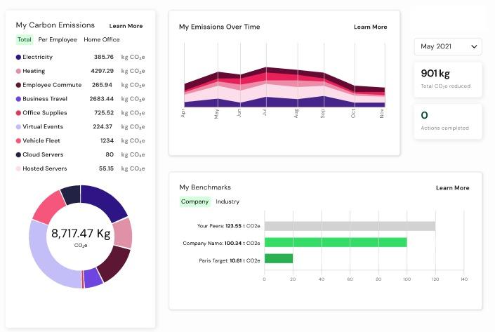
Model Output
EY Techathon 2: #iSolve4aBillion Challenge
We will be able to generate the company’s calculated carbon footprint value in a graphical form along with carbon emission per process and other relevant data as shown below
Page 8

Slide 9
Github Link
EY Techathon 2: #iSolve4aBillion Challenge
https://github.com/rahulnmayekar/Carbon-Footprint/tree/main/Prototype/example
Page 8

Slide 10
EY | Assurance | Tax | Strategy and Transactions | Consulting
About EY
EY is a global leader in assurance, tax, transaction and advisory services. The insights and quality services we deliver help build trust and confidence in the capital markets and in economies the world over. We develop outstanding leaders who team to deliver on our promises to all of our stakeholders. In so doing, we play a critical role in building a better working world for our people, for our clients and for our communities.
EY refers to the global organization, and may refer to one or more, of the member firms of Ernst & Young Global Limited, each of which is a separate legal entity. Ernst & Young Global Limited, a UK company limited by guarantee, does not provide services to clients. Information about how EY collects and uses personal data and a description of the rights individuals have under data protection legislation are available via ey.com/privacy. For more information about our organization, please visit ey.com.
© 2020 EYGM Limited. All Rights Reserved.
ED None
This material has been prepared for general informational purposes only and is not intended to be relied upon as accounting, tax or other professional advice. Please refer to your advisors for specific advice.
ey.com

