Slide 1
Facial Action Unit Recognition
- Rahul. k

Slide 2
INDEX
Introduction
literature review
Feature Extraction
Dataset Availability
Dataset collection and benchmarking
Comparative analysis(our work and benchmarking models)
Results
Limitations of current systems
Conclusion

Slide 3
Introduction
The Facial Action Coding System (FACS) taxonomizes human facial movements, enabling real-time, objective analysis of emotional states to aid stress detection in mental health applications.
This concept of decoding emotions through facial expressions is grounded in the research of Paul Ekman, who pioneered the Facial Action Coding System (FACS)
Specific combinations of Action Units (AUs) such as brow raising (AU1), eye narrowing (AU7), and lip tightening (AU23) are linked to stress, allowing psychologists to track a patient's stress levels effectively.
Research has shown that during high-stress situations, individuals often exhibit a combination of brow raising (AU1), eye narrowing (AU7), and lip tightening (AU23)

Slide 4
AU intensity is measured on a scale from 1 to 5, where 1 indicates least movement and 5 indicates maximum intensity.The intensity level of an AU (e.g., AU12 for smiling) can change the emotional interpretation—from politeness to genuine joy—making accurate intensity measurement essential.
Our work enhances AU recognition accuracy to achieve state-of-the-art performance in emotion recognition and stress detection.
This advancement aims to improve stress management and facilitate the creation of personalized stress-reduction strategies for Samjna Analytics..

Slide 5
Literature Survey
A literature survey is essential to understand the current landscape of technologies utilized for detecting Facial Action Coding System (FACS) and to inform the development of Samjna’s own AI model for detecting Action Units (AUs).
It will help us identify best practices in AU detection, reveal gaps in existing technologies, and establish benchmarks against state-of-the-art methods. This knowledge will guide our model development and foster collaboration with researchers.

Slide 6
We have obtained research articles from various well-known academic databases like IEEE, arXiv, ResearchGate to target the most recent advancements and challenges in the domain.
a set of carefully selected keywords was used(Keywords pertaining to FACS research, latest in Computer Vision models, top ranked papers and those with highest number of citations in the domain) .
These keywords were organized into two categories:
core terms such as Facial Action Unit Recognition, Affective Computing, Deep Learning, Vision Transformers, Comparative Study.
Technical focus areas like “Feature Extraction, Emotion Detection and Stress detection through facial action units”.

Slide 7
Dataset Availability
DISFA(Denver intensity of Spontaneous Facial Action).
videos of 27 individuals with 4845 frames each annotated with 12 action units
Their facial behavior was imaged using a high-resolution (1024 × 768 pixels) BumbleBee Point Grey stereo-vision system at 20 fps under uniform illumination. For each participant, 4845 video frames were recorded.
We have used DISFA in our work to train the AU detection model. Which is a publicly available dataset provided for research purposes only.

Slide 8
Other datasets which are coded with facial action units.
S.NO | Datasets | Subject count | Size per subject | Frame level labelling | Publicly Available
1 | DISFA+ | 9 | 4845 | yes | Yes(research)
2 | CK+ | 201 | 593 | yes | No
3 | AMFED | 5268 | 242 | yes | Yes(research)
4 | BP4D | 41 | 328 | yes | No
5 | CASME | 35 | 247 | no | No
6 | EmotioNet | NA | 950000 frames in total | yes | No

Slide 9
Flowchart for facial action unit detection
START
Facial image preprocessing(CLAHE and resizing)
YES
FACE DETECTED?
Video Frames
NO
Facial action unit recognition
(e.g., AU1, AU12, AU15, AU25, etc.)
Facial action unit Intensity estimation
(1-5)
Face Detection using Facial Landmarks
(DLIB)
Skip Frame
Mapping Detected Action Units to Emotions
Predicted Emotion

Slide 10
Face detection and Preprocessing
we conducted a series of experiments to fine-tune the CLAHE parameters, such as clip limit and grid size, which are crucial for maximizing the visibility of subtle facial features.
The clip limit parameter controls the contrast enhancement degree by limiting the maximum slope of the cumulative distribution function, while the grid size determines the size of the contextual regions used for histogram equalization.

Slide 11
Facial Image Preprocessing
To prepare facial images for our model and optimize computational efficiency, we standardized all inputs by resizing them to a fixed resolution of 224x224 pixels with three color channels (RGB). This was followed by applying CLAHE (Contrast Limited Adaptive Histogram Equalization), an advanced histogram equalization technique that enhances image contrast
CLAHE is particularly effective in improving feature visibility within facial regions, making it especially valuable for accurate feature extraction and analysis.

Slide 12
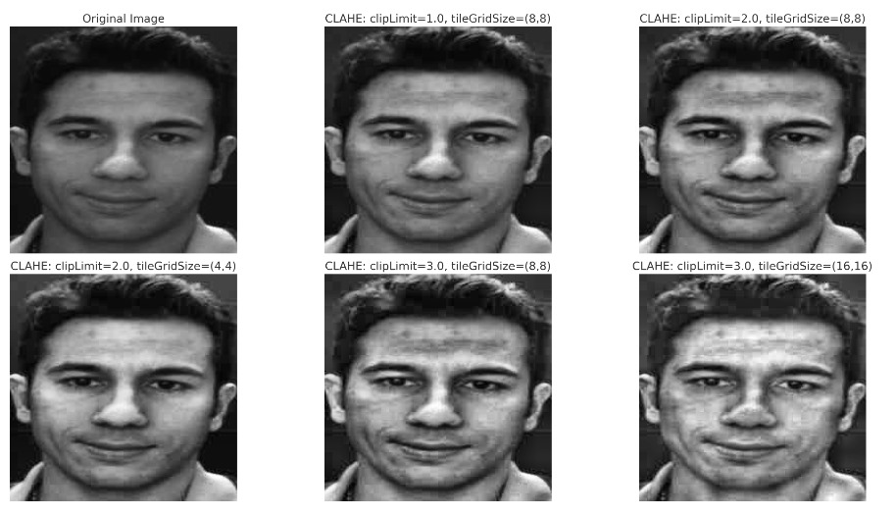
Based on our experiments, we selected a clip limit of 3.0 and a tile grid size of (8,8) for CLAHE, as these settings most effectively highlight muscle movements compared to other configurations.

Slide 13
Modelling
Task Division:
The project is divided into two parts: Action Unit (AU) detection and AU intensity detection.
Currently focusing on detecting the presence of AUs using various models.
In the DISFA dataset, which rates AU intensity from 0 to 5, we transformed action unit detection into a binary classification task by defining intensities above 2 as "AU present" and 2 or below as "AU absent."

Slide 14
Modelling
S.NO | Model | Feature extraction | Dataset
1 | MobileNet | - | DISFA
2 | InceptionV3 | - | DISFA
3 | XGBoost | GoogleVit- 16x16 | DISFA
4 | ViT | Pretrained Vit models (DinoV2 by Meta and google/Vit-base-patch16-224) | DISFA
5 | SVM | LBP,HOG and Gabor Filter | DISFA
6 | DNN | Configural features (landmark distances). | DISFA

Slide 15
Final model : Ensemble Approach (XGBoost)
Multi-label classification using XGBoost and MultiOutputClassifier for AU detection trained on Top of features extracted from Pre trained Vision transformer DinoV2 .
Trained on Kaggle GPU P100 with 2-fold cross-validation and varying hyperparameters like max depth,learning rate etc.
Efficiency is a major advantage, with faster performance than ViT models where vit models took much longer time to train.
Now after detecting action units we have mapped them to 7 major emotions using the traditional FACS rules by Ekman group.
Sampled 500 images per emotion from AFFECTNET Dataset and mapping resulted in a F1-Score of 0.2 and an Accuracy of 28%.

Slide 16
Mapping Results of Action Units (AUs) to Emotions on a Sample from the AffectNet Dataset (500 per Emotion)
Emotion | precision | Recall | F1-score
Anger | 0.23 | 0.14 | 0.18
Disgust | 0.23 | 0.23 | 0.23
Fear | 0.15 | 0.13 | 0.14
Happy | 0.33 | 0.58 | 0.42
Neutral | 0.15 | 0.05 | 0.07
Sad | 0.17 | 0.03 | 0.05
Surprise | 0.19 | 0.44 | 0.27

Slide 17
Evaluation metrics
We have used F1-Score , Accuracy and PR-AUC to assess our models performance during training and testing on DISFA dataset
F1 score gives us a balance between both the values which are important for our analysis where False Positives and False negatives play a crucial analysis in stress detection.
In our context, a False Positive means incorrectly classifying a non-stressed person as stressed.
A False Negative, however, implies identifying a stressed person as normal, which is highly undesirable.

Slide 18
Challenges Faced
we have very few publicly available datasets(DISFA,DISFA+) for research purpose whereas others come with a fee which have diverse subjects and more action units annotated.
Out of the few available datasets we have very few instances of action unit being present in them (nearly 10% of frames).

Slide 19
References
1. AUFormer: Vision Transformers are Parameter-Efficient Facial Action Unit Detectors Kaishen Yuan, Zitong Yu, Xin Liu, Weicheng Xie, Huanjing Yue, Jingyu Yang
2.Deep Adaptive Attention for Joint Facial Action Unit Detection and Face Alignment Zhiwen Shao, Zhilei Liu, Jianfei Cai, Lizhuang Ma
3.K. Zhao, W. -S. Chu and H. Zhang, "Deep Region and Multi-label Learning for Facial Action Unit Detection," 2016 IEEE Conference on Computer Vision and Pattern Recognition (CVPR), Las Vegas, NV, USA, 2016, pp. 3391-3399, doi: 10.1109/CVPR.2016.369.
4.FG-Net: Facial Action Unit Detection with Generalizable Pyramidal Features Yufeng Yin, Di Chang, Guoxian Song, Shen Sang, Tiancheng Zhi, Jing Liu, Linjie Luo, Mohammad Soleymani
5.Emotion Recognition Using Transformers with Masked Learning Seongjae Min, Junseok Yang, Sangjun Lim, Junyong Lee, Sangwon Lee, Sejoon Lim
6. J. Yang, F. Zhang, B. Chen and S. U. Khan, "Facial Expression Recognition Based on Facial Action Unit," 2019 Tenth International Green and Sustainable Computing Conference (IGSC), Alexandria, VA, USA, 2019, pp. 1-6, doi: 10.1109/IGSC48788.2019.8957163.
7. DISFA: A Spontaneous Facial Action Intensity Database S.Mohammad Mavadati, Student Member, IEEE, Mohammad H. Mahoor, Member, IEEE, Kevin Bartlett, Philip Trinh, and Jeffrey F. Cohn
8. Towards Independent Stress Detection: A Dependent Model Using Facial Action Units Carla Viegas; Shing-Hon Lau; Roy Maxion; Alexander Hauptmann
9. Automatically Recognizing Facial Indicators of Frustration: A Learning-centric Analysis Joseph F. Grafsgaard; Joseph B. Wiggins; Kristy Elizabeth Boyer; Eric N. Wiebe; James C. Lester
10. A real-time robust facial expression recognition system using HOG features Pranav Kumar; S L Happy; Aurobinda Routray

Slide 20
THANK YOU

