Slide 1
Customer retention project

Slide 2
Problem statement:
Customer satisfaction has emerged as one of the most important factors that guarantee the success of online store; it has been posited as a key stimulant of purchase, repurchase intentions and customer loyalty.
The data is collected from the Indian online shoppers. Results indicate the e-retail success factors, which are very much critical for customer satisfaction.
Need to find out on how to retain a customer back to site and what are the areas need to improve to get the customer back to site.

Slide 3
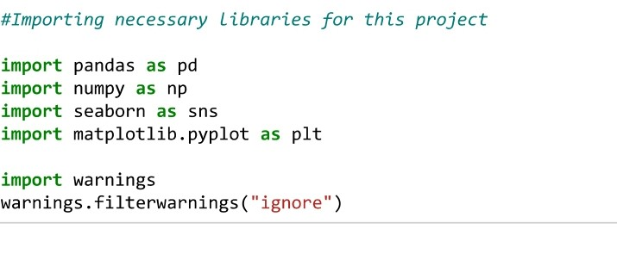
EDA:
Importing the required Libraries for this project,
Pandas, NumPy , Seaborn, Matplotlib for the analysis of the solution and visualizing the data using plot.
Pandas – It is an open-source python library providing high performance on data analysis. It has extensive set of features.

Slide 4
EDA:
NumPy is nothing but the Numerical Python and it is most used package for scientific computing, and it is most compatible with pandas, matplotlib.
Seaborn and Matplotlib are the libraries package which we will use for data visualization to visualize the graph in a better way.
In this dataset, we have categorical features mostly and very few has numerical features.
As per the analysis from the given dataset, we will see who is using online site more and customers expectation on online shopping and what made the customers to leave the site.

Slide 5



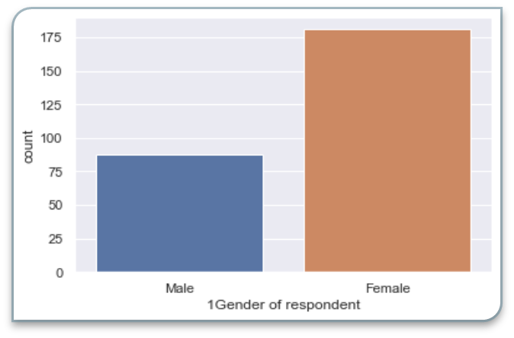
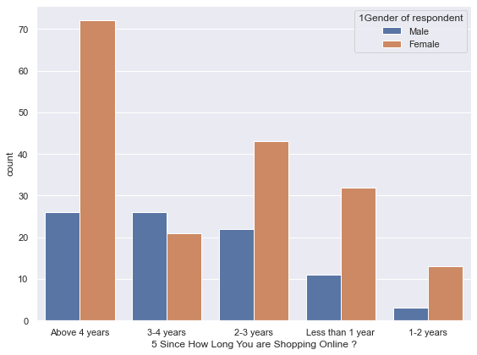
So, the customers who used to purchase online for different needs and in terms of gender, We can see that FEMALES are more who do online shopping more than males.
How long he/she are do online shopping?
Customers are doing online shop for more than 4 years and as we know that most of the customers are females.

Slide 6
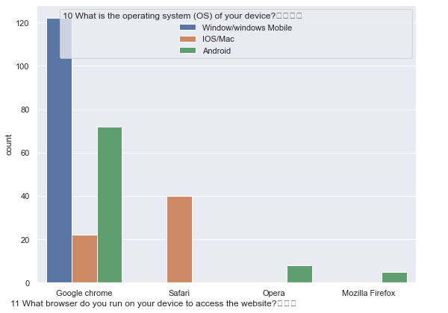
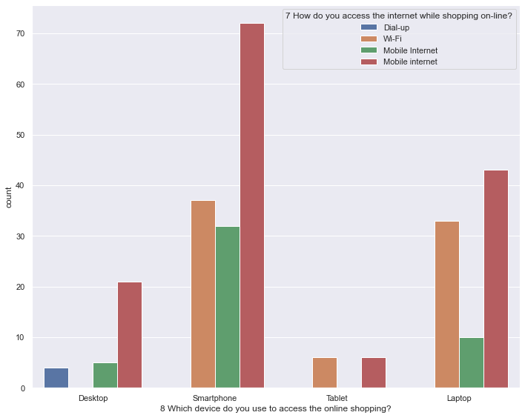
In Online shopping, accessing the site is also an important part and we should know how the users are accessing the site?
As per the plot we can see that most of the users are using smartphones and windows OS for accessing the site.

Slide 7

So, user is using Google chrome browser to access the site than any other browser.
As Google chrome will be supported in Android and IOS as well. Most of the users preferred to use Google Chrome than Safari / Opera/Mozilla.
So, Site should be compatible for the customers in Chrome and Safari.

Slide 8
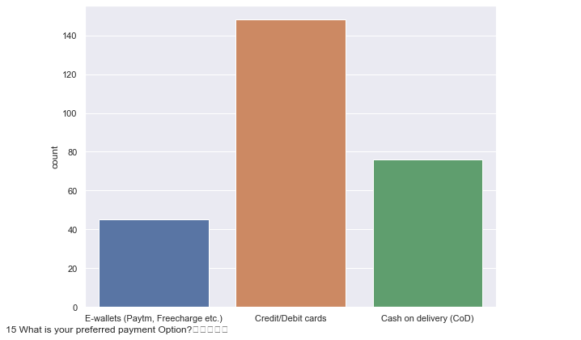
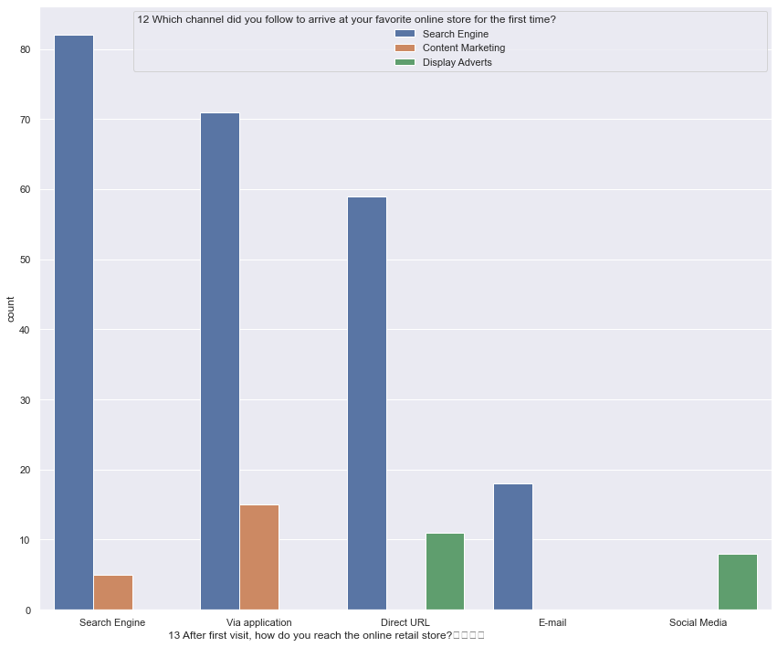
Customers preferred to pay Debit /Credit cards for their purchase and Cash On Delivery(COD).
So, Sites should have a safe and secure checkout to process the transactions.
Customers are using more Search Engine after their login into site than content / ADs and they are using APPs of the site to make their purchases than browser / email /direct urls.

Slide 9
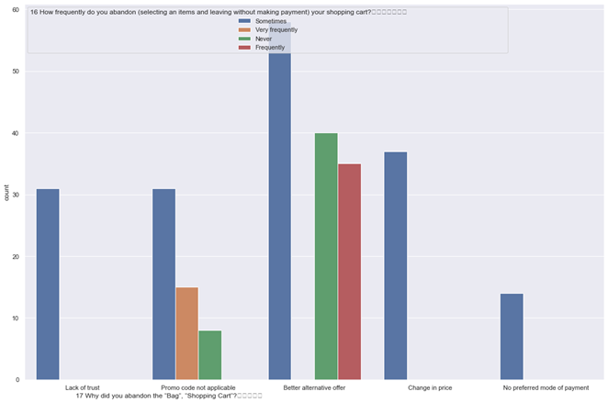
Why are customers abandoning the shopping bag ?
Majority of the customers felt that they will abandon the shopping cart without making payment due to alternative offers in various site.
So, Site should have offers / promotions for the customers.

Slide 10
Other than this , Site should be easily accessible and navigation inside sit should be easy and flexible for the customers.
Loading of the site and processing should have speed in order make payments or viewing the products.
Return / replacement policy of the retailer is important for purchaser decision to make a purchase on site.
Site should have wide variety of products under several categories.

Slide 11
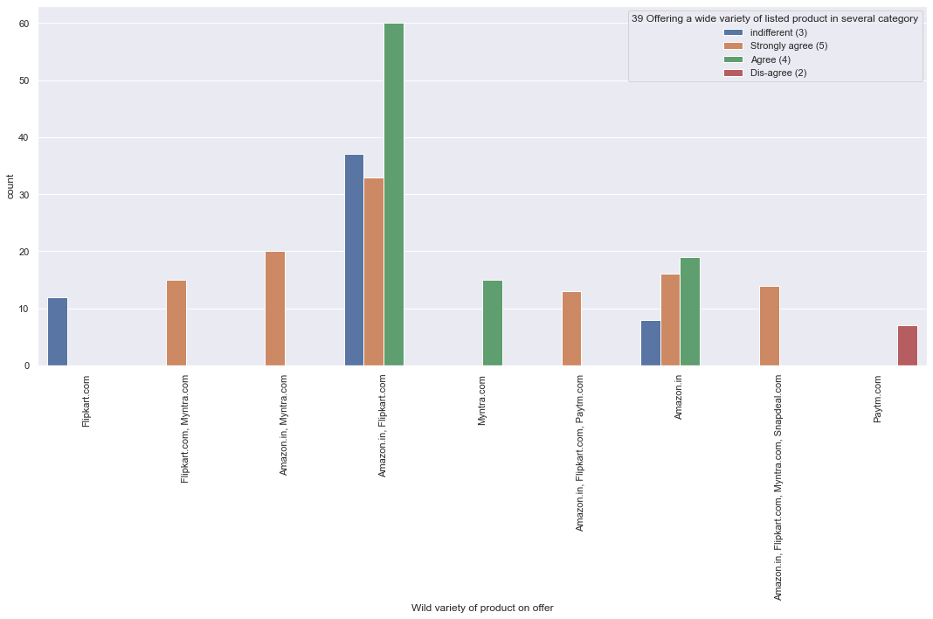
Among all famous sites such as Flipkart, Amazon, Myntra, Paytm, Snapdeal etc.., Amazon and Flipkart has wide variety of products in several categories.
Customers preferred to purchase more from Amazon and Flipkart as it has more categories on all products.

Slide 12
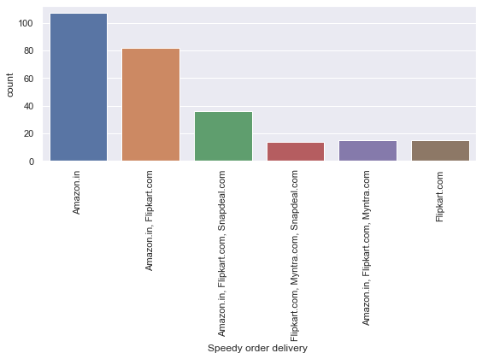
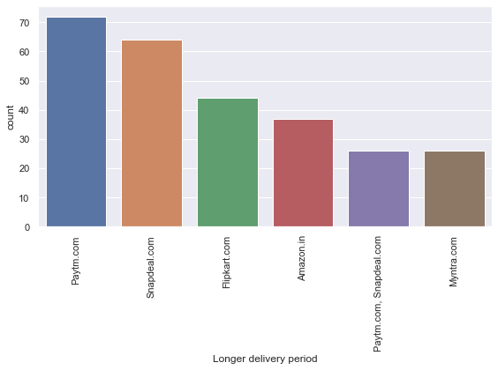
In terms of Speed delivery , Amazon ranks high on Customer Satisfaction and next is Flipkart.
Paytm and Snapdeal ranks less on Customer Satisfaction in terms of Longer period Delivery as these sites are taking more time for delivery.

Slide 13
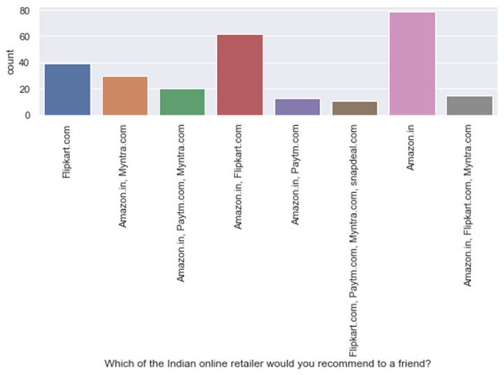
Which online retailer would you recommend to a friend?
Customers are satisfied with Amazon site as it has wide variety of offers to Customers on several categories and easy to use and access.
Next Flipkart scores high on customer satisfaction after Amazon.

Slide 14
conclusion :
Customer satisfaction is one of the most important factor in terms of online shopping to get success.
From the given Dataset, Customer survey has been taken for e-comm shopping sites and based on the survey answers, I am concluding the below points,
1) FEMALE customers are more in Online shopping in terms of Gender.
2) Most of the customers are from GREATER - NOIDA CITY who used to be active on Online Shopping
3) In terms of age group, Customers of AGE 21-40 are actively do online shopping.
4) Customers are using SMARTPHONES for accessing the e-comm sites for online shopping and As We know already that smartphones are the emerging trends in now - a days, Customers are using APP to purchase the products from Online.
5) Also, after get into site, Most of the customers are using SEARCH BAR to search for the products than looking into content / ADs.
6) Most of the customers preferred to pay through Credit/ Debit Cards.
7) Customers are expected the online site to be easy to access and use and user- friendly and return and replacement policy as it is important for purchaser.
8) Online Shopping site should be convenient and flexible and expecting to have offers / discounts and loading and processing speed should be good to have a smooth experience for customers on E-comm Shopping.
9) Among all other sites such as - Amazon, Flipkart, Myntra, Snapdeal, Paytm, Most of the customers preferred that Amazon,Flipkart are easy to use and access.
10) In terms of providing an offer to the wide variety of products, Amazon and Flipkart ranks higher than other sites.
So, Over-All Customers recommended AMAZON site as best site for Online Shopping.

