Slide 1
SERVER SIDE FRAMEWORK COMPARISON
By
Rahul Parekh(rbparekh)
Nikhil Aravind(naravind)
Manasa Mannava(mmannava)
Aaditya Maheshwari(amahesh3)

Slide 2
INTRODUCTION
What are server side “frameworks”? - Structures that help in saving time and efforts for development of web services, apps, etc.
“Don’t call us, we’ll call you” - Forget the underlying complexities of the API
The past, the present and the possible future
“A good framework provides best practices and helps set industry standards.”

Slide 3
POPULARITY

Slide 4
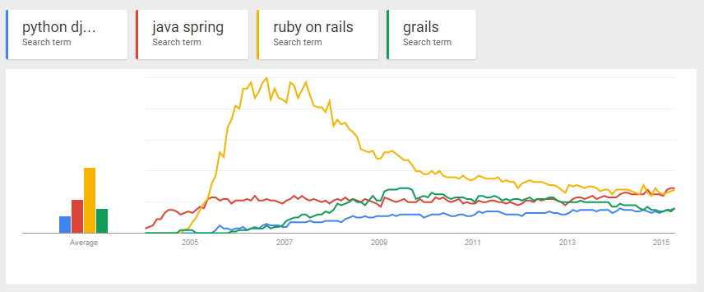
Search popularity on Google.com for Server-side Frameworks

Slide 5
Enter Client Side Frameworks

Slide 6
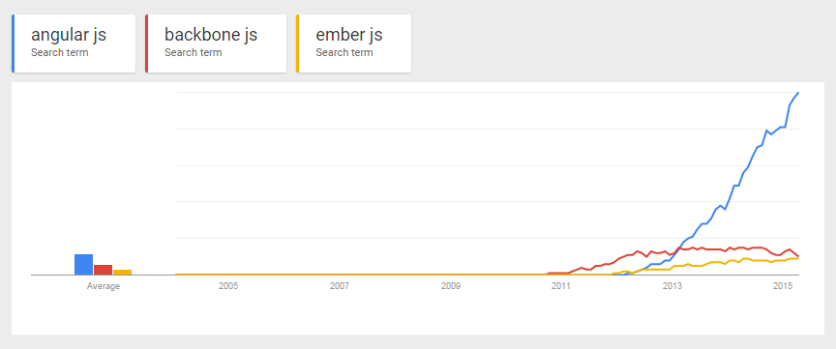
Search popularity on Google.com for Client-side Frameworks

Slide 7
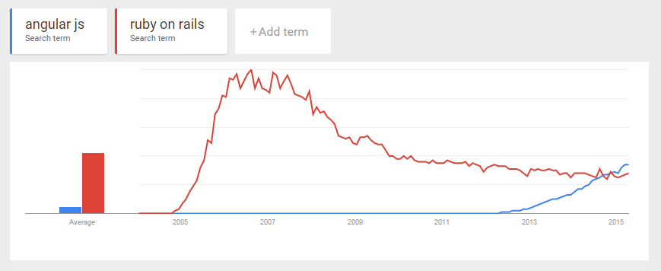
Comparison between Rails and AngularJS popularity

Slide 8
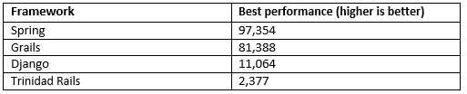
PERFORMANCE
What is Performance?
Why bench marks ?
-TechEmpower.com test results with
JSON serialization
Notes:
Performance /efficiency is the quality of system outputs in response to user inputs.

Slide 9
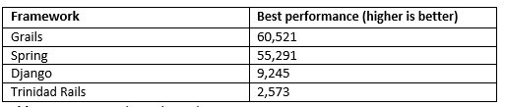
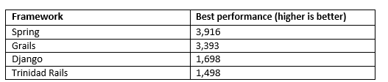
Single Query
Multiple Queries

Slide 10
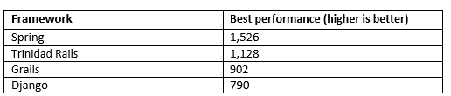
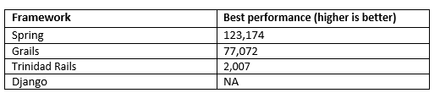
Data Updates
Plain Text

Slide 11
SCALABILITY
What is scalability?
How can frameworks be scalable?
Supporting frameworks
RESTful architecture
Caching
Data centric
Batch Processing
Scalability techniques employed by Spring, Django
Some highly scaled success stories
Django – Disqus.com, Instagram, BitBucket.com
Ruby on Rails – Basecamp.com
Spring – Bank of America, HSBC
Grails – LinkedIn.com
Notes:
Scalability is defined as the ability of the system to handle a growing amount of work in a
capable manner or its ability to be enlarged to accommodate said growth.

Slide 12
SECURITY
What is Security?
-Security features in
Rails:
devise, brakeman, secure headers, rack attack, code sake-dawn
Spring:
Acegi/Spring Security
Grails:
Spring Security
Django:
Cross site scripting (XSS) protection, Cross site request forgery (CSRF) protection, SQL injection protection, Clickjacking protection.

Slide 13
How do you decide between server-side and client-side architectures?

Slide 14
Advantages of Server-side Frameworks:
Security
Browser Compatibility
Inconsistency
Testing
Initial Rendering
Search Engine Optimization
Resource Intensive Computation

Slide 15
Advantages of Client-side Frameworks:
Bandwidth
Server load
Caching
User Experience
Flexibility
Reduced Latency
Uniformity

Slide 16
Conclusion !

