Slide 1
SERVER SIDE FRAMEWORK COMPARISON
By
Rahul Parekh(rbparekh)
Nikhil Aravind(naravind)
Manasa Mannava(mmannava)
Aaditya Maheshwari(amahesh3)

Slide 2
INTRODUCTION
What are server side frameworks? - Structures that help in saving time and efforts for development of web services, apps, etc.
Don’t call us, we’ll call you - Forget the underlying complexities of the API
The past, the present and the possible future
A good framework provides best practices and helps set industry standards.

Slide 3
POPULARITY

Slide 4
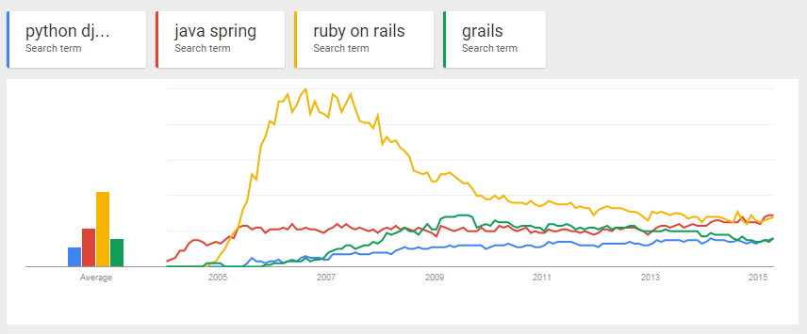
Search popularity on Google.com for Server-side Frameworks

Slide 5
Enter Client Side Frameworks

Slide 6
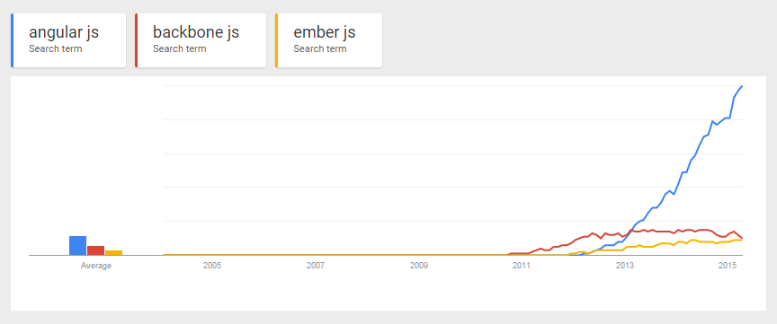
Search popularity on Google.com for Client-side Frameworks

Slide 7
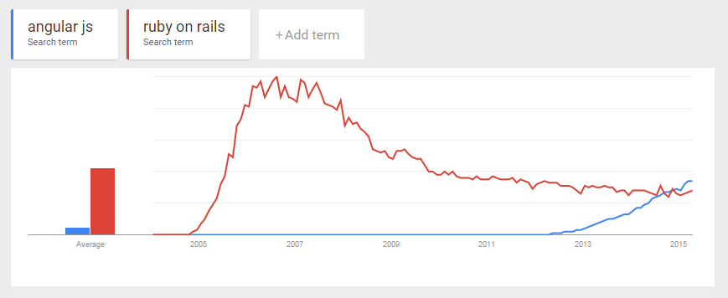
Comparison between Rails and AngularJS popularity

Slide 8
PERFORMANCE
What is Performance?
Why benchmarks ?
TechEmpower.com test results with
JSON serialization
Framework | Best performance (higher is better)
Spring | 97,354
Grails | 81,388
Django | 11,064
Trinidad Rails | 2,377
Notes:
Performance /efficiency is the quality of system outputs in response to user inputs.

Slide 9
Single Query
Framework | Best performance (higher is better)
Grails | 60,521
Spring | 55,291
Django | 9,245
Trinidad Rails | 2,573
Multiple Queries
Framework | Best performance (higher is better)
Spring | 3,916
Grails | 3,393
Django | 1,698
Trinidad Rails | 1,498

Slide 10
Data Updates
Plain Text
Framework | Best performance (higher is better)
Spring | 1,526
Trinidad Rails | 1,128
Grails | 902
Django | 790
Framework | Best performance (higher is better)
Spring | 123,174
Grails | 77,072
Trinidad Rails | 2,007
Django | NA

Slide 11
SCALABILITY
What is scalability?
How can frameworks be scalable?
Supporting frameworks
RESTful architecture
Caching
Data centric
Batch Processing
Scalability techniques employed by Spring, Django
Some highly scaled success stories
Django – Disqus.com, Instagram, BitBucket.com
Ruby on Rails – Basecamp.com
Spring – Bank of America, HSBC
Grails – LinkedIn.com
Notes:
Scalability is defined as the ability of the system to handle a growing amount of work in a
capable manner or its ability to be enlarged to accommodate said growth.

Slide 12
SECURITY
What is Security?
-Security features in
Rails:
devise, brakeman, secure headers, rack attack, code sake-dawn
Spring:
Acegi/Spring Security
Grails:
Spring Security
Django:
Cross site scripting (XSS) protection, Cross site request forgery (CSRF) protection, SQL injection protection, Clickjacking protection.

Slide 13
How do you decide between server-side and client-side architectures?

Slide 14
Advantages of Server-side Frameworks:
Security
Browser Compatibility
Inconsistency
Testing
Initial Rendering
Search Engine Optimization
Resource Intensive Computation

Slide 15
Advantages of Client-side Frameworks:
Bandwidth
Server load
Caching
User Experience
Flexibility
Reduced Latency
Uniformity

Slide 16
Conclusion

