Slide 1

V. T. Patel Department of Electronics & Communication Engineering
Project :
Procell
Internal Guide : Prepared By :
Trushit K. Upadhyay Mrugesh Patel (09EC080)
(Associate Professor) Digesh Patel (09EC099)
Rahul Parikh (9EC060)
CHAROTAR INSTITUTE OF TECHNOLOGY
EDUCATION CAMPUS-CHANGA

Slide 2
Outline
Introduction
Functions
Block Diagram
Functional units
Explorer16 Board
Schematics
External Peripherals used
Logics of various peripherals used
Applications
References

Slide 3
Introduction
Mobile communication current scenario :
  Number of BTS located within city and remote areas.
  Loss of valuable energy.
  More manpower requirement.

Slide 4
Functions
Procell is a device installed at the BTS station whose functions are:
1) To mollify the heat produced due to the operation of various functional units at the BTS by defining the operating temperature range of the air conditioner remotely.
2) To turn on the generator when there is a power cut and the battery is also not charged fully so that the functioning at the BTS doesn't alter or even breakdown.

Slide 5
Cont’d
3) To keep an eye on the door whether it is open or close so that the cooling done by the AC doesn't get wasted away.
4) To note down each and every event by signalling the event occurance and duration at the main controlling station where a database is created.

Slide 6
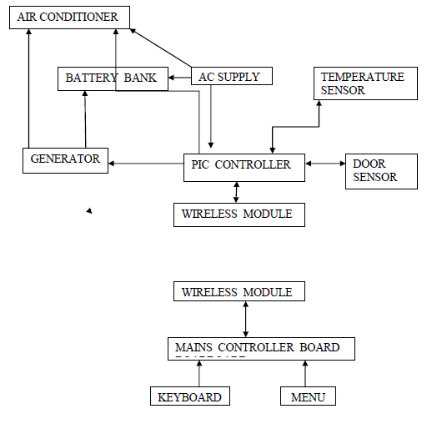

Block Diagram
CABIN
RCS

Slide 7
Functional Units
1)Remote Controller Station (RCS)
2)Procell device cabin

Slide 8
RCS :
Selects the operation at the procell device cabin by setting it from RCS and sending it wirelessly and also displaying it on LCD.
Menu operation
  Mode selection
  Battery voltage
  Set temperature

Slide 9
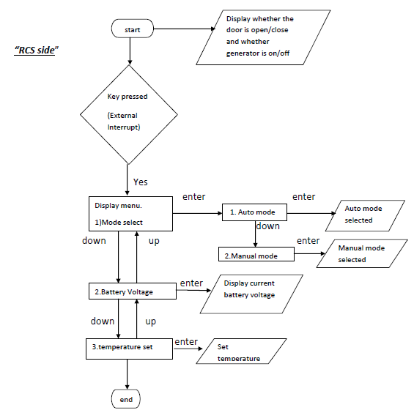
Flow chart of RCS

Slide 10
Procell Device Cabin
Different units that are functional in the device procell are as under:
1) AC mains sensing
2) Battery bank sensing
3) Temperature sensing and AC(Air Conditioner) controlling
4) Door sensing
5) Generator controlling
6) wireless module

Slide 11
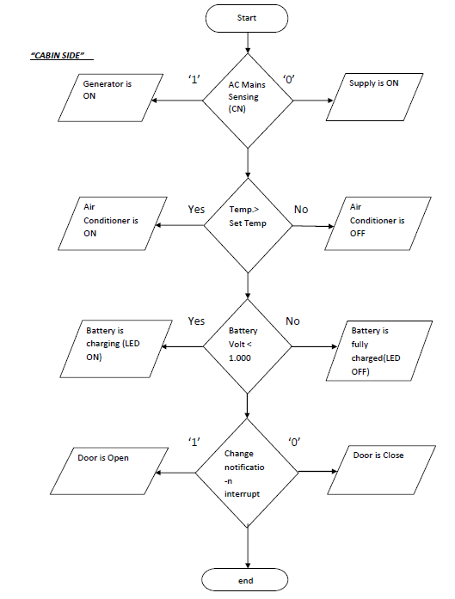
Flow chart of Procell Device Cabin

Slide 12
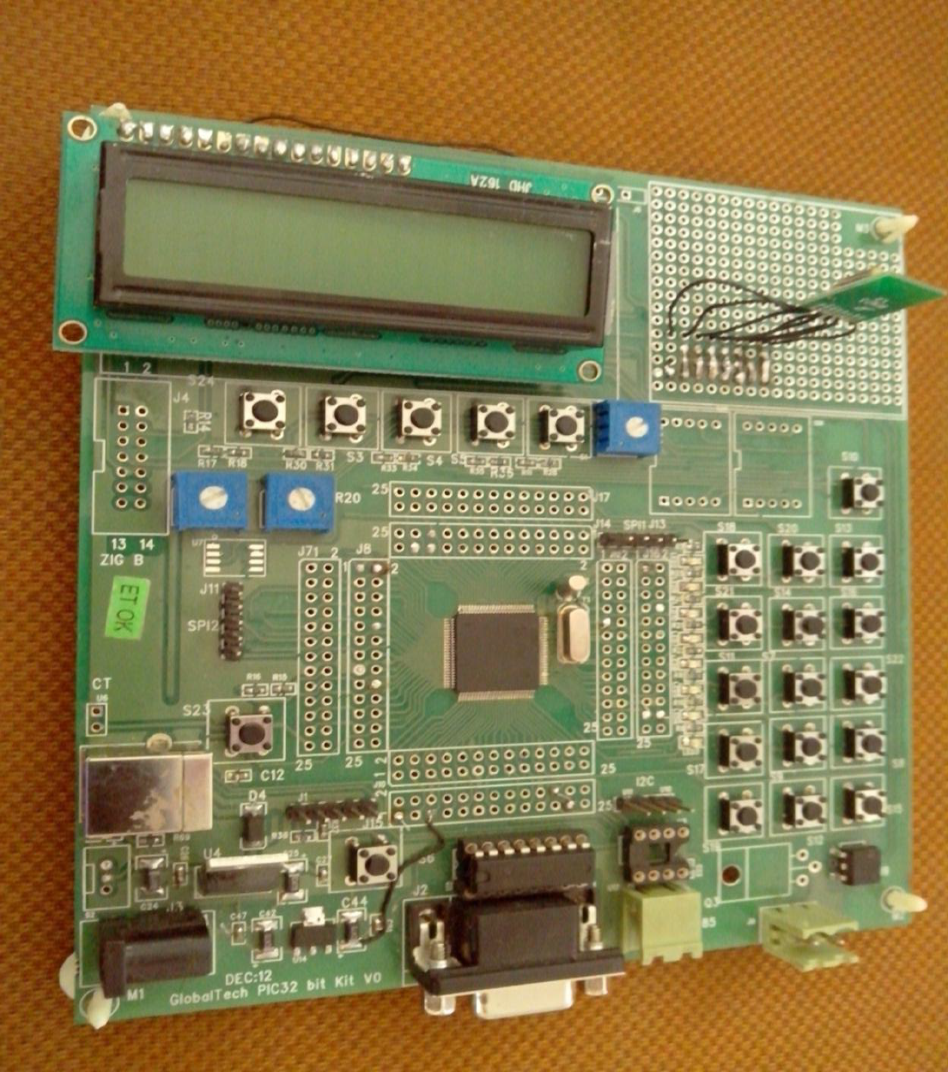
Explorer 16 Board

Slide 13
Devices used in Explorer16 Board
PIC 32 Microcontroller(PIC32MX575F256L)
Peripherals used :
  10 bit ADC
  Change Notification module
  RTCC(Real Time Clock and Calendar)
  Keypad
  LCD

Slide 14
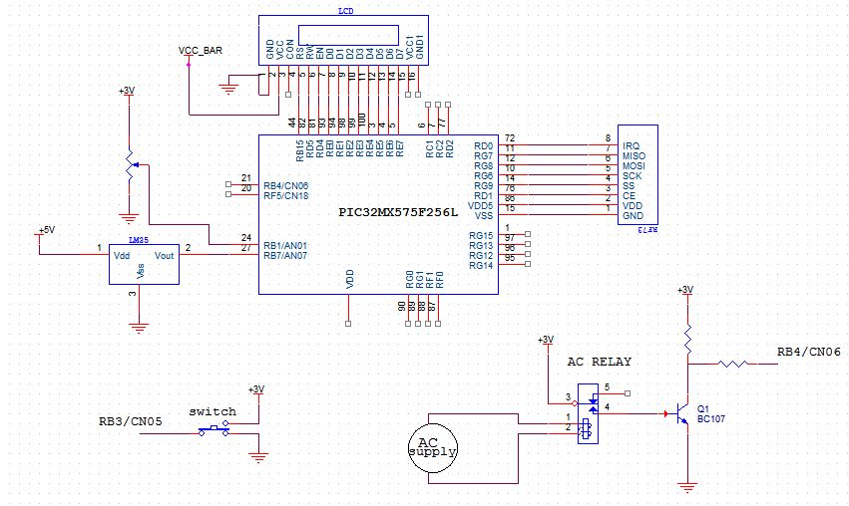
Schematic of Cabin side

Slide 15
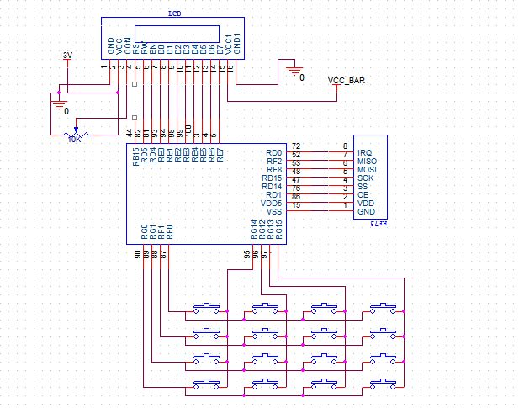
Schematic of RCS side

Slide 16
External Peripherals Used
AC Relay
DC Relay
Power Supply
Temperature Sensor(LM35)
Wireless module : low power high performance 2.4Ghz GFSK Transceiver.

Slide 17
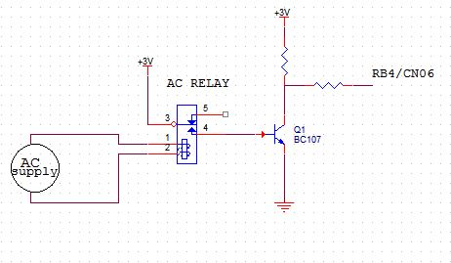
AC Relay
If AC mains is there then the 3V is provided at the base of the transistor
which grounds the 3 volts of the collector and if AC mains is not there then the pulled up 3 volts is provided as input to the controller.

Slide 18
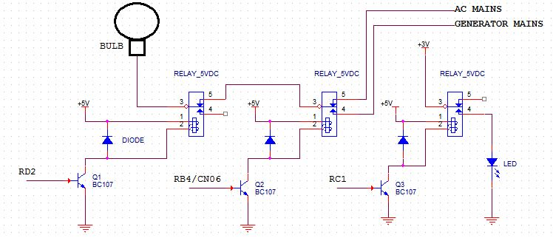
DC Relay
Hand over the mains supply to generator when power cuts
Operating the air conditioner according to temperature cut-off level set by RCS
Charging the back up battery when it is below the define level

Slide 19
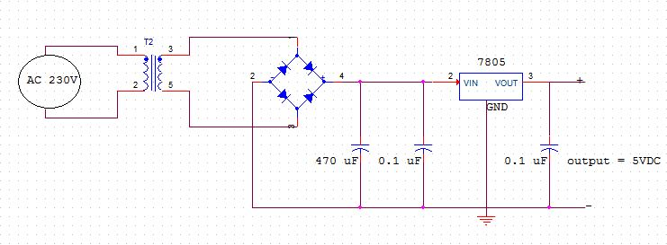
Power Supply
Step-down transformer
Bridge rectifier
Voltage regulator(7805)
Power supply of 5V is provided to the DC relay for energizing it and to LM35 temperature sensor.

Slide 20
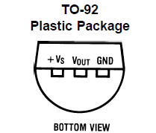
LM35
output voltage is linearly proportional to the Celsius (Centigrade) temperature
Operates from 4 to 30 volts
Output voltage : -1 to +6 volts
Linear + 10.0 mV/°C scale factor
Temp. range : -60 to +150 Celsius (Centigrade)

Slide 21
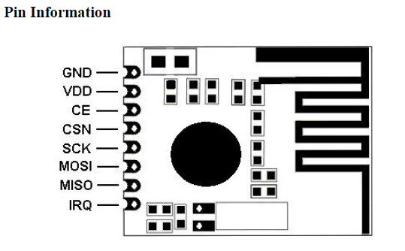
Wireless Module RFM73
Two register banks
CE=0 when writing command and CE=1 when writing data.
CSN is an active low pin and to change from high to low on writing command or data.
Modes :
  Power Down mode, where PWR_UP = 0.

Slide 22
Modes of RFM
  Standby-I mode, where PWR_UP=1 and CE=0
  Standby-II mode ,where PWR_UP=1 and CE=1
  TX mode : To enter transmit mode from standby-I mode, the PTX device must have the PWR_UP bit set high, PRIM_RX bit set low, a payload in the TX FIFO and a high pulse on the CE.
  RX mode : To enter receive mode from standby-I mode, the PRX device must have the PWR_UP bit set high, PRIM_RX bit set high and the CE pin set high.

Slide 23
RFM Usage
RFM is used to
  to wirelessly select the mode operation at the cabin
  Set temperature at the cabin.
  Check the battery voltage at the cabin
  To send information from cabin to RCS about door open/close, supply on/off, generator on/off

Slide 24
ADC
10 bit ADC resulting into 1024 steps (2^10)
Successive Approximation Register (SAR) conversion
Up to 16 analog input pins
External voltage reference input pins
16 buffers of 32 bits each.
ADC is used for :
  Sensing temperature
  Sensing battery bank voltage

Slide 25
Battery Bank Sensing
The backup battery bank in BTS cabin is of 48 volts.
But here we have considered a battery bank of 3 volts
by giving it the supply provided by the controller(3 volts) and then have set a cutoff level at 1 volt and if the level falls below 1 volt then LEDs glow and the battery is charged.
Now the 3volts are given to one of the 16 ADC channels through a potentiometer.
By varying the potentiometer we can change the voltage and can make the LEDs glow which indicates the cut-off level of the battery bank.

Slide 26
Door Sensing
For door sensing a switch is used as a source of interrupt.
If the switch is switched either way then an interrupt is generated.
This generation of interrupt is according to the functionality of change notification module.
This module generates an interrupt if there is a change of logic on the change notification pins of microcontroller whether the change is from ‘1’ to ‘0’ or from ‘0’ to ‘1’.

Slide 27
Menu operated with keypad
Here we have prepared a menu which is operated from the RCS side.
This menu is to select and make changes as per the requirement.
The menu is operated using some switches and keypad which provide numbers from 0 to 9 to set the temperature and for other purposes.
When the interrupt switch is pressed it generates an interrupt and the ISR of menu is served which calls keypad upon requirement.
The menu includes mode selection, setting temperature and battery bank voltage.

Slide 28
RTCC
RTCC means Real Time Clock and Calender.
PIC32 has an inbuilt clock having 24 hours format and calendar ranging from 2000 to 2099.
We initialise the clock from a definite time and then when an event occurs it is displayed with time on Hyperterminal using UART.

Slide 29
Applications
In all BTS(Base Transceiver Station) cabins especially where continuous communication is a must.
Procell is a device which not only monitors the BTS but also saves the power consumed leading to ENERGY CONSERVATION.
It helps to remotely operate the device cabins leading to low man power requirement.
It also keeps track of the events happening at the device cabin.

Slide 30
References
Microchip.com
Datasheets of LM35, PIC32 user manual, wireless module rfm73, explorer 16 user guide, EEPROM 25LC256.
32-bit-Peripheral-Library-Guide.
Wikipedia
Books.google.com
Books : -ANSI C (C programming)
- Let_Us_C_YashwantKanetkar (C programming)
- The 8051 Microcontroller and Embedded Systems Using Assembly and C-2nd-ed- Full Book
- Electronic Principles by Albert Paul Malvino
- Op-Amps and Linear Integrated Circuits by Ramakant A. Gayakwad.

Slide 31
Thank You….!

