Slide 1
Detecting and Defending Denial of Service (DOS) Attack in Software Defined Network (SDN) Controller
Rahul Parmani 2019H1030021G
Mohit Devarakonda 2019H1030026G
NSV Ram Prathap 2019H1030559G

Slide 2
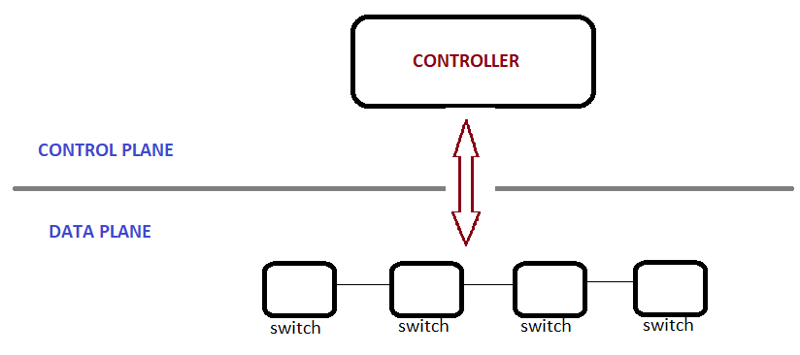
Introduction:
Software-Defined Networking (SDN) is a networking approach where data and control plane execution are made independent of each other.
SDN introduces a network architecture, where the controller acts as the brain of the network, controlling several tasks.
However, having a centralized controller makes the network vulnerable because it has a single point of failure. Hence if a controller is attacked and it fails then the whole network will come down.

Slide 3
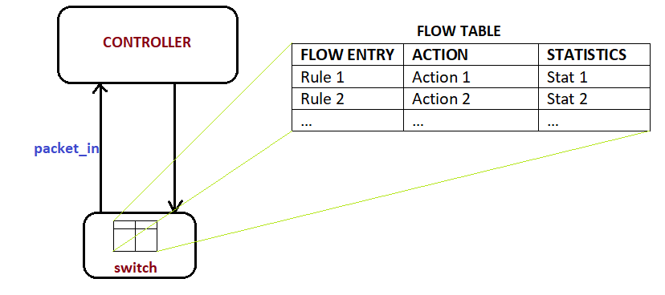
Introduction:
Each switch has a flow table, which contains flow entries that help the switch to inspect an incoming packet based on a certain field and accordingly take action.
A packet_in message is sent from switch to controller, if an incoming packet does not match with any flow table entry.

Slide 4
Problem Statement:
Denial of Service (DOS) attacks be caused by sending packets from a host to the switch so that these packets always mismatch in the routing table of the switch, triggering packet_in messages to the controller making it overloaded.
In Defending against the attack considering only the packet_in messages might be misleading, so in our proposed solution we consider the ratio of number of packet_in messages to the number of transmitted messages.

Slide 5


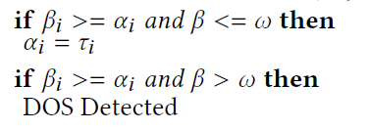


Proposed Solution
Controller
W=1100 , 𝛽 = 1150
W=1100 , 𝛽 = 1000
Gamma_ij is the number of packet_in messages received from switch i and Host j to the controller.
100
200
300
400
250
S1
S2
S3
S4
110
275
275
330
440
275
275
220
1
2
3
4
5
6
7
8
50
50
100
100
Beta_i is the sum of packet_in messages received from switch i.
w represents the number of packet_in messages the controller can handle to get a CPU utilization of σ%. w=1100
alpha_i is counter threshold value of switch i. By default it is calculated as w/n where n is number of switches.

Slide 6
Proposed Solution :
Differentiating hosts based on only packet-in counts may be misleading for detecting attackers.
Instead, Packet_in to transmitted packet count ratio is better for distinguishing attackers from legitimate users.
x_{ij} = r_{ij} / tr_{ij} where 0 <= x_{ij} <= 1
r_{ij} is the no of Packet_in messages
tr_{ij} is the total no of messages transmitted.
CPU Utilization σ% changes dynamically.

Slide 7
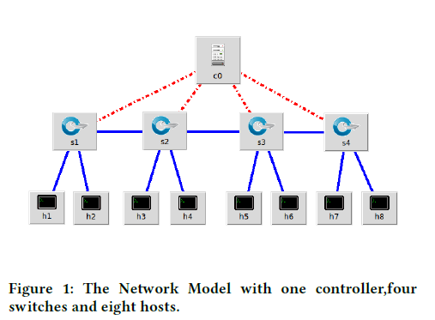
Implementation Platform and Performance Results
Simulation Environment used is Mininet to create the Network.
The timer value to update the 𝛽 value is set to 20 seconds.
The 𝜔 value is initialized with value of 20. All other counters are initialized to 0 and they will be updated according to the packet_in messages received by the controller.
The initial Thresholds will be 𝜔/𝑛 for all the switches which is 20/4(5). So 𝛼𝑖 =[5,5,5,5].

Slide 8
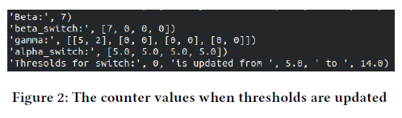
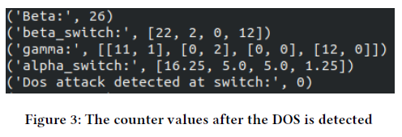
To make it more convenient to observe the results we are printing the counter values in the POX terminal.
When h1 ping h2 is started and after the number of Packet_in messages from h1 exceeds the default threshold of 𝛼𝑖 =(5) but the 𝛽=(7) still less than the 𝜔=(20) this comes under the condition as NOT a DOS attack but we have to update the 𝛼𝑖 =(5) with the 𝜏𝑖 =(14).
This is because at time point of time only messages from h1 are generated so the Switch 1 is the most used switch till now. So the value of threshold of that switch should be more than other switches. The updated Thresholds are [14,5,5,5]
To generate a DOS attack this ping can be continued such that the Packet_in messages from switch 1 should be greater than the threshold of switch 1 and the 𝛽 should be greater than 𝜔.
When this happened it is detected as DOS and the Packet_in messages from this switch should be dropped further.

Slide 9
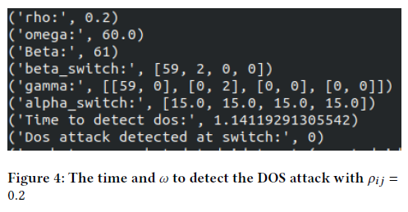
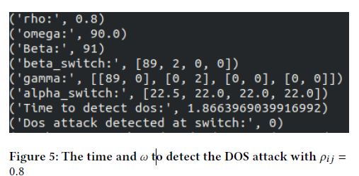
To test the working of 𝜌𝑖𝑗 to dynamically update 𝜔 started a DOS attack from host1 with min_𝜔=50 and max_𝜔=100 so that when 𝜌𝑖 𝑗 is varies between 0 to 1 the 𝜔 will be varied from 50 to 100.
When tested while the 𝜌𝑖 𝑗 is 0.2 which means it says that the host is intended to attack the network the 𝜔 is changed to 60.This detected the DOS attack in 1.14s time and the it took only 60 packets to detect the DOS attack.
The same algorithm and same DOS attack is simulated again but with a 𝜌𝑖𝑗 =0.8 which means the host is not intended to simulate an attack.
The 𝜔 value is changed accordingly to 90 and gave more time to the host before detecting it as DOS attack. The time took to detect the DOS attack is 1.86s and after receiving 90 Packet_in messages.

Slide 10
Conclusion
The algorithm successfully detected and defended the Network from DOS attack.
As we can see from the results the counter threshold values are updated dynamically according to the network traffic in that switches.
This gives more flexibility for the network to use this algorithm in any situation without effecting the dynamic property of traffic.
As the algorithm also uses the ratio between the Packet_in messages to the total transmitted packets this help it to idealize the nature of host either as a attacker or as a legitimate user.
It gives more CPU utilization and resources to a legitimate user and detects the attacker much faster than a normal counter based mechanism.

Slide 11
References :
[1] A. F. M. Piedrahita, S. Rueda, D. M. F. Mattos and O. C. M. B. Duarte, "Flowfence: a denial of service defense system for software defined networking," 2015 Global Information Infrastructure and Networking Symposium (GIIS), Guadalajara, 2015, pp. 1-6.
[2] J. S. Maddu, S. Tripathy and S. K. Nayak, "SDNGuard: An Extension in Software Defined Network to Defend DoS Attack," 2019 IEEE Region 10 Symposium (TENSYMP), Kolkata, India, 2019, pp. 44-49.
[3] R. Nagarathna and S. M. Shalinie, "SLAMHHA: A supervised learning approach to mitigate host location hijacking attack on SDN controllers," 2017 Fourth International Conference on Signal Processing, Communication and Networking (ICSCN), Chennai, 2017, pp. 1-7.
[4]H. Rathore, A. Samant and M. Guizani, "A Bio-Inspired Framework to Mitigate DoS Attacks in Software Defined Networking," 2019 10th IFIP International Conference on New Technologies, Mobility and Security (NTMS), CANARY ISLANDS, Spain, 2019, pp. 1-5.
[5] L. Zhang, Y. Guo, H. Yuwen and Y. Wang, "A Port Hopping Based DoS Mitigation Scheme in SDN Network," 2016 12th International Conference on Computational Intelligence and Security (CIS), Wuxi, 2016, pp. 314-317.
[6] T. Chin, X. Mountrouidou, X. Li and K. Xiong, "Selective Packet Inspection to Detect DoS Flooding Using Software Defined Networking (SDN)," 2015 IEEE 35th International Conference on Distributed Computing Systems Workshops, Columbus, OH, 2015, pp. 95-99.

