Slide 1
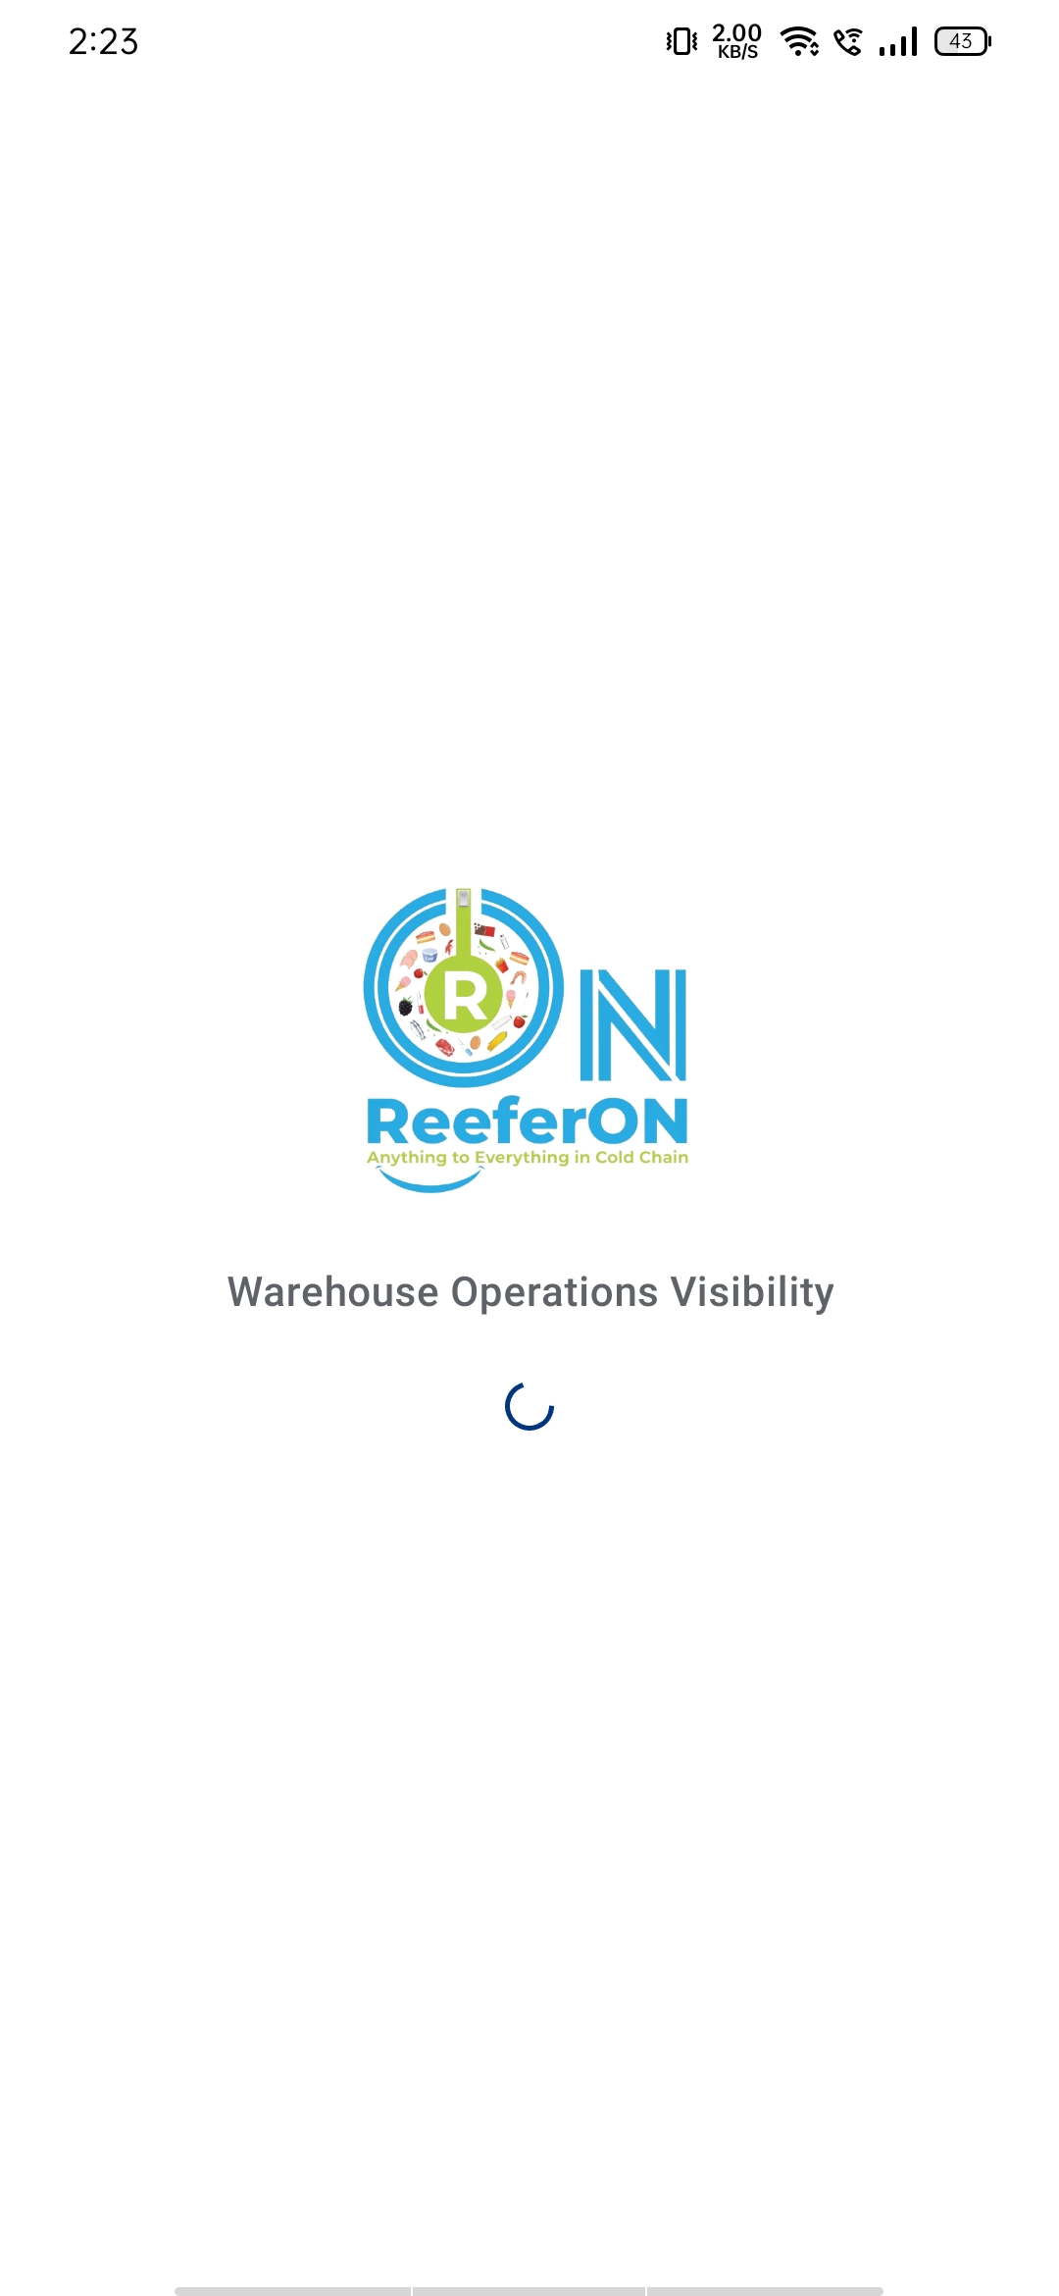
ReeferON
Warehouse Operations Visibility
Cold storage warehouse app
Daily chamber checks · Box stock · Client portal

Slide 2
The Problem
Temperature must be checked twice a day (morning and evening)
Box in/out often tracked on paper, WhatsApp, or Excel
Managers cannot see what is Done, Pending, or Late
Field staff often have weak internet inside cold rooms
Clients keep calling for stock and temperature proof
ReeferON · Warehouse Operations Visibility
2

Slide 3
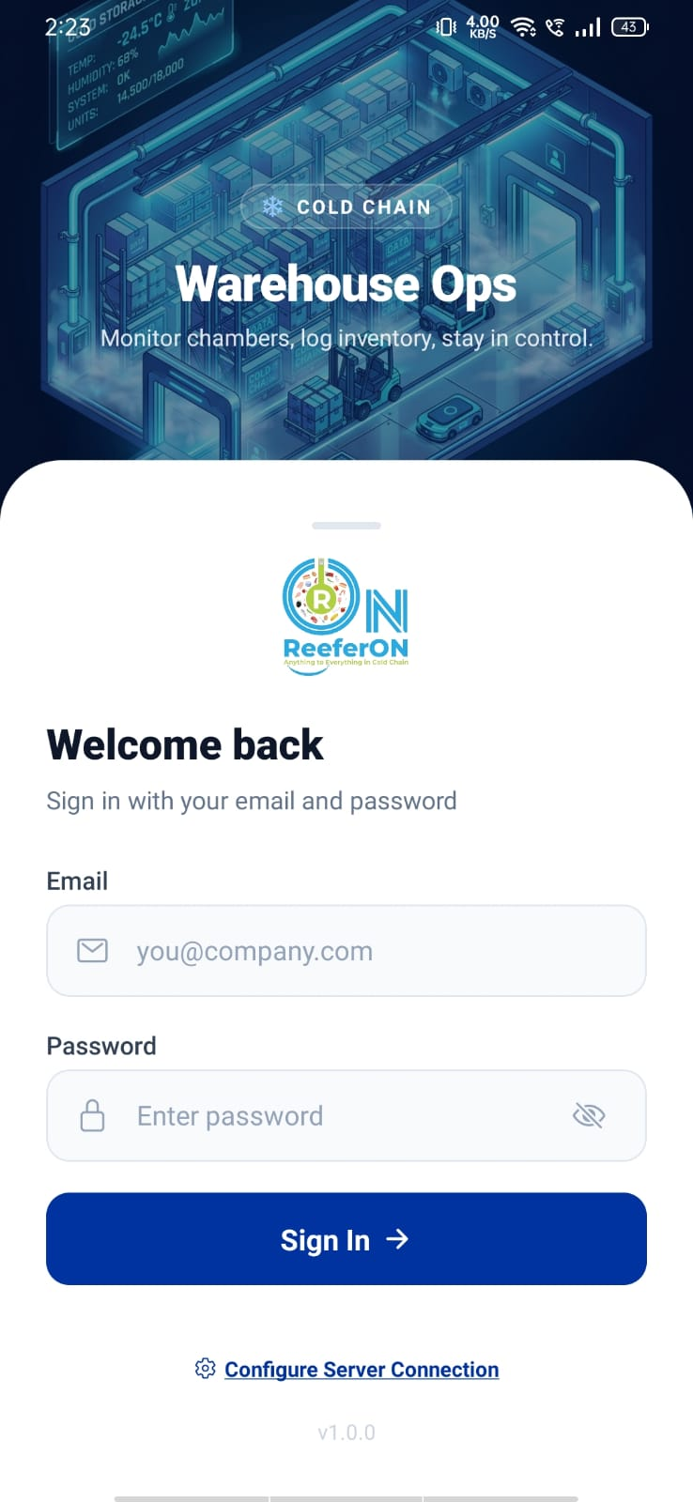
What ReeferON Does
One system for cold warehouse daily operations
Field staff log on mobile (with photo)
Managers watch on mobile and web
Clients see only their own data
Stock is tracked by box count (simple)
Important changes need approve / deny
ReeferON · Warehouse Operations Visibility
3

Slide 4
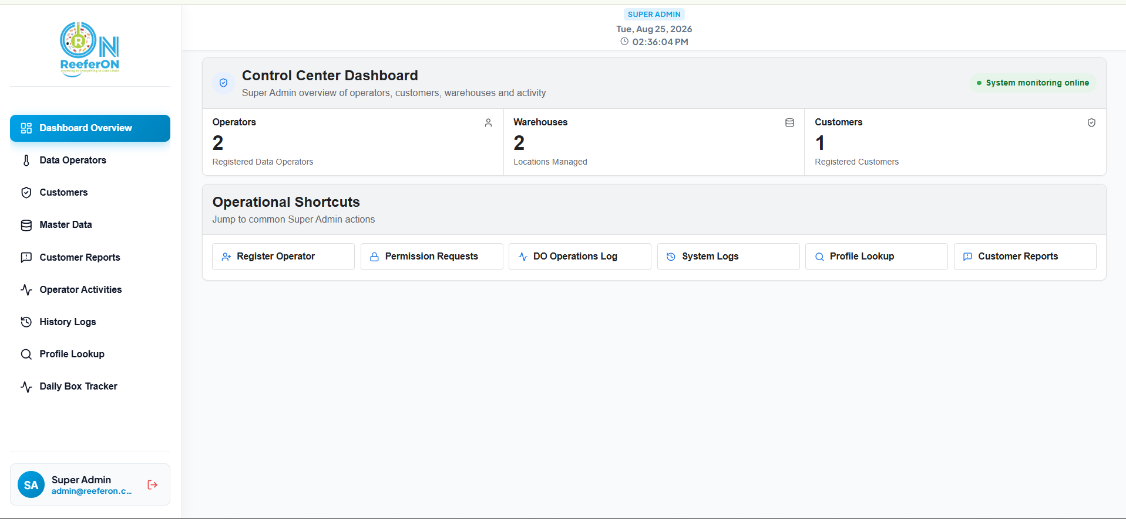
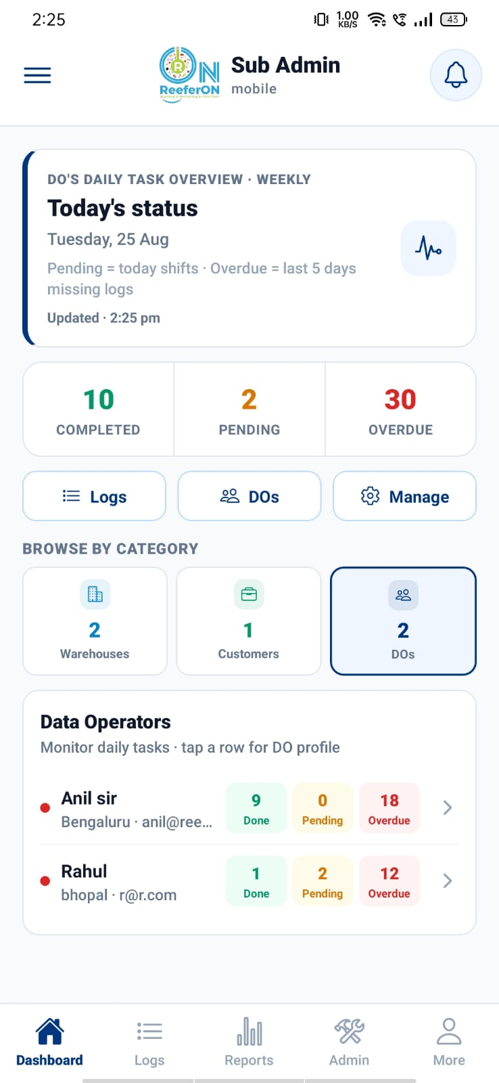
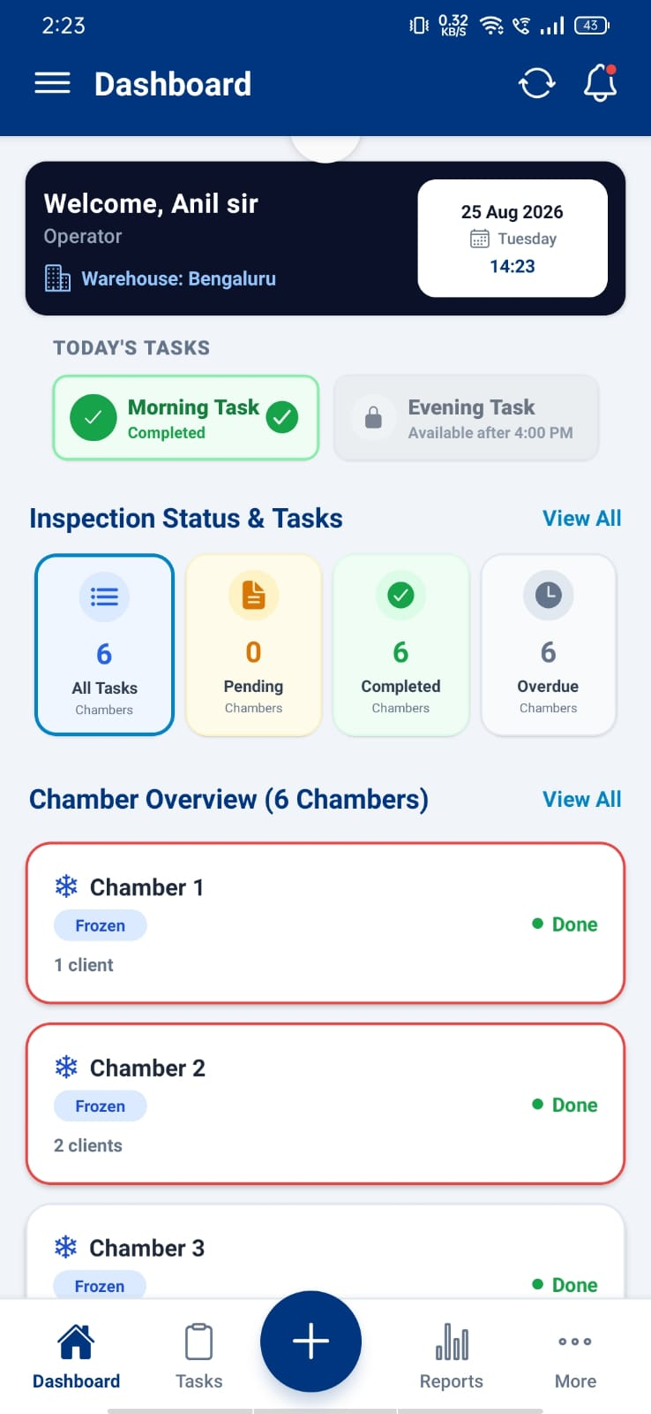
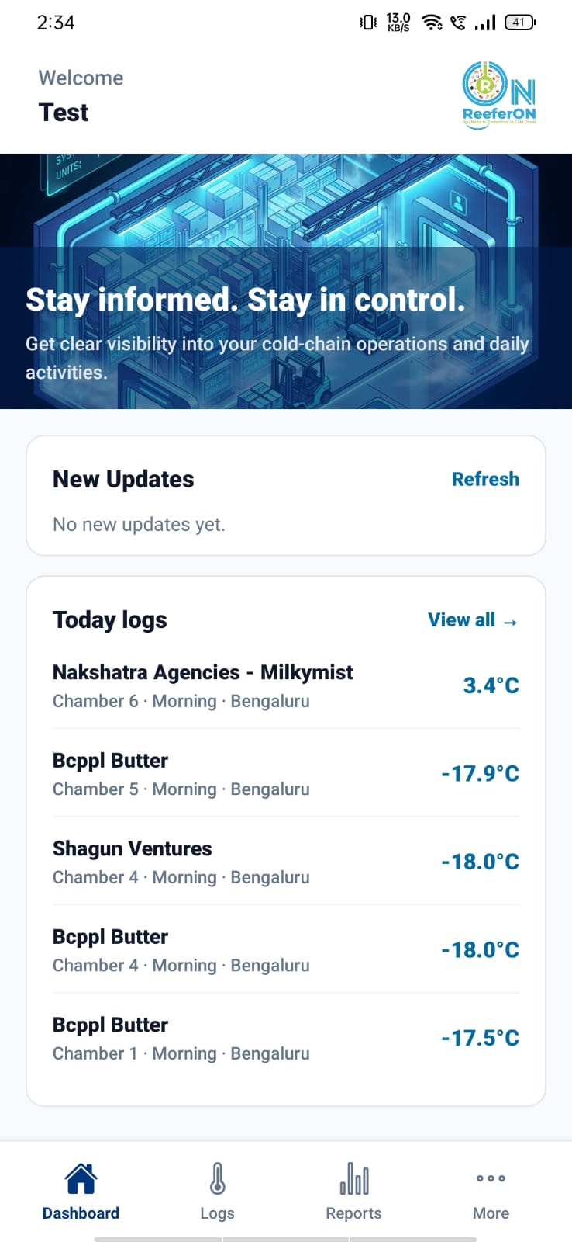
Four Roles
Super Admin · Web
Sub Admin · Mobile
DO · Mobile
Customer · Mobile
Each person opens only their own screen. Jobs are not mixed.
ReeferON · Warehouse Operations Visibility
4

Slide 5
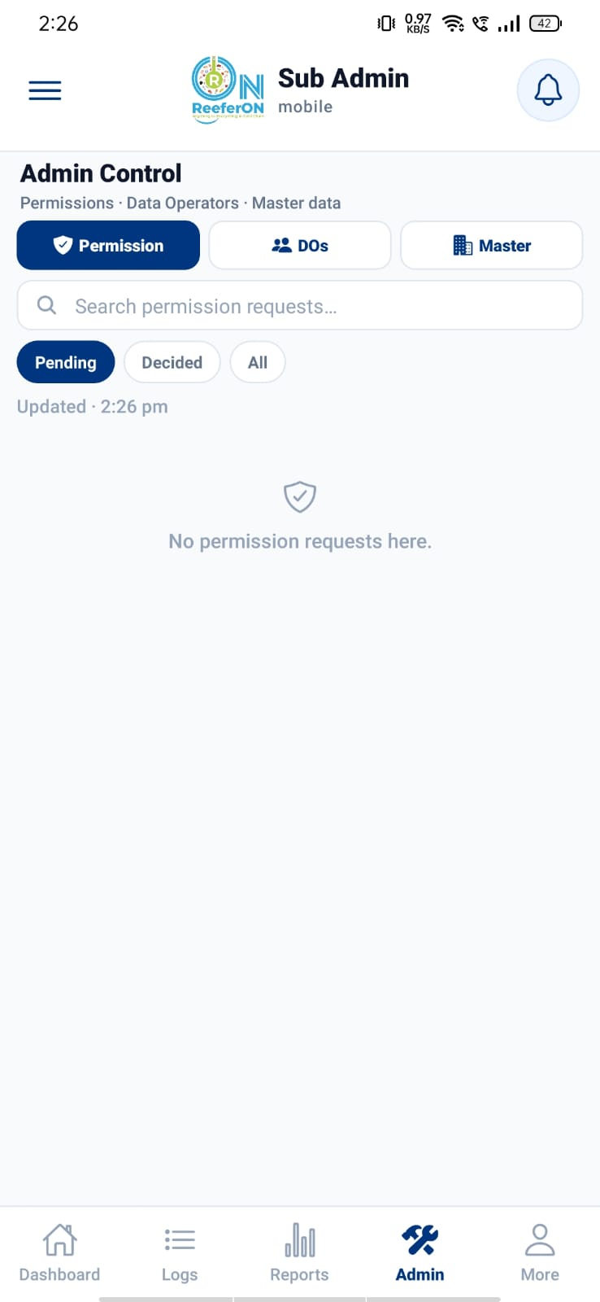
Role Responsibilities
Super Admin
Create users, warehouses, clients · see all reports · approve requests
Sub Admin
Watch DO progress · manage chambers/clients · approve requests on phone
DO
Do morning/evening checks · inward/outward · works offline
Customer
View own logs and box stock (read only)
ReeferON · Warehouse Operations Visibility
5

Slide 6
How It Works
1
Set up warehouses and clients
2
Assign a DO to a warehouse
3
Create chambers and assign clients
4
DO completes morning and evening tasks
5
Manager sees Done / Pending / Overdue
6
Customer checks their own stock and logs
ReeferON · Warehouse Operations Visibility
6

Slide 7
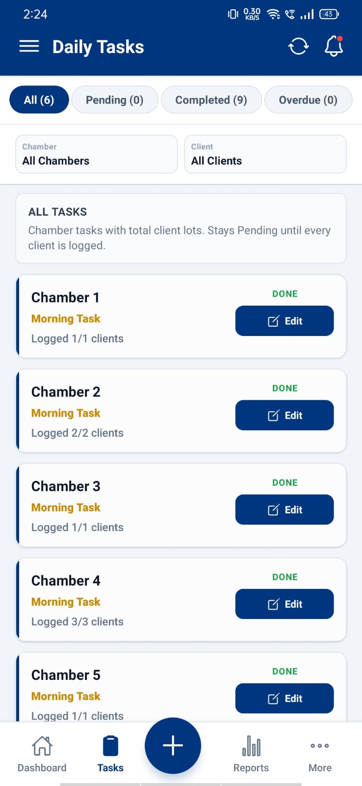
A Day for Field Staff (DO)
Morning
Open Tasks → Pending → Record Log (temperature + photo)
Day
Fill Inward / Outward when trucks come or leave
Evening
Do evening checks again
No internet
Save on phone → Sync later
Mistake
Ask permission → Manager approves → Then edit
Status: Pending · Completed · Overdue
ReeferON · Warehouse Operations Visibility
7

Slide 8
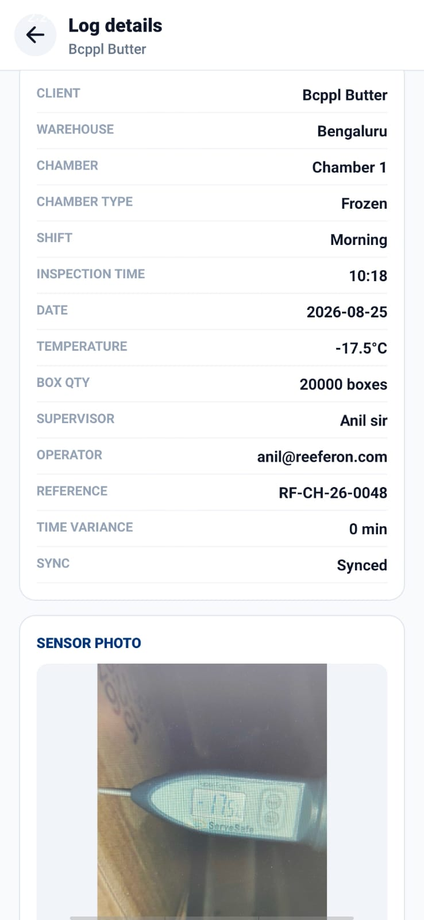
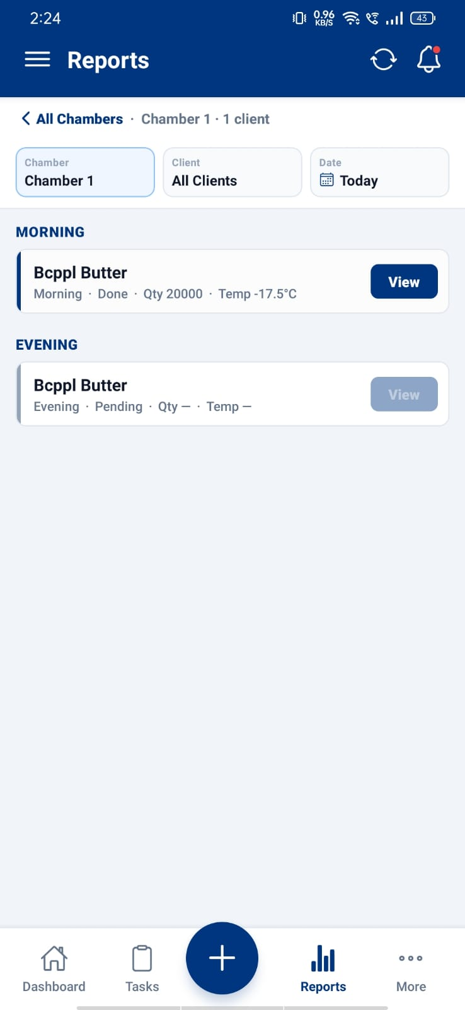
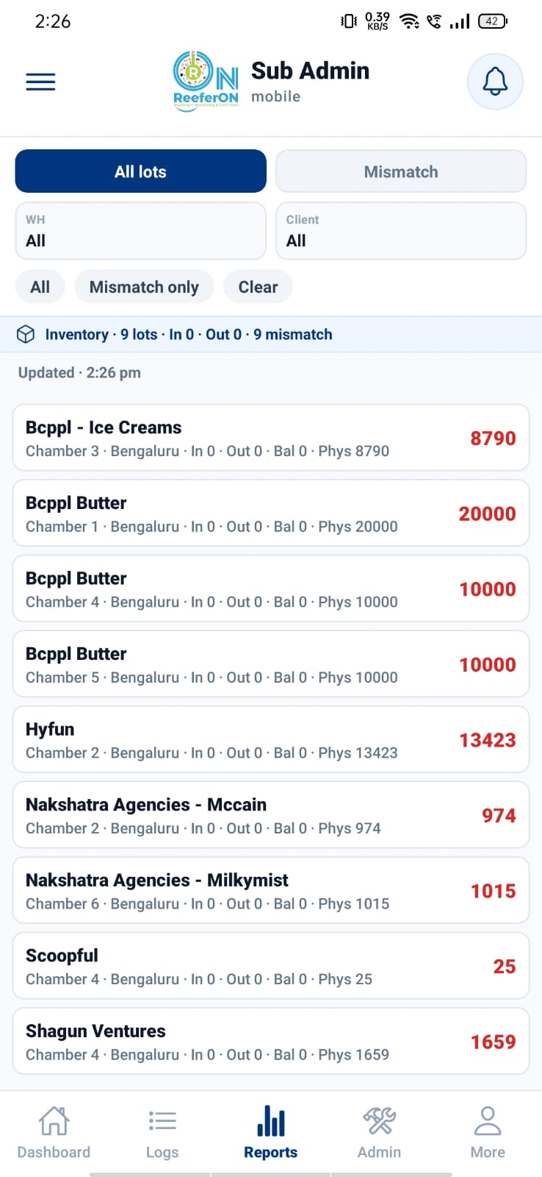
Key Features
Morning and evening chamber tasks
Photo proof (and location when available)
Inward and outward box forms
Offline save + sync
Permission approve / deny
Daily box tracker for managers
Client portal (own data only)
Multi-warehouse support
ReeferON · Warehouse Operations Visibility
8

Slide 9
Benefits
Who | Benefit
Owner | See all sites in one place
Manager | Know Done / Pending / Late quickly
DO | Clear task list, works offline
Client | Check stock without calling
Team | Clear record of who changed what
Not billing software · Not truck routing · Not SKU inventory (boxes only)
ReeferON · Warehouse Operations Visibility
9

Slide 10
Summary
1. Four roles — Admin, Manager, DO, Customer
2. Daily morning and evening chamber checks
3. Box counts for stock
4. Offline work for field staff
5. Permissions keep data safe
ReeferON = Warehouse Operations Visibility
Thank you · Demo / Q&A
ReeferON · Warehouse Operations Visibility
10

