Slide 1
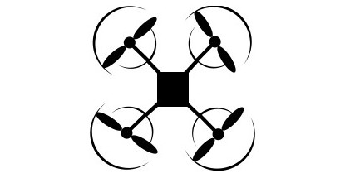


Demonstrations
Regression Model Training
x, y, t, J_{x}, J_{y}
Trajectory Decomposition
Trajectory Generation
p_{rx}(t)
Trained Regression Model
Command String Generation
J_{ax}
+
J_{cx}
Plant (UAV)
p_{x}
Integral, $g_{u}$
+
p_{ry}(t)
J_{ay}
+
Average Command, ${\overline{x}}_{u}$
J_{cy}
p_{y}
+
t
k_{p}
e
+
_

Slide 2




p_{r}(t)
Position Control
$\dot{v}$_{y}
Low Level Control
ϕ_{des}(t)
Attitude Control
Motor Dynamics
Quadrotor Body Dynamics
w_{i}
Fi, Mi
$\dot{v}$_{x}
θ_{des}(t)
$\dot{p}$(t),$\dot{q}$(t)
p(t)
Motion Planner
$\ddot{p}$(t)

