Slide 1
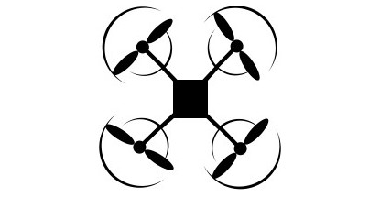

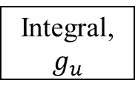
Demonstrations
Regression Model Training
x(t),y(t)
J_{x}, J_{y}
Trajectory Decomposition
Trajectory Generation
p_{rx}(t)
Trained Regression Model
Command String Generation
+
J_{cx}
Plant (UAV)
J_{ax}
p_{x}
Integral, $g_{u}$
+
p_{ry}(t)
+
J_{cy}
SMT Solver
Average Command, ${\overline{j}}_{u}$
J_{ay}
p_{y}
+
t
k_{p}
e
+
_

Slide 2
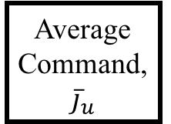
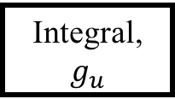
Demonstrations
Regression Model Training
Regression Error Analysis
x(t),y(t)
J_{x}, J_{y}
Trajectory Decomposition
Trajectory Generation
p_{rx}(t)
Integral, $g_{u}$
Command String Generation
+
J_{cx}
Plant
p_{x}
J_{ax}
Trained Regression Model
+
p_{ry}(t)
J_{ay}
J_{cy}
p_{y}
Average Command, ${\overline{j}}_{u}$
+
t
+
k_{p}
SMT-based Correction
e
+
_

Slide 3

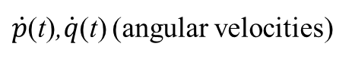

p_{r}(t)
Position Control
$\dot{v}$_{y}
Low Level Control
ϕ_{des}(t)
Attitude Control
Motor Dynamics
Quadrotor Body Dynamics
w_{i}
Fi, Mi
$\dot{v}$_{x}
θ_{des}(t)
$\dot{p}$(t),$\dot{q}$(t) (angular velocities)
p(t)

Slide 4
Teleoperation Input Commands
J_{y}
Low Level Control
ϕ_{des}(t)
Attitude Control
Motor Dynamics
Quadrotor Body Dynamics
w_{i}
Fi, Mi
J_{x}
θ_{des}(t)
p(t)

Slide 5
Quadrotor
Teleoperation Input Commands
Low Level Control
Attitude Control
Motor Dynamics
Quadrotor Body Dynamics
J
p(t)

