Slide 1
YoTube -redefining YouTube
By
Anvesh Tummala ClassID-48
Satish Chowdary Anumolu ClassID-2
Rahul Ponnada ClassID-39
Surya prabha ghanta classid-19

Slide 2
Abstract
When we are unclear about our searching videos on YouTube, we all face difficulty
So, linking the Ontological results from API’s like Freebase, WikiData to your YouTube results will better up your video search.
Ranking and refining the search results from the YouTube API will definitely improve the search process.

Slide 3
Functionalities
Login (with remember me and forgot password)
Rank based Search (that enhances your search results)
Ontological Suggestions
Dashboard of recent searches
Video play out board
Frequently logged user
Logout
Supportable for mobiles, tablets, etc

Slide 4
Architecture
Youtube API
Server
2. Get results from API
1. Search ‘apple’
3. Relevent videos, metabadata
yotube
Search
5. Ranked video results with ontological suggestions
2. Get Ontological terms
4. Push search results to DB
3. Ontological terms
5. Refine results
Freebase
API
MongoDB

Slide 5
Technologies used
Front End:
Twitter bootstrap
HTML5, CSS3, Java Script
Ajax
Back End:
Java EE(servlets and JSP’s)
MongoDB

Slide 6
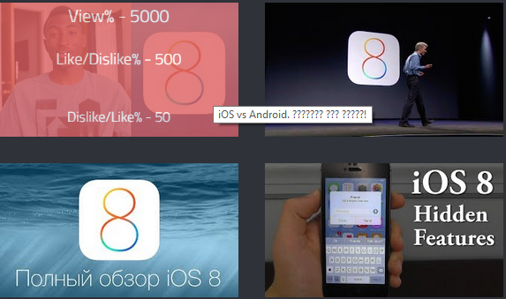
Ranking
Ranking is based on
High View%
High Like/Dislike%
Low Dislike/Like %
High Comment count

Slide 7
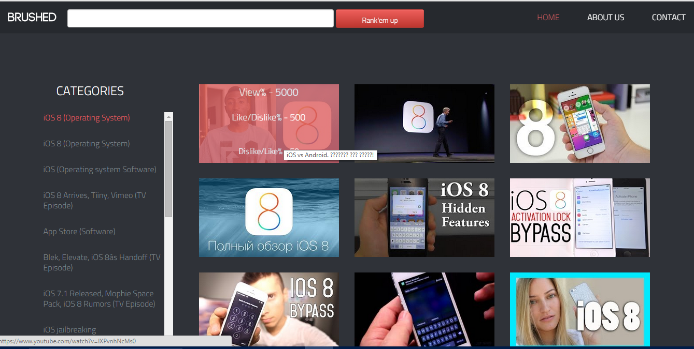
UI
Search Results of keyword ‘IOS 8’

Slide 8
Conclusion
By using the Ontological terms and Ranking the YouTube results will enhance the search results. Also the ontological results will act as a great suggestions for refining our search to a specific topic.

