Slide 1
YoTube - Redefining YouTube
By
Rahul Ponnada
Anvesh Tummala
Satish Chowdary Anumolu
Surya prabha ghanta

Slide 2
Billions of YouTube videos !!!
How to search semantically?

Slide 3
Abstract
When we are unclear about our searches, we all face difficulty in searching YouTube videos
So, linking the Ontological suggestions from API’s like Freebase, Wikidata to your YouTube results will better up your video search
Ranking and refining the search results from the YouTube API will definitely improve the search process
Our YoTube is a better solution with Ontological suggestions and videos ordered by significant ranking

Slide 4
Functionalities
Login (with remember me and forgot password)
Rank based Search (that enhances your search results)
Ontological Suggestions (Categories)
Video play out
Most Frequent searches
Frequently logged users
Mobile compatible design
Logout

Slide 5
Architecture
Server
1. Search ‘apple’
4. Push search results to DB
MongoDB
YoTube
Search
5. Ranked video results with ontological suggestions
5. Refine results
2. Ontological search
2. Get results from API
3. Ontological terms
3. Video results, metadata
Freebase
API
Youtube API

Slide 6
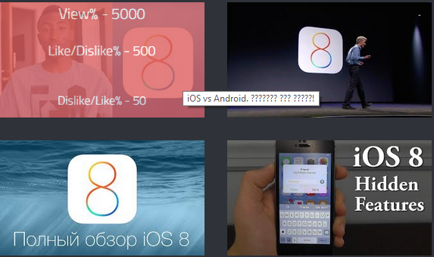
Ranking
Ranking is based on
High View%
High Like/Dislike%
Low Dislike/Like %
High Comment count

Slide 7
How we Rank videos
Video# | View% | Like/View% | Dislike/Like% | Comments | Rank
1 | 500(345,672) | 50(3000) | 100(7000) | 4,576 | 3
2 | 500(282,790) | 50(4000) | 50(3000) |  | 2
3 | 500(198,672) | 50(2000) | 100(8000) | 1,380 | 4
4 | 500(257,032) | 100(8000) |  |  | 1
5 | 100(70,545) |  |  |  | 5
6 | 50(30,000) |  |  |  | 6

Slide 8
Future Improvements
Ranking could be improved by including the metadata of YouTube videos from social networking sites
Different variants of ranking mechanisms can be developed

Slide 9
Conclusion
By using a knowledge base (E.g. Freebase - collection of structured data) to categorize YouTube search results and rank them accordingly will definitely improve your search experience
Github - https://github.com/rpqt7/YoTub-Redefining_YouTube
Youtube - https://www.youtube.com/watch?v=XeDJZRi5YaQ

Slide 10
Questions ?
Thank you

