Slide 1
FOSS in Engineering Education
Poruri Sai Rahul
FOSS United, Softcircuits Labs, Saryan Vigyan Foundation

Slide 2
Use FOSS
Operating Systems like Debian, Ubuntu, FreeBSD
Day-to-day tools like Chromium, LibreOffice, Codium, Matrix, Proton Pass Password Manager, Mastodon
College-specific tools like FreeCAD

Slide 3







Ref matrix.org
Ref debian.org
Ref joinmastodon.org
Ref freecad.org
Ref vscodium.com
Ref proton.me/pass
Ref libreoffice.org

Slide 4
Help your friends use FOSS

Slide 5
Assignment
Other FOSS alternatives?

Slide 6
Assignment
Make friends from different academic backgrounds

Slide 7
Assignment
Find communities to participate in

Slide 8
Assignment
Speak and Write in English,
Listen to English

Slide 9
Contribute to FOSS
Thoroughly read the documentation and improve it
Triage bug reports from users
Test the FOSS projects, manually and using automated tests

Slide 10







Ref ros.org
Ref scikit.bio
Ref scikit-image.org
Ref esim.fossee.in
Ref circuitverse.org
Ref qgis.org

Slide 11
Help your friends contribute to FOSS

Slide 12
Assignment
Other FOSS alternatives?

Slide 13
Assignment
Actively engage with FOSS communities

Slide 14
Assignment
Migrate course/lab to FOSS (e.g. FOSSEE)

Slide 15
Assignment
Find problems from different academic backgrounds

Slide 16
Understand FOSS
What is Free/Libre software? What is Open Source Software?
What are Free Software licenses and What are OSS licenses?
What is the history of the FOSS movement?

Slide 17

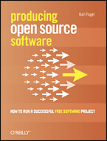
Ref oreilly opensources
Ref producingoss.com

Slide 18
Assignment
What is the history of your favorite FOSS project?

Slide 19
Assignment
What is the difference between a GPL and an MIT license?

Slide 20
Assignment
Follow FOSS leaders (other than just RMS and Linus Torvalds)

Slide 21
Create FOSS
Solve problems that you experience regularly
Create FOSS that can be used for your college courses
Make an impact, no matter how small

Slide 22







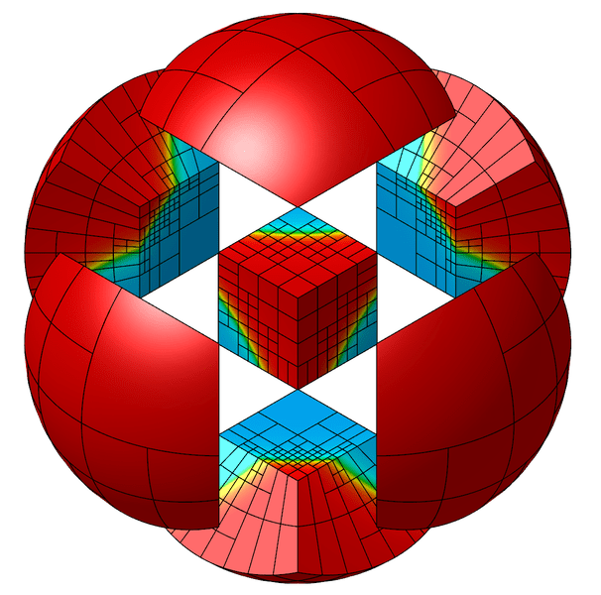

Ref riscv.org
Ref osdag.fossee.in
Ref oshwa.org
Ref cfd.fossee.in
Ref bioconductor.org
Ref astropy.org
Ref quantecon.org
Ref mfem.org
Ref dwsim.fossee.in

Slide 23
Work with your friends to create FOSS

Slide 24
Assignment
What problems do you care about?

Slide 25
Assignment
What problems do your friends care about?

Slide 26


Influences
Ref Implementers, Solvers, and Finders
Ref Untold stories from 6 years working on Python packaging: Links and refs from PyCon US 2024 keynote

Slide 28

Notes:
https://i.huffpost.com/gen/4393678/images/o-THE-MATRIX-facebook.jpg

Slide 29


Ref aosabook.org
Ref aosabook.org

Slide 30
Thank you

Slide 31
Engineering Physics
Engineering Chemistry
Engineering Graphics (CAD)
OOP using Java
Electronic Circuits Lab
Microprocessors Lab
Fluid mechanics
Structural analysis/simulations
Compiler design
Digital Signal Processing
Industrial instrumentation and automation
Geoinformatics
Computational Fluid Dynamics
Finite Element Analysis
Robotics and Automation

