Slide 1
“SHARE A COKE,
SHARE THE FIZZ”
Exploring the Enduring Popularity of Coca-Cola’s Carbonated Drink
Group – 2
Ajay Gaud – 904
Yash Kadam – 943
Anshu Shah – 945
Rahul Prajapati – 946

Slide 2
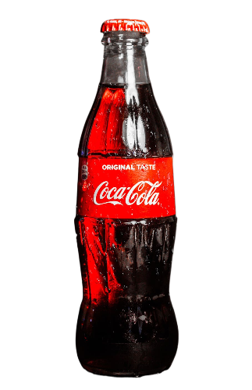
Objective
Factors influencing consumer perceptions and preferences regarding Coca-Cola’s Carbonated drink.
To assess the likelihood of consumers purchasing Coca-Cola within the next 30 days.

Slide 3

Data Adequacy
Key Points:
Sample Size – 238
Sampling Method – Convenient and Snow Ball Sampling
KMO Test:
value - 0.693
Survey QR
Bartlett test:
P-value - <0.001
Data is adequate for factor analysis.

Slide 4
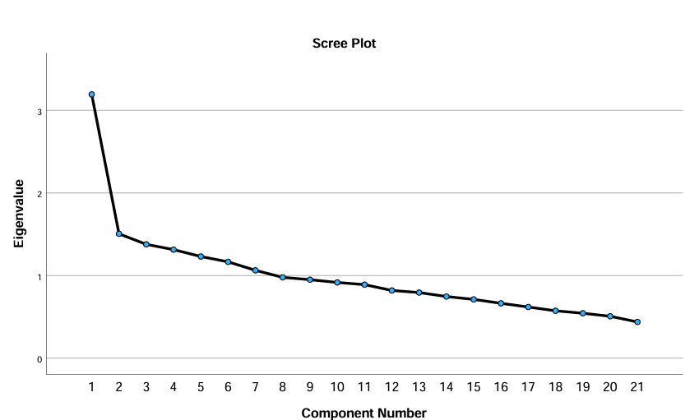
Total Variance Explained
 | Initial Eigenvalues |  |  | Extraction Sums of Squared Loadings
Component | Total | % of Variance | Cumulative % | Total | % of Variance | Cumulative %
1 | 3.193 | 15.205 | 15.205 | 3.193 | 15.205 | 15.205
2 | 1.505 | 7.169 | 22.373 | 1.505 | 7.169 | 22.373
3 | 1.378 | 6.562 | 28.935 | 1.378 | 6.562 | 28.935
4 | 1.314 | 6.256 | 35.191 | 1.314 | 6.256 | 35.191
5 | 1.23 | 5.859 | 41.05 | 1.23 | 5.859 | 41.05
6 | 1.166 | 5.552 | 46.602 | 1.166 | 5.552 | 46.602
7 | 1.063 | 5.063 | 51.665 | 1.063 | 5.063 | 51.665
8 | 0.978 | 4.658 | 56.322
9 | 0.95 | 4.523 | 60.845
10 | 0.916 | 4.363 | 65.209
11 | 0.89 | 4.239 | 69.448
12 | 0.819 | 3.902 | 73.35
13 | 0.794 | 3.782 | 77.132
14 | 0.746 | 3.552 | 80.684
15 | 0.711 | 3.387 | 84.071
16 | 0.664 | 3.162 | 87.232
17 | 0.619 | 2.948 | 90.181
18 | 0.573 | 2.729 | 92.91
19 | 0.544 | 2.589 | 95.499
20 | 0.507 | 2.414 | 97.913
21 | 0.438 | 2.087 | 100

Slide 5
Factors Loading
Rotated Component Matrixª
 | Component
 | Brand Promotion | Value & Affordability | Packaging | Advertisement & Lifestyle | Product Availability | Purchase decision | Taste Preference
sweetness |  |  |  |  |  |  | 0.206
taste_consistency_india |  |  |  |  |  |  | 0.801
taste_comparision_other_brand |  |  |  |  |  |  | 0.242
affordability |  | 0.702
value_for_money |  | 0.472
price_consideration_purchase |  |  |  |  |  | 0.585
positive_brand_image |  | 0.662
brand_trust |  |  |  | 0.589
recommend_on_brand_reputation | 0.608
availability_local_store |  |  |  |  | 0.567
availability_across_urban_rural |  |  |  |  | 0.649
stock_availability |  |  |  |  | 0.570
promotion_discount | 0.722
promotional_offers_encourages_purchase | 0.592
promotional_comparition |  |  | 0.328
design |  |  | 0.515
importance_of_packaging |  |  |  |  |  | 0.687
packaging_preservation |  |  | 0.795
quality_of_advertisement |  |  |  |  |  | 0.609
influence_of_advertisement |  |  |  | 0.437
advertisment_personal_value_lifestyle |  |  |  | 0.608
Extraction Method: Principal Component Analysis. Rotation Method: Equamax with Kaiser Normalization.
a. Rotation converged in 26 iterations.

Slide 6
Multinomial Logistic Regression
Objectives: To assess the likelihood of consumers purchasing Coca-Cola within the next 30 days.
Dependent Variable:
Likelihood Of Purchase ( In next 30 days )
Independent Variable:
Brand Promotion
Value & Affordability
Packaging
Advertisement & Lifestyle
Product Availability
Purchase Decision
Taste Preference
Base Case: Neutral

Slide 7
Parameter Estimates
Factor | Very Unlikely | Unlikely | Likely | Very Likely
Brand Promotion | -0.2984 | -0.3993 | 0.3155 | 0.2287
Value & Affordability | -0.2944 | -0.0144 | 0.3157 | -0.0551
Packaging | -0.1666 | -0.4946 | 0.4186 | 0.2244
Advertisement & Lifestyle | -0.3917 | -0.2052 | 0.1389 | 0.2148
Product Availability | -0.0636 | -0.4399 | -0.0106 | 0.7147
Purchase Decision | 0.0922 | -0.323 | 0.3047 | 0.1697
Taste Preference | -0.2141 | -0.0872 | 0.1985 | 0.2397
Category | Intercept
Very Unlikely | 0.6171
Unlikely | 0.5967
Likely | -0.205
Very Likely | -1.1015
Odds Ratio
Factor | Very Unlikely (OR) | Unlikely (OR) | Likely (OR) | Very Likely (OR)
Brand Promotion | 0.74 (-26%) | 0.67 (-33%) | 1.37 (+37%) | 1.26 (+26%)
Value & Affordability | 0.74 (-26%) | 0.99 (-1%) | 1.37 (+37%) | 0.95 (-5%)
Packaging | 0.85 (-15%) | 0.61 (-39%) | 1.52 (+52%) | 1.25 (+25%)
Advertisement & Lifestyle | 0.68 (-32%) | 0.81 (-19%) | 1.15 (+15%) | 1.24 (+24%)
Product Availability | 0.94 (-6%) | 0.64 (-36%) | 0.99 (-1%) | 2.04 (+104%)
Purchase Decision | 1.09 (+9%) | 0.72 (-28%) | 1.36 (+36%) | 1.19 (+19%)
Taste Preference | 0.81 (-19%) | 0.92 (-8%) | 1.22 (+22%) | 1.27 (+27%)
Accuracy: 0.5018 (50.18%)

Slide 8
Conclusion
Focus on Product Availability: Since it has the highest impact on "Very Likely" purchases, ensuring wide availability can significantly boost sales.
Improve Packaging: The high positive impact of packaging suggests that investment in attractive and functional packaging will likely enhance customer preference.
Enhance Brand Promotion & Lifestyle Advertising: These factors show positive influence in the higher likelihood categories, meaning marketing campaigns should emphasize branding and lifestyle associations.
Refine Pricing Strategy: Since Value & Affordability has mixed results, careful pricing strategies should be used to balance affordability and premium branding.
The overall accuracy of the model is 50.18%, indicating moderate predictive power.

Slide 9
Thank you !

