Slide 1
SLICE
Credit Card Startup | Hassle-Free Payments | Converted to EMI

Slide 2
About Slice
- Credit startup offering hassle-free payment cards converted to EMI.
- Slice Super Cards: Zero-fee cards for online and offline transactions.
- 2% cashback on every transaction using Slice Credit Card.
- Credit limit: ₹2,000 to ₹10 Lakhs
- No interest if the amount is repaid within 3 EMIs.
- In-app spending insights: track patterns, repayment reminders, and more.

Slide 3
Startup Story & Target Market
- Founded to address the hassles associated with traditional credit cards, particularly for
middle-class families in Tier 2 & Tier 3 cities.
- Target Market: Students and early-age business professionals ineligible for traditional credit
cards.
- Average age of Slice customers: 22 years.

Slide 4
Mission
- Provide accessible credit options for students and young professionals to purchase essential
items like laptops and mobile phones.
- Offer a more flexible and transparent repayment system through monthly installments.

Slide 5
Business Model (Pre-RBI Change)
- Subvention Income: Partnerships with merchants like Amazon and Flipkart for no-cost EMIs.
- Interchange Fees: Percentage-based fees on transactions from merchants.
- Interest Income from EMIs.
- Additional Fees: Late payment, foreign transaction, service charges, etc.
- Targeted Approach: Focus on young adults and millennials.
- Transparent Pricing: Building trust through clear fee structures.
- Data-Driven Insights: Provide users with spending patterns and recommendations for EMI
conversion.

Slide 6
Change in Business Model (Post July 20, 2022)
- RBI Announcement Impact: Transitioned from offering credit cards to 'classic term loans'.
- Purchase Power: Creditworthiness evaluated on a transaction-by-transaction basis, using factors
like payment history and financial situation.

Slide 7
Growth & Revenue Highlights
- Crossed one million app transactions within 5 months of launching physical cards in May 2019.
- Pivoted from BNPL to card products in 2019 and now includes UPI products.
- Achieved unicorn status in 2021 with a valuation of $1.8 billion as of March 2023.

Slide 8
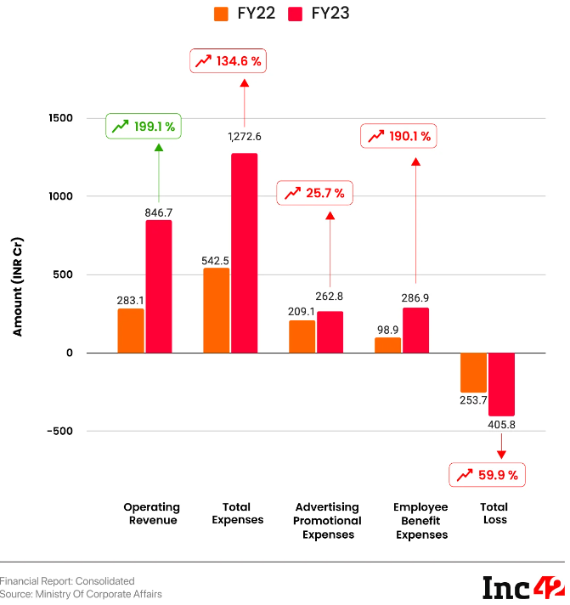
Financial Performance FY22-FY23
- Operating Revenue: Significant growth
(refer to chart data).
- Net Loss: Increased due to factors like
advertising expenses (refer to chart data).

Slide 9
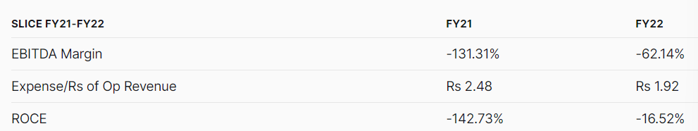
Expense to Revenue Ratio Analysis
- FY21: Expense to Revenue Ratio ~ 248.46%
(indicating high expenses).
- FY23: Expense to Revenue Ratio ~ 150.21%
(improvement, but still elevated).

Slide 10
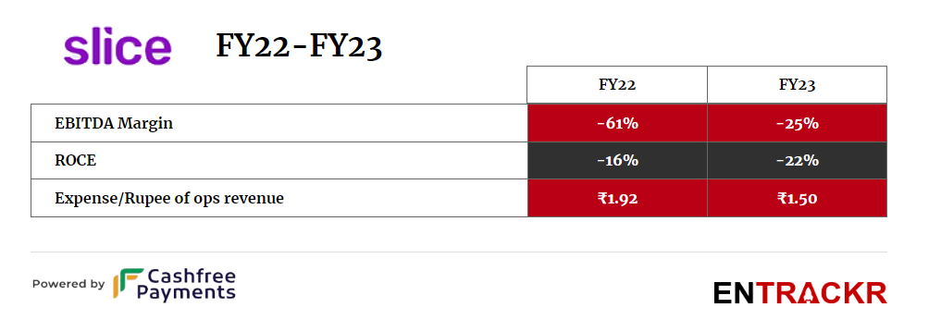
EBITDA Margin & ROCE
- EBITDA margin improved in FY22, indicating
better cost management.
- ROCE remained negative but showed
improvement.

Slide 11
Other Features
- Auto reload of money into the wallet.
- Seamless transactions with auto-reload functionality.
- Slice Card UPI.

