Slide 1
VAR Models
Gloria González-Rivera
University of California, Riverside
and
Jesús Gonzalo U. Carlos III de Madrid

Slide 2
Some References
Hamilton, chapter 11
Enders, chapter 5
Palgrave Handbook of Econometrics, chapter 12 by Lutkepohl
Any of the books of Lutkepohl on Multiple Time Series

Slide 3
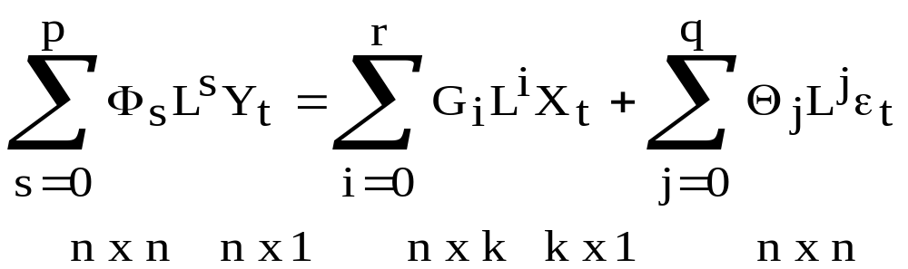
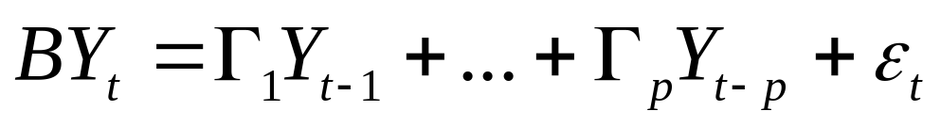
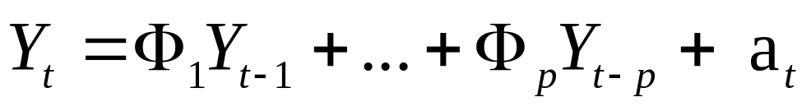
Multivariate Models
VARMAX Models as a multivariate generalization of the univariate ARMA models:
Structural VAR Models:
VAR Models (reduced form)

Slide 4
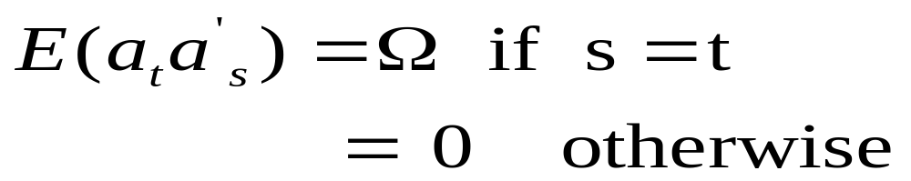
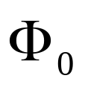

Multivariate Models (cont)
where the error term is a vector white noise:
To avoid parameter redundancy among the parameters, we need to assume certain structure on
and
This is similar to univariate models.

Slide 5
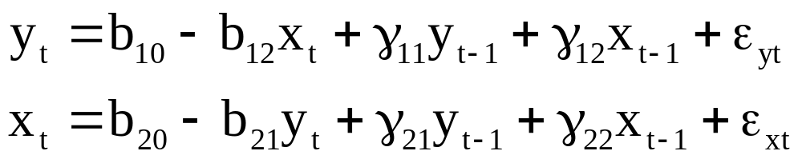
A Structural VAR(1)
Consider a bivariate Y_{t}=(y_{t}, x_{t}), first-order VAR model:
The error terms (structural shocks) ε_{yt} and ε_{xt} are white noise innovations with standard deviations σ_{y} and σ_{x} and a zero covariance.
The two variables y and x are endogenous (Why?)
Note that shock ε_{yt} affects y directly and x indirectly.
There are 10 parameters to estimate.

Slide 6
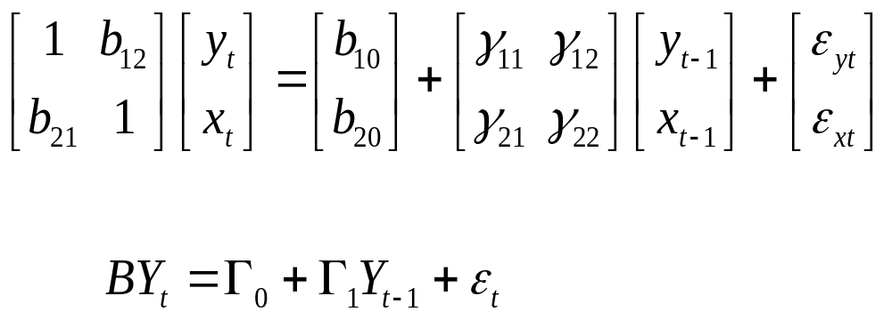

From a Structural VAR to a Standard VAR
The structural VAR is not a reduced form.
In a reduced form representation y and x are just functions of lagged y and x.
To solve for a reduced form write the structural VAR in matrix form as:

Slide 7
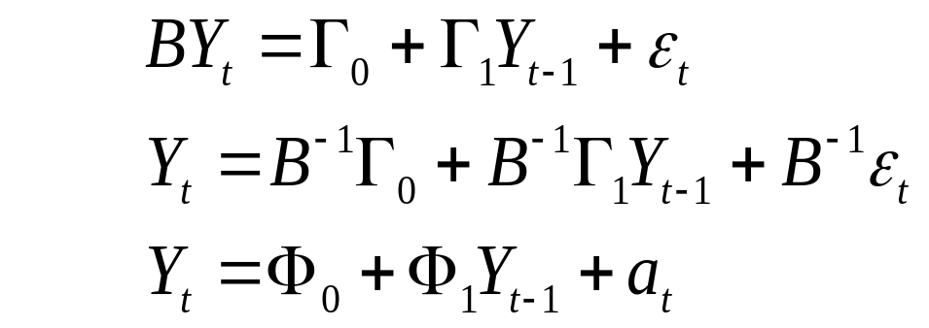
From a Structural VAR to a Standard VAR (cont)
Premultipication by B⁻¹ allow us to obtain a standard VAR(1):
This is the reduced form we are going to estimate (by OLS equation by equation)
Before estimating it, we will present the stability conditions (the roots of some characteristic polynomial have to be outside the unit circle) for a VAR(p)
After estimating the reduced form, we will discuss which information do we get from the obtained estimates (Granger-causality, Impulse Response Function) and also how can we recover the structural parameters (notice that we have only 9 parameters now).

Slide 8
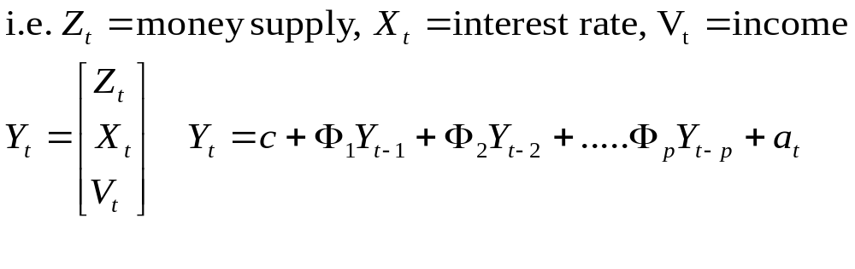
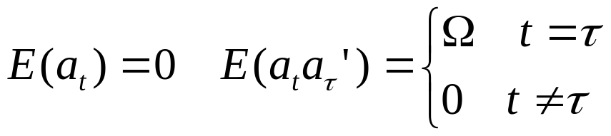
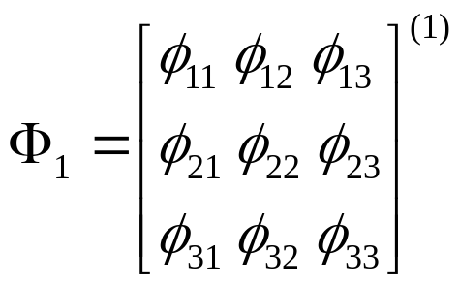

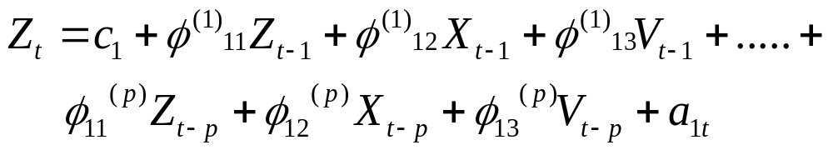
A bit of history ....Once Upon a Time
Sims(1980) “Macroeconomics and Reality” Econometrica, 48
Generalization of univariate analysis to an array of random variables
VAR(p)
are matrices
A typical equation of the system is
Each equation has the same regressors

Slide 9
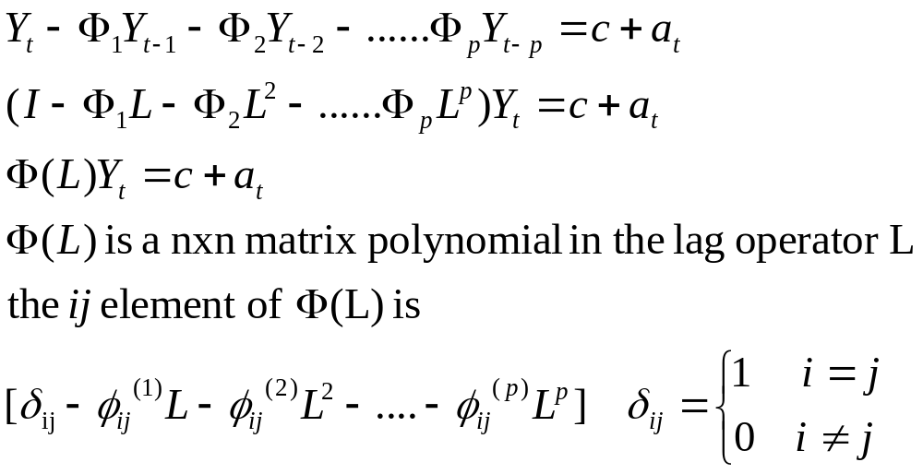

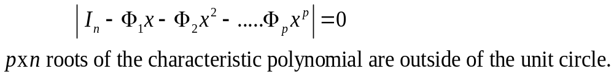
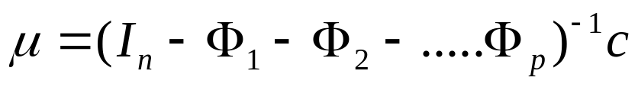
Stability Conditions
A VAR(p) for is STABLE if

Slide 10

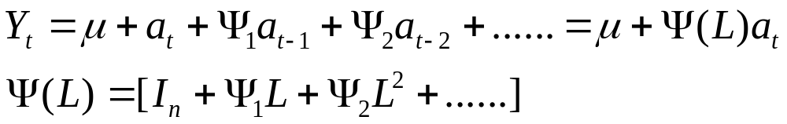
If the VAR is stable then a representation exists.
This representation will be the “key” to study the impulse response
function of a given shock.

Slide 11
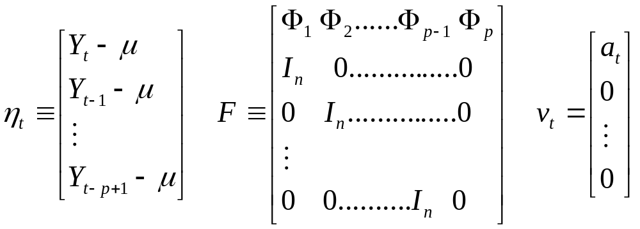
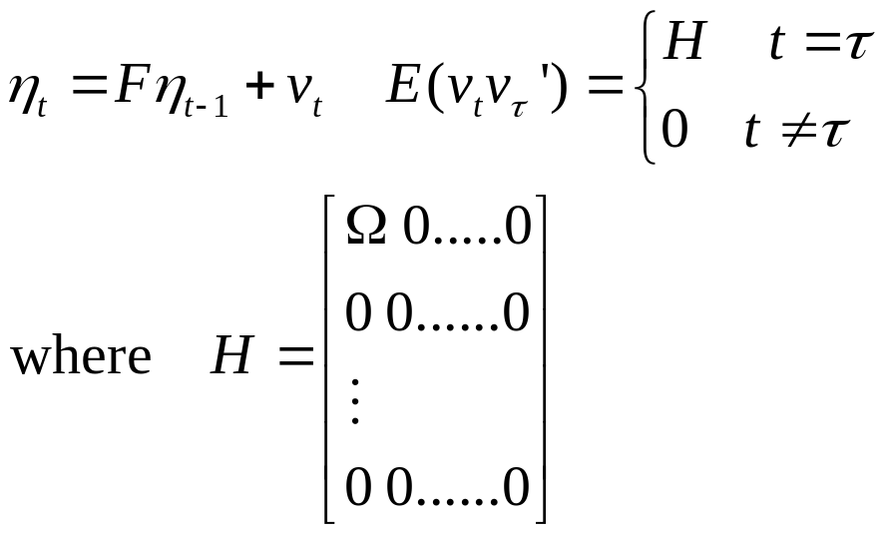
VAR(p) VAR(1)
Re-writing the system in deviations from its mean
Stack the vector as
(nxp)x1
(nxp)x1
(nxp)x(nxp)
STABLE:
eigenvalues of F lie inside
of the unit circle (WHY?).
(nxp)x(nxp)

Slide 12
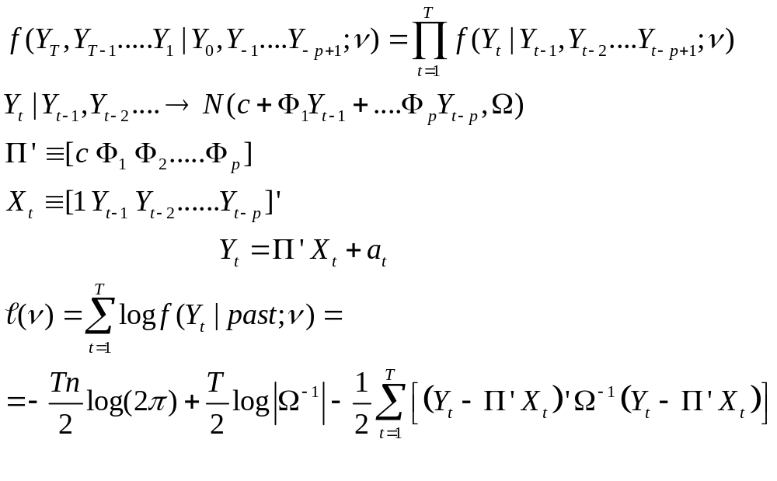
Estimation of VAR models
Estimation:
Conditional MLE
n x (np+1)
(np+1) x 1

Slide 13
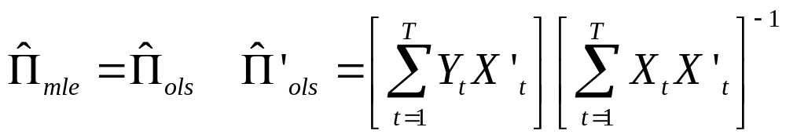
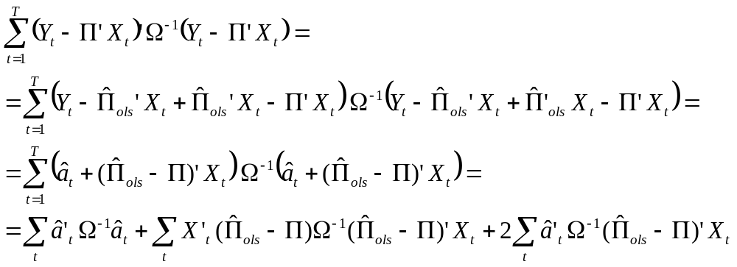
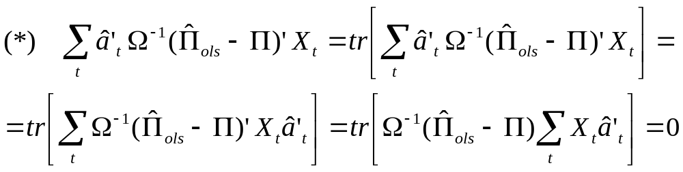
Claim: OLS estimates equation by equation are good!!!
Proof:

Slide 14
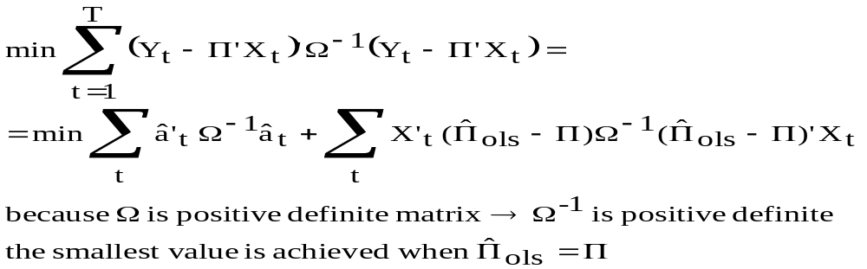


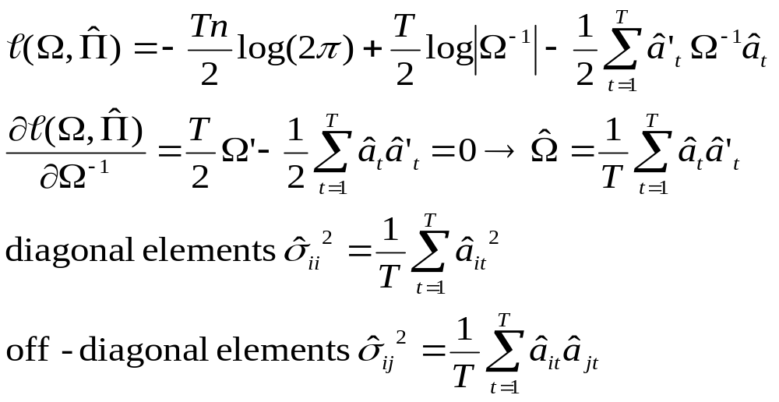
Maximum Likelihood of
Evaluate the log-likelihood at , then

Slide 15
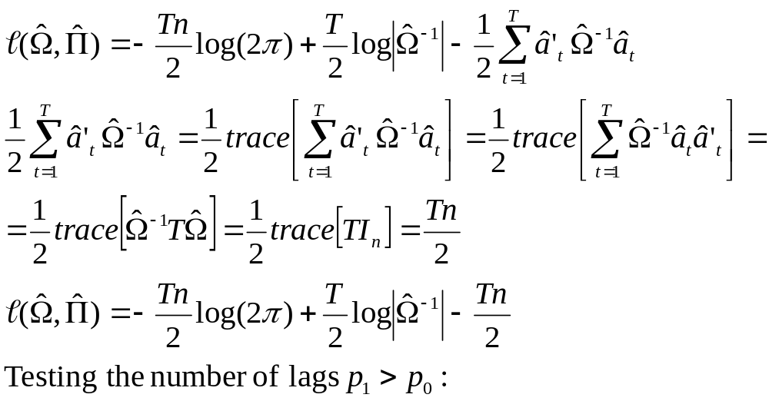
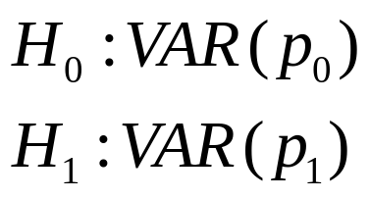
Testing Hypotheses in a VAR model
Likelihood ratio test in VAR

Slide 16
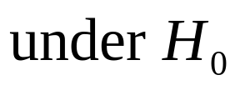
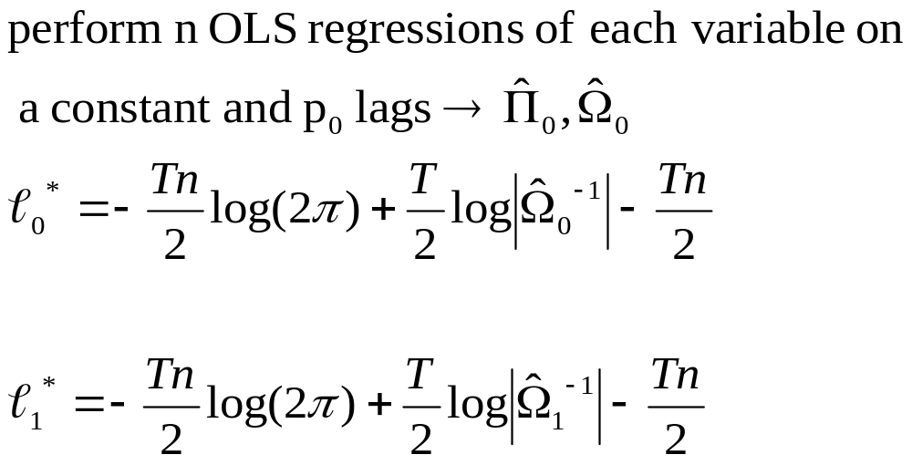
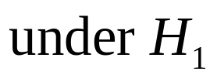
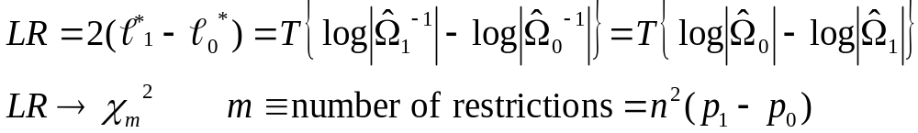
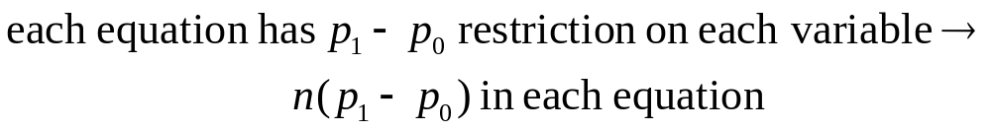

Slide 17
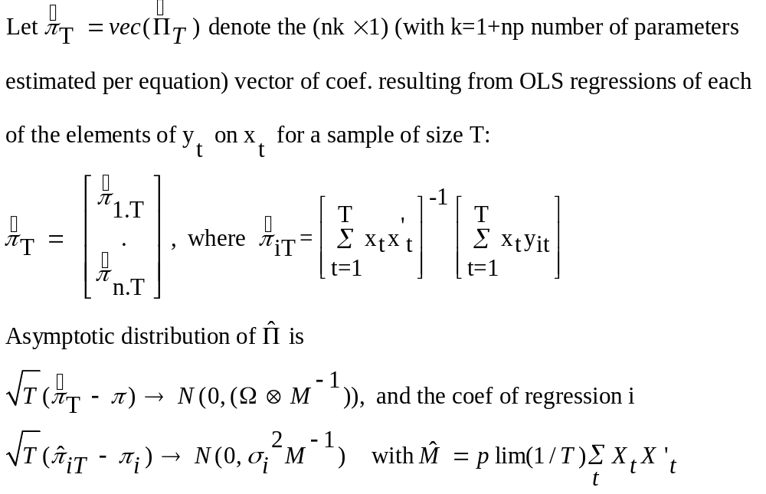
In general, linear hypotheses can be tested directly as usual and their A.D follows from the next asymptotic result:

Slide 18

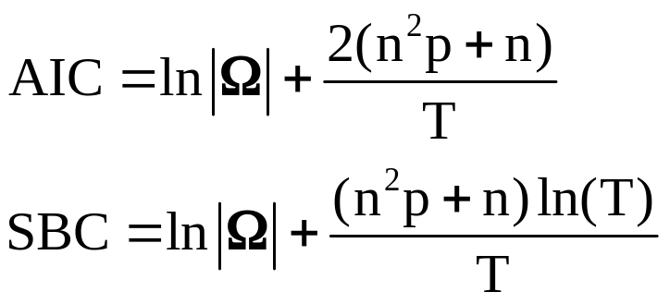
Information Criterion in a Standard VAR(p)
In the same way as in the univariate AR(p) models, Information Criteria (IC) can be used to choose the “right” number of lags in a VAR(p): that minimizes IC(p) for
p=1, ..., P.
Similar consistency results to the ones obtained in the univariate world are obtained in the multivariate world.The only difference is that as the number of variables gets bigger, it is more unlikely that the AIC ends up overparametrizing (see Gonzalo and Pitarakis (2002), Journal of Time Series Analysis)

Slide 19
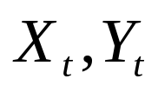
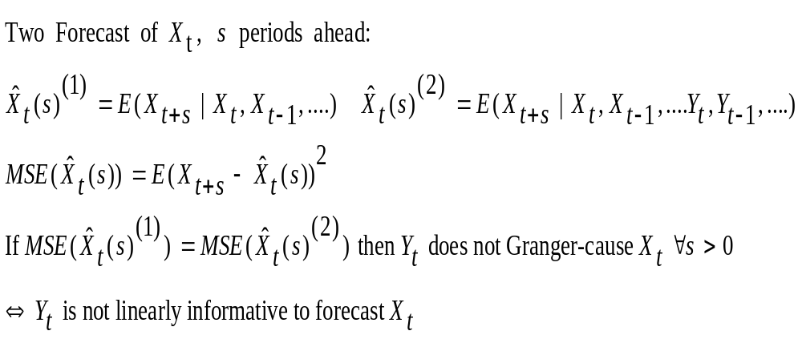
Granger Causality
Granger (1969) :
“Investigating Causal Relations by Econometric Models and Cross-
Spectral Methods”, Econometrica, 37
Consider two random variables

Slide 20
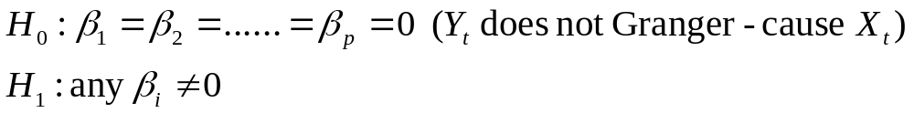
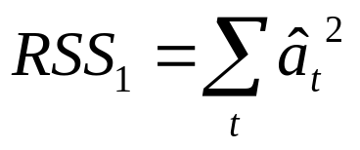
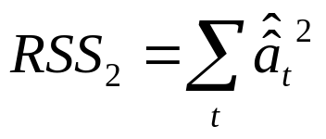
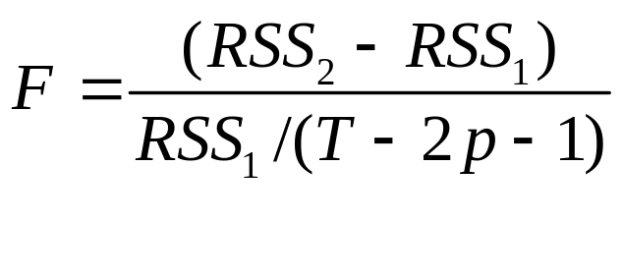
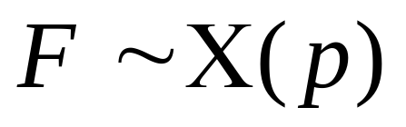
Test for Granger-causality
Assume a lag length of p
Estimate by OLS and test for the following hypothesis
Unrestricted sum of squared residuals
Restricted sum of squared residuals
Under general conditions

Slide 21
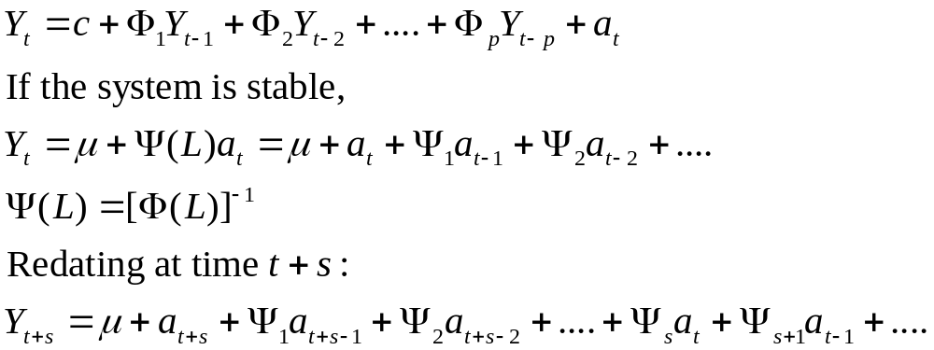
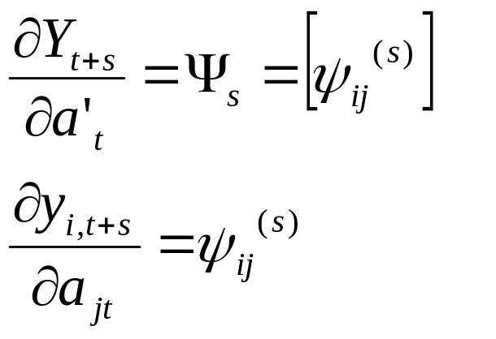
Impulse Response Function (IRF)
Objective: the reaction of the system to a shock
(multipliers)
n x n
Reaction of the i-variable to a unit change
in innovation j

Slide 22
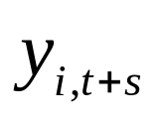
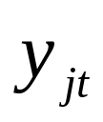
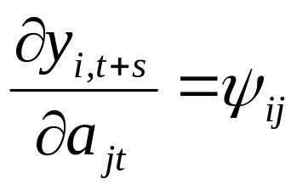

Impluse Response Function (cont)
Impulse-response function: response of to one-time impulse in
with all other variables dated t or earlier held constant.
1
2
3
s

Slide 23
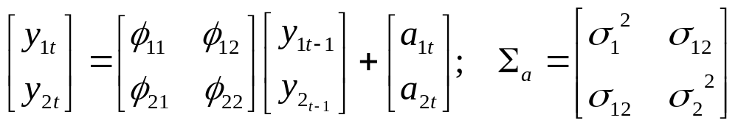
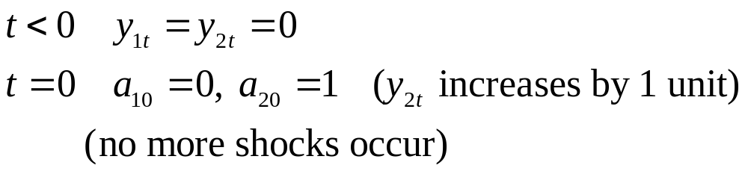
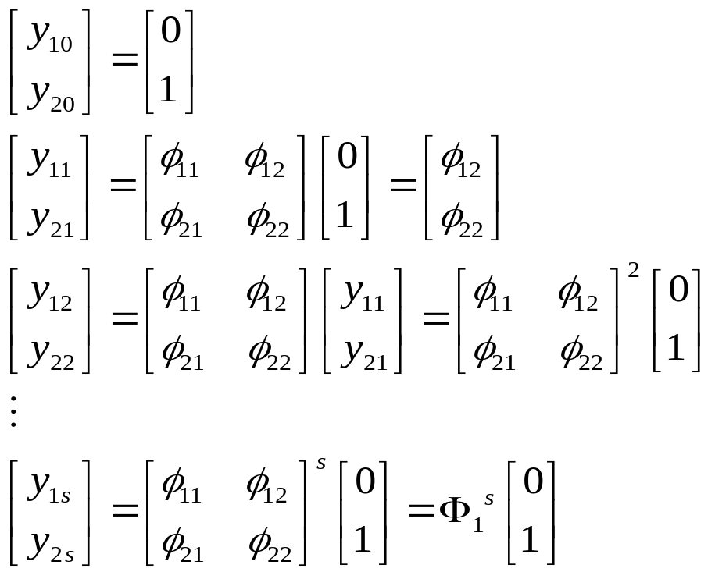
Example: IRF for a VAR(1)
Reaction of the system
(impulse)

Slide 24
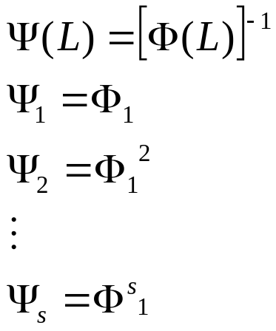
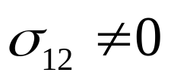

If you work with the MA representation:
In this example, the variance-covariance matrix of the innovations
is not diagonal, i.e.
There is contemporaneous correlation between shocks, then
This is not very realistic
To avoid this problem, the variance-covariance matrix has to be
diagonalized (the shocks have to be orthogonal) and here is where
a serious problems appear.

Slide 25



Reminder:
Then, the MA representation:
Orthogonalized impulse-response
Function.
Problem: Q is not unique

Slide 26


Variance decomposition
Contribution of the j-th orthogonalized innovation to the MSE of
the s-period ahead forecast
contribution of the first orthogonalized
innovation to the MSE (do it for a two variables VAR model)

Slide 27

Example: Variance decomposition in a two variables (y, x) VAR
The s-step ahead forecast error for variable y is:

Slide 28


Denote the variance of the s-step ahead forecast error variance of y_{t+s} as for σ_{y}(s)²:
The forecast error variance decompositions are proportions of σ_{y}(s)².

Slide 29

Identification in a Standard VAR(1)
Remember that we started with a structural VAR model, and jumped into the reduced form or standard VAR for estimation purposes.
Is it possible to recover the parameters in the structural VAR from the estimated parameters in the standard VAR? No!!
There are 10 parameters in the bivariate structural VAR(1) and only 9 estimated parameters in the standard VAR(1).
The VAR is underidentified.
If one parameter in the structural VAR is restricted the standard VAR is exactly identified.
Sims (1980) suggests a recursive system to identify the model letting b₂₁=0.

Slide 30


Identification in a Standard VAR(1) (cont.)
b₂₁=0 implies
The parameters of the structural VAR can now be identified from the following 9 equations

Slide 31
Identification in a Standard VAR(1) (cont.)
Note both structural shocks can now be identified from the residuals of the standard VAR.
b₂₁=0 implies y does not have a contemporaneous effect on x.
This restriction manifests itself such that both ε_{yt} and ε_{xt} affect y contemporaneously but only ε_{xt} affects x contemporaneously.
The residuals of e_{2t} are due to pure shocks to x.
Decomposing the residuals of the standard VAR in this triangular fashion is called the Choleski decomposition.
There are other methods used to identify models, like Blanchard and Quah (1989) decomposition (it will be covered on the blackboard).

Slide 32
Critics on VAR
A VAR model can be a good forecasting model, but in a sense it is an atheoretical model (as all the reduced form models are).
To calculate the IRF, the order matters: remember that “Q” is not unique.
Sensitive to the lag selection
Dimensionality problem.
THINK on TWO MORE weak points of VAR modelling

