Slide 1
Trail Sense: Optimising Trek Selection through Semantic Analysis
RAHUL PATIL
Student ID : 1109004
Thesis Supervisor : Ritupurna Dutta
Masters of Science in Computer Science
Liverpool John Moores University, UK

Slide 2


INTRODUCTION & PROBLEM STATEMENT
Adventure tourism, particularly trekking, is a rapidly growing sector. This growth has led to an explosion of online information regarding treks, including reviews, descriptions, difficulty levels, altitudes, seasons, durations, weather conditions, and regional highlights. The sheer volume and variety of this information make it challenging to sift through and select the right trek. This thesis aims to address the problem by leveraging Natural Language Processing (NLP) and state-of-the-art models to simplify the trek selection process, extracting relevant and important information from extensive data

Slide 3
Literature Review
The niche topic of NLP in the context of trekking has limited literature, but we can draw parallels from the broader tourism industry where NLP has been impactful. Here are some relevant studies and their contributions over time:
2022
2023
2015
Tourist Sentiment Mining Based on Deep Learning - (Li et al., 2022)
Natural language processing: state of the art, current trends and challenges. - (Khurana et al., 2023 )
Development of Social Media Strategies in Tourism Destination (Kiralova, Alzbeta & Pavlicek, Antonin. (2015) )
Sentiment Analysis
ChatBot
Marketing
Notes:
Understanding what customers think and feel is crucial in the tourism industry. [pause] This is where sentiment analysis, powered by Natural Language Processing (NLP), comes into play. [pause]
Sentiment analysis allows us to analyze vast amounts of unstructured text data – online reviews, social media posts, feedback forms – [pause] to gauge customer opinions and experiences. [pause] We can determine whether customers are happy, [pause] unhappy, [pause] or neutral about their travels, accommodations, and activities. [pause]
For example, Li et al. (2022) demonstrated how NLP-based sentiment analysis can be used to understand trekker experiences and identify factors contributing to customer satisfaction. By examining sentiments in reviews and social media posts, tourism businesses can detect patterns and trends, such as common complaints or praised services. [pause]
This knowledge empowers businesses to focus on the aspects that matter most to their customers. [pause] For instance, if analysis reveals that cleanliness and staff friendliness are top priorities for travelers, hotels can prioritize these areas in their service improvement plans. [pause]
Another game-changer in the tourism industry is NLP-powered chatbots. [pause] These virtual assistants provide instant support to travelers, [pause] answering questions about bookings, itineraries, and local attractions. [pause]
Khurana et al. (2023) showed how NLP-driven chatbots can provide real-time information and support to trekkers, answering common questions about trek logistics, weather conditions, and gear recommendations. [pause]
These chatbots engage with customers in natural language, [pause] offering personalized responses and reducing the need for human intervention. [pause] The use of chatbots not only improves customer satisfaction by providing quick and accurate information but also allows businesses to handle a higher volume of inquiries without increasing staff. [pause]
Beyond customer service, [pause] chatbots can gather valuable data on customer preferences and behavior. [pause] This data can then be used to personalize interactions [pause] and improve overall service quality. [pause]
With NLP techniques, [pause] marketers can identify what's hot in the travel world. [pause] For example, sentiment analysis of social media posts can reveal which destinations, activities, or accommodations are generating the most excitement. [pause] This allows businesses to tailor their offerings and promotions to align with current trends, [pause] staying ahead of the curve. [pause]
But NLP goes beyond just identifying trends. [pause] It enables personalized marketing, [pause] delivering tailored messages to specific customer segments based on their interests and past interactions. [pause] This personalized approach, as explored by Kiralova and Pavlicek (2015), [pause] is proven to increase engagement rates and improve the overall effectiveness of marketing campaigns. [pause]
In essence, [pause] sentiment analysis and chatbots, powered by NLP, [pause] are revolutionizing the tourism industry [pause] by enabling businesses to understand and respond to their customers more effectively, [pause] ultimately leading to enhanced customer satisfaction and loyalty.

Slide 4
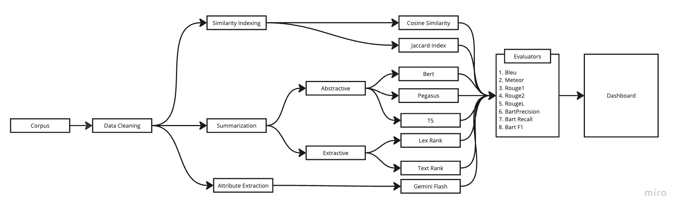
Methodology

Slide 5
Data Acquisition & Cleaning
Data Acquisition
Web scraping data from trekking website to get trek description for 225+ t¯reks all over India using Python.
05
Removing stop words
Removing english stop words such as “the”, “and” from the sentences as they do not add value to the content.
01
04
Lemmatizing words
Converting words to their base format. For example the word “running” becomes “run”
HTML Data Cleaning
Extracting the body of the trek description by removing unwanted tags from the html data using beautifulsoup library in Python.
02
03
Standardizing Data
Remove special character and unwanted line endings and convert everything to lowercase.

Slide 6
Similarity Index Calculation
Cosine Similarity
Jaccard Index
Cosine Similarity as Angular Distance:
Each trek description is a vector in a high-dimensional space.
Each dimension represents a word or term (e.g., "summit," "ridge," "waterfall").
The angle between two trek vectors is a measure of their similarity.
Smaller angle = more similar.
Key Points:
Accounts for the frequency of terms in each trek.
Works well when the length of descriptions varies.
Range: 0 (no similarity) to 1 (identical)
Jaccard Index as Set Intersection:
Each trek description is a set of unique words.
Jaccard similarity is the ratio of the intersection (shared words) to the union (all words) of the two sets.
Higher Jaccard similarity = more words in common.
Key Points:
Ignores word frequency, focusing only on the presence or absence of terms.
Useful when the vocabulary used to describe treks is consistent.
Range: 0 (no shared words) to 1 (all words are shared)
Notes:
Imagine each trek description is a collection of words, almost like a unique "word fingerprint."
Cosine Similarity: This measures how similar the direction of those fingerprints is. Imagine plotting each description as an arrow in a space where each dimension represents a word. If the arrows point in similar directions, it means the descriptions share a lot of the same words and are therefore similar. Cosine similarity also takes into account how frequently words are used, so descriptions that use the same words a lot will have a higher similarity score.
Jaccard Similarity: This is a simpler measure that focuses on whether two descriptions share the same words, regardless of how often they appear. It's like comparing two checklists – if they have a lot of items in common, the descriptions are likely similar. Jaccard similarity is good for comparing descriptions that are short or use a consistent vocabulary.

Slide 7
Extractive Summarization
Text Rank
Lex Rank
What it is:
Graph-based ranking model
Inspired by Google's PageRank algorithm
Ranks sentences based on importance
Advantages:
Unsupervised method
No need for labeled training data
Effective for identifying key sentences
Limitations:
Ignores semantic meaning
Relies on sentence connectivity
May not perform well on very short texts
Use Cases:
Summarizing news articles
Extracting key points from academic papers
Generating abstracts for long documents
What it is:
Graph-based algorithm
Uses cosine similarity for sentence connectivity
Ranks sentences by eigenvector centrality
Advantages:
Captures global structure of the text
Effective for multi-document summarization
Unsupervised method
Limitations:
Computationally intensive for large texts
May struggle with context understanding
Depends on quality of sentence similarity measures
Use Cases:
Multi-document summarization
Summarizing legal documents
Extracting key sentences from large corpora
Notes:
TextRank and LexRank are two methods used to automatically summarize texts. [pause] They both work by analyzing the relationships between sentences. [pause]
TextRank is like a voting system. [pause] Each sentence votes for other sentences that it finds similar. [pause] The sentences with the most votes are considered the most important and are included in the summary. [pause]
LexRank is similar, but it uses a different way to measure importance. [pause] It's like a popularity contest where the most well-connected sentences win. [pause] Sentences that are similar to many other sentences are considered more important and are included in the summary. [pause]
Both of these methods are unsupervised, [pause] meaning they don't need any examples of good summaries to learn from. [pause] They both work well in practice, [pause] but LexRank might be a bit faster for very long texts. [pause]

Slide 8
Abstractive Summarization
Pegasus
Text to Text ( T5 )
Bert
What it is:
Transformer-based model for abstractive summarization
Focuses on generating summaries by masking entire sentences
Size of Model: Large pre-trained model (up to 568 million parameters)
Advantages:
High-quality, coherent summaries
Specialized for summarization tasks
Effective at handling long documents
Limitations:
Requires significant computational resources
Training data dependency for domain-specific tasks
What it is:
Text-to-Text Transfer Transformer
Treats all NLP tasks as text generation tasks
Advantages:
Unified framework for various NLP tasks
Highly flexible and versatile
Strong performance across multiple benchmarks
Limitations:
Larger models require extensive computational resources
May overfit without careful fine-tuning
Complexity in training large model
What it is:
Bidirectional Encoder Representations from Transformers
Originally designed for various NLP tasks, adapted for summarization
Advantages:
Captures context from both directions
Highly versatile and pre-trained on diverse corpora
Effective at understanding sentence context
Limitations:
Not specifically optimized for summarization
Fine-tuning required for specific tasks
Computationally intensive
Notes:
Abstractive summarization, [pause] unlike its extractive counterpart, [pause] doesn't simply select existing sentences. [pause] Instead, it generates entirely new text [pause] that captures the essence of the original document [pause] using different words and phrases. [pause] This is a more challenging task, [pause] akin to how humans summarize information. [pause]
Leading the charge in this domain are transformer-based models like Pegasus, T5, and BERT. [pause] Pegasus, [pause] specifically designed for abstractive summarization, [pause] is pre-trained on a massive dataset of documents and their corresponding summaries [pause] using a unique self-supervised objective called "Gap Sentence Generation," [pause] where whole sentences are masked and predicted. This enables it to understand language nuances and generate fluent, concise summaries. [pause]
T5, [pause] a versatile text-to-text transformer, [pause] can be fine-tuned for various NLP tasks, [pause] including summarization. [pause] It's trained on a massive corpus of web text [pause] using a "masked language modeling" objective, [pause] where random words are masked and the model learns to predict them. This gives it a broad understanding of language that it can leverage for summarization. [pause]
While BERT, [pause] primarily designed for understanding language, [pause] can also be adapted for summarization. [pause] It's pre-trained on a large corpus of text [pause] using two self-supervised objectives: [pause] masked language modeling (like T5) [pause] and next sentence prediction, [pause] which teaches it to understand relationships between sentences. [pause] This foundation can be leveraged for summarization with additional fine-tuning. [pause]

Slide 9
Gemini Flash Model
What it is? : Gemini Flash 1.5 is built upon a transformer architecture, which is a powerful neural network designed for processing sequential data like text. It excels at understanding language nuances, context, and long-range dependencies. Its pre-training on a massive dataset of text and code gives it a broad understanding of the world and enables it to perform a wide range of tasks.
How we used it : We created a custom prompt where we passed trek description to the model and asked it to extract important attributes from the trek, using these attributes we were able to group and find similar treks to each other based on different attributes.
Custom Prompt : Extract the following keys from the trek description by interpreting it and getting the key-value pairs: region, difficulty, season, days, altitude. The values of these keys can have multiple values as lists. If the values are not explicitly mentioned in the text, infer them.Return a JSON dictionary with the key-value pairs, without adding any additional descriptions or comments. Trek Description : ```{text}```
Sample output:
{"Ajan Top": {"region": ["Uttarakhand"], "difficulty": ["Easy"], "season": ["Summer", "Autumn"], "days": [1], "altitude": ["<10k"], "month": ["April", "May", "June", "September", "October", "November"], "temperature": ["(10 Deg C, 20 Deg C)"]}
Notes:
Gemini Flash 1.5 is a cutting-edge large language model, [pause] or LLM for short. [pause] But what exactly are LLMs? [pause]
LLMs are a type of artificial intelligence that has been trained on a massive amount of text data. [pause] This training allows them to understand and generate human-like language, [pause] making them incredibly versatile tools. [pause] They can answer questions, [pause] summarize information, [pause] translate languages, [pause] write different kinds of creative content, [pause] and even code. [pause]
Gemini Flash 1.5 is a prime example of this technology. [pause] It's trained on an even larger dataset than many other LLMs, [pause] giving it a broader understanding of the world and a greater ability to generate high-quality text. [pause]
But Gemini Flash 1.5 isn't just about size. [pause] It also incorporates several innovative techniques that enhance its performance, [pause] making it one of the most advanced LLMs available today. [pause]

Slide 10
Evaluation Metrics
ROGUE - 1
ROGUE
ROGUE - 2
ROGUE - N
METEOR
Evaluation Metrics
BLEU
BERT PRECISION
BERT RECALL
BERT
BERT F1
Notes:
Evaluating summaries, especially those generated by machines, requires understanding several key concepts:
Precision: [pause] Think of this like cooking a dish. [pause] High precision means using only the most essential ingredients, [pause] leaving out anything unnecessary. [pause] In summarization, high precision means that most of what's in the summary is truly relevant and important.
Recall: [pause] Imagine packing for a camping trip. [pause] High recall means making sure you've packed everything you need for a safe and comfortable experience. [pause] In summarization, high recall means that the summary captures most of the essential information from the original document.
F1 Score: [pause] This is the perfect camping trip where you've packed everything you need [pause] without any extra weight. [pause] In summary evaluation, the F1 score is the balance between precision and recall. [pause] It's a single number that tells us how well the summary combines both accuracy and comprehensiveness. [pause]
Now, let's dive into specific metrics used in summary evaluation:
BLEU: [pause] This metric focuses on precision, essentially measuring how much of the generated summary overlaps with a reference summary in terms of exact word or phrase matches. [pause] A higher BLEU score means more words in the summary are also found in the reference, indicating a focus on factual accuracy.
METEOR: [pause] Going beyond exact matches, METEOR takes into account synonyms and paraphrases. [pause] It emphasizes recall, or how much of the reference meaning is captured, while still considering precision. [pause] A higher METEOR score suggests that the summary not only contains the right words but also conveys the intended meaning.
ROUGE-N/L/S/SU: [pause] This family of metrics offers different perspectives on recall. [pause] ROUGE-N looks at the overlap of n-grams, ROUGE-L assesses the longest common subsequence, ROUGE-S considers skip-bigrams, and ROUGE-SU combines skip-bigrams and unigrams. [pause] Higher scores on these metrics indicate the summary's effectiveness in capturing various elements of the reference text, [pause] from phrases to broader semantic concepts.
BERTScore: [pause] Leveraging the power of pre-trained language models like BERT, [pause] this metric evaluates the semantic similarity between the summary and the reference. [pause] It looks at the meaning of words and sentences, [pause] rather than just exact matches. [pause] A higher BERTScore signifies a stronger semantic alignment between the two texts.
BERT Precision/Recall/F1: [pause] These metrics take the concept of precision, recall, and F1 further [pause] by incorporating BERT's understanding of language, [pause] giving us a deeper insight into the summary's relevance and comprehensiveness.

Slide 11
Results & Discussion

Slide 12
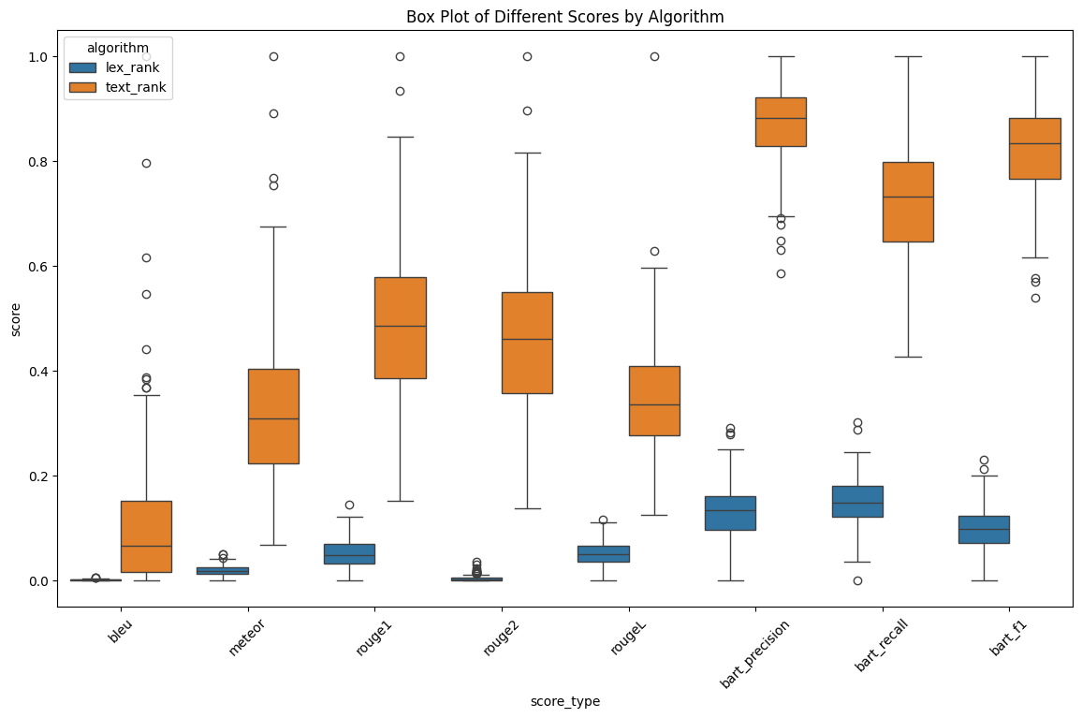
Extractive Summarization Results

Slide 13
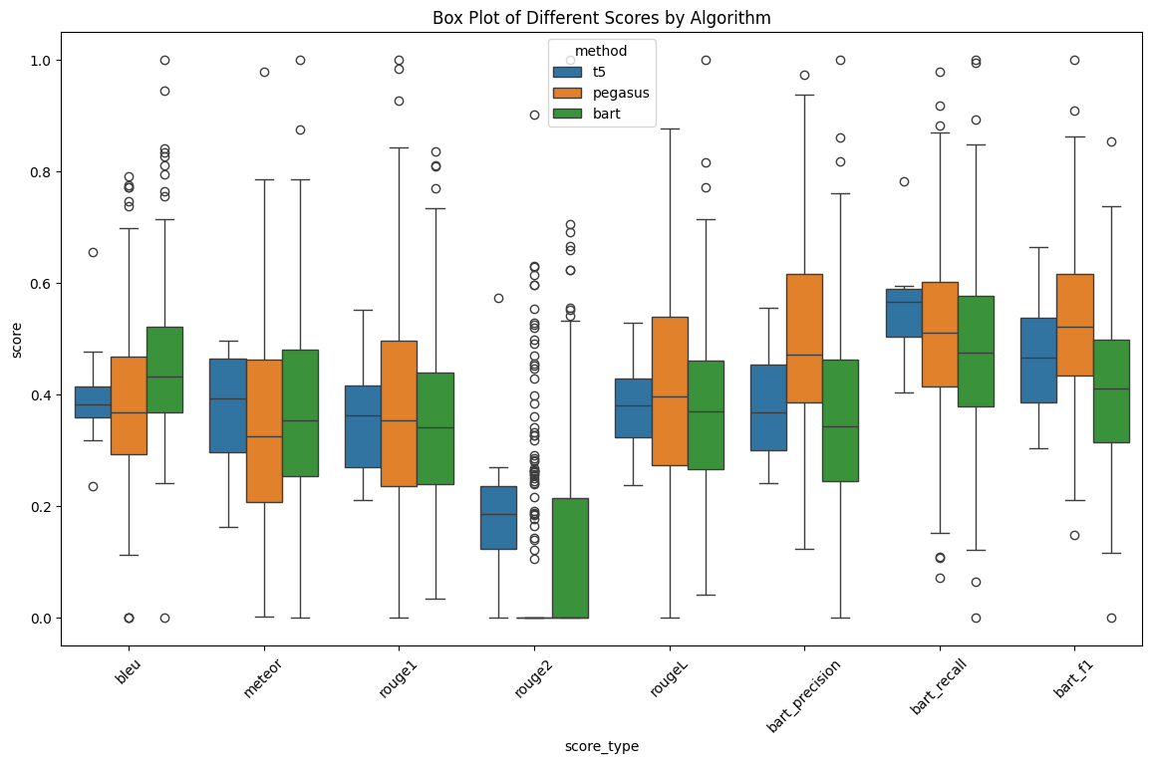
Abstractive Summarization Results

Slide 14
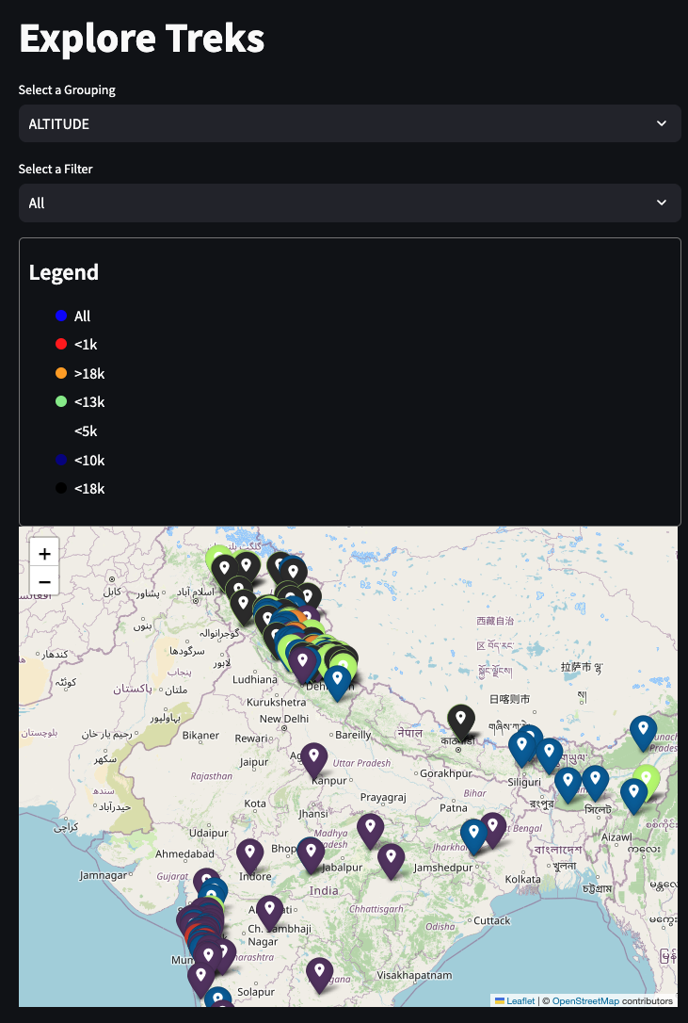
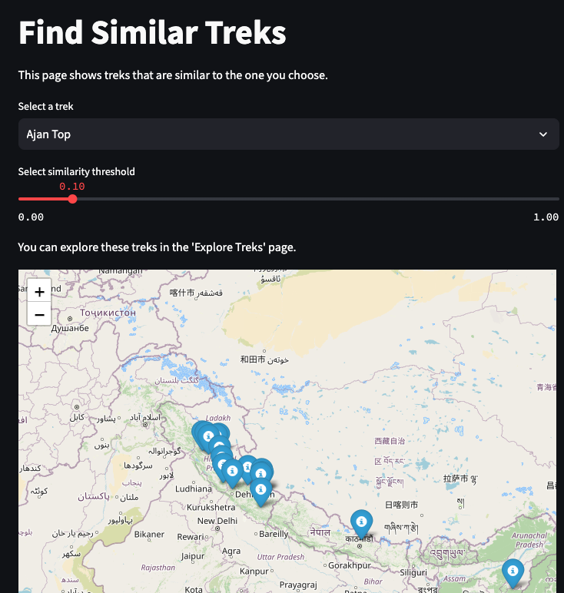
Sample Dashboard

Slide 15
Conclusion
In summary, our research demonstrates the effectiveness of both extractive and abstractive summarization techniques in generating useful summaries of trek descriptions. The interactive dashboard provides a user-friendly way to explore and analyze these summaries. While the qualitative feedback from trekkers has been positive, future work will focus on incorporating quantitative metrics, developing a sophisticated recommendation system, integrating external data sources, enhancing summarization techniques, expanding evaluation metrics, and adding multi-lingual support. These steps will ensure that our data generation and summarization system remains a valuable tool for trekkers looking to evaluate and select trekking options.
Notes:
Our implementation and evaluation have yielded valuable insights into the effectiveness of our methods:
Summarization Techniques: [pause]
Extractive Summarization (TextRank): [pause] This method proved effective in identifying and highlighting key sentences within trek descriptions. [pause] This allowed users to quickly grasp the most important aspects of a trek, [pause] saving them time and effort.
Abstractive Summarization (BART, Pegasus, T5): [pause] Our models demonstrated the ability to generate coherent and contextually accurate summaries. [pause] These summaries read more naturally and provided a more human-like understanding of the trek experience. [pause]
Combined Approach: [pause] By using both extractive and abstractive techniques, [pause] we provided users with both concise highlights and a more narrative-style summary, [pause] enhancing the overall user experience and providing a more complete picture of each trek.
Similarity Measures for Grouping Treks: [pause]
Cosine Similarity & Jaccard Index: [pause] These measures were highly effective in grouping similar treks together. [pause] This enabled us to provide users with relevant recommendations based on their preferences and past experiences. [pause] We received positive feedback from trekkers, [pause] who found this feature helpful in discovering new treks.
Topic Extraction & Grouping with Gemini Models: [pause]
Gemini Models: [pause] These models were successful in extracting key attributes from trek descriptions [pause] and grouping treks based on those attributes (altitude, season, duration, difficulty, region). [pause] This provided a structured way for users to compare and select treks that aligned with their interests and abilities. [pause] Trekkers appreciated the clarity and relevance of this information, [pause] as it greatly simplified their decision-making process.
Overall, our approach to summarizing trek descriptions, grouping similar treks, and extracting key attributes [pause] has demonstrated its value in enhancing the user experience [pause] and providing trekkers with the information they need to plan their adventures.

Slide 16
FUTURE WORKS
External Data
Sources
Multi Lingual
Support
User Centric Metrics
Recommendation
Systems
Notes:
We envision several key enhancements to further improve our trek information system:
Recommendation System: [pause] We'll create a personalized recommendation engine that leverages user interaction data. [pause] This means tailoring trek suggestions based on each user's past preferences and behavior. [pause] By integrating sentiment analysis on user reviews, [pause] we'll also incorporate the overall sentiment of other trekkers into the recommendation algorithm, [pause] leading to more accurate and relevant suggestions. [pause] We'll also use collaborative filtering techniques, [pause] which means finding similar users and recommending treks they enjoyed. [pause]
Integration with External Data Sources: [pause] To make our system even more robust, [pause] we plan to integrate real-time data sources like weather updates, [pause] trail conditions, and seasonal availability. [pause] This will provide trekkers with the most current and relevant information. [pause] We'll also incorporate geographic information systems (GIS) [pause] to offer detailed maps and elevation profiles. [pause] Finally, we'll tap into the wealth of information on social media, [pause] where trekkers share their experiences, photos, and videos, [pause] further enriching our trek descriptions. [pause]
Multi-Lingual Support: [pause] To ensure our system is inclusive, [pause] we'll develop multi-lingual models that can summarize trek descriptions in various languages. [pause] We'll also implement translation features [pause] so users can view summaries and extracted attributes in their preferred language. [pause]
User-Centric Enhancements: [pause] We're committed to continuous improvement. [pause] We'll actively collect feedback from trekkers to refine our data generation and summarization techniques. [pause] We'll expand our dataset to include a wider variety of treks, [pause] making our system even more comprehensive. [pause] We'll also enhance the dashboard's interactivity and usability, [pause] potentially adding features like saving and comparing treks. [pause] And we'll develop a mobile-friendly version [pause] to ensure accessibility for users on the go. [pause] Advanced search functionalities will also be a priority, [pause] allowing users to find treks based on specific keywords, regions, or even their own custom criteria. [pause]
With these enhancements, [pause] we aim to create a comprehensive, user-friendly, and informative platform [pause] that caters to the diverse needs of trekkers around the world.

Slide 17
Thank you!

