Slide 1
RAIR and KAIR
Multi-hop question answering
with inspectable evidence
A local research prototype and controlled comparison
Student or team ______________________________
College ______________________________________
Guide ________________________________________
Final project presentation | 27 October 2026
Notes:
Introduce the team after filling the blank fields. This project compares Role-Aware Iterative Retrieval with a local competitive Knowledge-Aware Iterative Retrieval baseline. We built both engines, a common evaluator and a working dashboard. The strongest conclusion concerns an improvement over the earlier RAIR core. Superiority over KAIR is not established. The covers intentionally leave personal details blank at the user’s request.

Slide 2
The multi-hop question answering task
In which city was the author of The Glass Orchard born?
The Glass Orchard
was written by
Mira Solen
Mira Solen
was born in
Nerava
Answer
Nerava
The system must preserve both links and show their sources.
An unsupported link should lead to abstention.
02
Notes:
Use this fictional example to explain why two documents are needed. The book gives its author and the author gives the city. Both systems receive exactly the same question and source pool. These demonstration inputs have been exposed and are not a fresh accuracy benchmark. Source: src/experiments/check_rair_pipeline.py make_task and docs/DASHBOARD.md.

Slide 3
RAIR role-based retrieval
Decompose
information gaps
Plan query
and retrieve
Filter evidence
and extract facts
Verify facts
and update state
Synthesize
answer or abstain
Shared state
Accepted facts, gaps and query history guide the next retrieval.
Short source aliases and required candidate decisions reduce malformed outputs.
03
Notes:
RAIR means Role-Aware Iterative Retrieval. Explain responsibilities, not separately trained models. The same model is prompted for each specialized operation. The diagram is an editable representation of the actual pipeline. Source: src/rair/controller.py and docs/RAIR.md. A fact enters shared state only after acceptance guards. A rejected candidate cannot resolve a gap. A single deterministic original-question fallback is charged to retrieval. Structural validity and model checking do not guarantee factual truth.

Slide 4
KAIR competitive retrieval
Agent 1
Private facts and requirements
Select a valid proposal
Complete or fewest
unresolved requirements
Agent 2
Private facts and requirements
Share selected source context while keeping private knowledge separate.
Local execution is serial and bounded.
04
Notes:
Each agent solves the whole question using private K/R/Q/context. Identical templates with independent seed offsets allow variation. The selected proposal supplies source context for the next competition iteration; private facts are not merged. A complete valid initialized proposal may finish early. Otherwise fewest unresolved requirements wins, with current order as tie-break. Local adaptations include serial execution, two agents, bounded launches and common final synthesis. This is not an exact reproduction of the asynchronous scheduler or paper scores. Sources: docs/KAIR.md; Song et al., KAIR, IEEE TCSS 2026, DOI 10.1109/TCSS.2026.3668728. Earlier preprint Song 2025 https://arxiv.org/abs/2503.13275v2 describes the competition principle but not the journal Algorithm 3.

Slide 5
Fair comparison protocol
Control | Frozen protocol
Question cohort | 100 fresh questions after 125 exposed IDs were excluded
Runs | 2 seeds and 3 arms give 600 runs, 200 per arm
Model and sources | Same qwen3.5:4b, supplied pool and BM25 top 3
Resource ceilings | 4 retrievals and 18 LLM attempts including the final call
Answer policy | Same final synthesizer, scoring and post-inference gold
Uncertainty | Resample 100 question clusters with both seeds together
Actual cost is measured. A matched cap does not make token use equal.
05
Notes:
Source: results/step5_fresh_benchmark.summary.json and results/step5_fresh_benchmark.jsonl. All 600 planned runs retained. 100 question clusters, two seeds. Primary endpoint RAIR minus earlier-core control EM. 10000 paired cluster bootstrap resamples, seed 20261022. F1 and RAIR versus KAIR are secondary, with pointwise approximate intervals. Sources: config/step5_benchmark.json, config/step5_exclusions.json, docs/EVALUATION.md and docs/RAIR_IMPROVEMENTS.md. HotpotQA dataset reference: Yang et al. 2018, https://aclanthology.org/D18-1259/. Retrieval background: Robertson and Zaragoza 2009, DOI 10.1561/1500000019. BM25 searches supplied per-question pools only. Earlier-core arm uses the same updated final policy as the other arms.

Slide 6
Final benchmark results
+22.0 points
RAIR over earlier RAIR core
95% interval +15.0 to +29.5
+4.5 points
RAIR over KAIR
95% interval -3.0 to +12.0
Superiority is not established
200 runs per arm. Errors and abstentions remain in the denominator.
06
Notes:
Source: results/step5_fresh_benchmark.summary.json and results/step5_fresh_benchmark.jsonl. All 600 planned runs retained. 100 question clusters, two seeds. Primary endpoint RAIR minus earlier-core control EM. 10000 paired cluster bootstrap resamples, seed 20261022. F1 and RAIR versus KAIR are secondary, with pointwise approximate intervals. Earlier RAIR core EM 37/200, updated RAIR 81/200, KAIR 72/200. The control is the earlier core on these same questions with the current common final policy. The primary gain is the bundled core effect conditional on that policy. It does not isolate each component. RAIR versus KAIR interval crosses zero. Do not claim universal superiority or compare different cohorts causally.

Slide 7
Resource use and answer coverage
Metric | Updated RAIR | KAIR
Exact match | 40.5% | 36.0%
Answer F1 | 47.1% | 45.5%
Answered coverage | 69.5% | 73.5%
Mean LLM calls | 12.27 | 9.57
Mean total tokens | 9,657 | 11,364
Mean retrievals | 2.69 | 2.13
RAIR uses more calls but fewer total tokens in this experiment.
07
Notes:
Source: results/step5_fresh_benchmark.summary.json and results/step5_fresh_benchmark.jsonl. All 600 planned runs retained. 100 question clusters, two seeds. Primary endpoint RAIR minus earlier-core control EM. 10000 paired cluster bootstrap resamples, seed 20261022. F1 and RAIR versus KAIR are secondary, with pointwise approximate intervals. Means per run, all 200 runs per arm. Tokens combine recorded prompt and output counts. RAIR 8956.67+700.05=9656.72; KAIR 10564.15+800.22=11364.37. LLM calls RAIR12.265 KAIR9.57. Serial controller latency RAIR14.9019s KAIR16.9187s on the recorded local setup, not a general hardware-independent speed claim. Citation F1 compares source references with gold supports, not entailment.

Slide 8
Remaining outcomes
Outcome out of 200 | RAIR | KAIR
Exact answer match | 81 | 72
Answered but not exact | 58 | 75
Abstained | 61 | 50
Question execution error | 0 | 3
RAIR abstentions
Nonexact answers include both
real errors and wording differences.
39 budget stops, 15 repeated queries
7 after planned gaps were resolved
08
Notes:
Source: results/step5_fresh_benchmark.summary.json and results/step5_fresh_benchmark.jsonl. All 600 planned runs retained. 100 question clusters, two seeds. Primary endpoint RAIR minus earlier-core control EM. 10000 paired cluster bootstrap resamples, seed 20261022. F1 and RAIR versus KAIR are secondary, with pointwise approximate intervals. Post hoc descriptive audit: results/step7_build/failure_analysis.json and outcome_census.csv. The nonexact answered counts subdivide into zero/partial token overlap: RAIR31/27 KAIR40/35. These are not semantic correctness labels. RAIR61 abstentions:39budget15repeatedquery7allgapsresolved,29zero-fact32some-fact.42of61 retrieved all gold support titles. KAIR25 agent error events are not 25 question failures; only3whole-question errors, all NoValidProposal.

Slide 9
What the failed traces reveal
Bridge evidence can be rejected
Negative evidence can be lost
RAIR discards the coaching-at-Fordham link because it is not a city.
Welsh nationality is rejected, then a yes answer is inferred from one person.
Metrics can penalize wording
Strict validation can retire agents
Both engines return 5 against five books, receiving zero token overlap.
Duplicate document selections cause both KAIR proposals to fail.
Illustrative cases only. The benchmark scores are unchanged.
09
Notes:
The examples were purposefully chosen after inspecting frozen logs and sources, not randomly sampled. They are illustrative mechanisms and cannot estimate prevalence. All original scores stay unchanged. QID5a8efef05542997ba9cb3178 RAIRseed42: coaching-at-Fordham bridge rejected as not a city, final abstains. QID5adcfb5f5542990d50227d81 RAIRseed43: Welsh evidence rejected, final yes based only on Danny Shirley, incorrect. QID5a84524a554299123d8c2203 bothseed42: 5 vs five books yields EM0/F10 despite matching number. KAIR QID5ae60d36554299546bf8303e seed43: both agents retire on duplicate document selections, NoValidProposal. Source: results/step7_build/failure_analysis.json; complete source journal results/step5_fresh_benchmark.jsonl. These findings motivate future development on exposed cases and a new untouched cohort, not benchmark tuning.

Slide 10
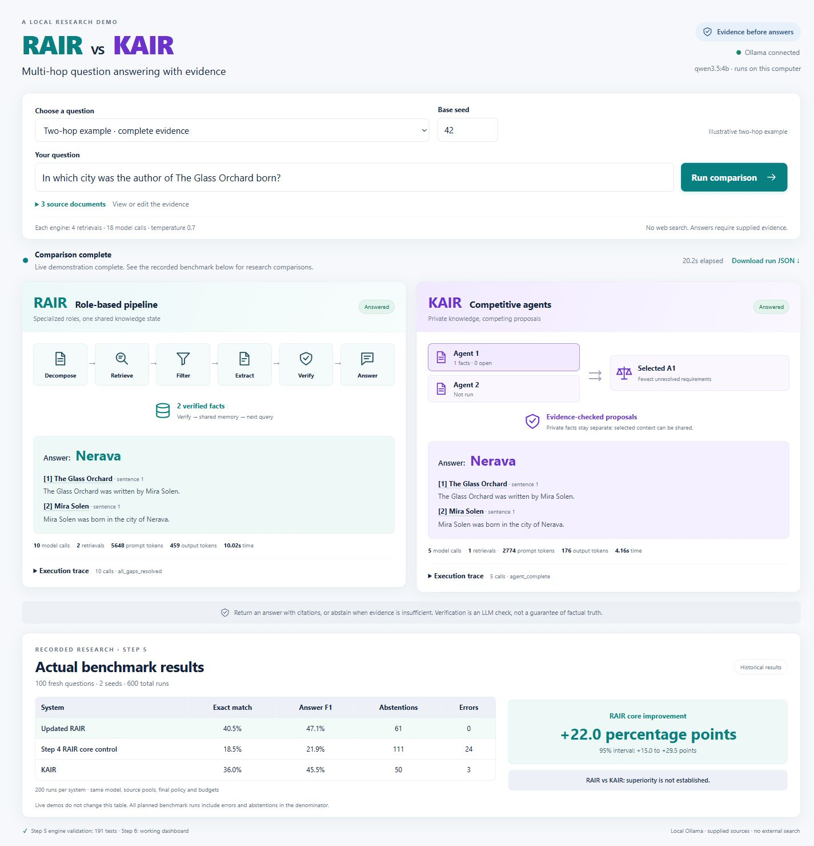
The working local dashboard
http://127.0.0.1:8765/
Inspect the evidence
Run the same question and sources through both actual controllers.
Explain the decision
Open source citations, gaps, agent proposals and raw model traces.
10
Notes:
Actual screenshot from docs/assets/dashboard_step6_desktop.png, captured from the working local application during Step6 browser QA. This is not the earlier generated concept image. The application calls the real controllers through local Ollama. Demonstrate citations and execution traces after the slides. Source: docs/DASHBOARD.md, results/step6_browser_checks.json, results/step6_validation.json. Complete example returned Nerava from both engines, missing example abstained, custom director example returned Selvara, labeled development question returned Regional Rural Bank with EM/F1=1.0. Live examples do not update or replace the frozen benchmark table.

Slide 11
Verification before presentation
207 automated tests passed
Engine behavior, evaluation controls and dashboard contracts.
600 frozen runs rechecked
Scores, call budgets, source references and confidence intervals.
Real browser evidence retained
Complete, missing, custom and labeled development scenarios.
11
Notes:
Release sources: results/step7_build/verification_core.json, results/step6_validation.json, results/step6_browser_checks.json and results/step5_current_verification.json. Final test run:207tests,0failures,0errors,9.922seconds. The source audit matches engine hashes from Step5 and dashboard hashes fromStep6. Offline audit rescored all600runs, validated every recorded call/resource budget/source reference and recomputed both EM contrast intervals. Prior Step6 browser evidence consists of5comparisons10actualengine runs across4scenarios. Fresh release smoke and artifact render/application checks are additionally recorded in results/step7_verification.json. Tests verify software behavior, not 100percent answer accuracy.

Slide 12
Conclusion and next research steps
A working and inspectable local QA comparison
Clear improvement over the earlier RAIR core.
The comparison with KAIR remains inconclusive.
Next research steps
Improve bridge and negative evidence handling, then test on a new
untouched cohort with additional models and component ablations.
12
Notes:
Source: results/step5_fresh_benchmark.summary.json and results/step5_fresh_benchmark.jsonl. All 600 planned runs retained. 100 question clusters, two seeds. Primary endpoint RAIR minus earlier-core control EM. 10000 paired cluster bootstrap resamples, seed 20261022. F1 and RAIR versus KAIR are secondary, with pointwise approximate intervals. The project is complete as a local prototype and teacher demonstration. Main conclusion: substantial improvement over the earlier RAIR core under this protocol. Secondary RAIR/KAIR comparison inconclusive. No general truth guarantee. Future work: bridge/negative evidence, relation-complete decomposition, multi-entity final checks and constrained KAIR source selection, then evaluation on a fresh untouched cohort. Consider additional models, larger samples and component ablations to test generality. References: Yang et al.2018 HotpotQA https://aclanthology.org/D18-1259/; Song,Chawla,Madisetti2026 KAIR DOI10.1109/TCSS.2026.3668728 (publisher blocked at release check, prior direct verification retained in docs/KAIR.md); Song2025 preprint https://arxiv.org/abs/2503.13275v2 (different author metadata); Robertson and Zaragoza2009 BM25 DOI10.1561/1500000019. Full bibliography and evidence paths are in the final report.

