Slide 1
Voice Hackathon 2020
Project submission
Team ID [2020_Q1_093] Project name [Guardians of peace]

Slide 2
Vision and value proposition
“Giving a voice to Jira”
Our aim is to reduce time and eliminate the need of the Scrum Master/Developer to carefully look at and interact with the Scrum Board.
Cuts down the amount of time that users would normally spend clicking through various sections of the Jira software to find the simplest information.
By saving valuable minutes, employees could plan out their next week or project more quickly and efficiently.

Slide 3
The problem
We know how widespread is the Agile methodology in software industry and our intention aims to simplify an important part of their day-to-day tasks. Stand up meetings require physical effort by all the team members and human-computer interaction.
Most project management and development teams find themselves on Jira constantly throughout their working day.

Slide 4
The solution
Using the Webhook functionality provided by the Google Dialog flow , will fire the request to external API and get the expected response to convert into voice.
User is only giving short instructions as voice input to our bot and output is easily provided to the team member.
This AI Based project will have in-built data/phrases for instructing the commands to perform on jira so any member of the team can input voice and extract the response(Updating the tickets, creating the story/tasks which results in time saving).

Slide 5
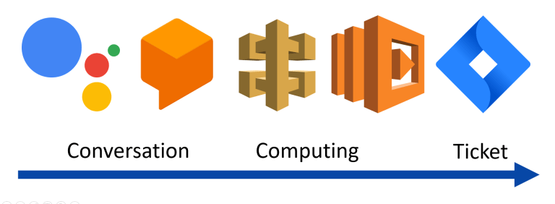
Technical design

Slide 6
Innovation
It is designed to be used by a large community of Agile practicing Software Engineers.
Well designed Training Phrases to understand user's instructions as it can misinterpret voice input many times.
To reduce time of Scrum master/Employees from manually updating the Jira tickets by writing JQL.
We have used multiple technologies and integrated them to provide this end-to-end scrum master service. JIRA Software is used for Scrum Board and we have built Java service as well as using JIRA REST APIs to make API calls for task movements and obtain summary report

Slide 7
Business Value
Perform daily standup meeting task just by giving voice input thereby automating task movement and witness changes on the JIRA scrum board
Reducing each team member's effort and time put in, thereby eliminating need of a physical Scrum Master.
Anyone who is not aware of the JQL will just instruct the Google mini to get the list

Slide 8
Re-usabilty
The built-in training phrases will trigger a response for the instructed command by voice to update the Jira ticket for example, to create a new ticket/Movement of tasks etc.
Dialog flow automatically recognizes the phrases and respond back in seconds which saves lot of time.

Slide 9
Choice of technology
Google AI libraries
JIRA Rest APIs
Google Mini Home
WebHook, DialogFlow

Slide 10
Guardians of Peace
Email | Hackathon Role | Job Role | Team Lead | Location
 | Hacker, Hustler or Hipster? | Cloud architect, UX Consultant, etc | Yes/No | Pune, Chennai, Mumbai, Bangalore, Other?
rahul.ranjan@atos.net | Developer | Consultant | No | United Kingdom
Vijayalakshmi.gs@atos.net | Developer | Associate Consultant | No | United Kingdom

Slide 11
Voice Hack 2020
For more information please contact: Hackathon@atos.net

