Slide 1
Musical instruments Identification
Using deep learning approach

Slide 2
OUTLINE
Relevance of the topic
Description
Objectives of the study
Existing and Proposed Systems
Input / Output and Modules
Algorithms
Dataset

Slide 3
Relevance
Recording music –
Earlier - recording in studios with acoustics designed for that purpose
Now - music is recorded everywhere and with whatever sensors are available, including smartphones.
Identifying musical instruments is of importance in many areas no longer closely related to music, i.e., automatically creating sound for games, organizing music social services, separating music mixes into tracks, amateur recordings, etc.
Both classical and sensor-based instruments need to be subject to sound identification and further applications

Slide 4
Description
The work aims to propose an algorithm for automatic identification of instrument present in an audio excerpt using sets convolutional neural networks (CNN).
In the proposed work a convolutional neural network is implemented to identify the musical instrument present in a monophonic audio file. The model is trained on London Philharmonic dataset which consists of 6 different classes of musical instruments. Mel spectrogram representation is used to extract features for the Convolutional Neural Network model.

Slide 5
Objectives
The project propose to develop a system Using Convolutional Neural Network which enables the classification of 6 different musical instruments.
The audio of instrument is converted into Mel- Spectrum and then trained with model to classify into different category.

Slide 6
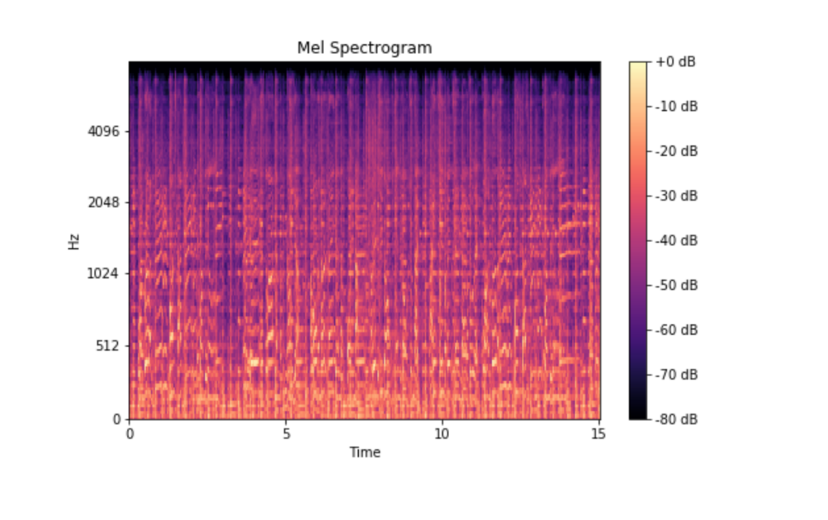
Mel – Spectrogram
Mel spectrogram is a spectrogram that is converted to a Mel scale. Then, what is the spectrogram and The Mel Scale? A spectrogram is a visualization of the frequency spectrum of a signal, where the frequency spectrum of a signal is the frequency range that is contained by the signal.

Slide 7
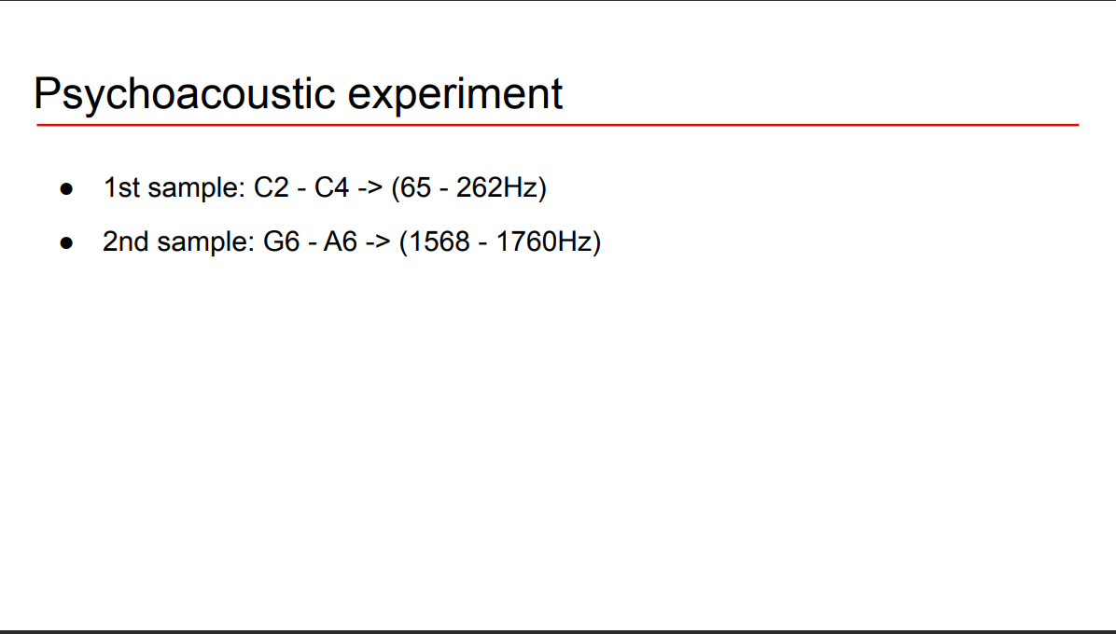
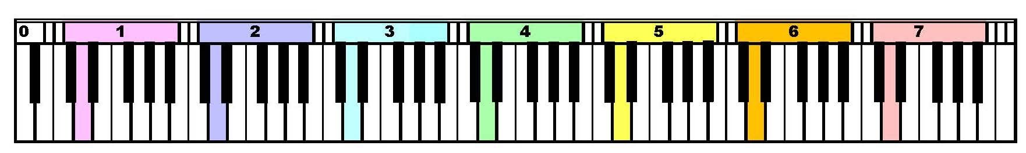
200Hz
192Hz
C2
C4
G6
A6

Slide 8
Humans perceive frequency logarithmically!!

Slide 9
Ideal audio feature
● Time-frequency representation
● Perceptually-relevant amplitude representation
● Perceptually-relevant frequency representation (mel-spectrograms)

Slide 10
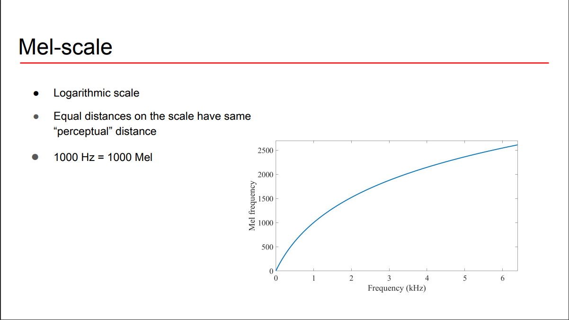

Slide 11
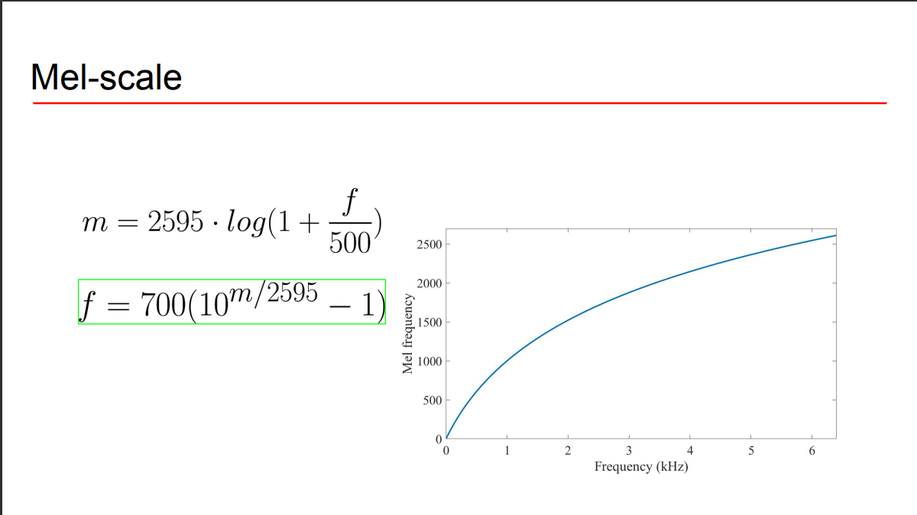

Slide 12
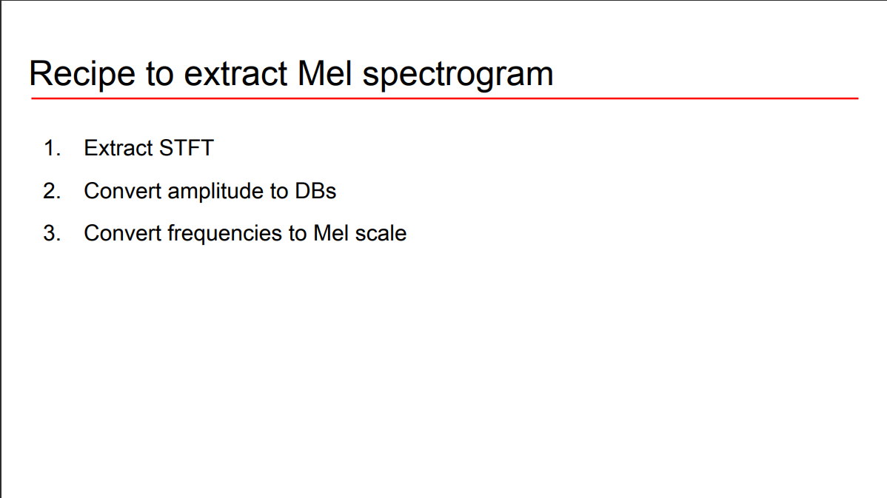

Slide 13
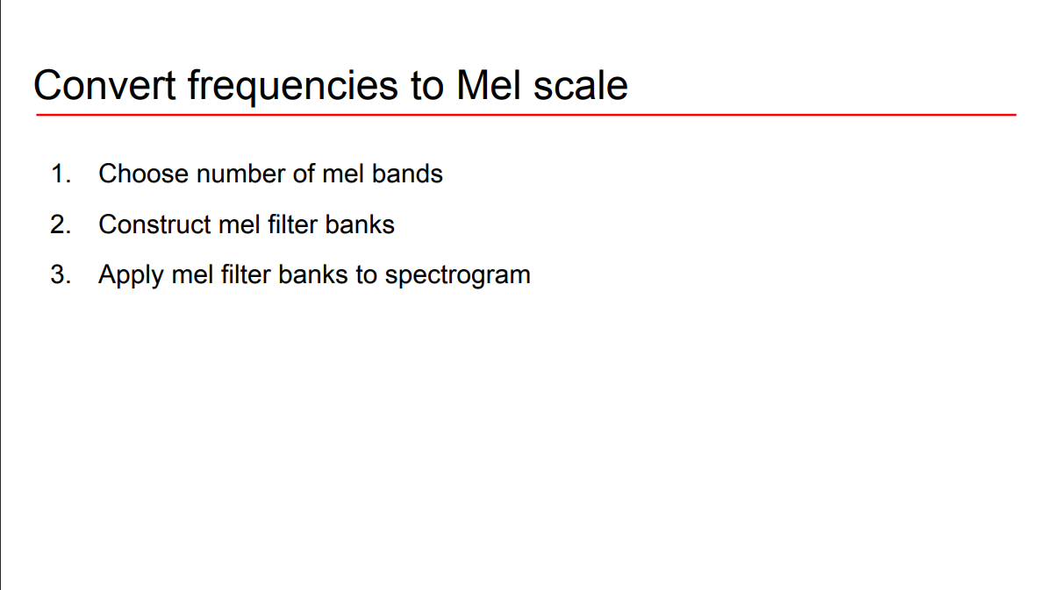

Slide 14
I/O and Modules
The model helps to label the unlabeled audio files so that manual annotation can be avoided.
Audio to Mel – Spectrogram
Data Processing
Model
User Interface

Slide 15
Algorithm
Convolutional Neural Network(CNN) or ConvNet, is a class of neural networks
It specializes in processing data that has a grid-like topology, such as an image.
• A CNN typically has three layers:
✓ a convolutional layer
✓ a pooling layer
✓a fully connected layer

Slide 16
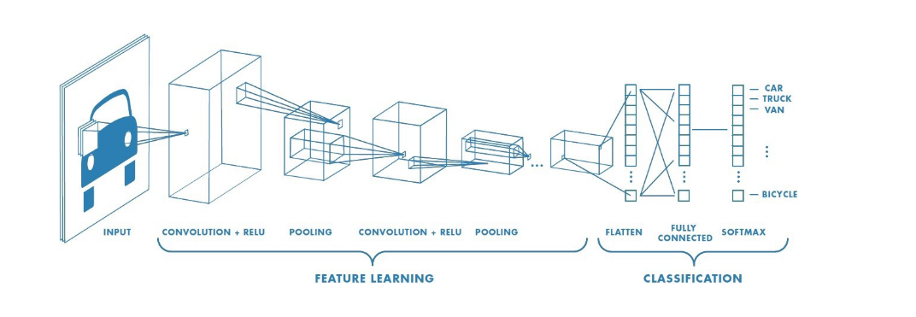
Algorithm

Slide 17
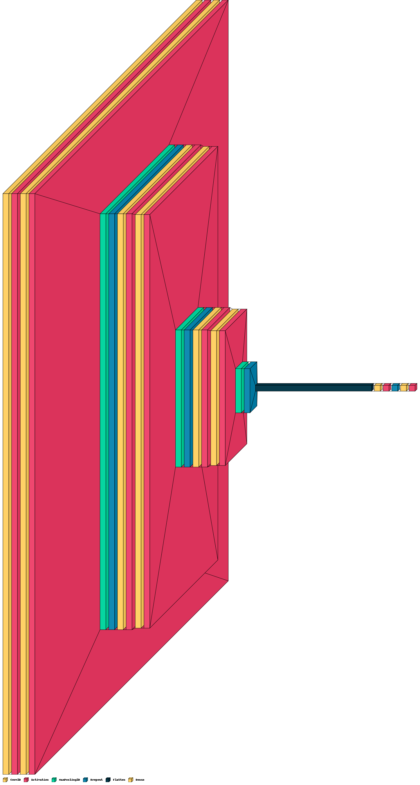
CNN - Architecture

Slide 18
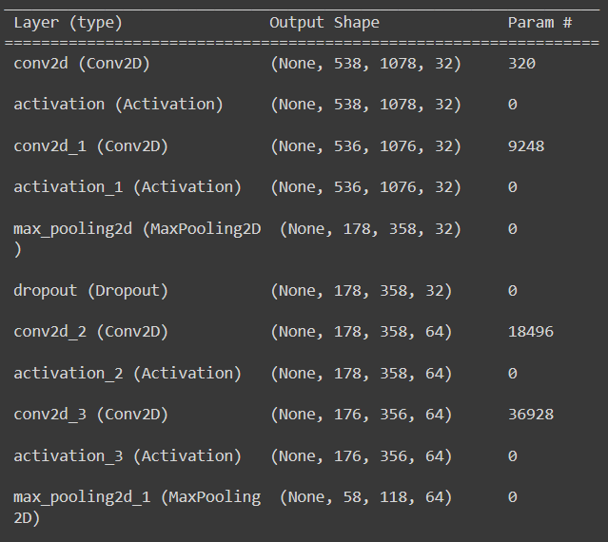
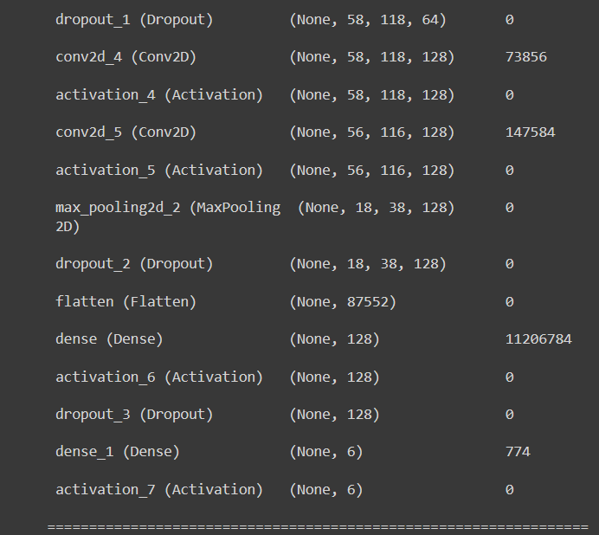
CNN - Architecture

Slide 19
Dataset
The model is trained on London Philharmonic dataset which consists of 6 different classes of musical instruments.
Viola
Trumpet
Saxophone
Oboe
Flute
Cello
Each classes consist of audio file playing different notes at different velocity.

Slide 20
Thank You

