Slide 1


Tata Steel Workforce Resource Analysis & Utilization Applications

Slide 2
Executive Summary
Category | Details
Total Records Analyzed | 6,635
Unique Personnel | 1,409
Divisions | 22
Groups | 63
Departments | 289
Data Challenges | Unstructured formats, missing fields, manual mapping
Key Takeaways | Identified optimization opportunities and relationships

Slide 3
Proposed Automation Process
Step | Details
Data Extraction | `extract_pdf.py` script to handle unstructured data
Data Analysis | `analyze_data.py` for summarizing personnel and structure
Visualization | Charts via `create_charts.py`
Presentation | Slides built using `python-pptx`
Output | Reusable workflow with standardized reporting

Slide 4
Problem Statement and Objectives
🔍 Problem Statement: To perform a deep analysis on Tata Steel’s workforce data and deliver insight-driven recommendations for optimal personnel utilization.
🎯 Objectives:
• Analyze division-wise and group-wise personnel distribution
• Identify areas for structural optimization
• Highlight resource imbalances and bottlenecks
• Recommend actionable improvements for better utilization
• Present a scalable roadmap for implementation

Slide 5
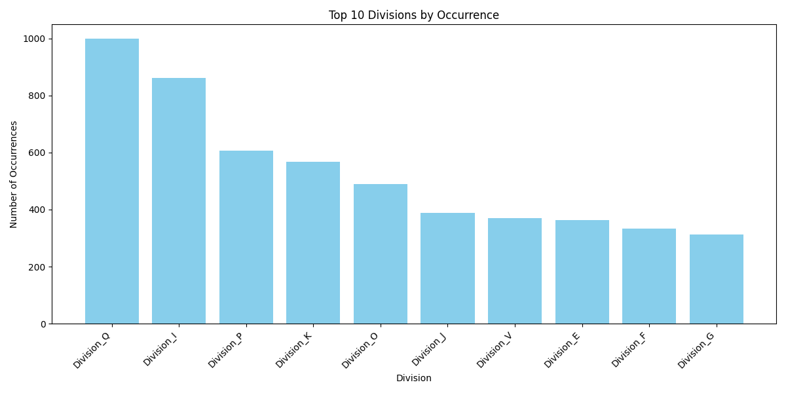
Division Distribution Analysis

Slide 6
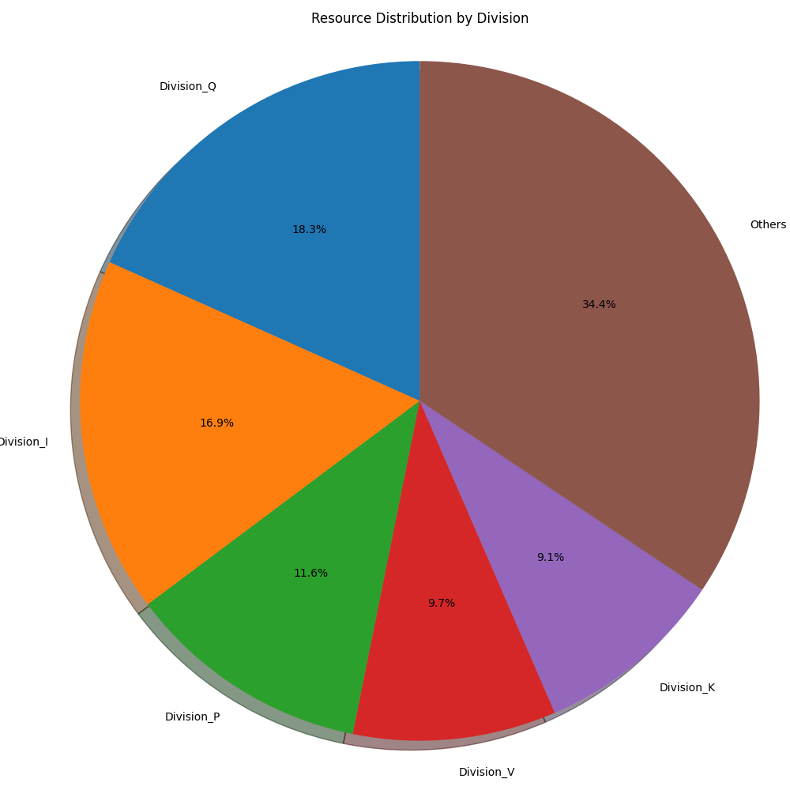
Resource Concentration

Slide 7
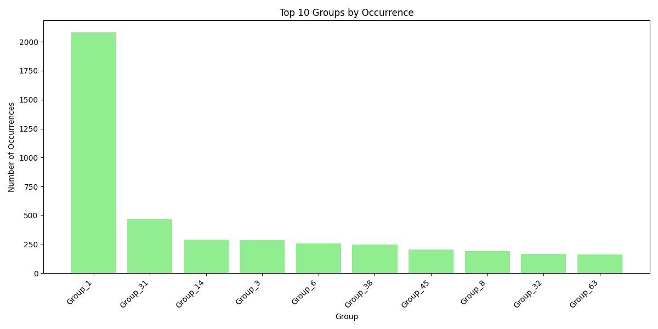
Group Analysis

Slide 8
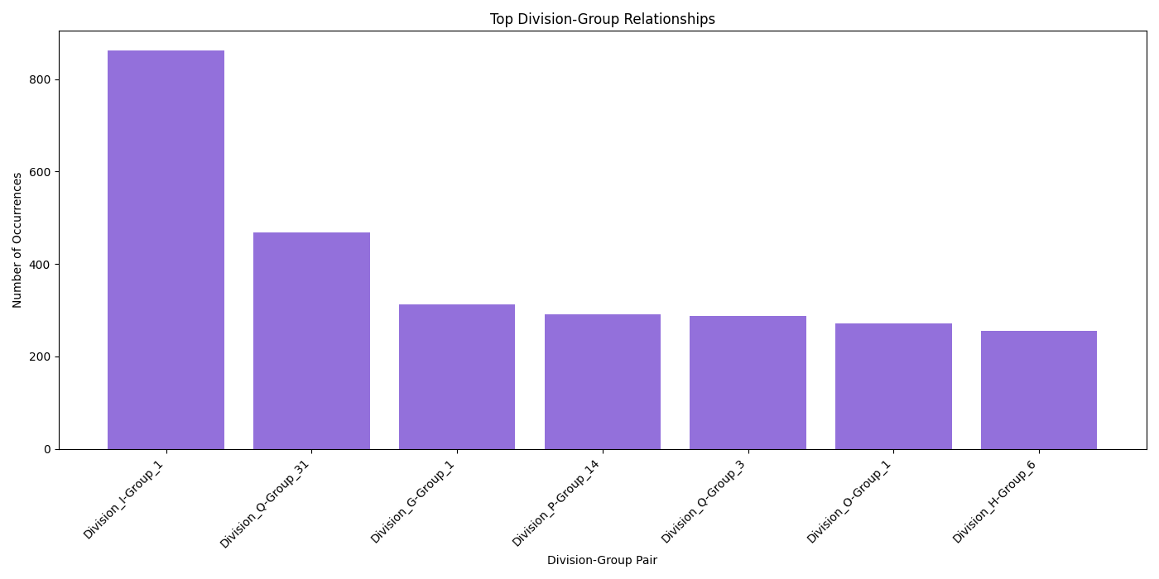
Key Division - Group Relationships

Slide 9
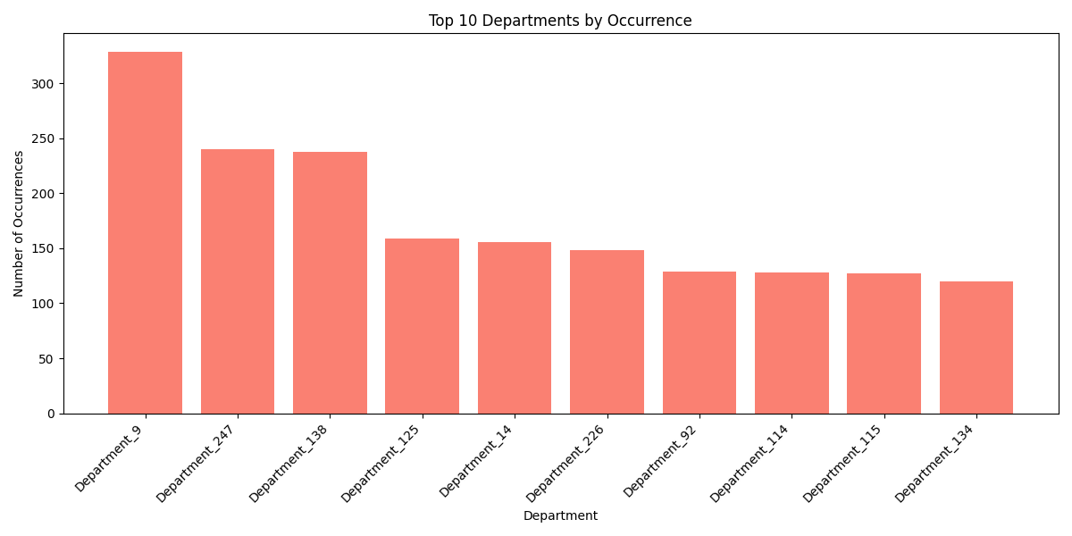
Department Analysis

Slide 10
Thank You

