Slide 1




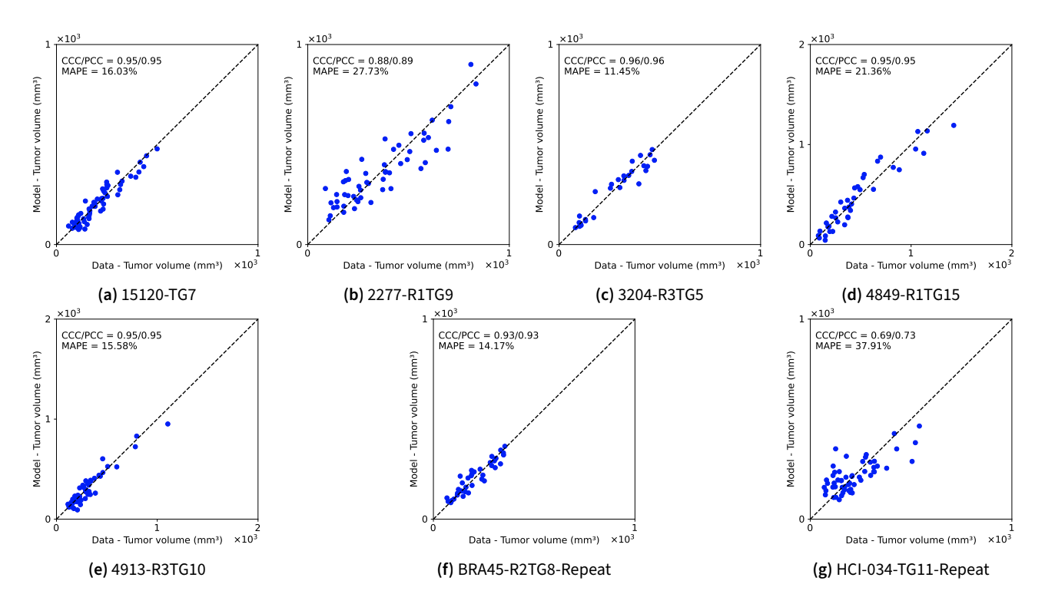
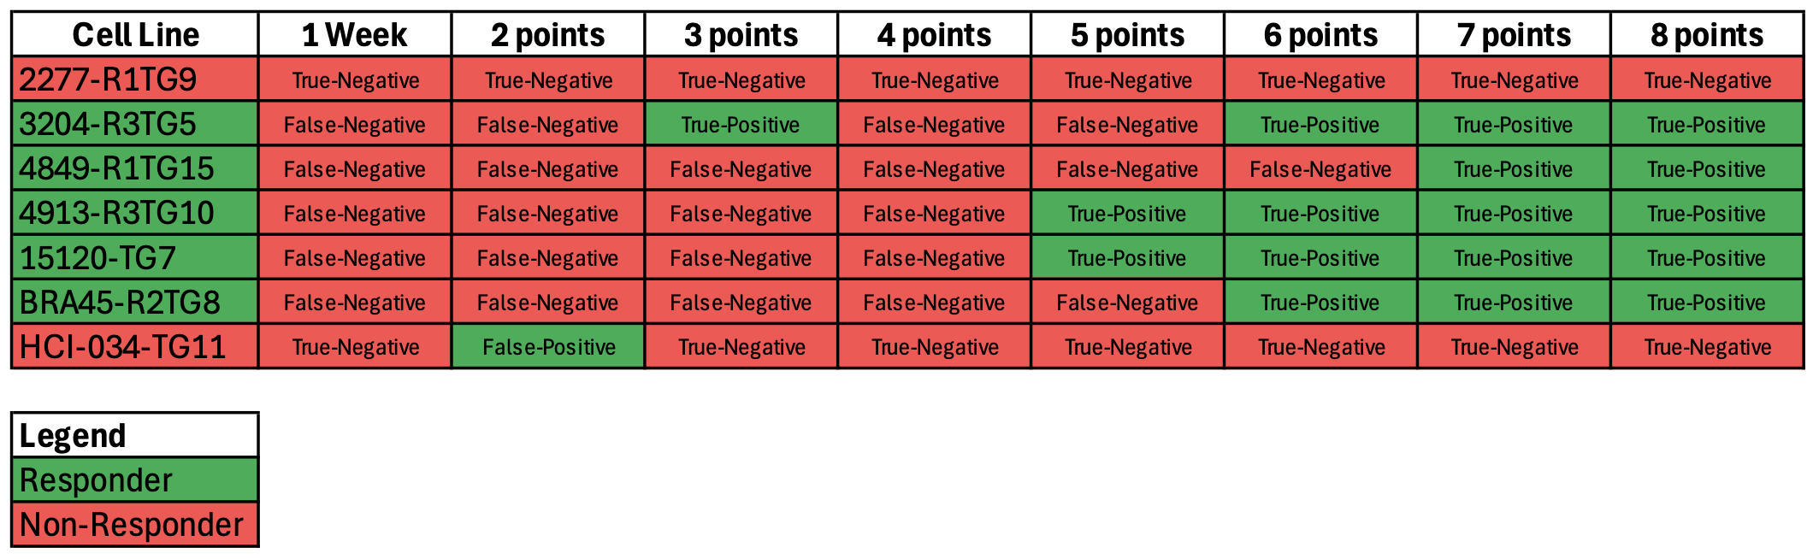
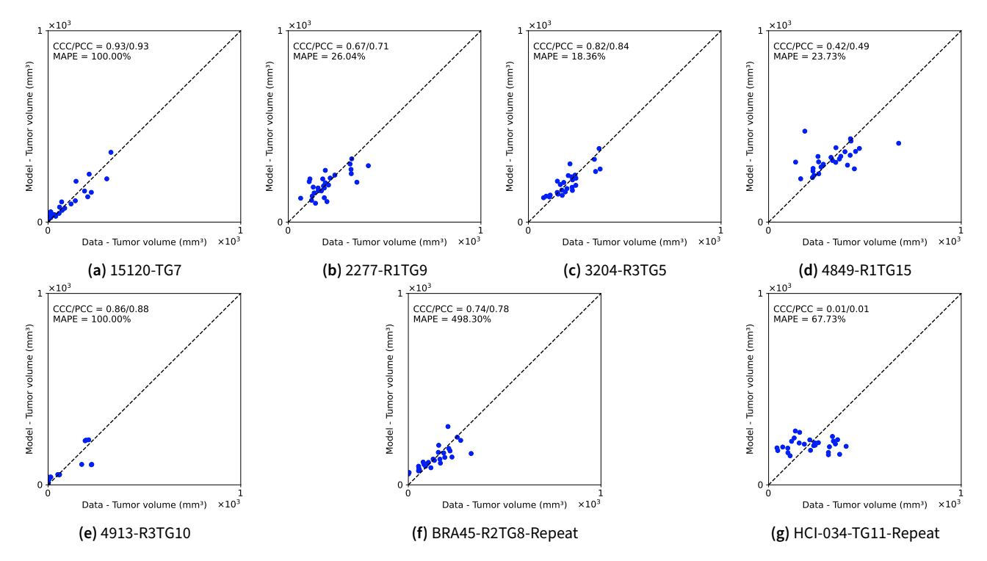

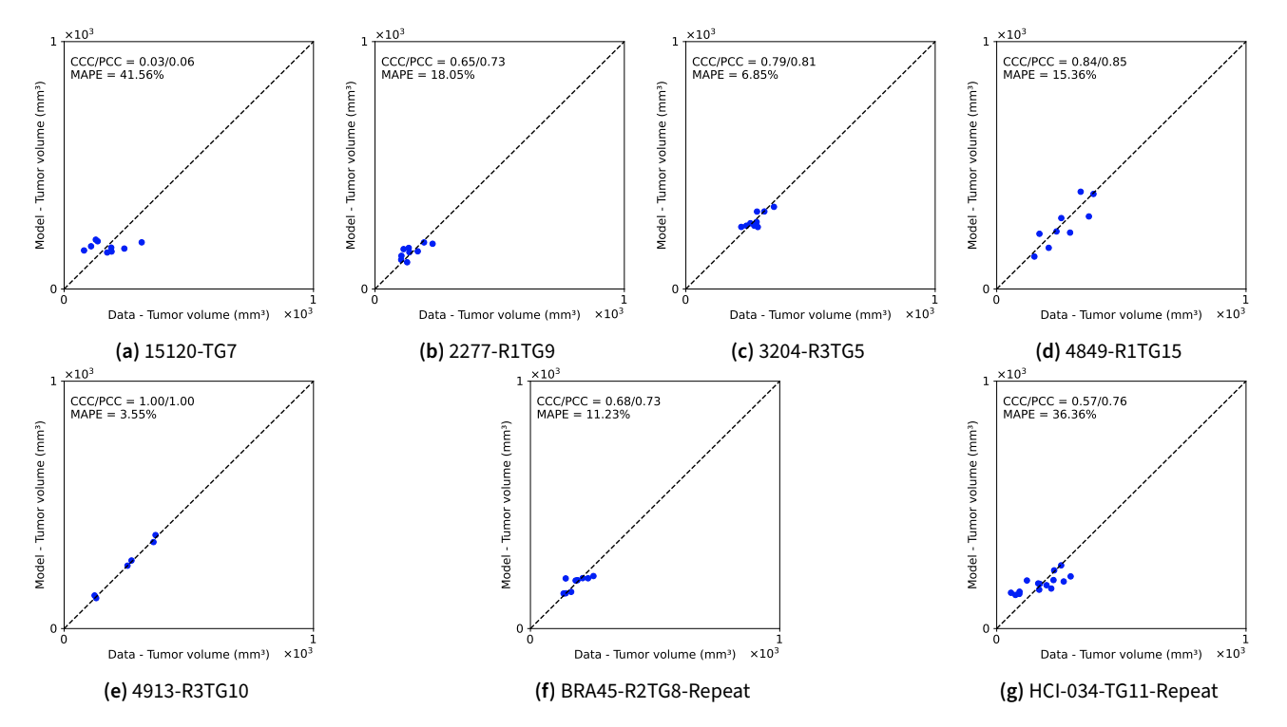
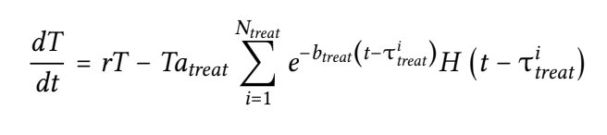

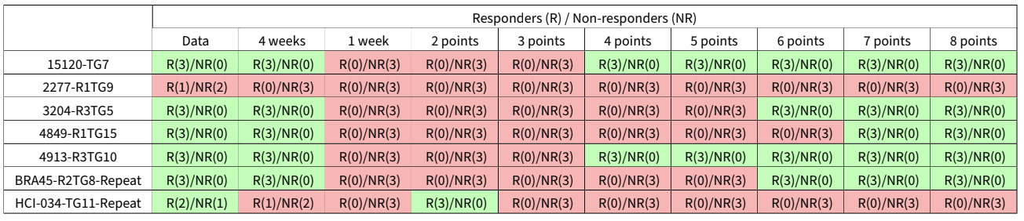

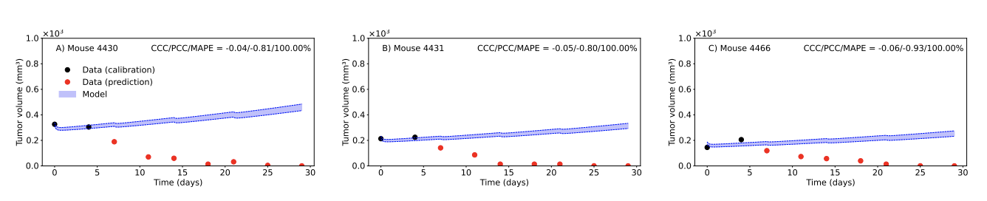
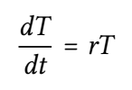
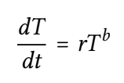
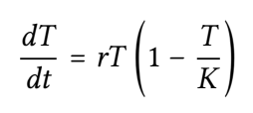
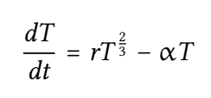
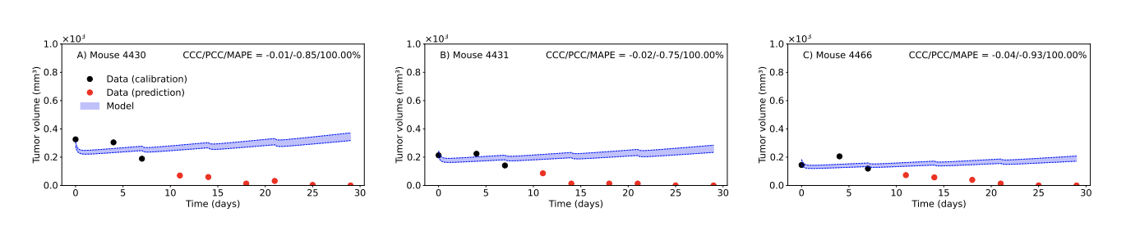
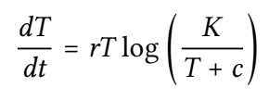
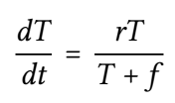
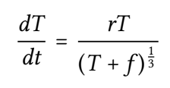
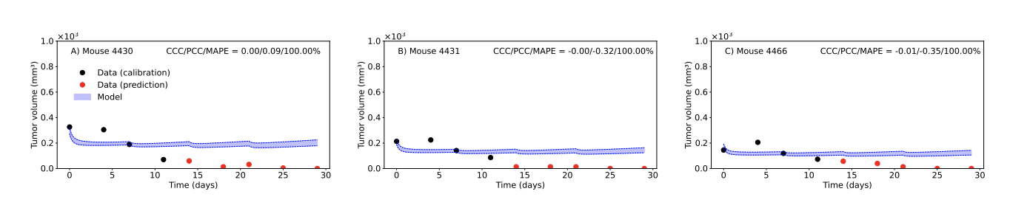


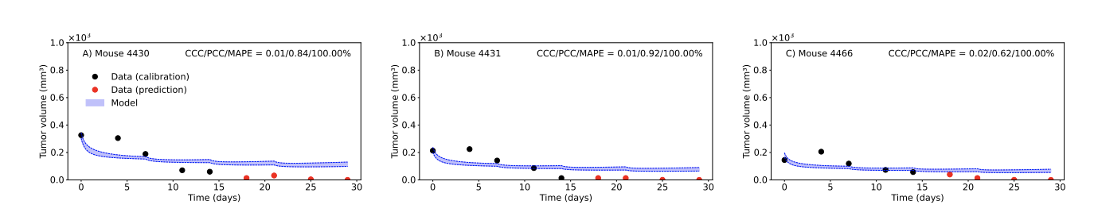
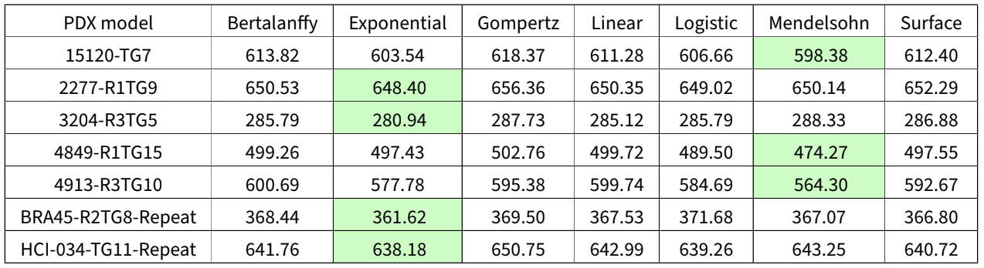
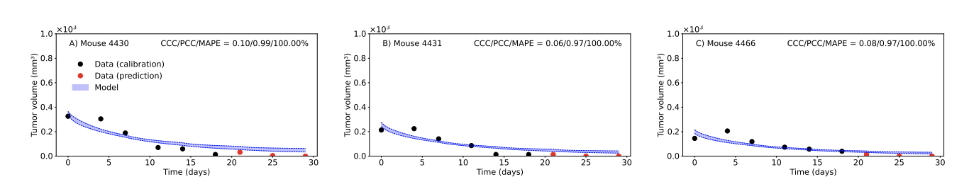
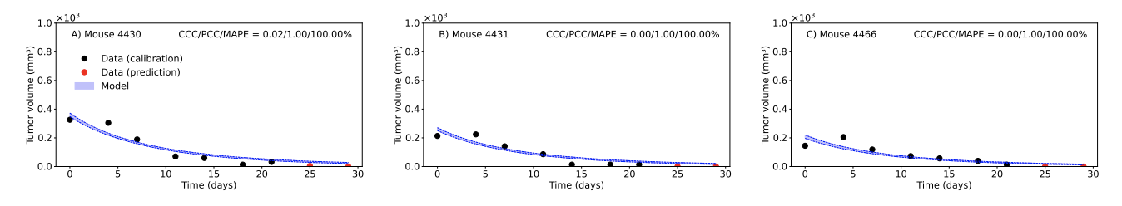
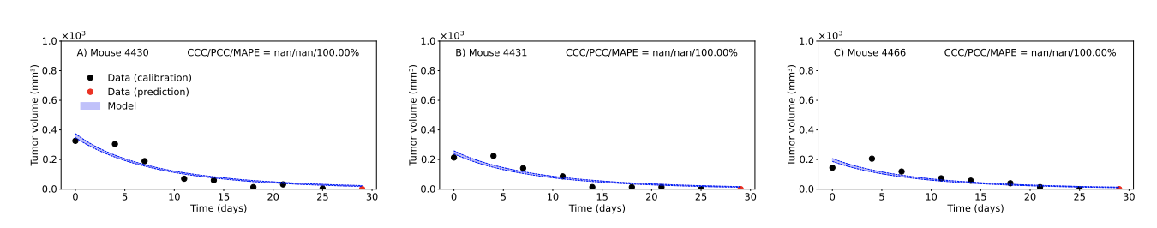
Modeling Tumor Response to Paclitaxel and Carboplatin using Patient-Derived Xenografts:
A Bayesian Calibration Approach
Rahul Raja Durai Murugan¹⁻², Elizabeth L. Dobrolecki⁵, Michael T. Lewis⁵⁻⁶, David A. Hormuth II²⁻⁴, Thomas E. Yankeelov^{1-2,6}, Ernesto A. B. F. Lima²⁻³ ¹University of Texas at Austin, ²Oden Institute for Computational Engineering and Sciences, ³Texas Advanced Computing Center, ⁴Livestrong Cancer Institutes, ⁵Lester and Sue Smith Breast Center, ⁶Dan L. Duncan Cancer Center at Baylor College of Medicine
Motivation
Control, 1-Week and 4-Week Calibration
Results
Patient-derived xenografts have been a promising tool in understanding tumor behavior and testing various treatment options before administering these therapies to human patients. Previous experiments have led to the development of commonly known chemotherapy medications. Utilizing this practice, this project aims to mathematically model the tumor developments in response to Paclitaxel + Carboplatin treatment to build a statistical analysis that can determine whether (or not) and when a patient responds to the aforementioned drug combination.
Exponential model control based on the PDX-specific calibration displays strong correlation
4-Week and 1-Week Exponential + Treatment model show a strong relationship as well
Data
Identifying at what stage of treatment the model accurately identifies a PDX model as a responder or non-responder to Paclitaxel + Carboplatin
7 patients
Longitudinal changes in tumor size were measured via calipers from twelve mice for each of the seven patient-derived xenografts
Divided into three different groups: Control, 1-week treatment, and 4-week treatment
12 mice
Exponential Growth + Treatment Effects Model
Control
1-Week Treatment
4-Week Treatment
(n = 6)
(n = 3)
(n = 3)
Predictive Performance
Mouse-specific designation as responder or non-responder corroborates that 6 data points/18 days is sufficient to accurately predict tumor response to Paclitaxel + Carboplatin
Model Development
Model calibration with two measurements and subsequent prediction
Exponential
Mendelsohn
Logistic
Bertalanffy
Model calibration with three measurements and subsequent prediction
Conclusion and Future Steps
Gompertz
Linear
Model calibration with four measurements and subsequent prediction
Our calibrated mathematical model fits the experimental data well and allows for an accurate prediction of whether the PDX will respond to the drug combination or not within 18 days
Ultimately, this prediction model will aid healthcare providers in making decisions regarding the treatment course of cancer patients; early detection of a potentially failing treatment plan allows physicians to change the drug administered for a better chance of cancer survival.
Surface
Model calibration with five measurements and subsequent prediction
Model Selection Criteria
Model calibration with six measurements and subsequent prediction
Model calibration with seven measurements and subsequent prediction
Acknowledgments
Several mathematical growth models were tested to see which one better represents the tumor growth without treatment. The selected growth function will be the basis of the complete model.
AIC and BIC values were compared for each of the 7 models; Exponential model displayed the most consistent results across all PDX models.
Model calibration with eight measurements and subsequent prediction
The authors acknowledge the Dan L. Duncan Comprehensive Cancer Center at Baylor College of Medicine for providing PDX data.
The authors acknowledge the Texas Advanced Computing Center (TACC) at The University of Texas at Austin for providing HPC resources.

Slide 2
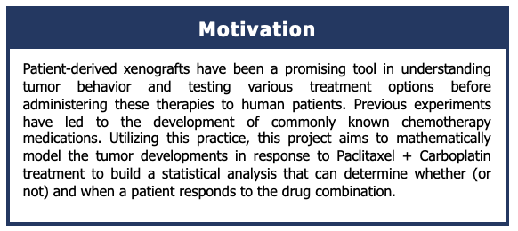
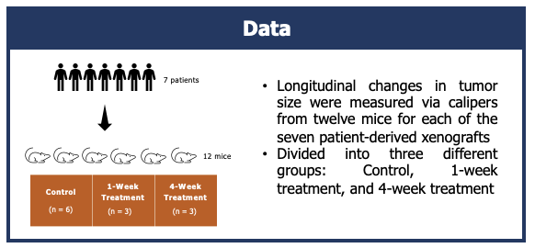

Slide 3
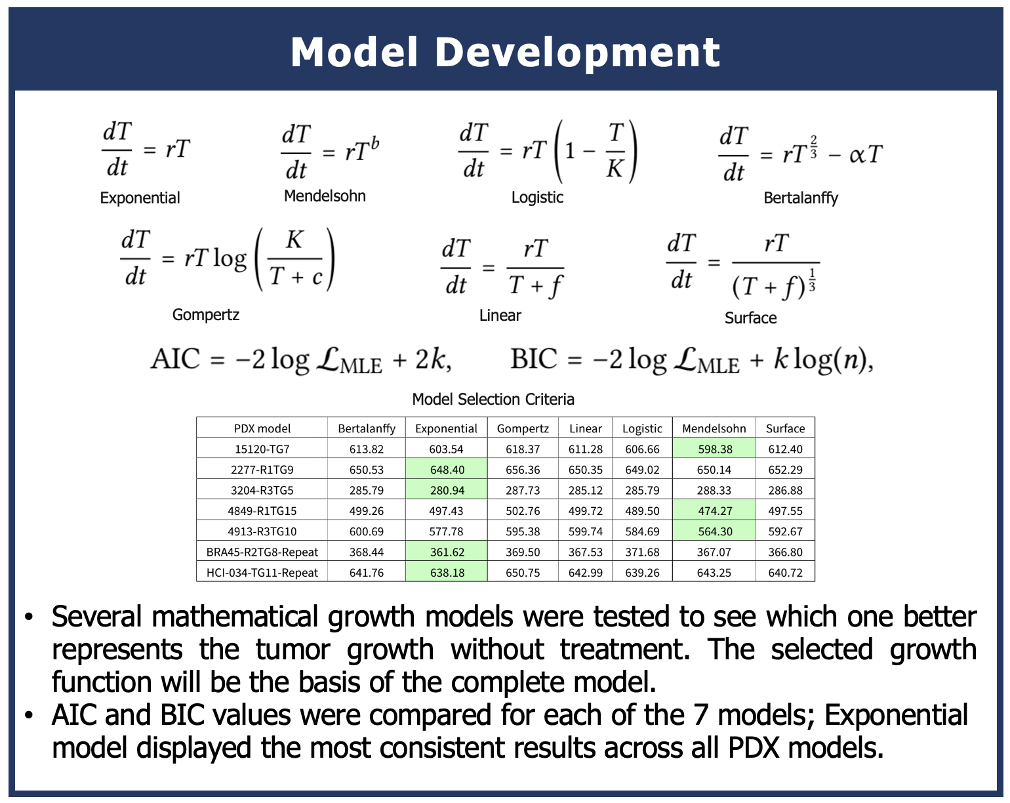

Slide 4
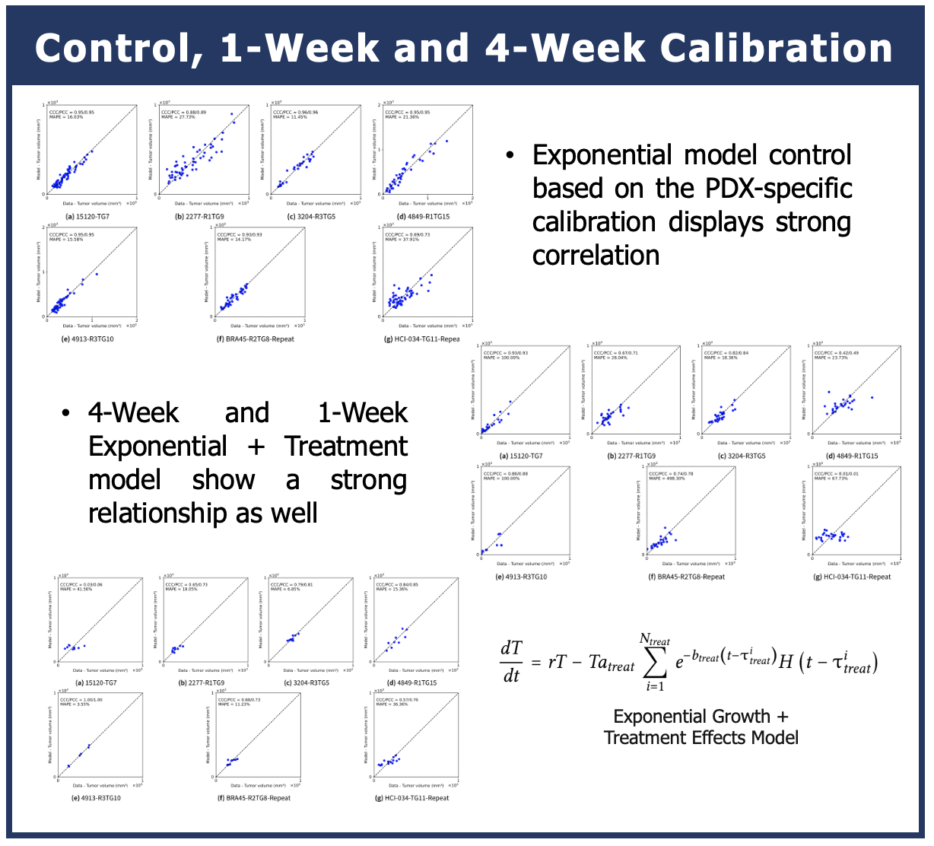
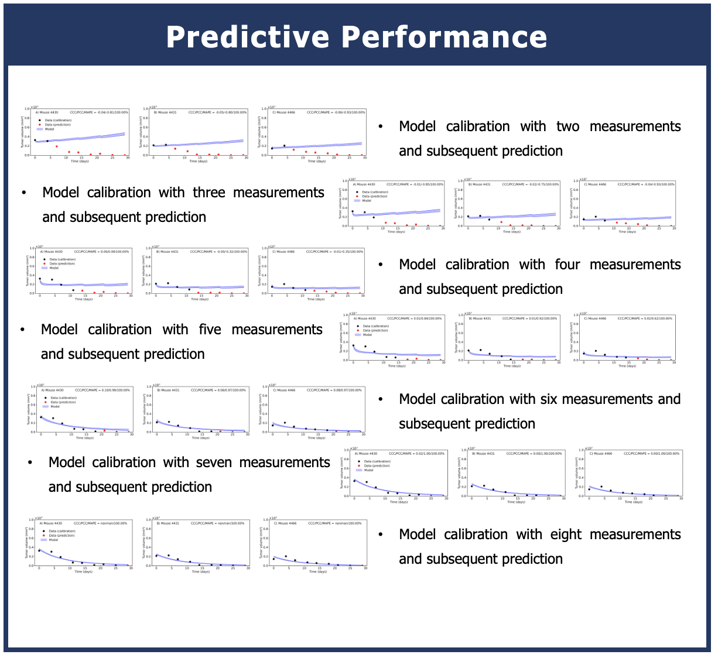

Slide 5
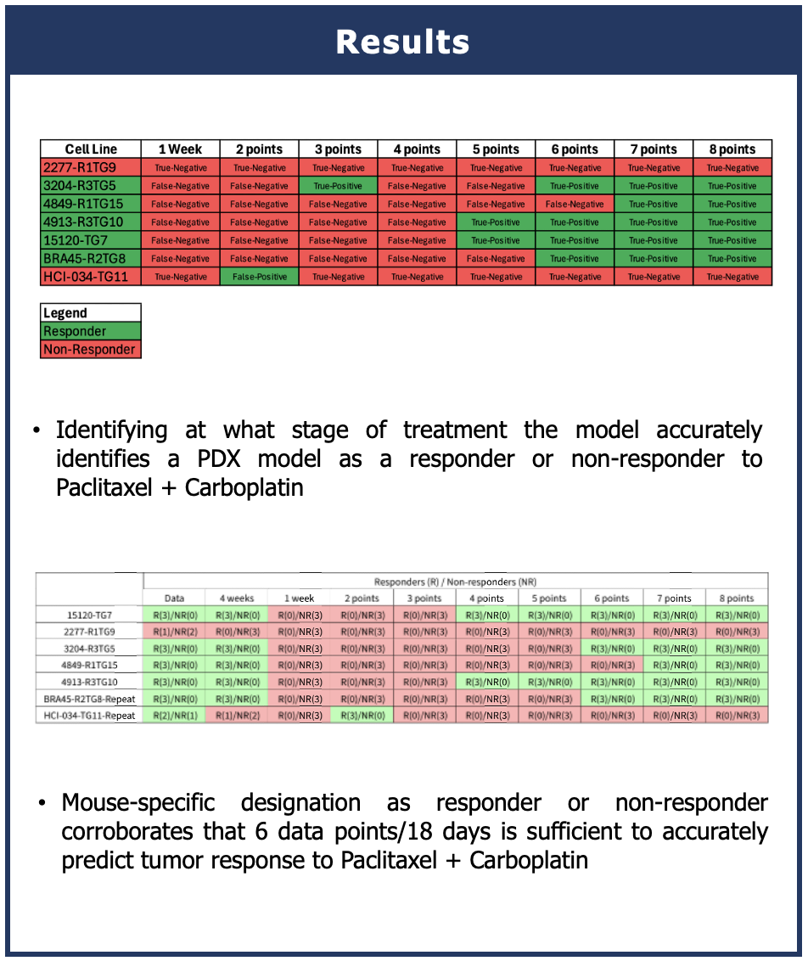

Slide 6
