Slide 1
CX Agent Performance Dashboard
- Rahul RAJAN

Slide 2
Problem Statement
Calculate and track total calls received, including differentiation between answered and rejected calls.
Determine call resolution status by introducing columns for resolved and unresolved calls.
Identify top-performing agent based on call handling metrics and satisfaction rates.
Visualize call distribution and duration, alongside analysis of call volume by time.
Enable interactive analysis through slicers and provide an overall performance rating for 2021, including a custom chart for satisfaction rating visualization.

Slide 3

KPI’s present in the Dashboard
In this dataset, we've gathered information from 3 months, totaling 5000 calls. I've set up Key Performance Indicators (KPIs) based on what the business needs. These KPIs include the percentage of calls answered and rejected, as well as the total number of agents. By using a slicer, we can change the data dynamically to focus on a specific agent and see their performance and related data. This helps us understand how each agent is doing.

Slide 4
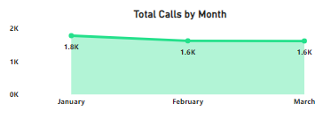
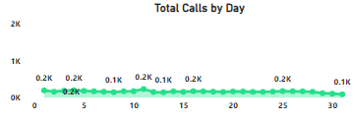
Month and Day wise calls
Here, I've made an area chart to show the call volumes month by month, with the option to dive deeper into each day's details by using drilldown option. You can zoom in on specific days to see the total calls, and use slicers to focus on specific agents for each month.

Slide 5
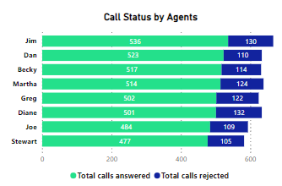
Calculate and track total calls received, including differentiation between answered and rejected calls.
In 2021, Jim answered the most calls, handling 536 out of 666 and successfully closing 80% of them. Diane rejected the highest number of calls, with 132 out of 633. These rejections could be due to network problems or other technical issues.

Slide 6
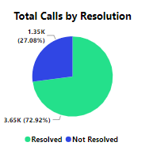
Determine call resolution status by introducing columns for resolved and unresolved calls.
Agents have resolved 72% of the tickets, leaving 27% pending. This could be because some calls were rejected, tickets weren't closed properly after being answered, agents encountered new situations, or tickets were escalated to higher teams but not closed yet.

Slide 7
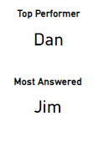
Identify top-performing agent based on call handling metrics and satisfaction rates.
The top performer in 2021 is Dan, with an 82% success rate in resolving tickets. Jim answered the most calls, 536 in total, with an 80% success rate in resolving tickets. To help others improve, we can organize a training session where top performers like Dan share their insights. We'll also gather input from other agents to create a training plan aimed at boosting everyone's performance.

Slide 8
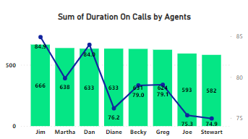
Visualize call distribution and duration, alongside analysis of call volume by time.
The data indicates that two agents have longer call durations, suggesting potential issues affecting call resolution. We'll gather insights from them to understand what's causing the longer times. This way, we can work on improving call resolution for the next month.

Slide 9

Enable interactive analysis through slicers and provide an overall performance rating for 2021, including a custom chart for satisfaction rating visualization.
I've set up slicers for the months, agents, and a customer calendar. Since our dataset covers only three months, I've used a tile format. If we had more months, a dropdown list would be better. I've also added a dropdown for selecting specific agents to view their performance and data.

Slide 10
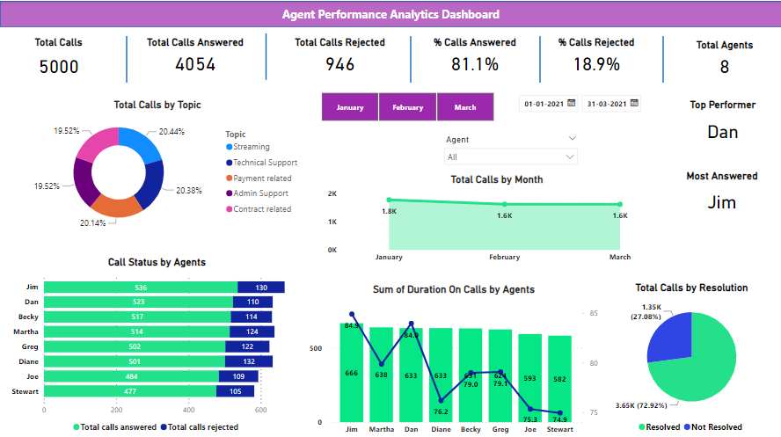
Final Dashboard

Slide 11
Thank You
- Rahul Rajan

