Slide 1
GNR 631
Tutorial
Date: 15th March 2018
Spectroradiometer based hyperspectral data and its use

Slide 2
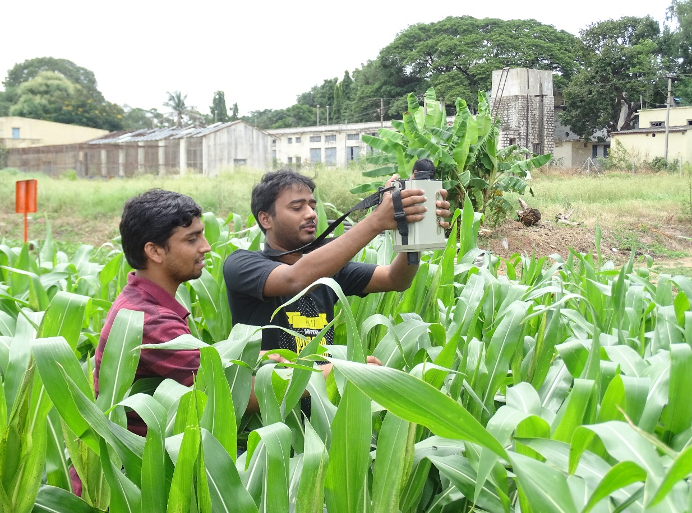
Use of spectroradiometer in field

Slide 3
Raw data in csv format
///GER SIGNATUR FILE///
name= corn_7_Aug_17_000.sig
instrument= 1500: 2107
time= 8/7/2017 1:03:54 PM,8/7/2017 1:03:11 PM
long= ,
lati= ,
gpstime= ,
comm=
memory slot = 2,1
averaging= 1,1
integration Speed= 6,5
optic= 1,1
data=
290.25 0.19 2.42
292.02 0.22 12.10
293.79 0.16 13.14
…..
1093.79 26690.15 53914.09
1095.21 20226.77 48881.35

Slide 4
Raw data in csv format
///GER SIGNATUR FILE///
name= corn_7_Aug_17_000.sig
instrument= 1500: 2107
time= 8/7/2017 1:03:54 PM,8/7/2017 1:03:11 PM
long= ,
lati= ,
gpstime= ,
comm=
memory slot = 2,1
averaging= 1,1
integration Speed= 6,5
optic= 1,1
data=
290.25 0.19 2.42
292.02 0.22 12.10
293.79 0.16 13.14
…..
1093.79 26690.15 53914.09
1095.21 20226.77 48881.35
Wavelength Target_Radiance Ref_Radiance
290.25 0.19 2.42
292.02 0.22 12.10
293.79 0.16 13.14
…..
1093.79 26690.15 53914.09
1095.21 20226.77 48881.35

Slide 5
Raw data in csv format
///GER SIGNATUR FILE///
name= corn_7_Aug_17_000.sig
instrument= 1500: 2107
time= 8/7/2017 1:03:54 PM,8/7/2017 1:03:11 PM
long= ,
lati= ,
gpstime= ,
comm=
memory slot = 2,1
averaging= 1,1
integration Speed= 6,5
optic= 1,1
data=
290.25 0.19 2.42
292.02 0.22 12.10
293.79 0.16 13.14
…..
1093.79 26690.15 53914.09
1095.21 20226.77 48881.35
Wavelength Target_Radiance Ref_Radiance
290.25 0.19 2.42
292.02 0.22 12.10
293.79 0.16 13.14
…..
1093.79 26690.15 53914.09
1095.21 20226.77 48881.35
Extract data from 400-1000 nm wavelength range

Slide 6

Raw data in csv format
///GER SIGNATUR FILE///
name= corn_7_Aug_17_000.sig
instrument= 1500: 2107
time= 8/7/2017 1:03:54 PM,8/7/2017 1:03:11 PM
long= ,
lati= ,
gpstime= ,
comm=
memory slot = 2,1
averaging= 1,1
integration Speed= 6,5
optic= 1,1
data=
290.25 0.19 2.42
292.02 0.22 12.10
293.79 0.16 13.14
…..
1093.79 26690.15 53914.09
1095.21 20226.77 48881.35
$$Reflectance$$
$$=\frac{Target_{Radiance}}{Ref_{Radiance}}$$
Wavelength Target_Radiance Ref_Radiance
290.25 0.19 2.42
292.02 0.22 12.10
293.79 0.16 13.14
…..
1093.79 26690.15 53914.09
1095.21 20226.77 48881.35
Extract data from 400-1000 nm wavelength range

Slide 7
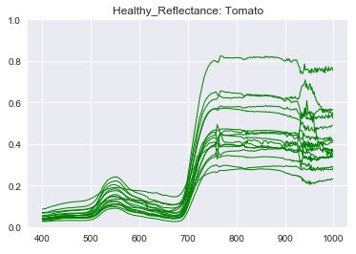
Hyperspectral signature of tomato leaf

Slide 8
Hyperspectral signature of tomato leaf
Why these ups and downs in the reflectance ???
What decides them ???

Slide 9
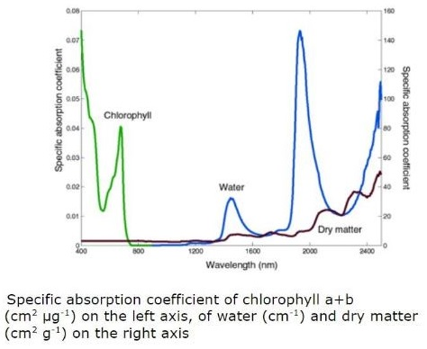
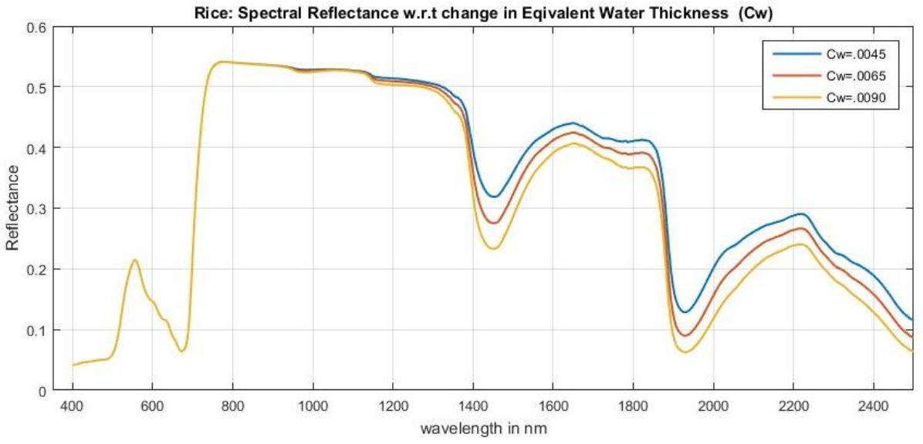
Specific absorption coefficient
Fig: Rice Leaf Reflectance (from PROSPECT Model)
(Ref.: Jacquemoud et al., 2000)
Jacquemoud, S., et al. "Comparison of four radiative transfer models to simulate plant canopies reflectance: Direct and inverse mode." Remote Sensing of Environment 74.3 (2000): 471-481.
Notes:
Effect of absorption coefficient on reflectance.
Also show that some peaks (dry matter and water) are around same region.

Slide 10
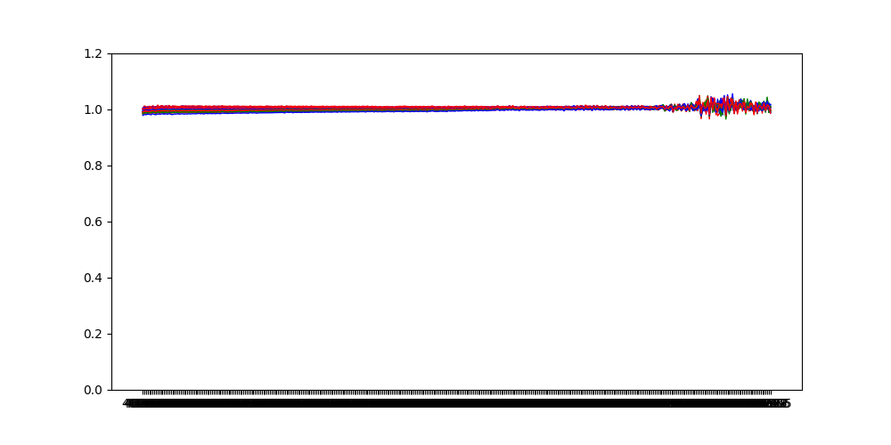
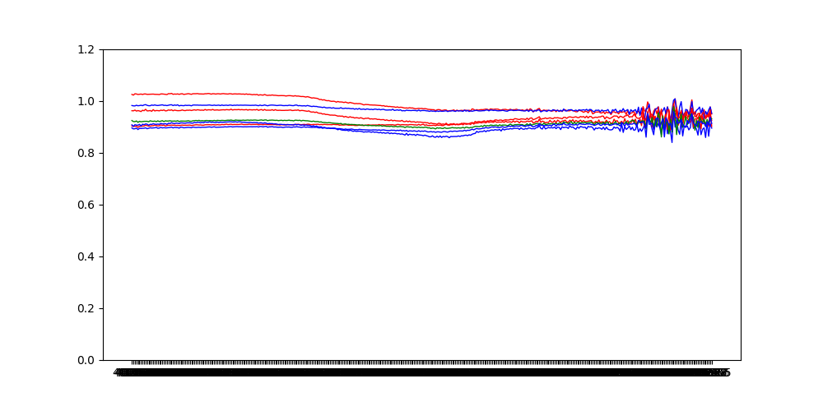
How to collect spectroradiometer data
Target and reference both are barium sulphate plate in both the cases
Direct Sunlight condition
Diffused sunlight condition

Slide 11
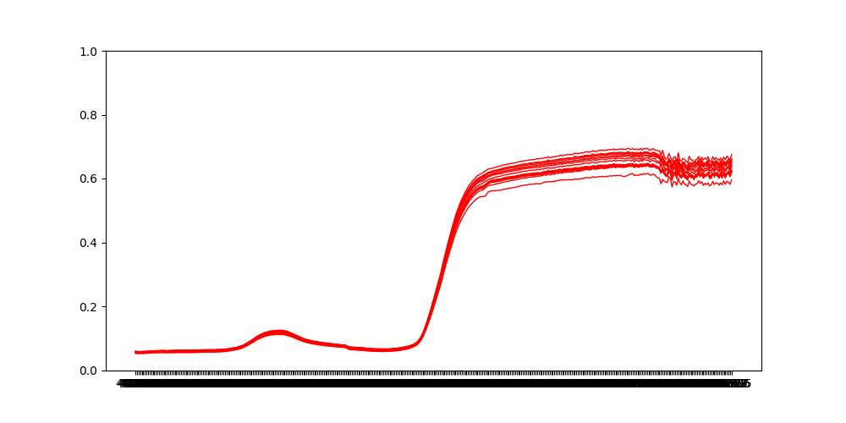
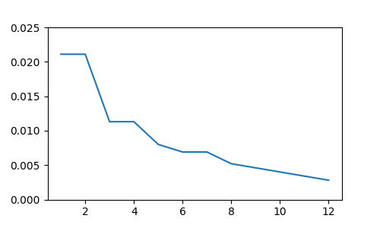
Variability in data for same leaf

Slide 12
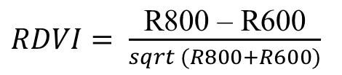


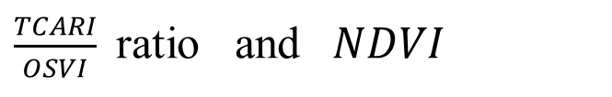
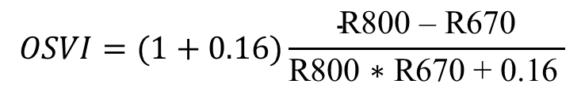

Proxy indices for Water stress detection
$PRI= \frac{\text{R}\text{550 – }\text{R}\text{531}}{\text{R}\text{550} \text{+} \text{R}\text{531}}$
$PRInorm=PRI ∗RDVI ∗ \frac{\text{R}\text{700}}{\text{R}\text{67}\text{0}}$
Where,
PRI is related to energy dissipation during epoxidation of xanthophyll cycle which is related to water stress
$RDVI= \frac{\text{R}\text{800}\text{ – }\text{R}\text{600}}{sqrt (R800+R600)}$
$Red Edge Index=\frac{\text{R}\text{700}}{\text{R}\text{6}\text{70}}$
(Ref.: Gitelson et al. 2017)
Chlorophyll fluorescence is also used for leaf water stress detection
PRI and ChlFlor are pre-visual indicators of water stress
Sensitive index towards chlorophyll content
(Ref.: Gago et al., 2015)
$\frac{TCARI}{OSVI}$ ratio and $NDVI$
$$OSVI=(1+0.16)\frac{\text{R}\text{800}\text{ – }\text{R}\text{670}}{\text{R}\text{800 ∗ }\text{R}\text{670 }\text{+}\text{ 0.16 }}$$
$$TCARI=3[\left(R700 − R670\right)−0.2 ∗\left(\text{R}\text{700 − }\text{R}550\right)∗(\text{R}\text{700 − }\text{R}\text{670})]$$
Gitelson, Anatoly A., John A. Gamon, and Alexei Solovchenko. "Multiple drivers of seasonal change in PRI: Implications for photosynthesis 1. Leaf level." Remote sensing of environment 191 (2017): 110-116.
Gago, Jorge, et al. "UAVs challenge to assess water stress for sustainable agriculture." Agricultural Water Management 153 (2015): 9-19.
Notes:
The Xanthophyll cycle: In order to protect itself from absorbing too much light, and thus causing photoinhibition, Xanthophyll cycle converts pigments that do not quench energy into ones that do. When a plant receives too much light, the xanthophyll cycle changes violoxanthin to antheraxanthin and zeaxanthin which are photoprotective pigments.
PRInorm helps in normalization of the values considering chlorophyll content(red edge) and canopy structure(RDVI).
TCARI=Transformed Chlorophyll Absorption Reflectance Index
OCAVI=Optimized soil adjusted vegetation index

