Slide 1
BAKERS

Slide 2
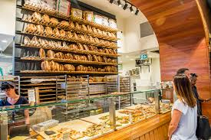
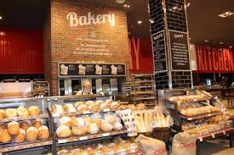
BAKERS
It is android application.
Through this application bakery owners can sell their bakery items.
Through this application customer can reach to the bakery which is nearer them.

Slide 3
HOW TO CUSTOMER HAVE TO USE THIS APPLICATION
Customer have to login with their id.
The map will show the bakery which is nearer to us.
They have to select bakery from which they have to buy items.
The app will show all the bakery items which are available in that bakery.
Customer have to select bakery items.
Customer have to pay amount online.
Time will be shown on your screen which specifies at that time customer have to collect their order.
Customer can also access to the bakery which is far away from them.

Slide 4
HOW BAKERY OWNER HAVE TO USE THIS APPLICATION
Bakery owners will have a separate id.
They have to login with their id.
Enter all the details.
They have to add the name of the items which are available in their bakery.
After getting order they have to enter the time at which they will prepare the order.
They have to update the avaibility of the bakery items.

Slide 5
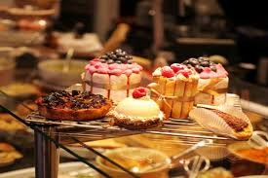
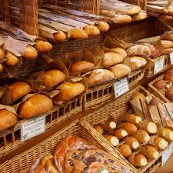
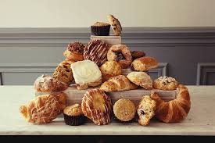
USES OF THIS APPLICATION
It will save customers time by not standing in the shop.
We does not have to wait for the food.
We can order food from any place.

Slide 6
THANK YOU

