Slide 1
Ericsson Use case
Expression Evaluation
By:
Sree Ravi Kishore Lellapalli
Shanmukha Reddy Aalla
Manoj Kumar Ravilla
Rahul Ramini

Slide 2
Use Case requirements:
A string representing an expression or a text file containing multiple expressions in it is given as input and the function should return TRUE or FALSE.
Examples:
(3+2) <= 5 produces result true.
2*(3+6/2)/4 == 4 produces false.

Slide 3
Features:
This program can handle thousands of expressions given at a time.
Each and every expression can be as complex as possible provided it has only four basic math operations(+,-,*,/) and every expression is well balanced and syntactically correct.
The most salient feature of this program is that it generates a text file as an output containing results for all the expressions.

Slide 4
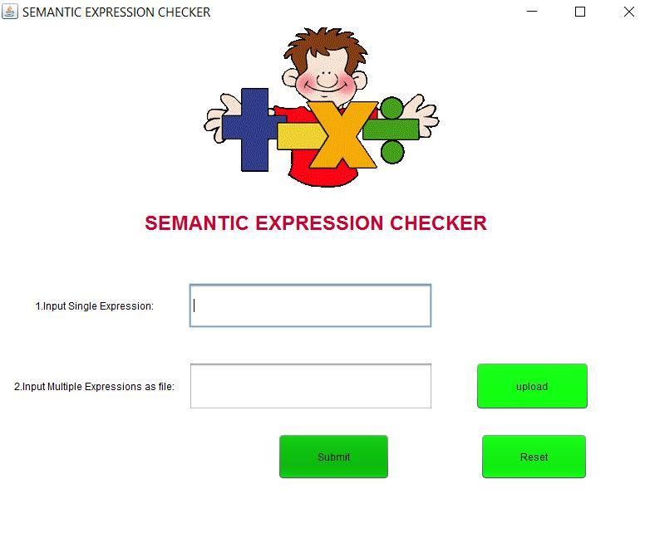
Home Page

Slide 5
Work flow:
The input for the program will be the expressions which are needed to be evaluated whether TRUE or FALSE.
Either a single expression can be given in the space provided or the text file containing multiple expressions can be given as input which can be uploaded from our local machines.

Slide 6
System Workflow
Displays Error Message on Console
Input Single Expression
(type expression to text box)
No
Submit
If Error in input
Input Multiple Expressions
(browse & upload input file)
Yes
Result
For single expression result will be displayed on console
For Multiple Expressions result will be generated to a separate output file
Evaluates data
(numerical expressions as well as expressions containing variables)

