Slide 1
Investment plan Analytics
By SRKM
Sree Ravi Kishore lellapalli
Shanmukha Reddy aalla
Manoj Kumar ravilla
Rahul ramini

Slide 2
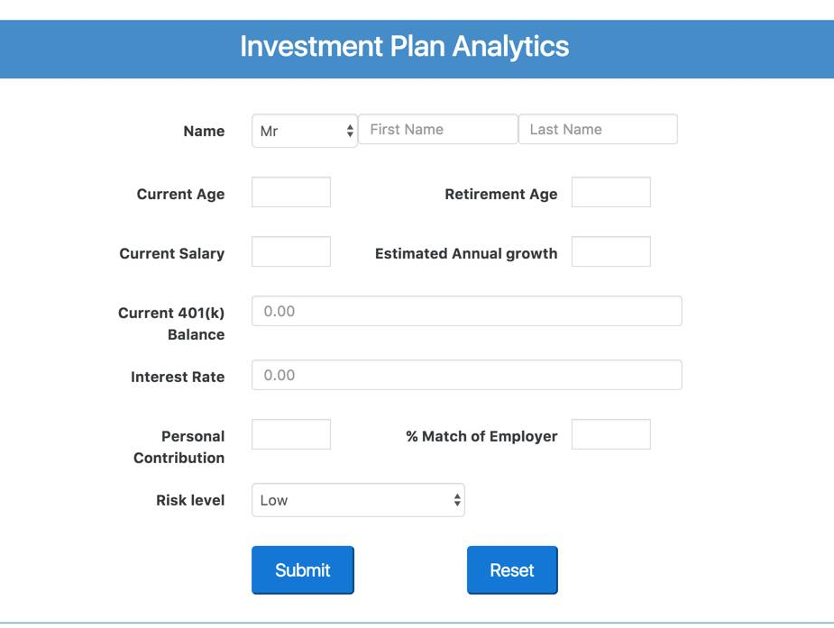
Abstract
This web application collects the 401(k) data from the individual, usually an employee of a company, and displays the 401(k) balance which will be available to the employee at the end of each year
At the same time, this application proposes an investment plan of asset allocation based on the given inputs such as current age, retirement age, risk level etc..,

Slide 3
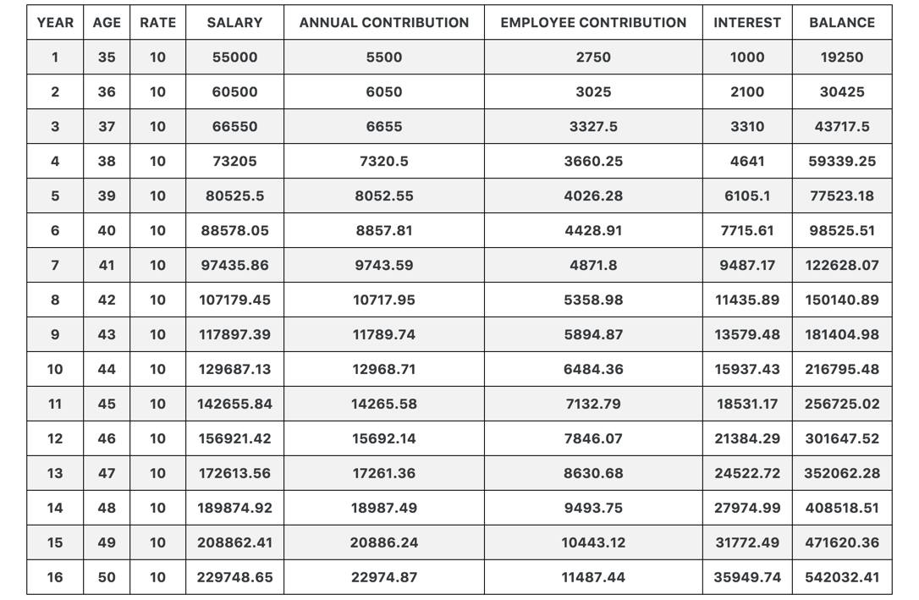
401(k) Data analytics
By considering the inputs current annual salary, employer and personal contributions, rate of interest, we calculate the 401(k) balance using compound interest at the end of each year.
These analytics are displayed in a tabular manner

Slide 4
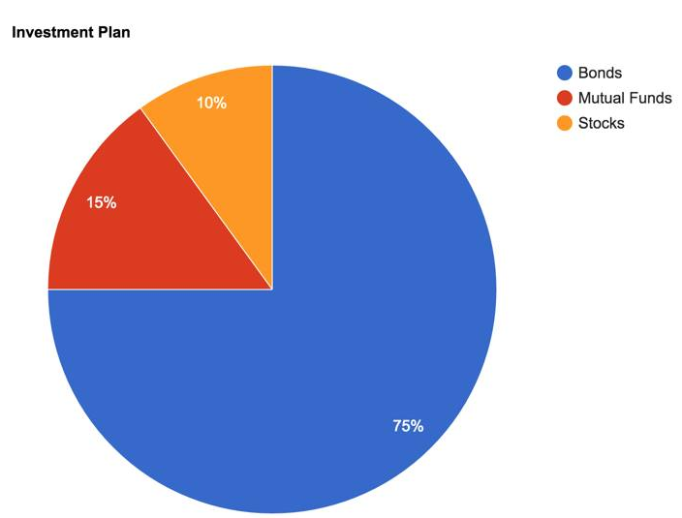
Investment plan
Based on the market research and the data taken from different investment advising companies like CNN Money, Fidelity etc.., we came up with some asset allocation plans.
The output result for the investment plan is visualized using pie chart which gives a better understanding to the user.

Slide 5
THANK YOU

