Slide 1

Real Time Market Research on reviews and tweets using AWS tools
01

Slide 2


Slide 3

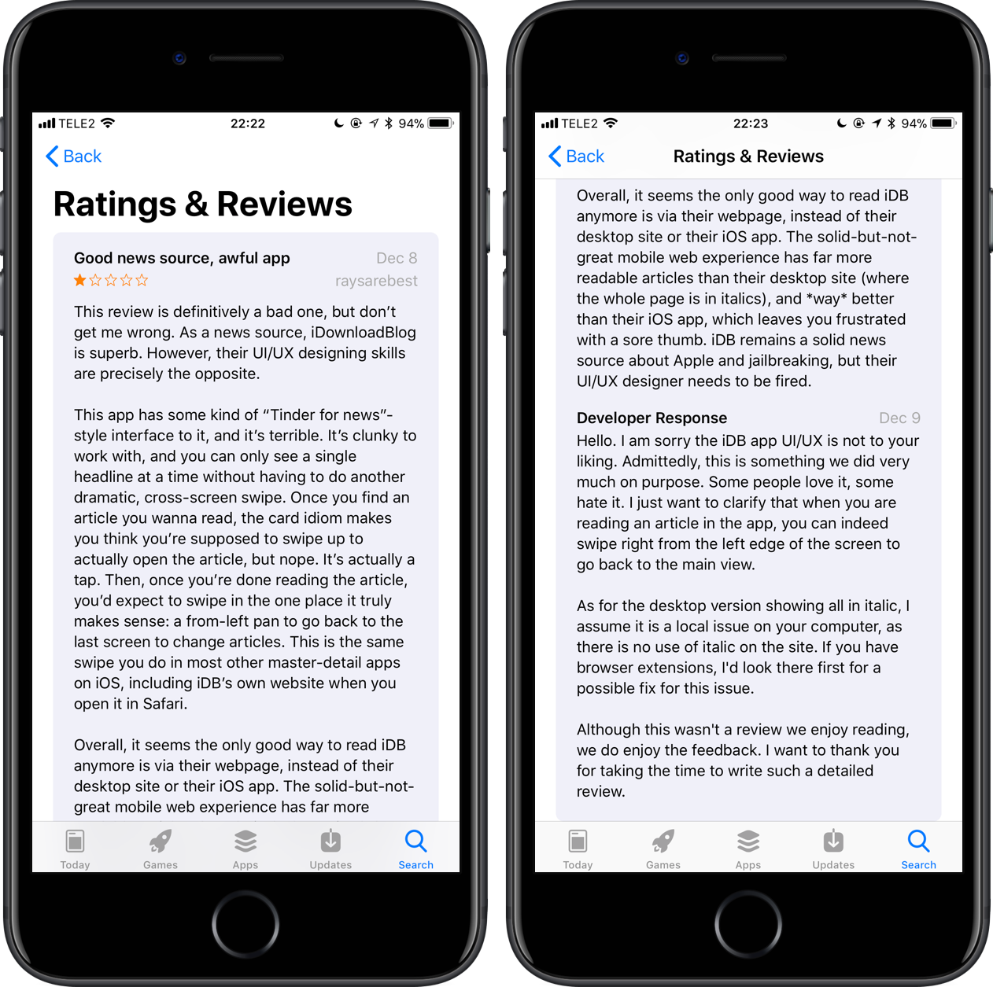
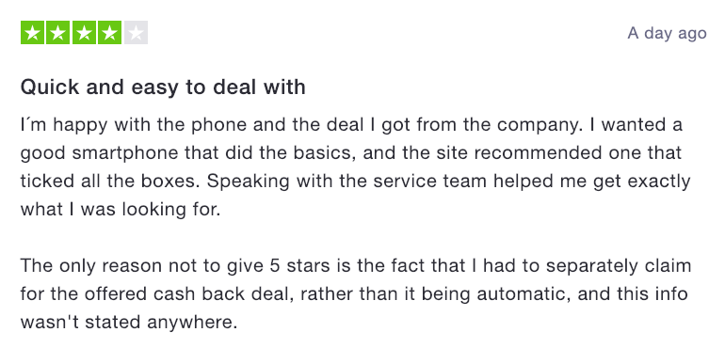
Traditional way of product market research is ineffective and time consuming

Slide 4
AWS can provide integrated solution with scalable and data driven insights to product teams

Slide 5

Why AWS?
Cost Effective Reasonable cost comparison to other on-premise services
Flexibility
Enable to select operating system, programming language, web application platform, database
Data security Data will be stored in the secure Amazon data center

Slide 6




AWS SERVICES
Simple Storage Service
AWS Comprehend
Athena
Quicksight
object storage service that offers scalability, secure, and performance
Sentiment Analysis
Key Phrases Extraction
serverless, interactive analytics service built on open-source frameworks
What are the blockers you're facing? What are factors outside of your control?
Notes:
(NLP) service that uses machine learning to uncover valuable insights and connections in text

Slide 7
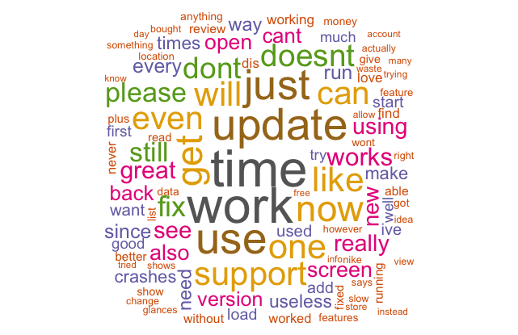
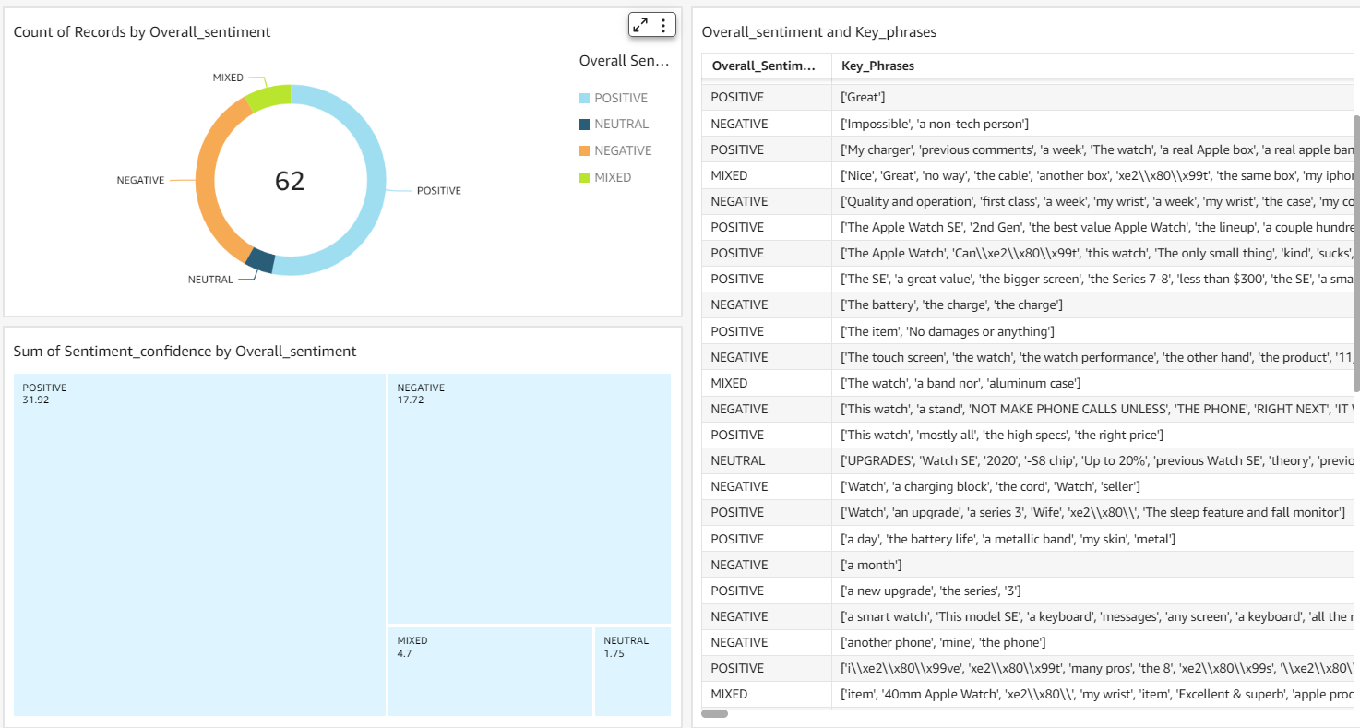
Automatic Sentiment Visualization
To understand the sentiment of the product reviews

Slide 8
Demo

