Slide 1
Problem Statement and Objective.
Problem Statement
Tata Steel imports bulk material such as coal, iron ore and flux etc.
Most imports are from Australia, South Africa and Middle East through vessels such as Capesize, Panamax through sea routes.
These vessel daily hire rates are dynamic, route specific and market driven.
Project Objective
Prediction of daily vessel hire rate well in advance [1-6 months].
The model should adjust according to recent trends. freight rate in 3 months advance

Slide 2
Flow of work
Preprocessed the data to make it suitable for modelling.
Preformed Autocorrelation and stationarity test on BCI-C5TC data.
Formatted data for daily and weekly analysis.
Used different ways to predict ocean freight price (Different shifts on Data 15 days ,30 days ,2 week , 4 week).
Used pycaret regression to find the best performing model.
Calculated Mape to analysis the performance of the model.
Current Challenges .
Multicollinearity is high between features.

Slide 3
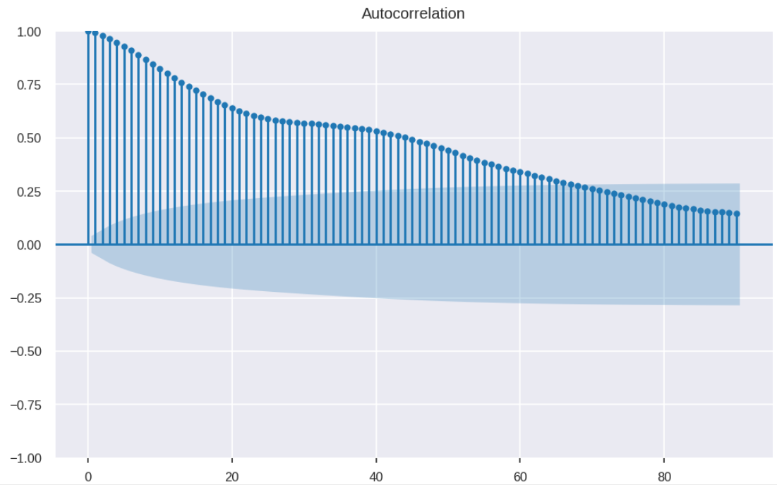
Correlation and Prediction
Lag | 1 week | 2 weeks | 3 weeks | 1 month
Autocorrelation | 0.89 | 0.75 | 0.64 | 0.59

Slide 4
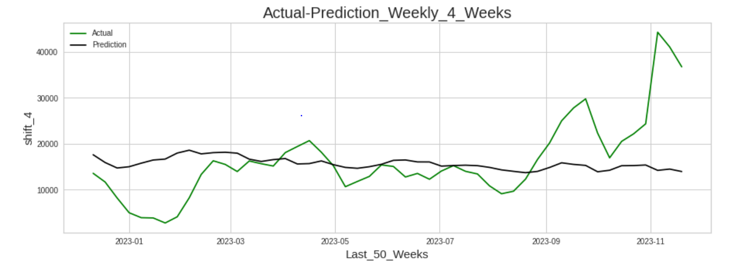
Prediction vs Actual Plot
MAPE=0.59

Slide 5
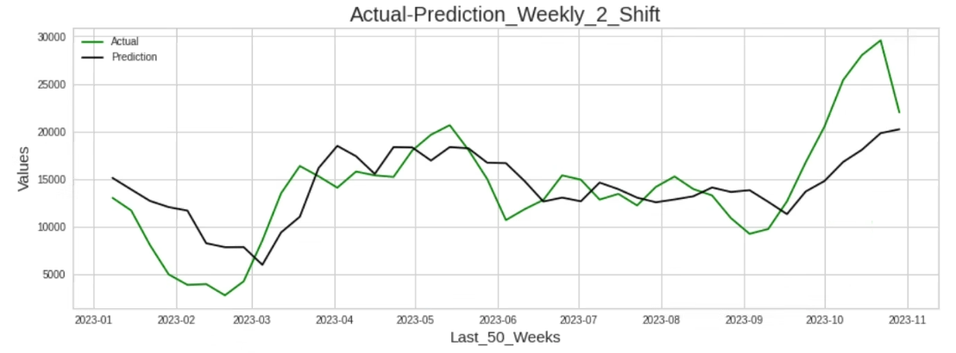
MAPE=.30

