Slide 1


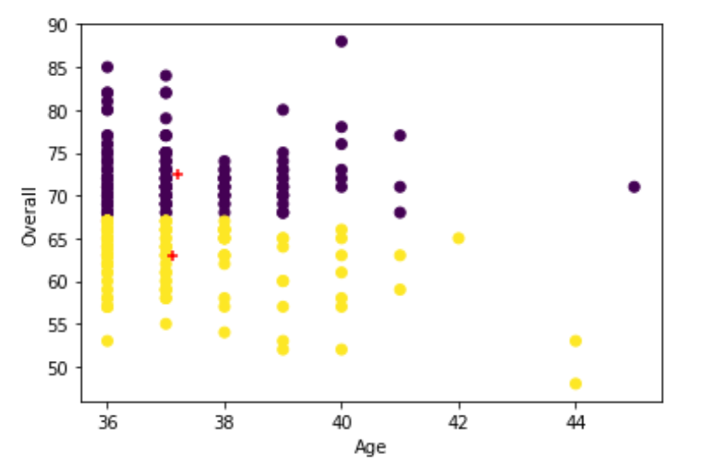
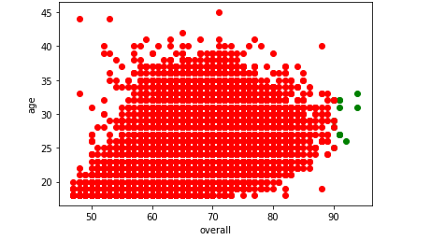
Predicting the overall rating of a FIFA player.
Rahul Reddy Dayam
School of Computer Science and Information Systems, Northwest Missouri State University
Introduction
Results
Conclusions
FIFA 19 is a soccer video game. There are many playing modes but the one that appeals me the most is career mode.
The integral part of career mode is overall rating which decides how good a player is and decides his market value.
The goal of this project is to determine the overall of a player which determines the success of a person playing the game.
Evaluation of Overall rating of a FIFA player based on his age and his potential.
The data I have chosen is continuous so I performed linear regression to predict the overall rating with age and potential with an accuracy of 82%.
I have classified the players based on their overall ratings into 4 groups and performed decision tree classifier to determine if a player belongs to a particular group or not with an improved accuracy of 90%.
I have performed PCA i.e. dimension reduction and found that the features I have chosen are both required as the Rsquared values is too less.
I have performed clustering to determine whether or not to invest on a player whose age is above 36.
In feature I would predict how much a player rating would decrease if he plays in a different position.
Based on the clustering I would pick a player who has more age and whose value is closer to the centroid of the top cluster rather than the bottom cluster.
Materials/Methods
Features
Age of the player.
Potential(The maximum rating a player can reach in the future.)
Performed data cleaning to remove unwanted values.
Performed linear regression to find the correct features and relationships.
Performed classification to predict group memberships and perform feature selection.
Evaluate
Based on the scatter plot I have determined that a player would have an overall rating of 90 or above only when there age is between 25 and 35. This is acceptable
Additional Resources
Acknowledgements
Poster Repository
https://www.kaggle.com/karangadiya/fifa19
https://scikit-learn.org/stable/auto_examples/classification/plot_classifier_comparison.html
Mentor: Dr. Charles hoot
https://github.com/rahulreddy062/ml-project-poster

