Slide 1


Resolving Webex Quiet Hours Notification Issue
Rahul Reghulal, a Tier 2 Webex Support Engineer, presents a case study on resolving a critical Webex notification issue. This presentation outlines the problem, diagnosis, solution, and key takeaways for support teams.
by Rahul R

Slide 2


Problem Overview
1
Quiet Hours Enabled
User's Webex account had Quiet Hours activated, silencing crucial meeting alerts and notifications.
2
Productivity Impact
Missed meetings led to decreased productivity and delayed communication within the organization.
3
Support Relevance
Resolving this issue aligns with Jabra's commitment to seamless platform collaboration.

Slide 3

Initial Diagnosis
1
User Feedback
User reported not receiving alerts for scheduled Webex meetings despite being online.
2
Verification
Confirmed single-user issue across multiple devices and operating systems(MAC/WINDOWS/LINUX).
3
Settings Check
Examined Webex notification settings and system-level configurations for potential conflicts.
4
Quiet Hours Discovery
Identified that Quiet Hours feature was inadvertently enabled on the user's account.

Slide 4
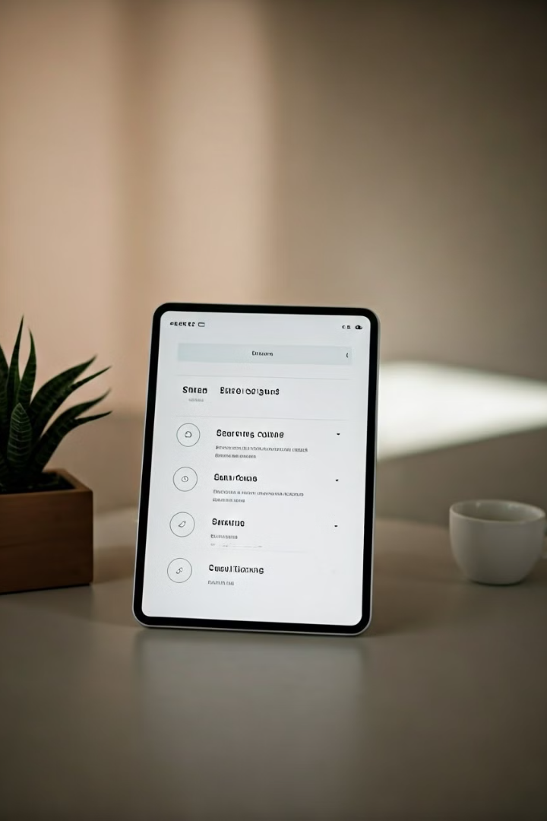




Troubleshooting Steps
Locate Quiet Hours
Navigated to Webex settings to find the Quiet Hours feature.
Disable Feature
Turned off Quiet Hours to restore normal notification functionality.
User Education
Explained the impact of Quiet Hours to prevent future accidental activation.
Verification
Tested notifications to ensure the fix resolved the issue completely.

Slide 5
Resolution Outcome
Issue Resolution
User Empowerment
Improved Workflow
Disabling Quiet Hours successfully restored all Webex notifications for the user.
Provided guidance on managing Quiet Hours to prevent future notification disruptions.
User reported enhanced productivity and timely meeting attendance post-resolution.

Slide 6




Key Takeaways
Thorough Investigation
Always check status settings like Quiet Hours during troubleshooting.
Clear Communication
Provide concise explanations to users about feature impacts and management.
Proactive Measures
Implement strategies to prevent similar issues in the future.

Slide 7

Business Case Summary
Issue
Silenced notifications causing missed meetings and escalations
Solution
User education, proactive alerts, and real-time monitoring of settings
Benefits
Reduced support escalations, improved productivity, enhanced user satisfaction

Slide 8

Contact Information
Rahul Reghulal
Jabra Support Engineer, Tier 2
Email
rahulreghulal@gmail.com
Expertise
Webex troubleshooting, UC solutions, collaborative platforms

