Slide 1
Covid-19 Smart Chatbot

Slide 2
Covid-19 Smart Chatbot
Please note that the health information generated by the chatbot is for general research purposes only. It is not a diagnostic tool, nor is it a substitute for medical advice or treatment for specific conditions.

Slide 3
Paper
My Covid-19 Smart Chatbot paper presentation is available here:

Slide 4
Dataset
The dataset is the initial commercial use subset taken from many of the Online available sources including COVID-19 Open Research Dataset (CORD-19).
For the training purposes, I have extracted the abstract and the main body of these articles and have merged them together.

Slide 5
Model
The model was trained using the Google Dialogflow. Dialogflow. It is a natural language processing (NLP) platform that can be used to build conversational applications and experiences for a company's customers in various languages and on multiple platforms.
The working smartbot model is hosted and available at this link https://dialogflow.cloud.google.com/#/agent/covidchatbot-fapm/intents.

Slide 6
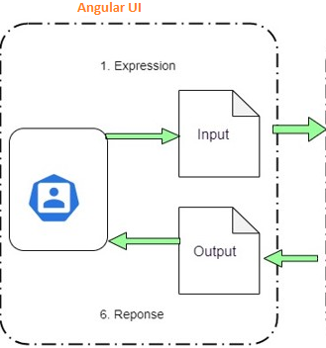
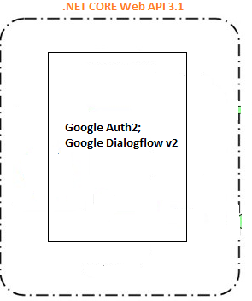
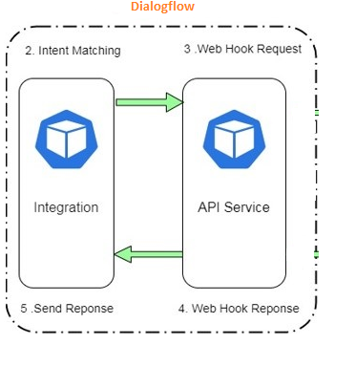

Architecture

Slide 7


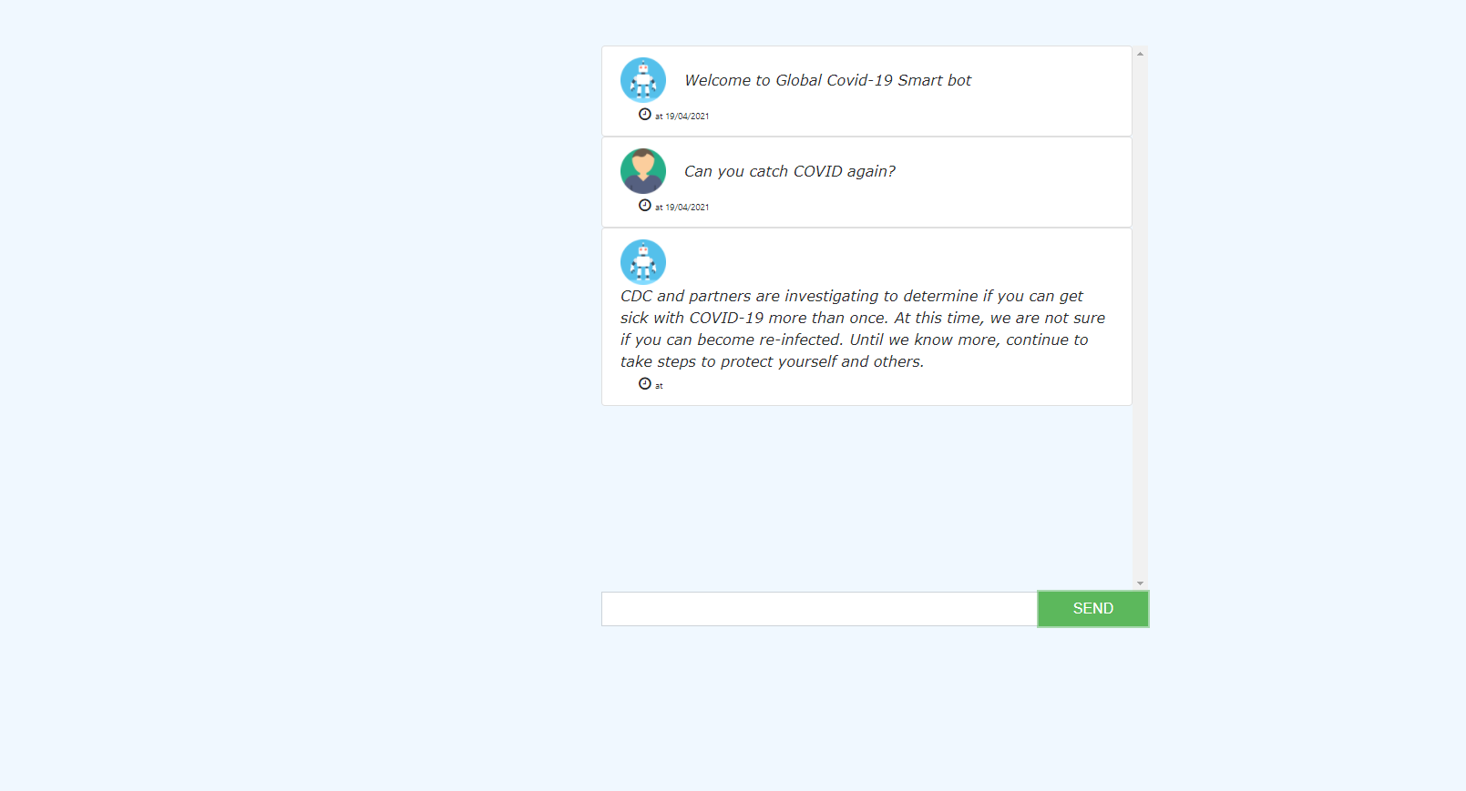

SmartBot - Web Application
This is an open-source multi-channel bot for querying and subscribing information and data about Novel Coronavirus (COVID-19).

Slide 8
Intents
Basic Intents Default Fallback Intents
Greetings Intents
Covid-19 Intents cornavirus.test_negative
coronavirus.airborne
coronavirus.animals
coronavirus.antibody_
coronavirus.at_risk coronavirus.china
coronavirus.cleaning
coronavirus.closure
coronavirus.confirmed_cases coronavirus.contact
coronavirus.death
coronavirus.define
coronavirus.hand_sanitizer

Slide 9
Intents
Covid-19 Intents coronavirus.symptoms_children
coronavirus.test_kind
coronavirus.test_me
coronavirus.testing
coronavirus.travel
coronavirus.treatment
coronavirus.update
coronavirus.vaccine
Covid-19 Intents coronavirus.wash_hands
coronavirus.weather
covid-basic-question-death
covid-basic-question-naturalmedicines
covid-basic-question-prevention
covid-basic-question-Self-care
covid-basic-question-selfcheck
pts-start-screening-no
pts.start-screening

Slide 10
Integration and Future The Bot is integrated with web demo app built in Angular8 There is option to integrate the bot with the following platforms
Facebook Messenger
Hangouts
Google Assistant
Slack
Viber
Twitter
Skype
Telegram

Slide 11
Development

Slide 12
Demo
https://az-testwebapp-fun.azurewebsites.net

