Slide 1
IT204: Data Structures and Algorithms
Heaps
Anish Mathuria, Faculty Block 1, 1105
anish_mathuria@daiict.ac.in
TexPoint fonts used in EMF.
Read the TexPoint manual before you delete this box.: AA

Slide 2
Heap Definition
Heap is a complete binary tree, such that:
  the root node is never greater than the entries of its children
  left and right subtrees are also heaps
Root
N >=
N >=
heap
heap

Slide 3
Heap Definition
Note: in computer systems, the memory region used for dynamic memory allocation is referred to as the “heap”
However, this definition and the ADT heap have NOTHING to do with one another

Slide 4
Heaps
4
4
4
18
9
18
9
4
4
28
19
11
28
11
19
4
4
4
Yes Indeed!
Nope!
(not a complete binary tree)
Yes Indeed!

Slide 5
Heap Definition
If each node in the tree has a key that is greater than or equal to the key of its parent, the heap is sometimes called a min-heap
We can also define a max-heap (each node in the tree has a key that is less than or equal to the key of its parent)

Slide 6
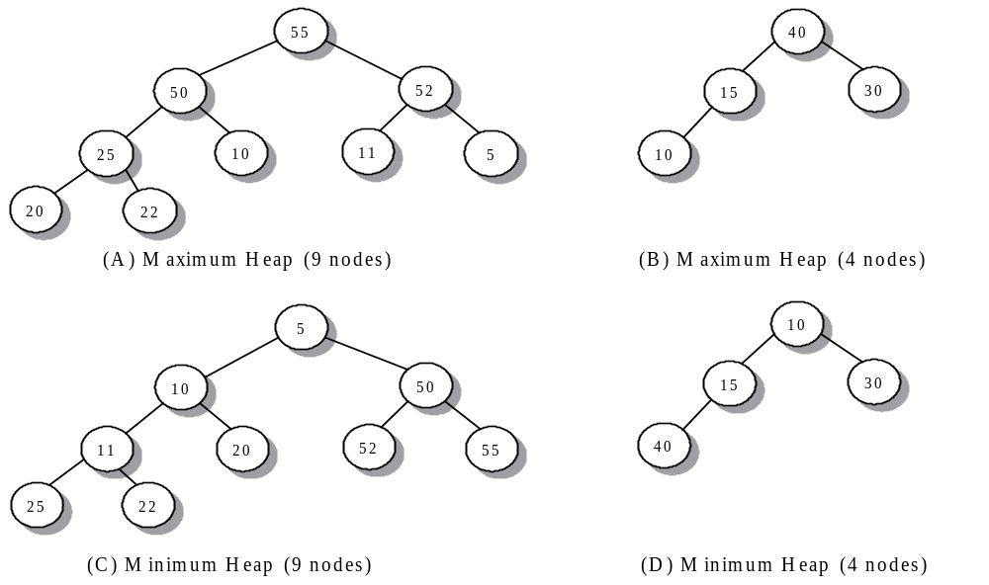
Maximum and Minimum Heaps

Slide 7
Heap Insertion Example
4
5
6
15
9
7
20
16
25
14
12
11
13
2
How to insert the key “2” into the heap?

Slide 8
Example continued
4
5
6
15
9
7
2
16
25
14
12
11
13
20
Restore the heap ordering property by “bubbling” the new item into its proper location. If the parent is bigger than the bubbling item, then swap the parent with the “bubbler”.

Slide 9
Example continued
4
5
2
15
9
7
6
16
25
14
12
11
13
20
The “up heap bubbling” restores the heap property. A node is only replaced by a “smaller” node. Therefore all the nodes children are still greater-than-or-equal to the new node value.

Slide 10
Example continued
2
5
4
15
9
7
6
16
25
14
12
11
13
20
A Heap!

Slide 11
Heap Deletion Example
2
3
4
15
9
7
6
16
25
14
12
11
13
20
How to remove an item from the heap?

Slide 12
Example continued
2
?
3
4
15
9
7
6
16
25
14
12
11
13
20
The item to remove is always at the root
How to restore the heap?

Slide 13
Example continued
20
3
4
15
9
7
6
16
25
14
12
11
13
20
Remove the “last” item in the “last” row and place it at the root.
How to restore the heap ordering property?

Slide 14
Example continued
3
20
4
15
9
7
6
16
25
14
12
11
13
Perform a “down heap bubble”! If either child is smaller than the bubbler, recursively swap the bubbler with its smallest child.

Slide 15
Example continued
3
9
4
15
20
7
6
16
25
14
12
11
13

Slide 16
Example continued
3
9
4
15
12
7
6
16
25
14
20
11
13
A Heap!

Slide 17
Heap - Array Implementation
Heaps are essentially binary trees
Their requirements and properties allow us to use a very clever implementation using any array
Consider a typical array:
00
01
02
03
04
05
06
07
08
09
10
11
12
13
14
15

Slide 18
Heap Array Implementation
Now think of it this way:
00
This has a
special purpose
01
02
03
04
05
06
07
08
09
10
11
12
13
14
15

Slide 19
Heap Array Implementation
Now think of it this way:
00
This has a
special purpose
01
The lines are not
pointers! They simply
indicate the "tree-like"
nature of this arrangement!
02
03
04
05
06
07
08
09
10
11
12
13
14
15

Slide 20
Heap Array Implementation
Now think of it this way
Note: The parent of any node i is given by i/2 (integer division)
00
01
02
03
Note: The right child of any node i is given by 2i+1
Note: The left child of any node i is given by 2i
04
05
06
07
08
09
10
11
12
13
14
15

Slide 21
Array Implementation Example
For any element at array position i:
  left child is at ( 2i )
  right child is at ( 2i+1 )
  parent is at (int) (i / 2)
1
A
3
2
B
C
4
5
6
7
D
E
F
G
8
9
10
H
I
J
A
B
C
D
E
F
G
H
I
J
0
1
2
3
4
5
6
7
8
9
10
11
12
13

Slide 22
Two Basic Operations
These two operations are used to fix an array whose Heap property is broken at one end or the other
  shiftUp - used when A[1..N-1] is a heap, but A[1..N] is not
  shiftDown - used then A[2..N] is a heap, but A[1..N] is not

Slide 23
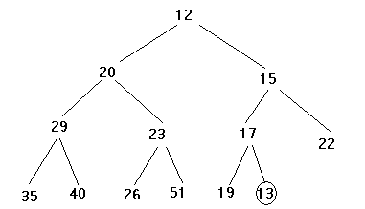
shiftUp illustrated (1)
out of order

Slide 24
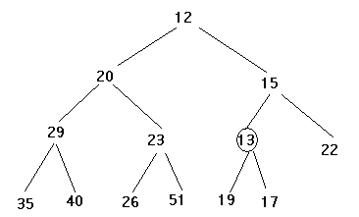
shiftUp illustrated (2)
Swapped

Slide 25
shiftUp illustrated (3)
out of order

Slide 26
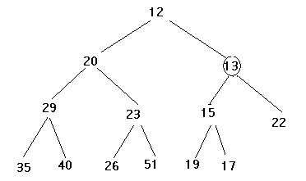
shiftUp illustrated (4)
Swapped

Slide 27
shiftUp
This process continues until the circled node is greater than or equal to its parent, or until it is the root of the tree
If we let i be the index of the circled node, the loop invariant for shiftUp becomes
/* invariant: A[1..N] is a heap except perhaps between i and its parent */

Slide 28
shiftUp psuedocode
procedure shiftUp(A, N)
//pre: A[1..N-1] is a heap, N > 0
//post: A[1..N] is a heap
int i = N;
loop
if (i == 1) break; // i is the root
int p = i /2; // p is the parent
if (A[p] <= A[i]) break; //in order
swap(A[p], A[i]);
i = p;
end loop;

Slide 29
shiftDown
Assigning a new value to A[1] when A[1..N] is a heap
Routine shiftDown restores the heap property to A[1..N]
A[1] is shifted down until it has no children or is less than or equal to the children it does have
/* invariant: A[1..N] except perhaps between i and its (0,1,or 2) children */

Slide 30
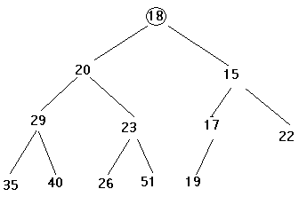
shiftDown Illustrated
out of order

Slide 31
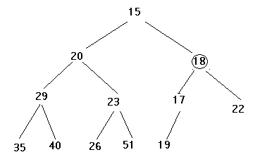
shiftDown Illustrated (2)
Swapped

Slide 32
shiftDown Illustrated (3)
out of order

Slide 33
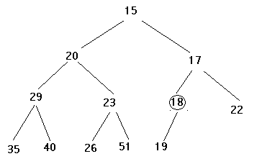
shiftDown Illustrated (4)
Swapped

Slide 34
shiftDown psuedocode
procedure shiftDown(A, N)
//pre: A[2..N], N >= 0
//post: A[1..N] is a heap
int i = 1;
loop
int c = 2*i;
if (c>N) break; //no children
if (c+1 <= N)
if (A[c+1] < A[c])
c = c+1; // c -- least child
if (A[i] <= A[c]) break;
swap(A[c], A[i]);
i = c;
end loop;

Slide 35
Efficiency of Insert and Delete
For insertion at most height comparisons
For deletion at most height*2 comparisons
The height of a complete binary tree is given by ⎣log₂(n)⎦+1
Remark: but deletion is only implemented for
the element with the smallest key!

Slide 36
Building a heap
Williams
Given a filled array of elements in random order, how to convert it into a heap
Top-down: Start with an empty heap and and sequentially insert elements into it
Ex: Use the top-down method to build a heap for numbers 2 9 7 6 5 8

Slide 37
Now we cover a fundamental procedure regarding heaps: the heapify procedure
Condition: binary trees rooted at left(i) and right(i) are heaps, but at A[i] the heap property is violated; i.e., A[i] maybe larger than its children
1
X
4
2
3
5
6
9
12
8
10
7
₁₁

Slide 38
heapify
The situation
  We want to “fix” the heap property for the subtree rooted at index i
  We assume that the subtrees rooted at left(i) and right(i) are already heaps
a
a is not less than b or c
b
c
heaps

Slide 39
heapify
We want to “fix” the heap property for the subtree rooted at index i
The solution
  compare A[i], A[left(i)], A[right(i)]
  let j be the index of the smallest of the three
  if j is i, do nothing
  otherwise, swap the elements at indices i, j
  repeat for index j (why?)

Slide 40
heapify (recursive version)
procedure heapify(A, i)
l ← left(i)
r ← right(i)
smallest = i
if l <= n and A[l] < A[i]
then smallest ← l
else smallest ← i
if r <= n and A[r] < A[largest]
then smallest ← r
if smallest ≠ i
then swap(A[i], A[smallest])
heapify(A, smallest)

Slide 41
1
1
13
2
3
2
3
5
6
9
13
5
6
9
12
8
10
7
₁₁
12
8
10
7
₁₁
1
3
2
8
5
6
9
12
13
10
7
₁₁

Slide 42
Heap navigation
Given the size, N, of a heap, the location of the first leaf element is
  N/2 + 1
Given the location of the first leaf element, the location of the last non-leaf element is 1 less
Use the figures shown on the next slide to justify these relationships to yourself
⎣
⎦

Slide 43
Example
Position 7 is leave
Position 6 is non-leaf node
1
2
2
3
4
5
4
5
6
7
7
6
10
8
8
9
11
9
12
14
20
10
11
12
0
1
2
3
4
5
6
7
8
9
10
11
12
2
4
5
7
6
10
8
11
9
12
14
20

Slide 44
Building a heap
Floyd
Bottom-up: Put everything in the array and then heapify/fix the trees in a bottom-up way
Elements A[⎣N/2⎦ +1] through A[N] are leaves, so they can be considered one-element heaps
Call heapify in a bottom-up manner starting at index ⎣N/2⎦

Slide 45
Psuedocode
Iterate i from element int(N/2) down to element 1
heapify(i)

Slide 46
Example of bottom-up construction
12
5
11
3
10
6
9
4
8
1
7
2
pretend it’s a heap and fix the heap-order property!
12
5
11
3
10
6
9
4
8
1
7
2

Slide 47
Build(this)Heap
12
12
5
11
5
11
3
10
2
9
3
1
2
9
4
8
1
7
6
4
8
10
7
6
12
12
5
2
1
2
3
1
6
9
3
5
6
9
4
8
10
7
11
4
8
10
7
11

Slide 48
Finally…
1
3
2
4
5
6
9
12
8
10
7
11

Slide 49
Storage
Top-down construction
  Requires us to have space big enough for twice the quantity of elements we have
Bottom-up construction
  In-place conversion: only constant storage beyond the array is needed

Slide 50
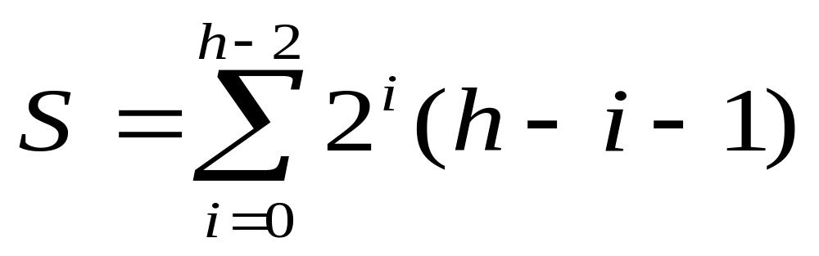
Complexity of Bottom-up
Each key on level i of the tree will travel to the leaf level h – 1 in the worst case
The total number of comparisons for a key on level i will be 2(h – i – 1)
So the total number of comparisons in the worst case will be (ignoring the constant 2)

Slide 51
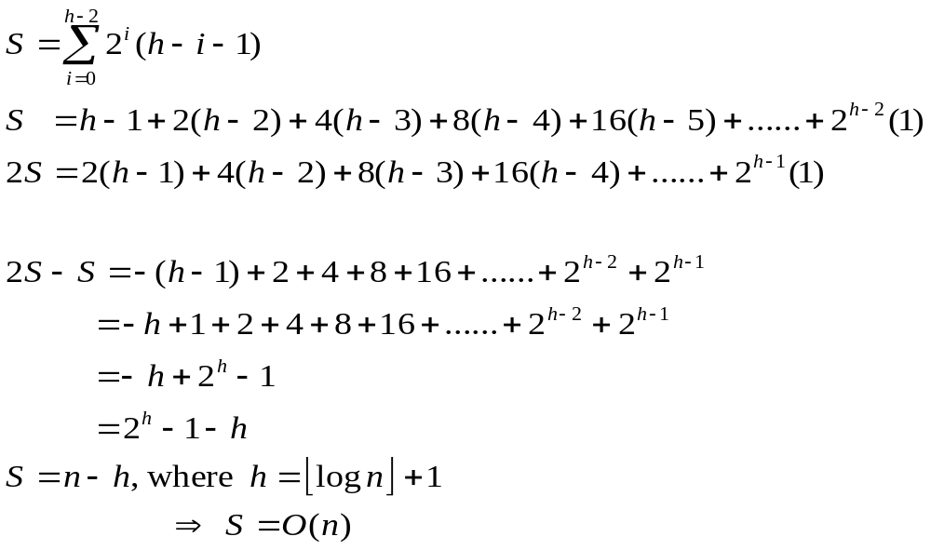
Proof of Summation

Slide 52
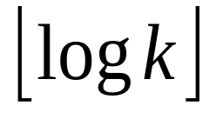
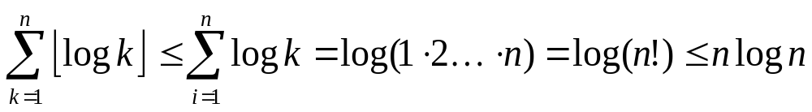
Complexity of Top-down
At most comparisons when inserting the kth element

