Slide 1
PART 1: JOB SLOT SALES AND PERFORMANCE DISTRIBUTION What is the variation across the Job Slot packages we sell?

Slide 2
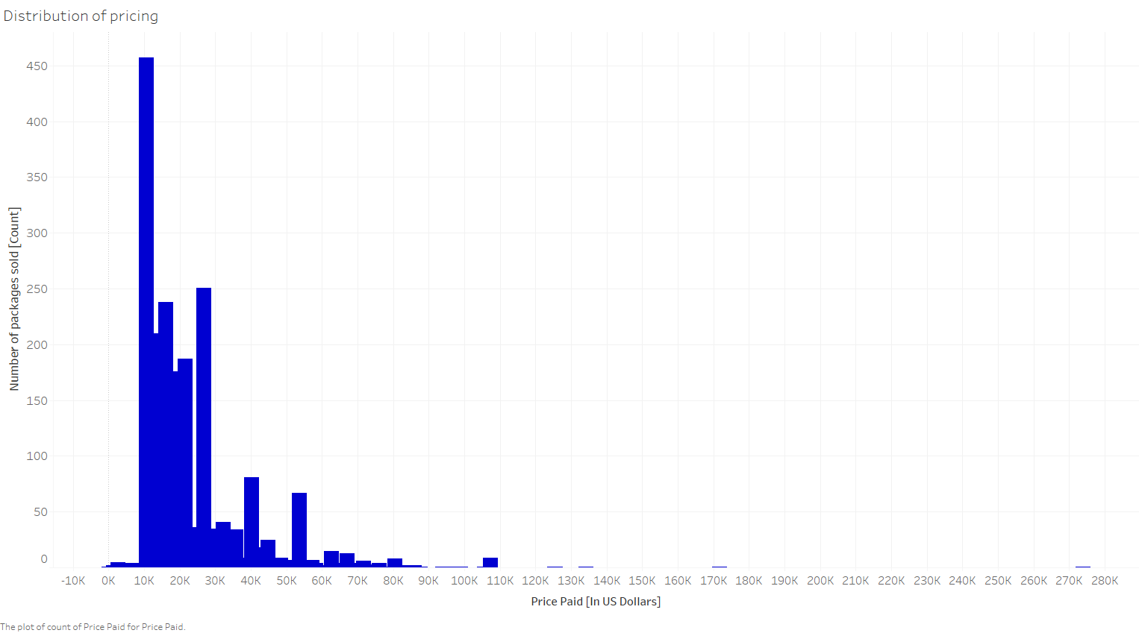
What does the distribution of pricing look like?
Based on the above distribution, we can conclude that most contracts cost around $17,096.5 (median). Also, the mean price per package is $22,367.55 - but this is higher because of outliers present in the data (for example, one package was sold for $2,73,870 : which ends up skewing the mean calculation).

Slide 3
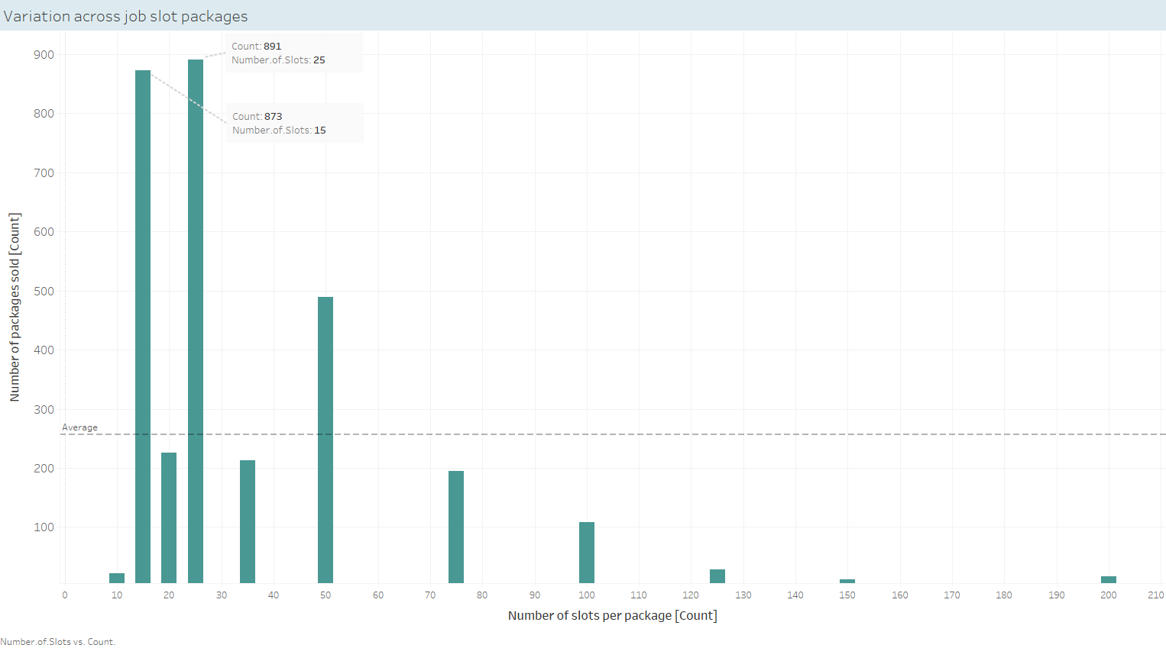
What packages are most popular, based on the number of slots?
The packages with 25 and 15 slots are most popular, with 891 and 873 contracts being signed respectively for those categories.

Slide 4
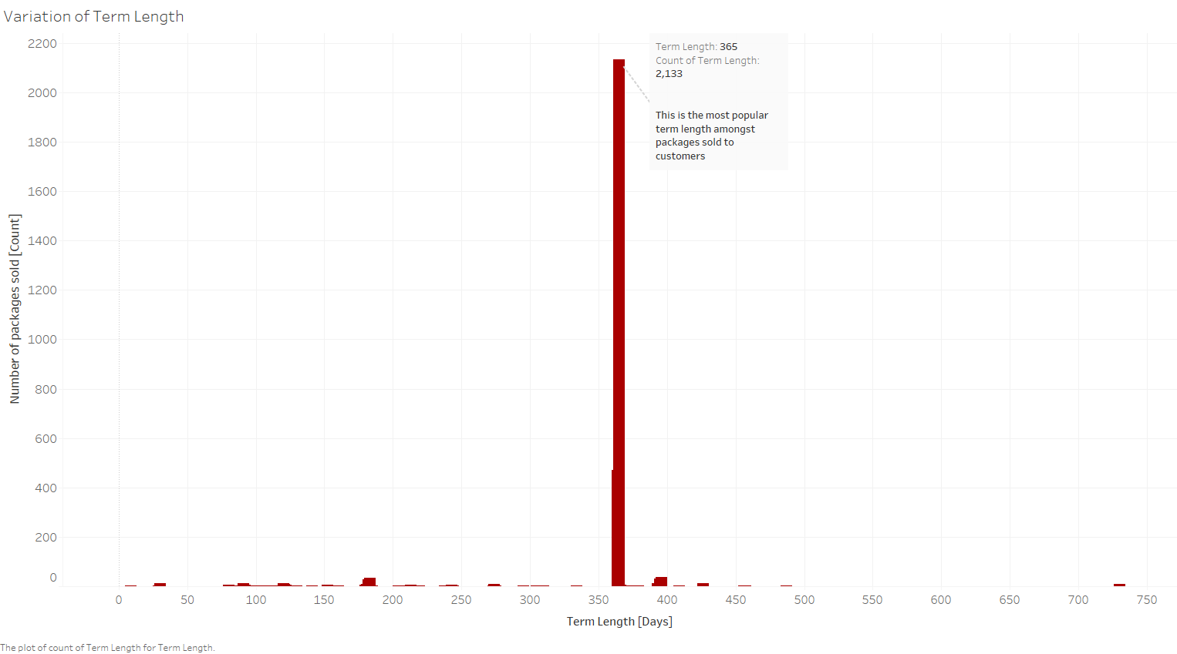
How does term length vary?
As we can see here, the overwhelming favorite amongst contracts is the one with 1 year term (duration of 365 days). Out of the total contracts (3078) in this dataset, 2133 contracts are signed for a duration of 1 year - which is 69%.

Slide 5
PART 1: JOB SLOT SALES AND PERFORMANCE DISTRIBUTION What metrics should we use to compare delivery performance across customers? How does performance vary in terms of:

Slide 6
We use the following performance metric to assess our business – Performance Metric = Number of applications / (Number of Slots per contract * Contract Length / 365)

Slide 7
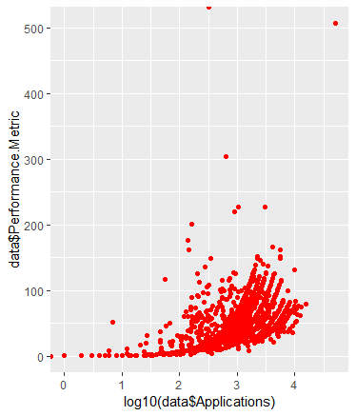
How does performance vary in terms of application metrics?
The relationship between the performance metric and number of appears to be decidedly non-linear - i.e. exponential in nature.

Slide 8
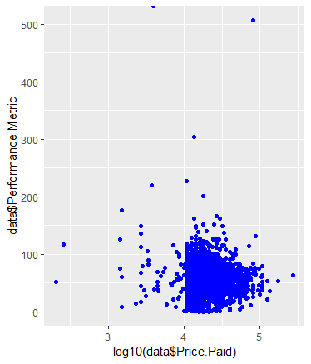
How does performance vary in terms of cost?
Here, the relationship between the performance metric and Price Paid is not to clear. It is hard to spot a trend here.

Slide 9
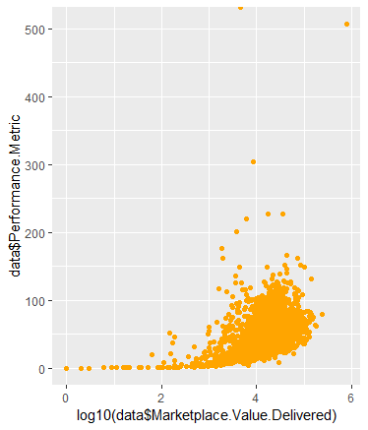
How does performance vary in terms of marketplace value?
The relationship here, appears to be non-linear again - and looks like it is exponential in nature.

Slide 10
Based on the above plots, we can see that the logarithm (base 10) all of 2 metrics (Applications & Marketplace Value Delivered) correlate well with our calculated performance metric. Comparing all plots above, the performance metric seems to be something feasible that can be used to evaluate performance across customers!

Slide 11
PART 2: RETENTION ANALYSIS

Slide 12
What factor or combination of factors best predict likelihood to retain (i.e., Renewed = 1)? Which factors appear to have the greatest impact on retention?

Slide 13
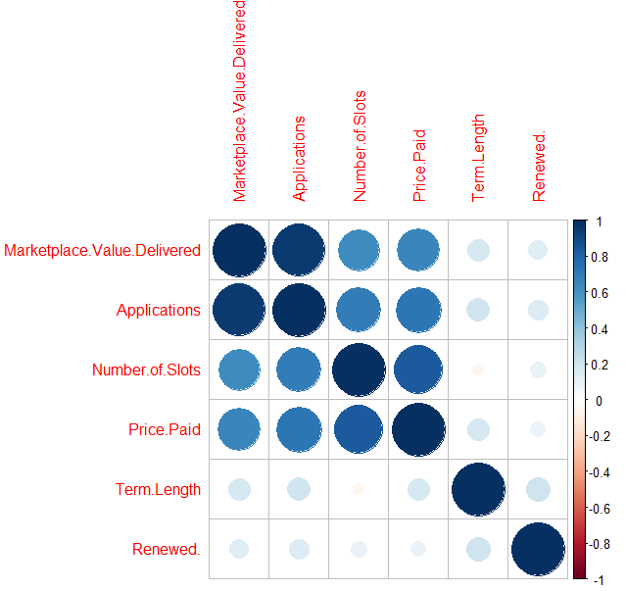
Based on the correlation plot and the forward subset selection calculation results, we can conclude that the predictor variables being checked here are correlating well with the response variable (albeit to varying degrees).

Slide 14
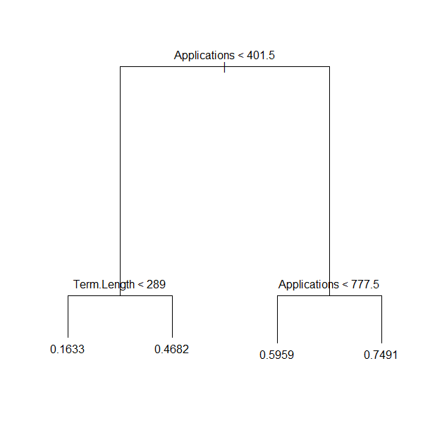
The factors Term Length and Number of Applications received seem to be the better indicators of contract renewal results.

Slide 15
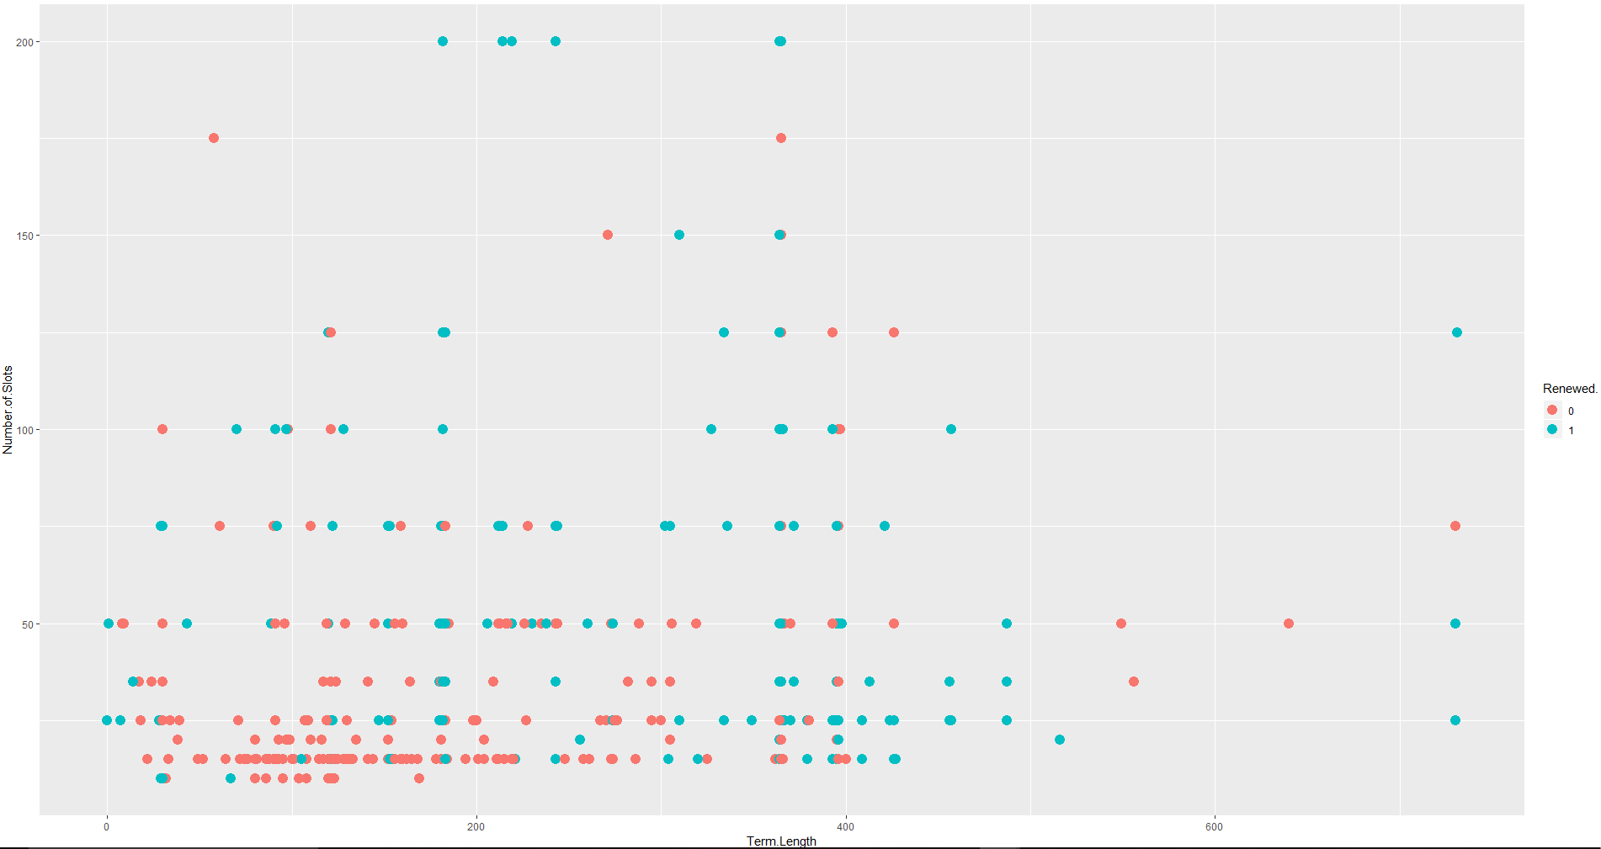

Slide 16
How well does your analysis in #3 predict retention? What other factors might you want to investigate to see if they could improve your analysis?

Slide 17
Based on the confusion matrix for the tree model (which is the better amongst the three models (two logistic regression and one classification tree model) we fitted – see R markdown HTML output) we developed, we can see that it has -
Raw accuracy is 69.3%
Sensitivity = TP/(TP + FN) = 57/(57 + 39) = 57/96 = 0.594 i.e. 59.4%
Specificity = TN/(TN + FP) = 477/(477 + 197) = 477/674 = 70.8%
So, we can conclude that our classification tree model does a better job of predicting whether a contract will be renewed, compared to whether the contract will not be renewed.
Also, we might want to figure out what impact factors like job industry, job roles being posted, the employer's attractiveness to the job applicants etc. have on the renewal of contracts that are being posted - see if there is some correlation between those variables!

Slide 18
Based on your analysis, what modifications would you recommend we make to our ad platform algorithm to improve retention?

Slide 19
Based on my analysis, I can say that the Term length of the contract and the Number of slots being offered play a huge role in determining whether a contract is renewed or not.
Glassdoor should try to sell more contracts that are one year (365 days in terms of duration) and focus on assessing which packages are renewed more (compare the number of slots being offered per package)!
Please see the output of the R Markdown HTML for better insights into my analysis!

