Slide 1

Soho Suite
Centralized Analytical Platform
By Rahul Reji
©
Small Office Home Office

Slide 2

PROBLEM STATEMENT
Small Businesses use spreadsheets, notebooks, or physical paper to store the business data. This can cause stock mismatches, redundancy in data, and reorder problems. These data are disconnected, and this will lead to inefficiency in storing, retrieving, and analysing data. The existing platform requires heavy Fee and have a very steep learning curve. This project aims to provide a user friendly Centralized System for managing data and analysing data efficiently.

Slide 3
EXISTING SOLUTIONS AND TARGET USERS
Existing small scale erp lacks in functionalities and how they operate.
High Cost for small computation.
Difficulty in learning curve.
Basic metrics needed for running a business are not available.
Market based functionalities are unavailable.
SAP / Oracle
Microsoft Dynamics
Odoo
Soho Suite
Source: Reddit

Slide 4
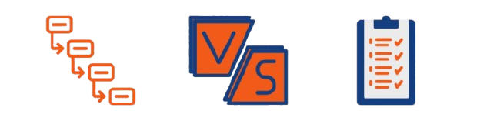
Requirements Gathering
Functional Requirements
Non-Functional Requirements
Usability: Simple enough for non-technical small-business users; no SQL or programming required.
Performance: Standard dashboards should load within about 3 seconds; filters within about 2 seconds.
Security: Secure authentication, password hashing, authorization, and business-level data isolation.
Reliability: Failed imports or processing must not corrupt valid data.
Data Accuracy: KPI formulas and calculations must remain consistent and traceable to source data.
Scalability: Architecture should support increasing users, businesses, and data volumes.
Maintainability: Authentication, ingestion, analytics, reporting, and other modules should remain separated and testable.
Affordability: Infrastructure should remain suitable for small-business usage and low-cost deployment.
Compatibility: Support major desktop browsers with responsive dashboard layouts.
Backup & Recovery: Business data should be backed up and recoverable.
User registration, login, logout, and role-based access.
Create and manage a business workspace.
Upload CSV and Excel business data.
Preview imported data and detect column data types.
Identify missing values, duplicates, and invalid records.
Clean and standardize uploaded data.
Define relationships between related datasets.
Calculate core KPIs such as Revenue, Orders, Profit, Average Order Value, Customer Count, and Sales Growth.
Display KPI cards, charts, and trend dashboards.
Filter analytics by date, product, category, customer, and location.
Drill down from summary KPIs to detailed records.
Show data refresh status and last-updated time.
Export reports/data as CSV, Excel, and PDF.
Provide basic sales, customer, product, and financial analytics.
Alerts System for data regulation

Slide 5
Project Scope and Feasibility Study
Build a reliable and free ERP system

Slide 6
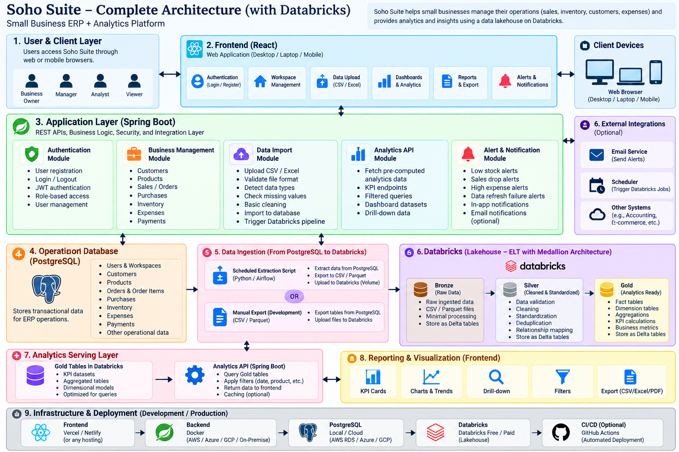
System Architecture

