Slide 1
E-retail factors for customer activation and retention: A case study from Indian e-commerce customers
Submitted by: Rahul sharma

Slide 2
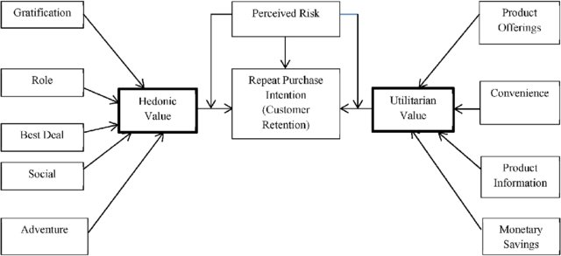
Conceptual Background of the Domain Problem
Problem Statement: Analyse the Features affecting Customer Satisfaction & retention and test if brand preference depends on factors like age and gender.
The combination of both utilitarian value and hedonistic values are needed to affect the repeat purchase intention (loyalty) positively.
The data is collected from the Indian online shoppers. Results indicate the e-retail success factors, which are very much critical for customer satisfaction.

Slide 3
Analytical Problem Framing
Data Scientists must apply their analytical skills to give findings and conclusions in detailed data analysis written in Jupyter notebook.
Only data analysis is required.

Slide 4
Data sources and info
There are two sheets (one is detailed) and second is encoded in the excel file.
Using df.shape(), we get dimensions i.e. 269 rows and 71 columns.
Using df.head() we display the first five rows of the dataset.
Using df.info(), we get info of the features of the dataset and we get 70 “object” type features and 1 “int64” type feature.

Slide 5
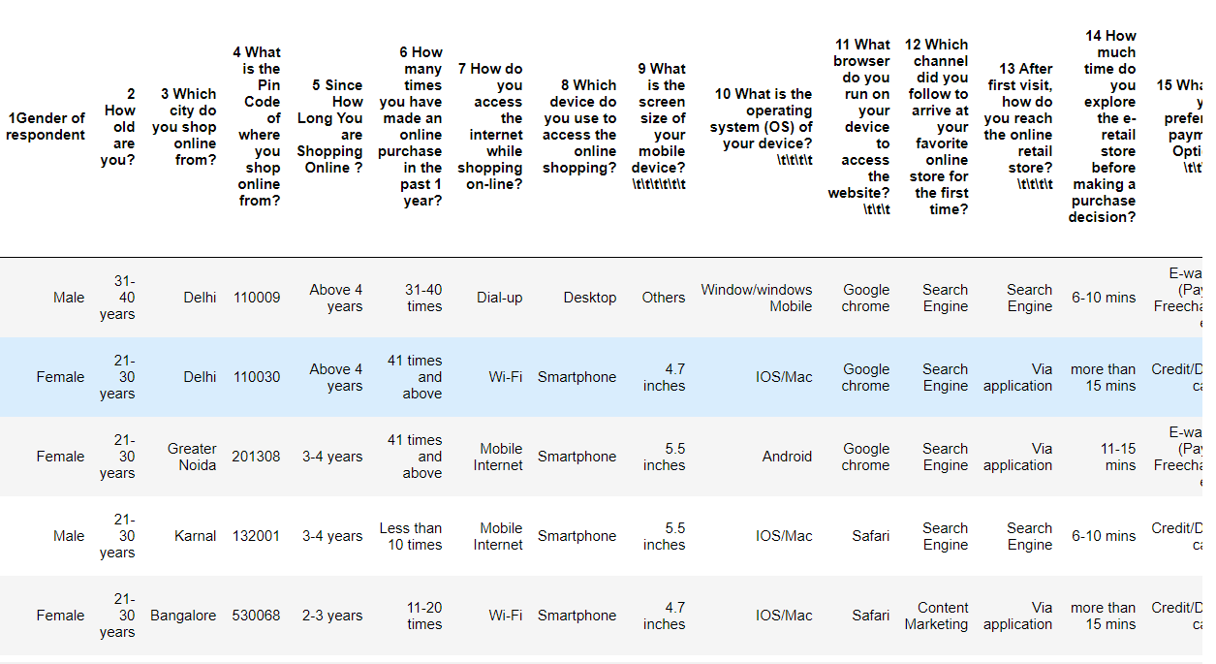

Slide 6
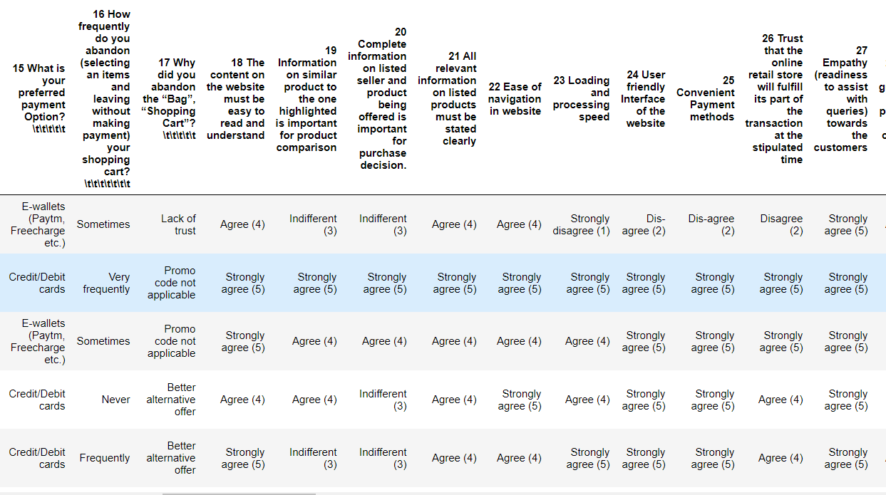

Slide 7
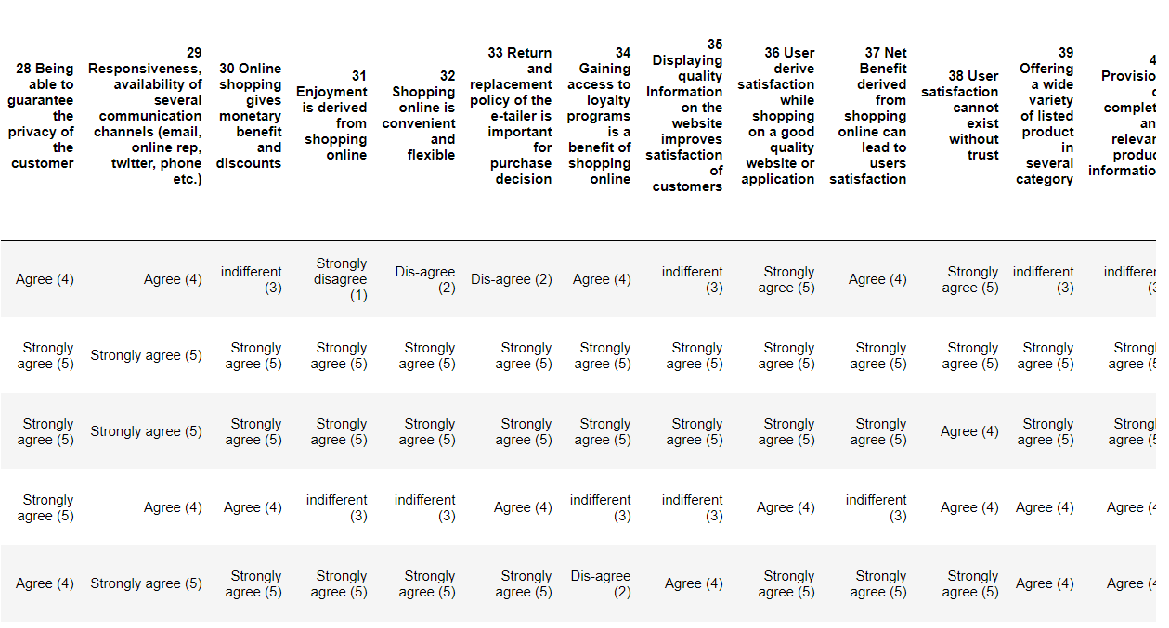

Slide 8
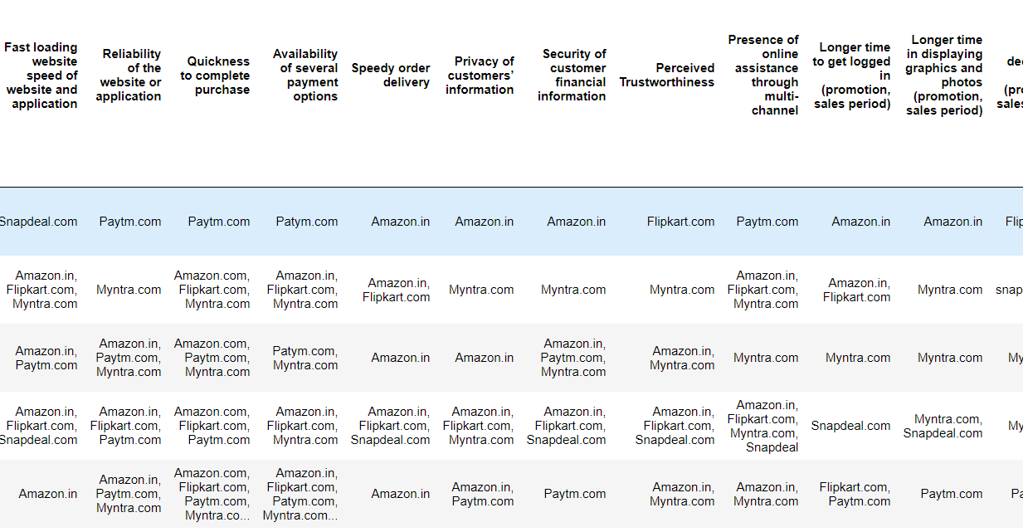

Slide 9
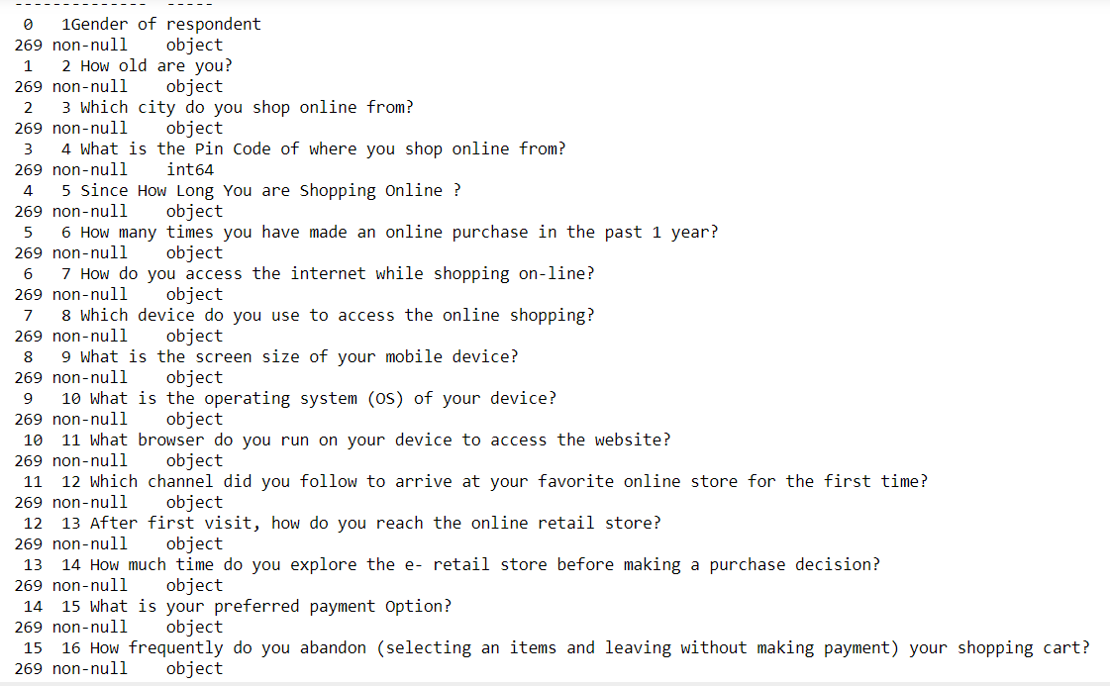
Dataset info: (269 rows and 71 columns)

Slide 10
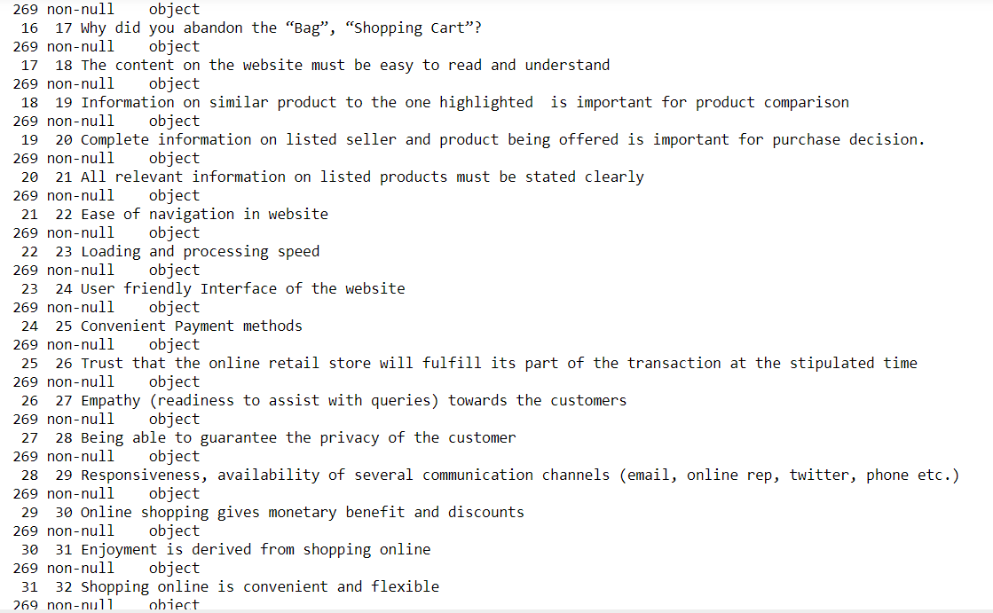

Slide 11
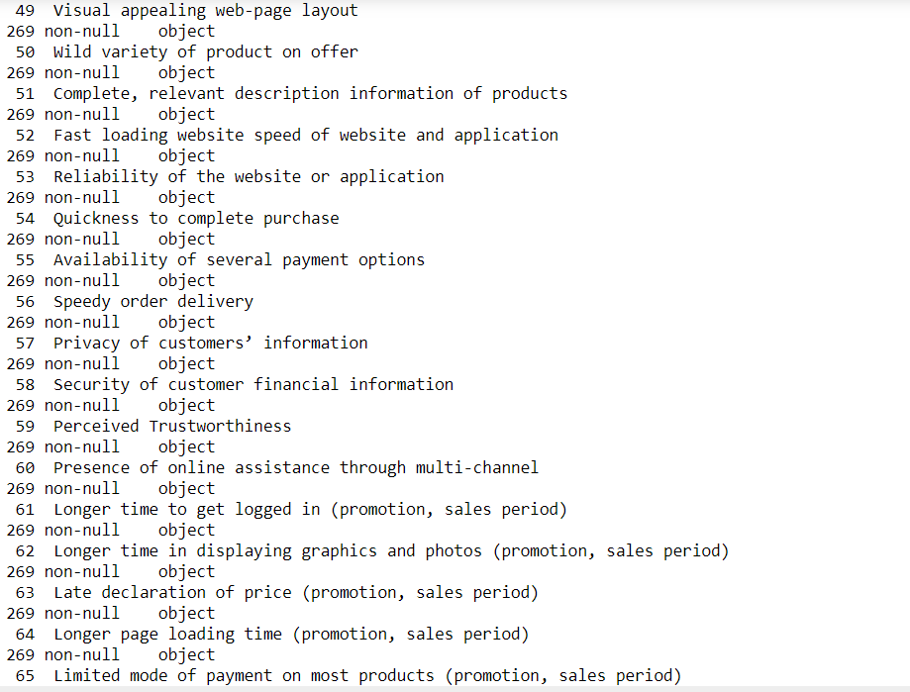

Slide 12
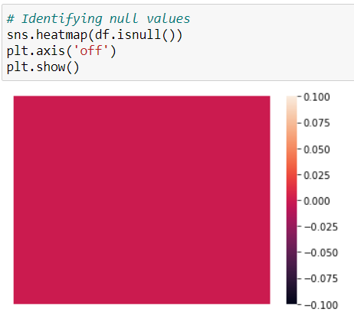
Checking for the null values: sns.heatmap(df.isnull().sum())
From the plot we can see that there are no null values present in the dataset.

Slide 13
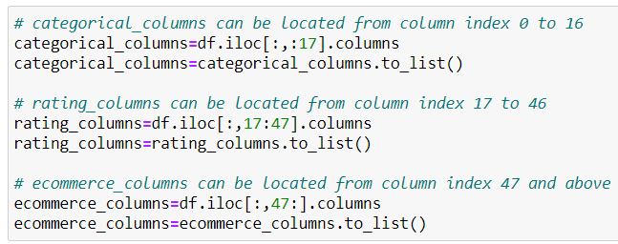
As there are a huge number of features, it makes sense to divide the data into these categories:
categorical_columns = This will contain demographic features and other person specific features like age, gender, browser]
rating_columns = This will contain all questions which have answers in the form of (Agree, Strongly Agree, Indifferent etc.)
ecommerce_columns = This will contain all questions which have answers in the form of (amazon, flipkart, myntra etc.)

Slide 14
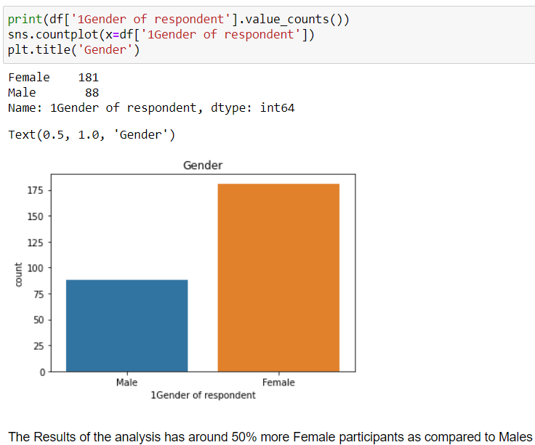
Data visualization:
From the plot we can see that the female customers are more as compared to male customers.

Slide 15
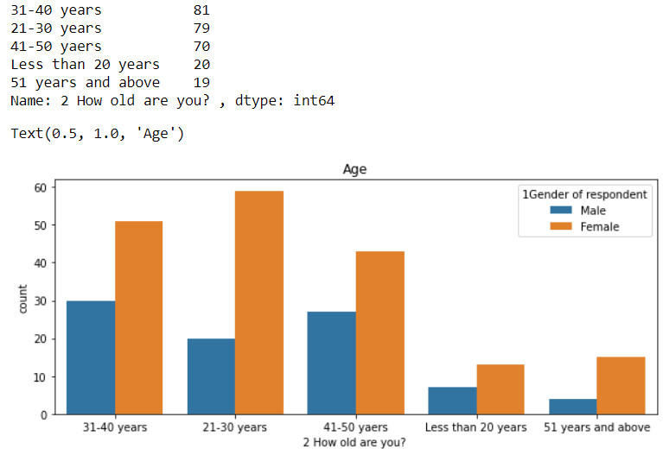
from the plot we can see that females are more in all the age groups as compared to males.

Slide 16
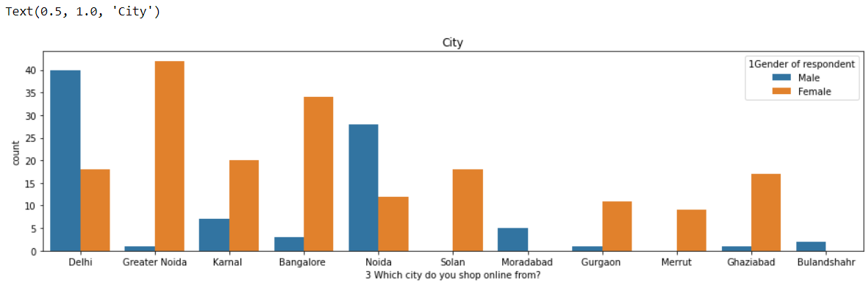
from the plot we can say that cities like Delhi , Noida, Moradabad, Bulandshahr has more male customers and cities like greater Noida, karnal, Bangalore, Solan, Gurgaon Merrrut, Ghaziabad has more female customers.

Slide 17
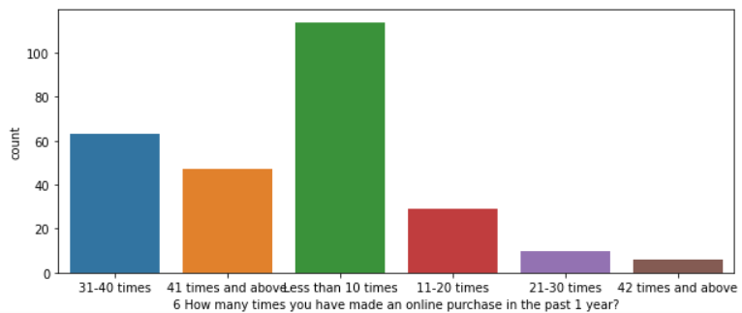
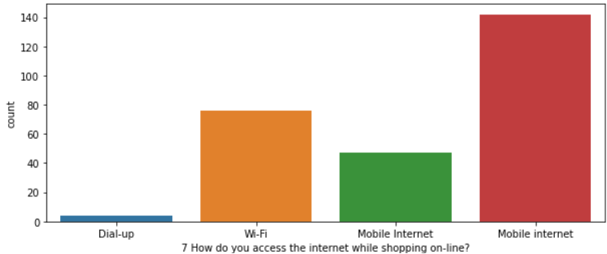
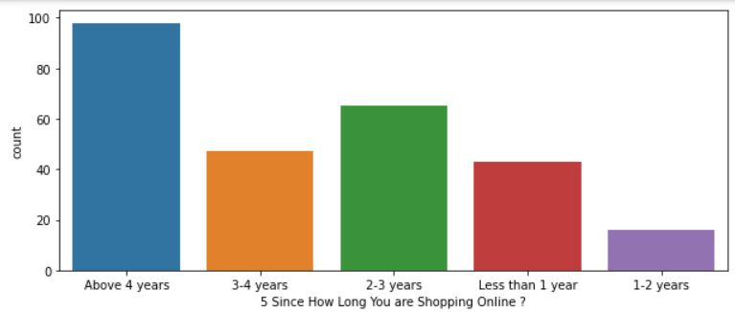
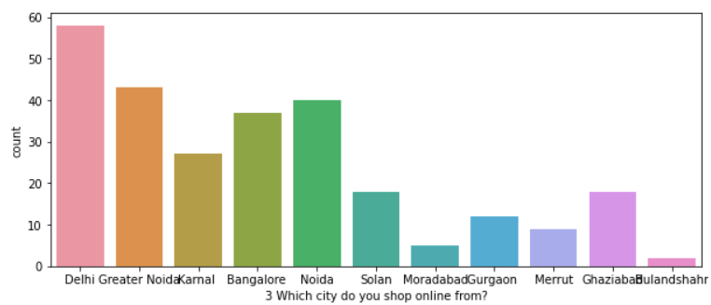
Univariate analysis:
Univariate analysis:

Slide 18
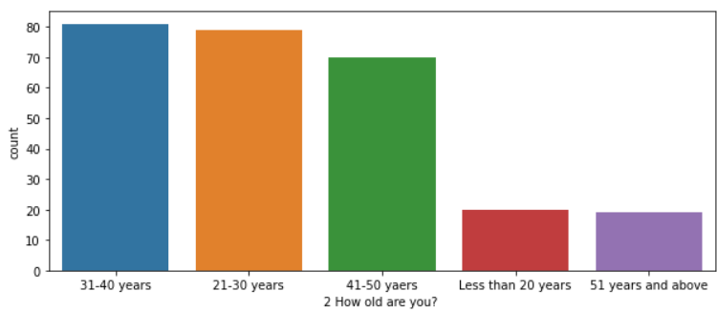
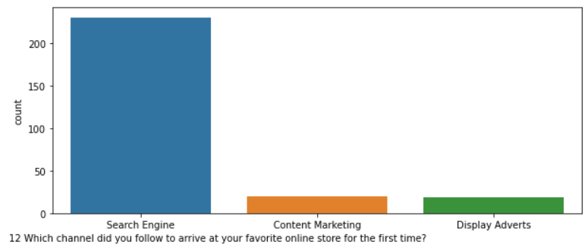
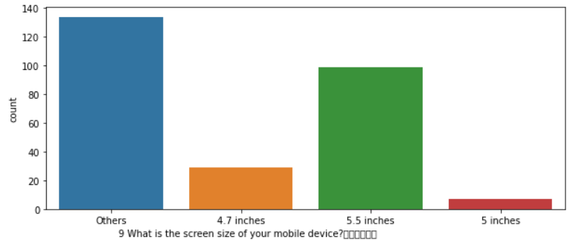
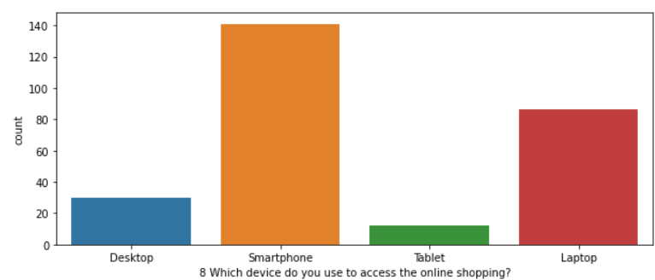

Slide 19
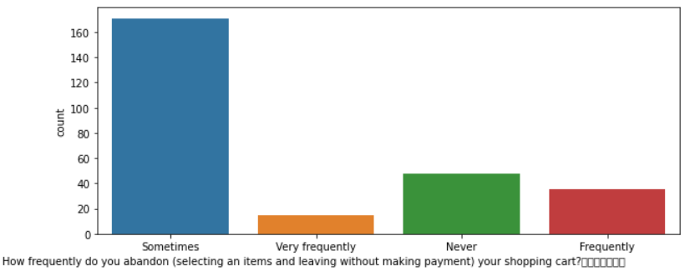
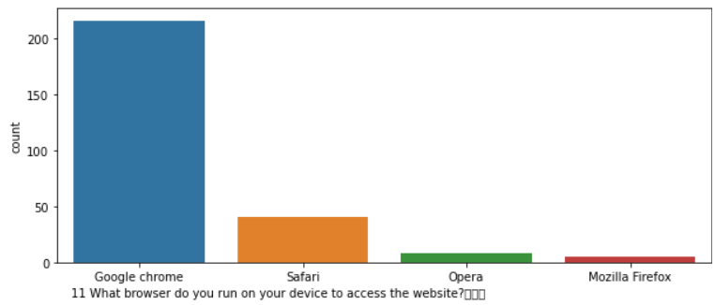
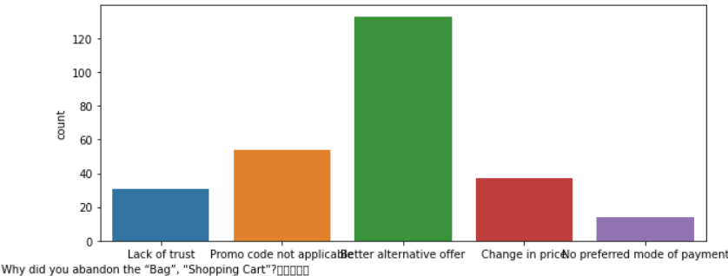
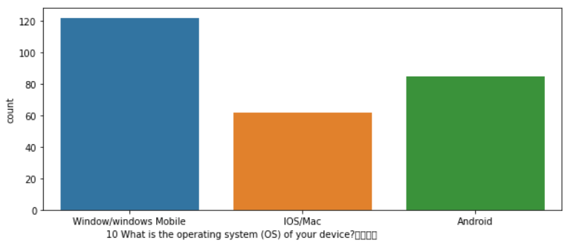

Slide 20
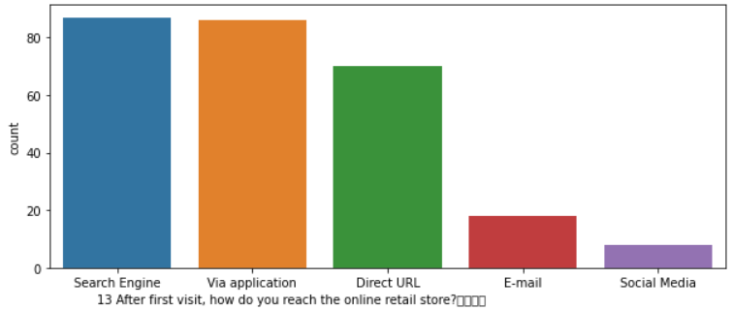
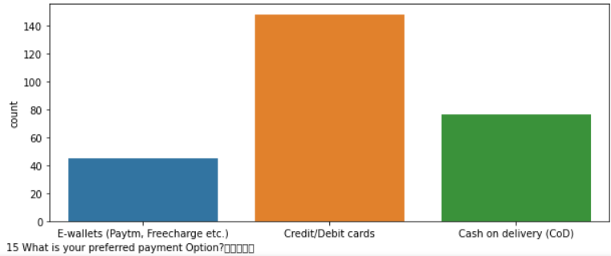
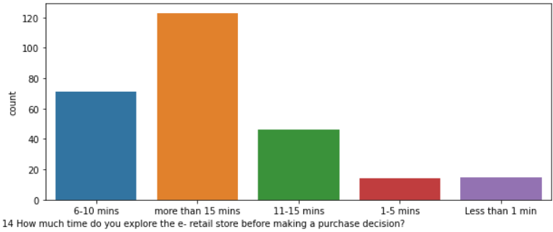

Slide 21
Observations:
80% of the people are within age group 31-40 years,80%(approx.) of the people are within age group 21-30 years and 72%(approx.) of people are within age group 41-50 years.so we can say that 70-80%(approx.) people lies with in age group of 21-50 years.20%(approx.) of people lies with in range of less than 20 years or more than 50 years old.
Cities like Delhi, Greater Noida, Noida and Bangalore have the maximum number of online shoppers.
Maximum number of customers have been using Online Shopping platforms for more than 4 years.
The maximum purchases made in past 1 year by the customers are less than 10 times as compared to 31-40 times and 41 times and above.
The maximum customers(142) use Mobile internet for online shopping.
Maximum customers are using Smartphones and then some are using laptops but very few people are using tablets for shopping.
most of customer screen size of mobile lies in others range and then customers use 5.5 screen size mobile for shopping.
The maximum number of customers are using Window/window Mobile as operating system for online shopping.
Maximum customers use Google Chrome as the browser for online shopping.
Search Engines are the most used channel which they follow to arrive at their favorite online store for first time.
After the first visit, most of customer reach the online store through search engine.
Most people take purchase decision after spending more than 15 minutes.
Credit/Debit cards are the most used mode of payment option.
Maximum people abandon the items in cart 'sometimes' as opposed to never or frequently.
The biggest reason to abandon the "bag", "Shopping Cart" is that they get a 'Better alternative offer'.

Slide 22
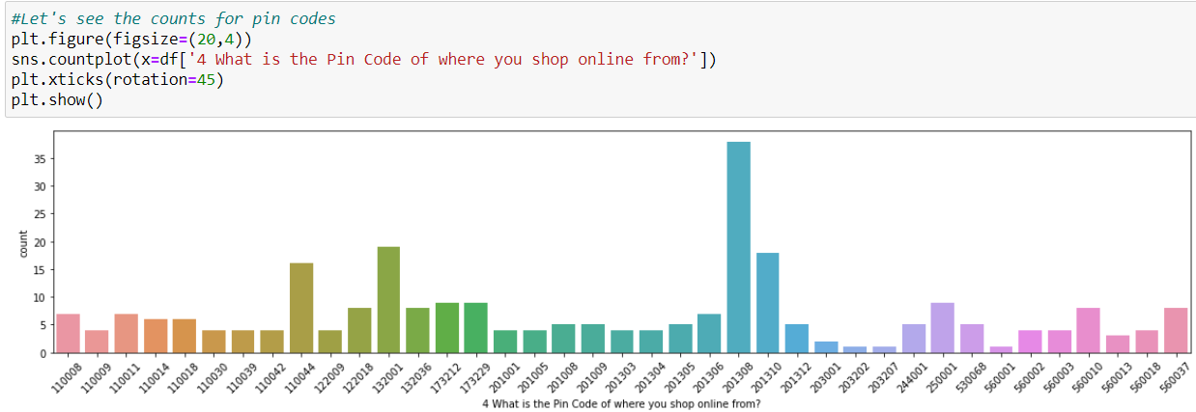
value_counts for “pincode” column:
from the plot we can see that "Pin Code: 201308" has the Most Number of buyers followed by 132001, 201310 and 110044.

Slide 23
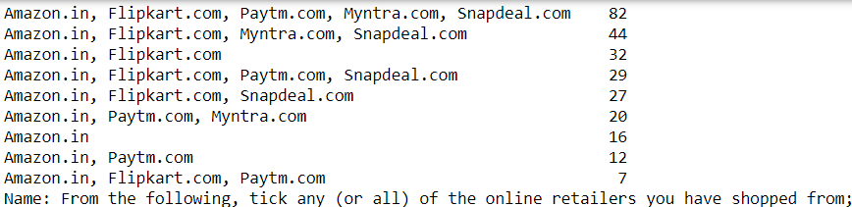
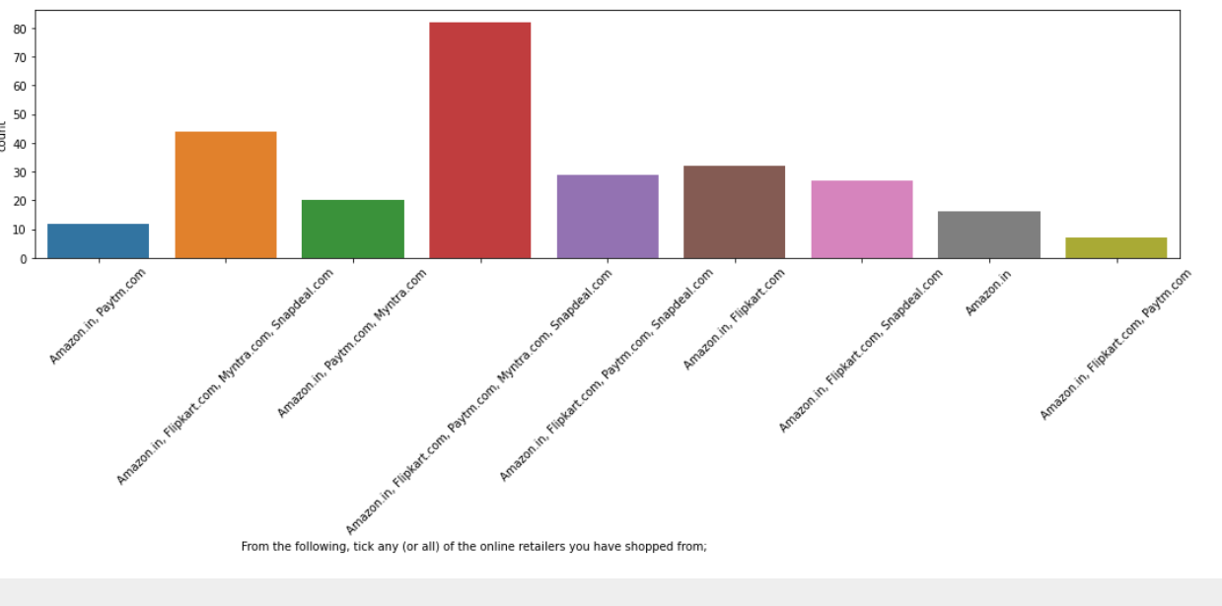
other categorical columns:

Slide 24
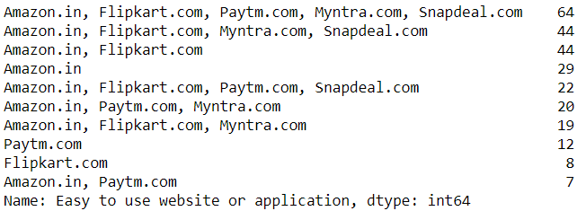
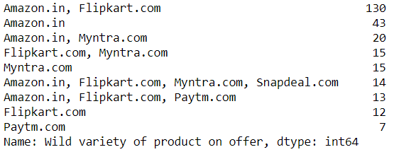
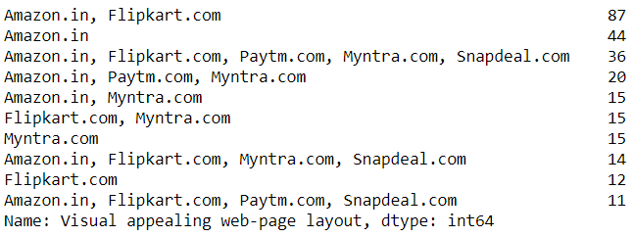
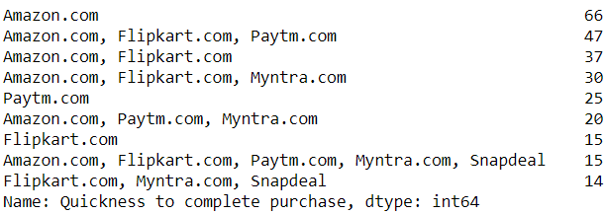
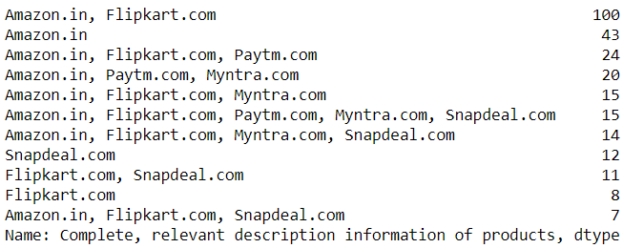
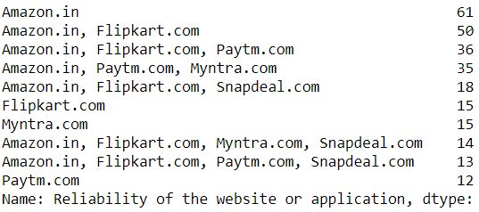

Slide 25
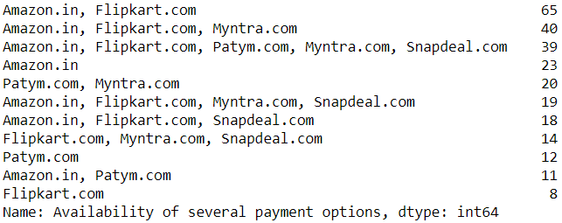
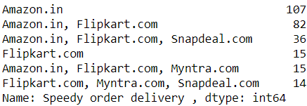
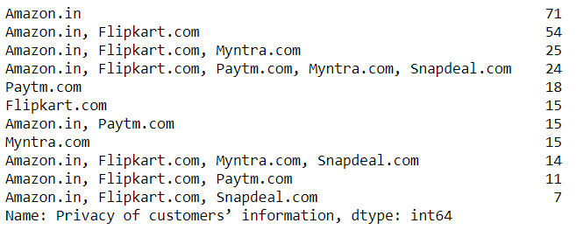
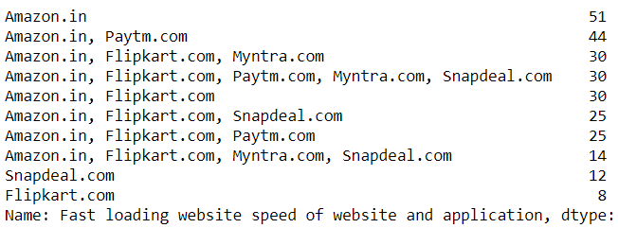
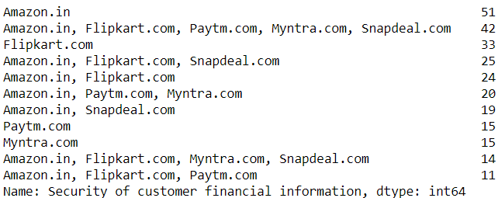
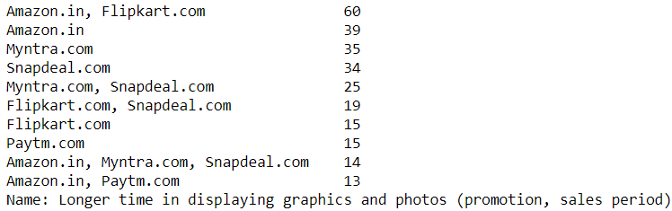

Slide 26
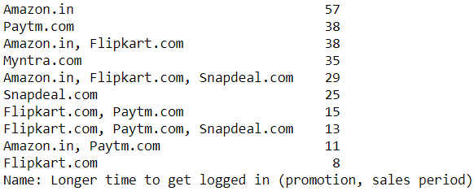
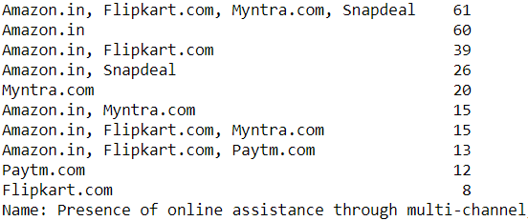
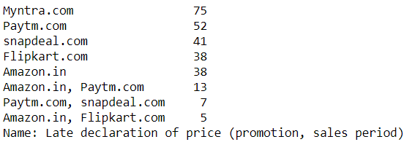
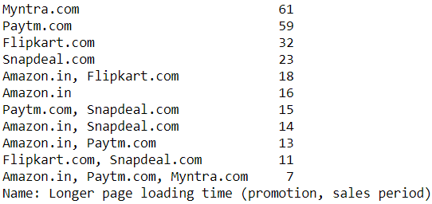
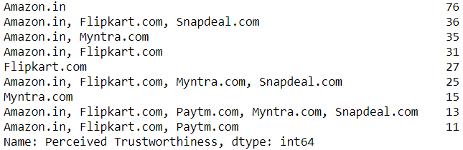
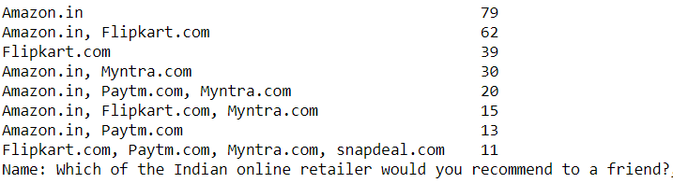

Slide 27
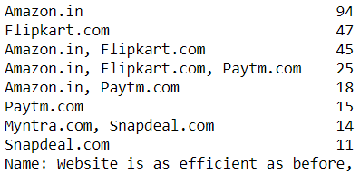




Slide 28



Slide 29



Slide 30



Slide 31



Slide 32
Observations:
1. Maximum people have shopped from the following 5 companies - Amazon.in, Flipkart.com, Paytm.com, Myntra.com, Snapdeal.com.
2. Most people find Easy to use website or application are - Amazon.in, Flipkart.com, Paytm.com, Myntra.com, Snapdeal.com
Also, Amazon.com and Flipkart.com are the best choices.
3. In terms of Visual appealing web-page layout also, Amazon.com and Flipkart.com are the best choices.
4. Talking about Wide variety of product on offer: Amazon.com and Flipkart.com are the major choices.
5. Complete, relevant description information of products: Once again, maximum people have chosen to go with mazon.com and Flipkart.com
6. Fast loading website speed of website and application: Amazon seems to take the lead in this category, although paytm and Flipkart are not far behind.
7. Reliability of the website or application: Amazon seems to take the lead in this category too, although Flipkart and paytm are not far behind.
8. Quickness to complete purchase: Amazon seems to take the lead in this category too, although Flipkart and paytm are not far behind.
9. Availability of several payment options: Here, Amazon and Flipkart, both are the favourites. Although a lot of people also tend to go towards Myntra
10. Speedy order delivery: Amazon seems to take the lead in this category too, followed by Flipkart.

Slide 33
Observations:
11. Privacy of customers’ information: Amazon has a good reputation for maintaining privacy, followed by Flipkart
12. Security of customer financial information: Here other than Amazon and Flipkart, Paytm.com, Myntra.com, Snapdeal.com are also trusted by a lot of people. This shows that all companies pay special attention to security.
13. Perceived Trustworthiness: Amazon and Flipkart are winners here as well. Although Myntra.com and Snapdeal.com are also not far behind.
14. Presence of online assistance through multi-channel: Amazon.in, Flipkart.com, Myntra.com, Snapdeal
15. Longer time to get logged in (promotion, sales period): Amazon, paytm
16. Longer time in displaying graphics and photos (promotion, sales period): Amazon.in, Flipkart.com
17. Late declaration of price: Myntra, Paytm, Snapdeal. These companies should work on this area to improve.
18. Longer page loading time (promotion, sales period): Myntra and Paytm have bad feedback in this. Flipkart should also have a look into it, as it is at the 3rd place.
19. Limited mode of payment on most products (promotion, sales period): Snapdeal is the most voted answer for this.
20. Longer delivery period: Paytm and Snapdeal need to shorten their delivery time.
21. Change in website/Application design: Amazon.in
22. Frequent disruption when moving from one page to another: Amazon.in
23. Website is as efficient as before: Amazon.in
24. Which of the Indian online retailer would you recommend to a friend?: Amazon/Flipkart

Slide 34
Conclusion:
Comparing the Customer's Perceptions and the Company's performance we can conclude that the Companies likely to have
High Customer Satisfaction and Retention:
1. Amazon.com
2. Flipkart.com
High Risk of Customer Churn:
1. Myntra.com
2. Snapdeal.com

