Slide 1
Dia-HCMS

Slide 2
SYNOPSIS
Millions of people around the world live with diabetes. Beyond managing the condition itself, it’s crucial to get diabetes under control because of the risk for serious complications, ranging from kidney failure and nerve damage to heart disease and stroke.
However, Diabetes can be managed by following just a few simple healthy-living strategies:
Monitoring your blood sugar
taking any prescribed medications
eating a smart diabetes diet
exercising regularly — every day.
Adhering to strict routines everday can be difficult in the midst of tight schedules and daily activities. The DiaHCMS application can be used to ease the process of managing diabetes in the patient’s everyday life.
The application interacts with the patient my giving reminders about meal timings, medication,etc. , and also by taking the description of any anomalies in the patient’s health or routine as input.
Using the MySQL relational database in the backend, the patient’s everyday activities and anomalies are stored, along with meal plans, Insulin dosages, and several other routine activities.
The entries in the database are then used to generate a monthly report, that can be used by the doctor to assess the variation in the patient’s condition. This can further aid in providing suggestions for adapting to and controlling the condition.

Slide 3
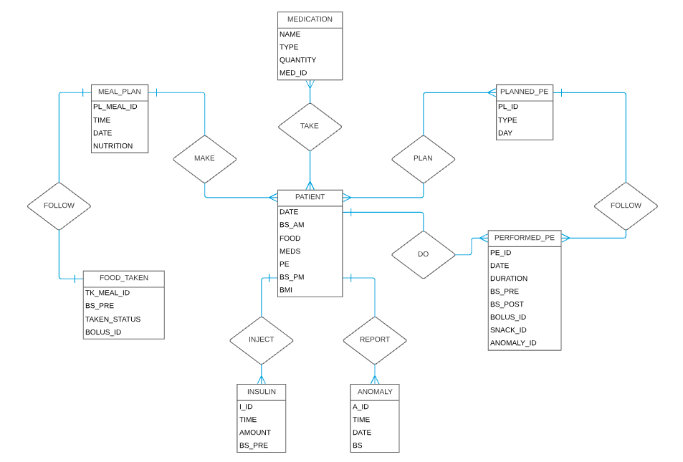
ER - DIAGRAM

Slide 4
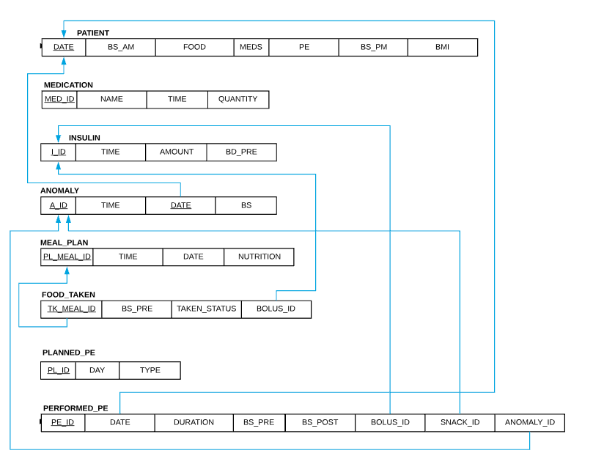
SCHEMA DIAGRAM

Slide 5
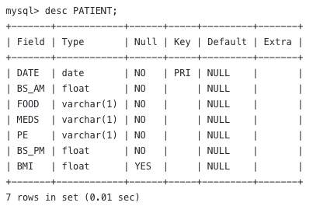
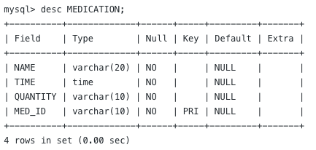
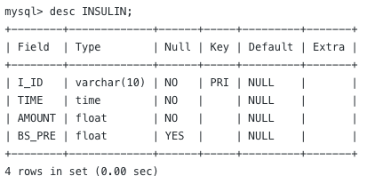
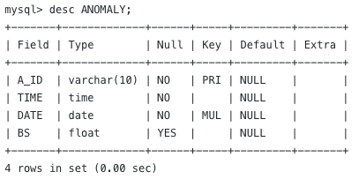

Slide 6
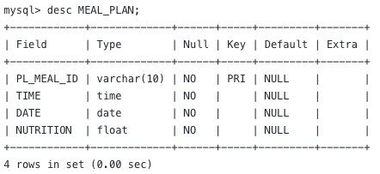
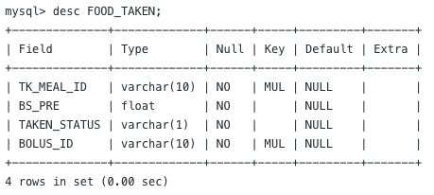
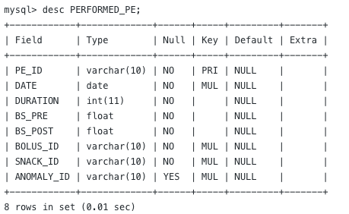
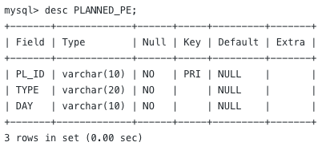

Slide 7
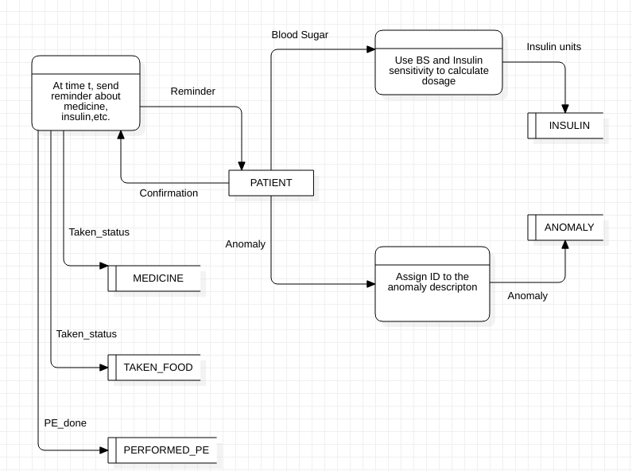
Data flow diagram

Slide 8
THANK YOU

