Slide 1

Insurance Claim Prediction

Slide 2
Business Challenge
This dataset contains relevant data regarding the medical cost for multiple people
The goal of this exercise is to observe which variables help affect the likelihood of an insurance claim
Will then help predict the likelihood of an insurance claim for future users.

Slide 3
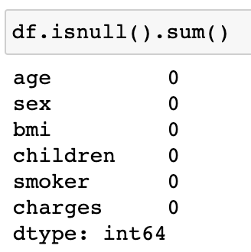
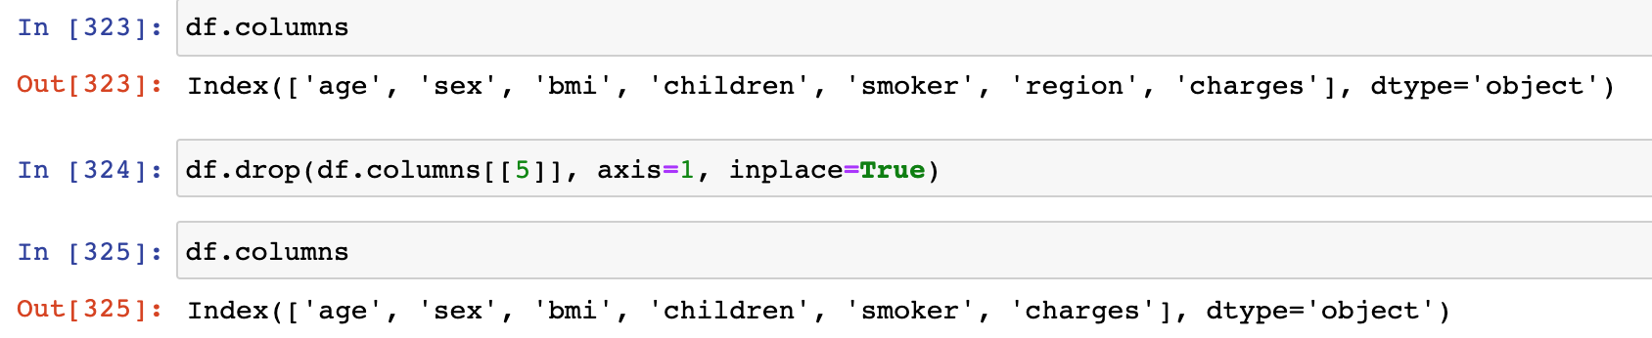
Data Pre-Processing
Remove unnecessary columns
In this case, I removed the region column as it did not pertain to my business question
Handle data anomalies
Were not any data anomalies in this dataset

Slide 4
Data Exploration
Find out
Find out which factors most affect charges(individual medical costs billed by health insurance)
Visualize
Visualize said factors that affect charges and observe key trends
Create
Create a new column of type object where any charges value below the median(in this $9382) to determine whether a client qualifies for insurance claim

Slide 5
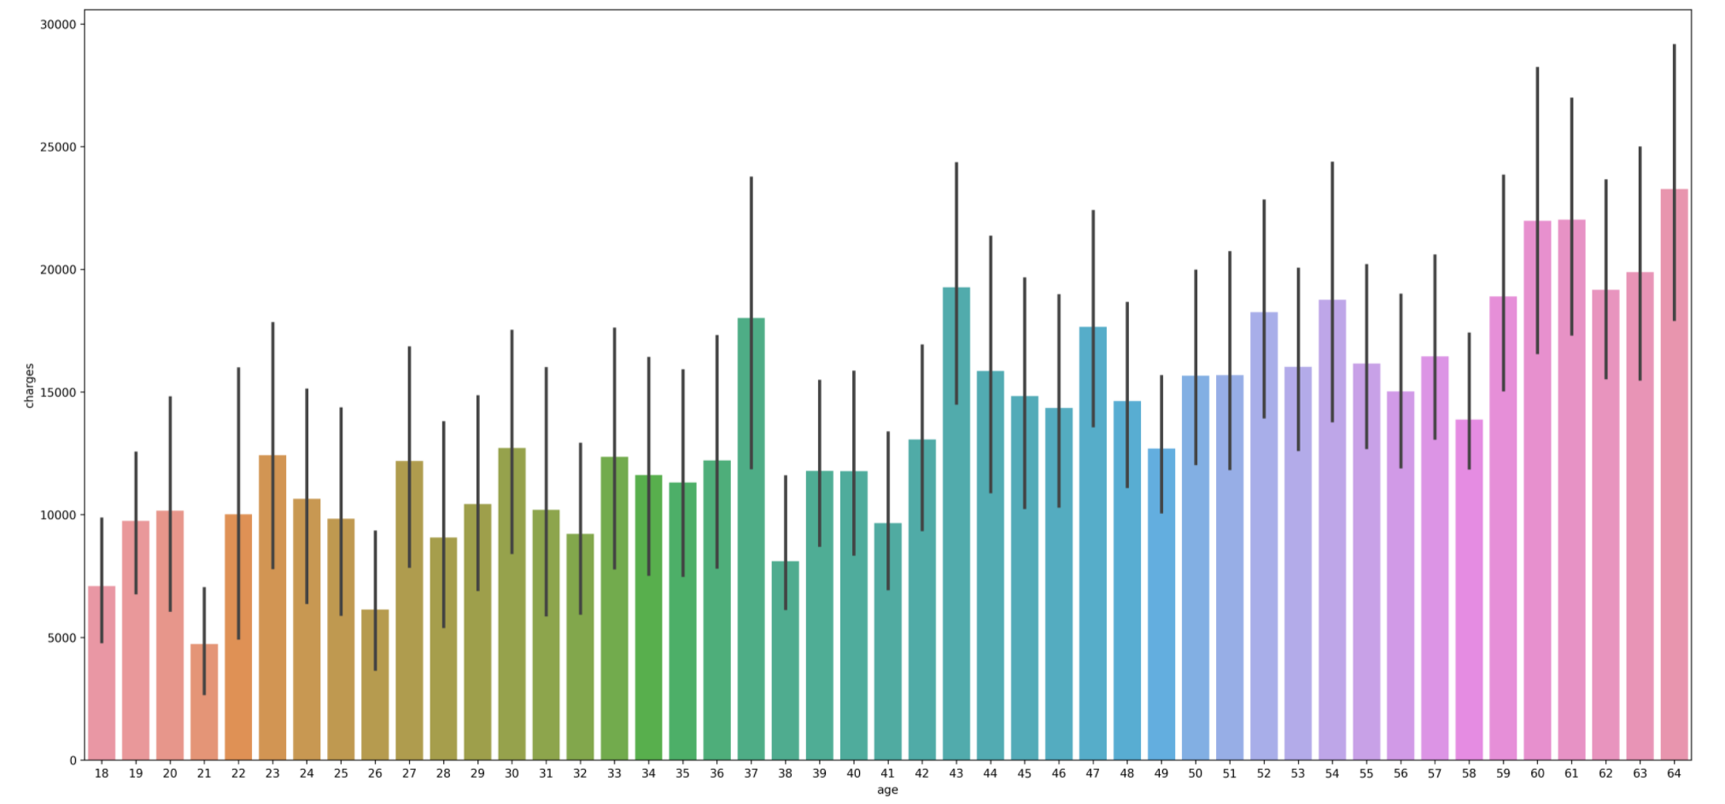
How Does Age Affect Insurance Medical Charges
Generally, the greater the age, the greater the insurance charge
Checks out due to older people having more medical problems as they age

Slide 6
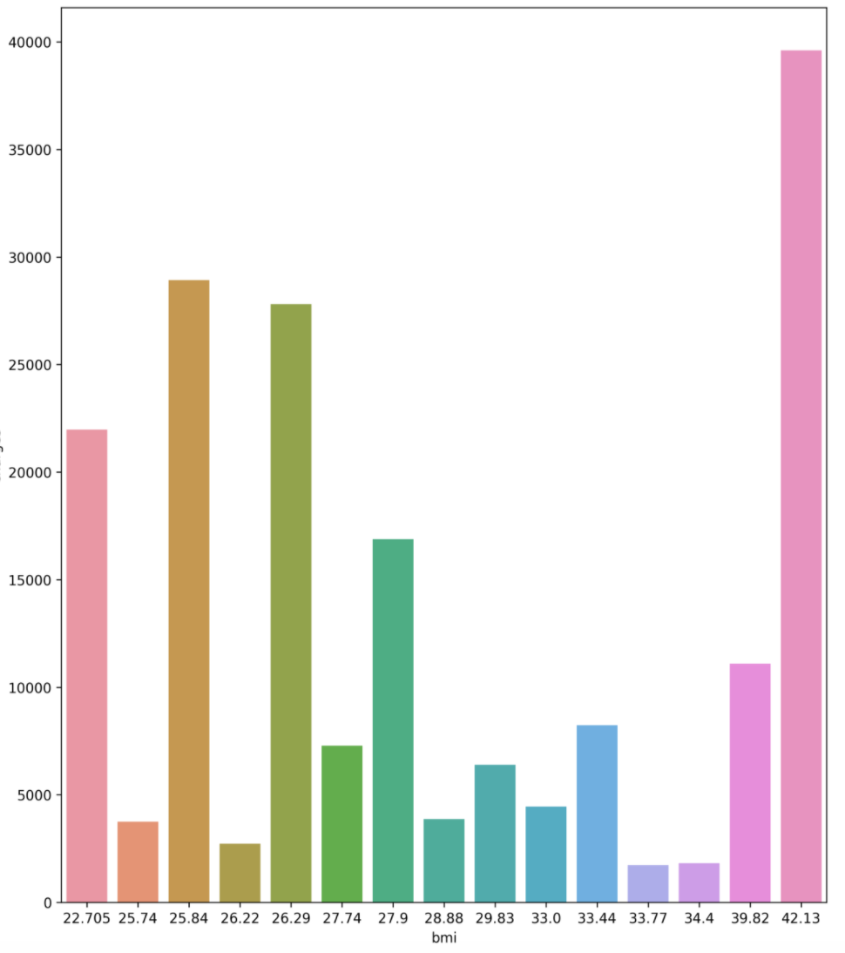
Is There A Correlation Between BMI And Insurance Charges
No discernable relationship between BMI and insurance charges

Slide 7
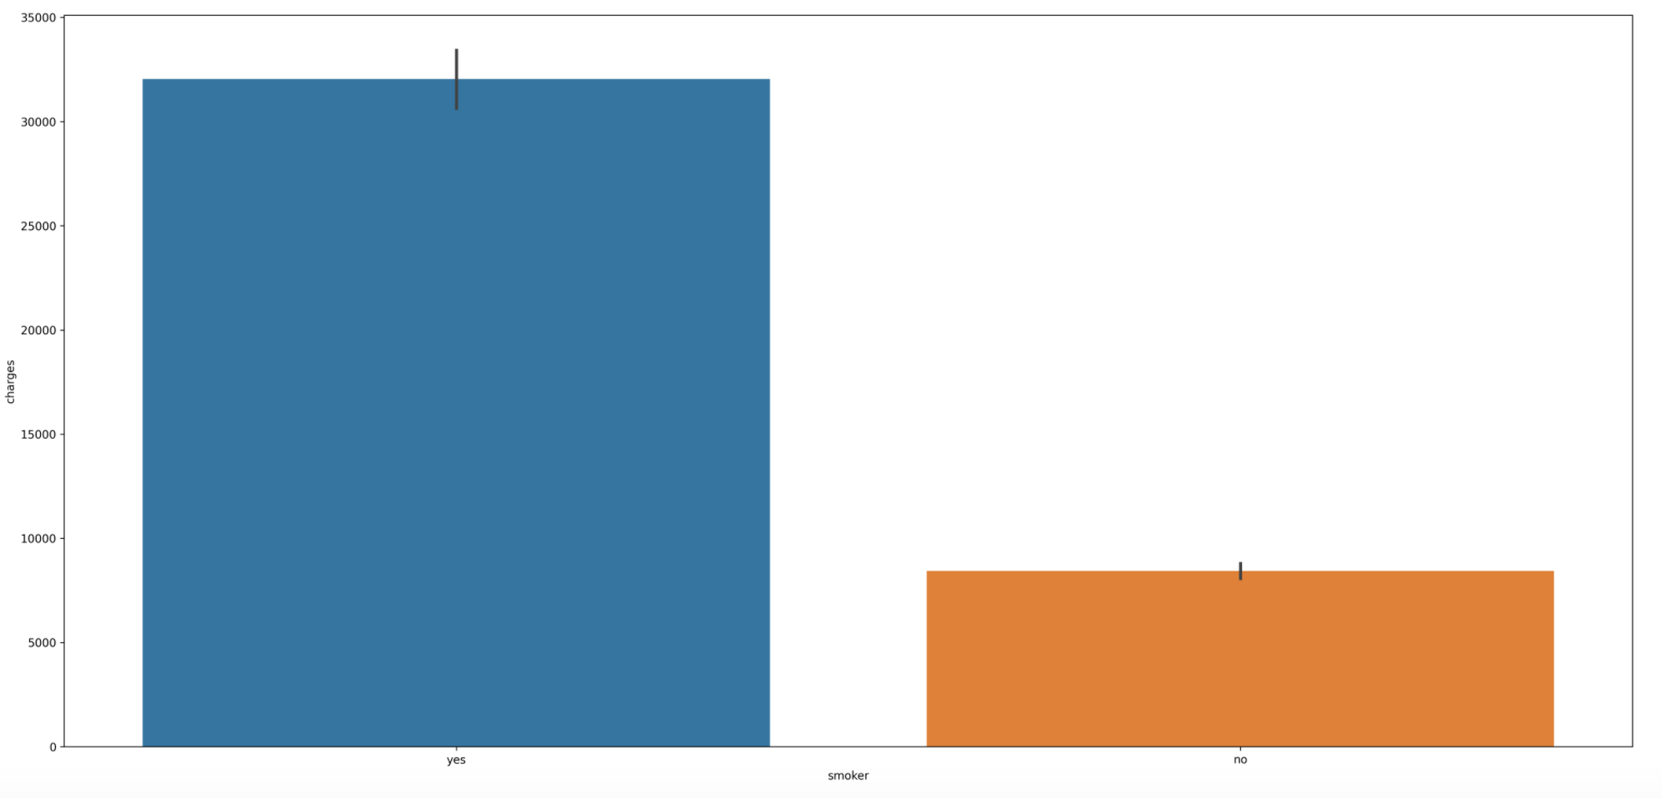
Do People Who Smoke Have Higher Insurance Charges

Slide 8
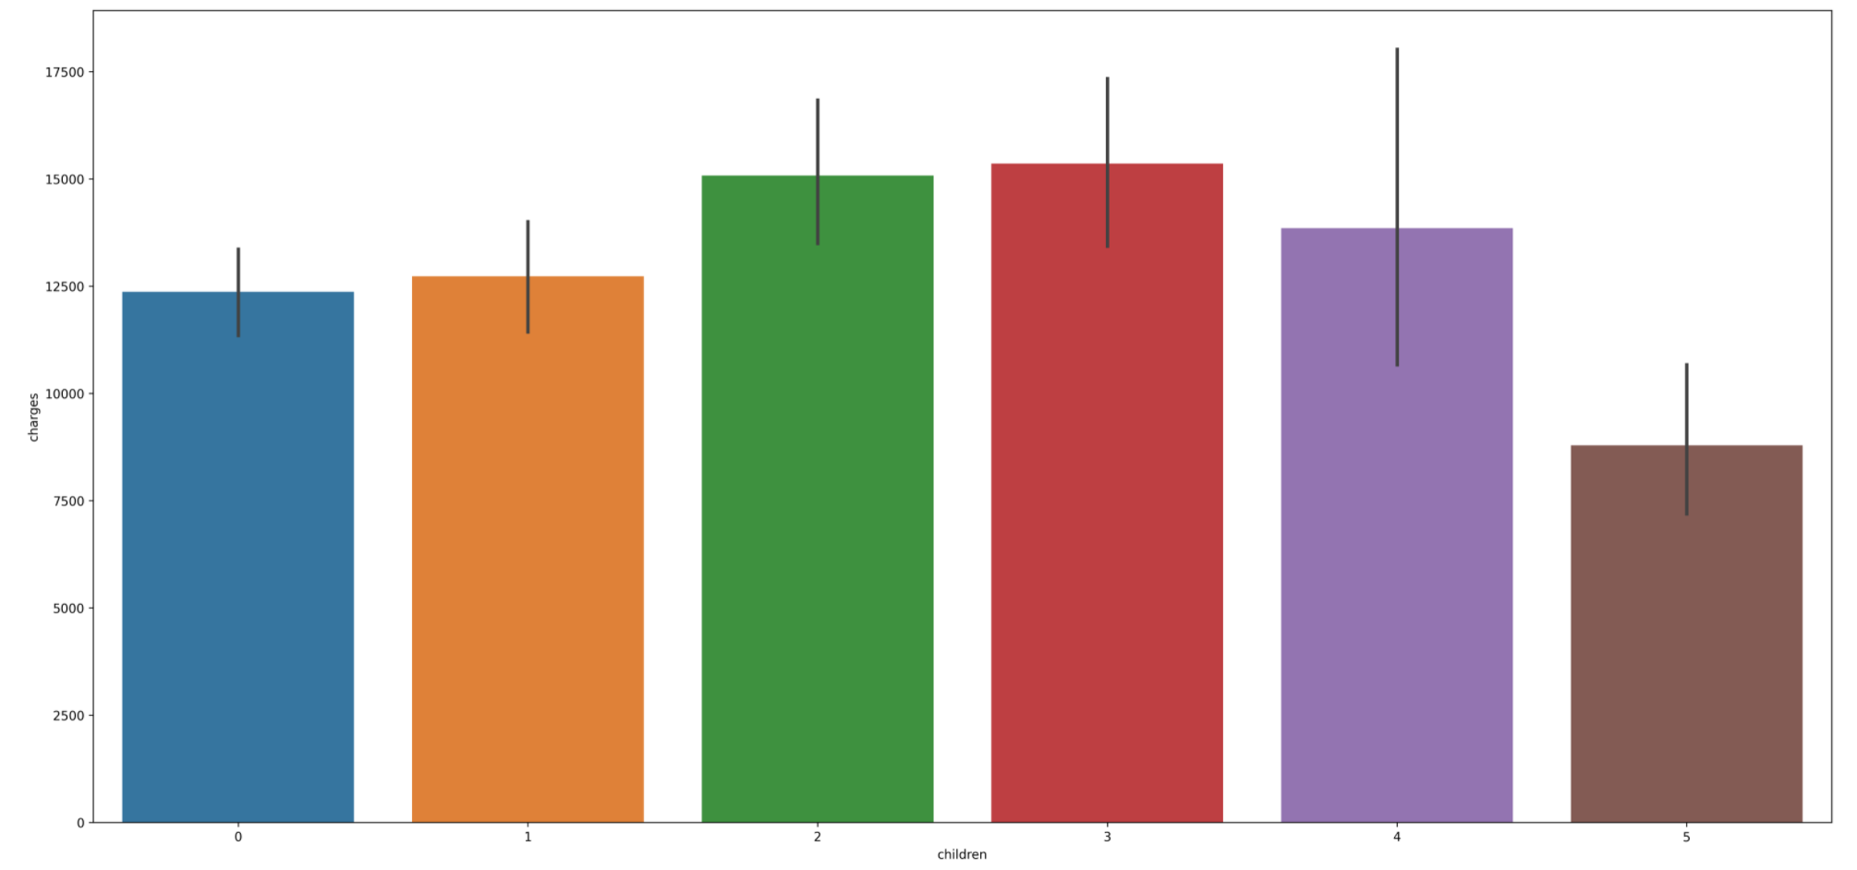
What Is The Relationship Between The Number of Children And Insurance Charges
People with 2-3 children have the highest insurance charges
However, dataset is slightly inconclusive due to a minuscule sample size for clients with 4 or 5 children relatively

Slide 9
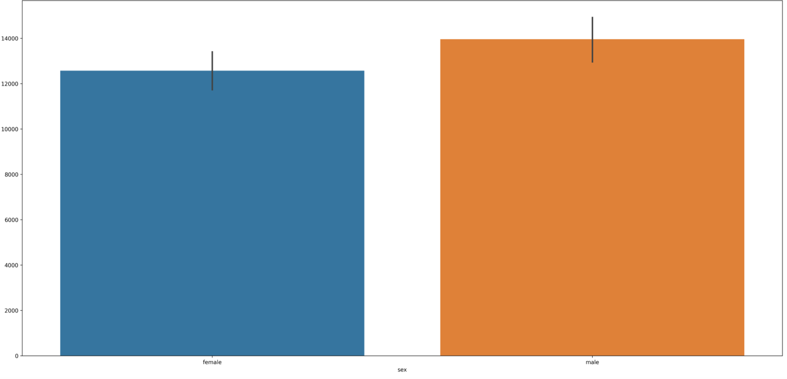
Does A Person’s Gender Affect Insurance Charges

Slide 10
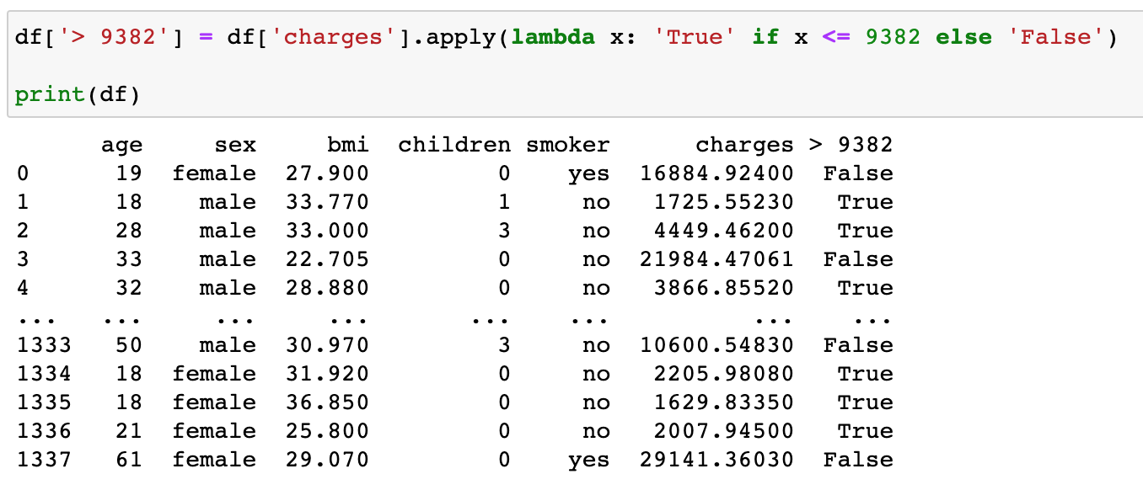
Data Transformation
Using various classification models predicting insurance claim based on the insurance charge amount
Due to charges being of type float as well as the response variable, my models will not work
Thus, I created a new column of type object and assigned a value of True(Insurance Claim) if the charge is less than $9382 and vice versa

Slide 11
Data Modeling
Use machine learning techniques such as Logistic Regression, Decision Tree, and Random Forest to best help predict future insurance claims
Based on findings of EDA, my predictor variables are sex, children, smoker, children, and age and my response/target variable is the new column I created during Data Transformation
This will hopefully give my models a more accurate indication of future insurance claims

Slide 12
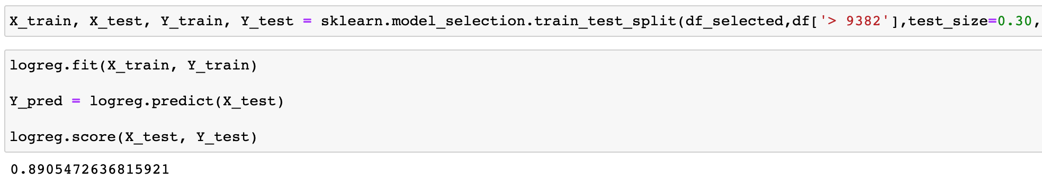
Logistic Regression
An algorithm for classification
Helps find relationships between features and a particular outcome
With a score of 0.89, my model is highly accurate, and it implies that my predictor variables will be a good indicator of future insurance claims

Slide 13
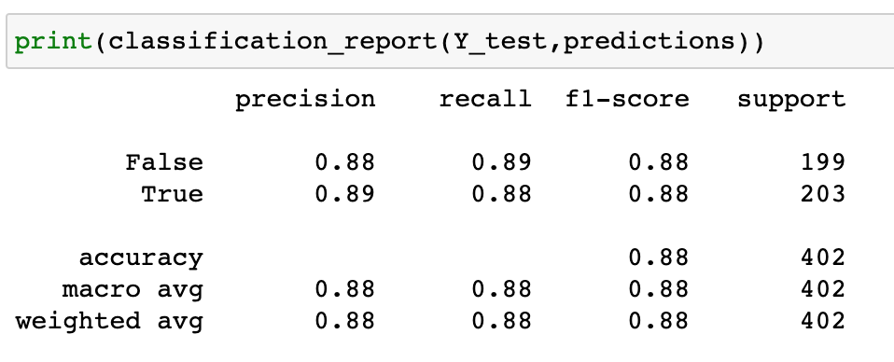
Decision Tree
Supervised, non-parametric learning method that is used for classification
Helps create a model that is inferred from the data features by predicting the value of a selected variable through simple decision rules
Both recall and precision scores are significantly high. This is a very accurate model

Slide 14
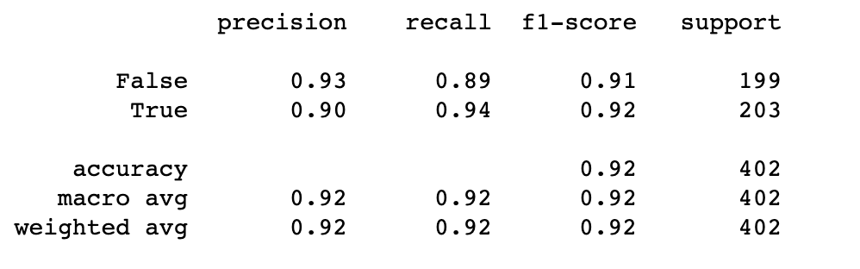
Random Forest Classifier
Helps select random samples from a dataset
Using each sample, constructs a decision tree
Then performs a vote for each sample with an associated predicted result
Both recall and precision scores are significantly high. Highly accurate model that also means that this is an excellent indicator in predicting future insurance claims

Slide 15
Model Comparison And Conclusion
Used three machine learning models: Logistic Regression, Random Forest, and Decision Trees
Highly accurate and do lend credence to the business statement that a person’s age, sex, smoking status, and number of children are great indicators of predicting future insurance claims
Random Forest was the most accurate model with a precision and recall score of 0.93.

Slide 16

Any Questions?

