Slide 1
MEDICAL REPORT GENERATION ON CHEST X-RAY IMAGES
Name - R.S.Rahul Sai
Reg. No - 17BCE0136
Project Guide
Prof. Sharmila Banu K

Slide 2
Introduction
Computer Aided Diagnosis (CAD) and medical imaging systems have evolved in the past decade to a point where they can partially mimic radiologists and doctors. These systems can learn and differentiate the features and abnormalities in medical images, and provide objective evidence with a higher diagnostic confidence and faster inference.
In this project, we focus on generating detailed medical reports on chest X-ray images, which can be adapted later to work with other diagnostic tools such as ultrasounds and mammograms.
The first task is to treat the problem as a multi-label classification task to obtain the accurate tags for a particular image from the visual features. This is performed using Convolutional Neural Networks and a transfer learning framework called ChexNet, which is specialized for chest X-ray images.
The second task is to generate the reports using these aforementioned tags, which requires the use of recurrent neural networks such as hierarchical LSTMs. A co-attention mechanism is also required, which makes use of the spatial information from the convolutional layers and the generated words in order to find localized regions from which the abnormalities are found.

Slide 3
Problem Formulation
Image captioning is a challenging problem as it requires the machine to generate textual description from the contents of an image, similar to how a human brain would describe an image.
But consider the same scenario for medical images, with the example of Chest X-ray images. For a normal human eye, chest X-ray images are just images with the skeletal and muscular features of the lungs defined in black and white.
But highly trained radiologists who have studied and diagnosed various respiratory and cardiovascular abnormalities, can mark multiple areas of the images and can write down clear reports for potential abnormalities. However, even for highly trained and experienced radiologists, writing reports is highly time-consuming especially in regions with higher population density.

Slide 4
Problem Formulation
Looking at the other side of the spectrum, radiologists or pathologists in rural areas, with inferior imaging equipment face a similar issue. They either cannot get objective evidence to diagnose anything properly or lack the knowledge of the respiratory or cardiovascular abnormalities.
Misdiagnosis of symptoms and medical errors are the third-leading cause of deaths across the world, leading to more than 3 million deaths.
This project focuses on the automation of generating detailed medical reports using Chest X-ray images, which can facilitate the diagnosis of various respiratory and cardiovascular diseases.

Slide 5
Dataset
A medical report can usually consist of various parts, which are usually heterogenous in nature. There may be images, abbreviations and complicated terminology in these reports. To avoid this issue, we will focus on three sections from a medical report i.e., findings – a large paragraph which contains keywords and parameters, indication – the doctor’s advice for the patient and impression – a sentence finalizing the results for a report.
The dataset to be used in this project is the Indiana University Chest X-Ray (CXR) Image dataset [2]. It is a high resolution CXR dataset with multiple views i.e., frontal, side and posterior views. There are 7,470 images accompanying 3,955 well written reports encoded in XML. These XML reports have references to the CXR images, the findings, impressions and the indication from the CXR images. These CXR images are obtained from patients diagnosed with tuberculosis, pneumonia and various heart ailments.

Slide 6
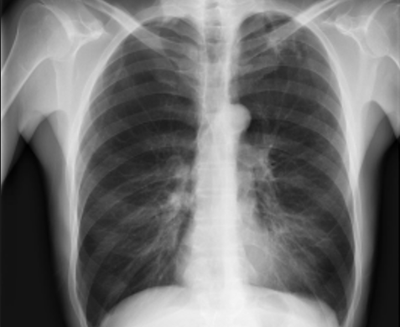
Aim of the proposed system
To generate detailed medical reports with three heterogenous sections i.e., Findings, Impressions and Indications from IU Chest X-Ray images, highlighting the context of the particular disease i.e., location, severity and affected organs, using a combination of CNN, hierarchical LSTMs and co-attention mechanism.
Compare the model with other state-of –the-art models using standard evaluation metrics such as BLEU or Meteor Scores and improve the model by using newer NLP techniques such as Transformers and BERT embeddings
Findings: No pleural effusion or pneumothorax. No acute bone abnormality. Mild degenerative change of the thoracic spine
Indication: Evaluate for infection
Impression: No acute cardiopulmonary findings

Slide 7
Objectives
Preparing an NLP Pipeline for the original findings, impressions and indication
Removing Contractions, Punctuations and Numbers
Tokenization
Representing the reports in word embeddings
Obtain the image features using a Convolutional Neural Network and the Transfer Learning framework i.e., ChexNet (acts as the encoder here).
Use a multi-label classification technique to get the tags/labels from the visual features.
Generate the text using the labels/tags obtained from the encoder using Hierarchical LSTMs which act as the decoder in our Sequence-to-Sequence Model.
Substituting Attention mechanisms to improve the encoder-decoder approach and compare the results.
Improving the results by utilizing newer NLP techniques such as BERT Embeddings [3] and Transformers [4] and generate better reports.

Slide 8
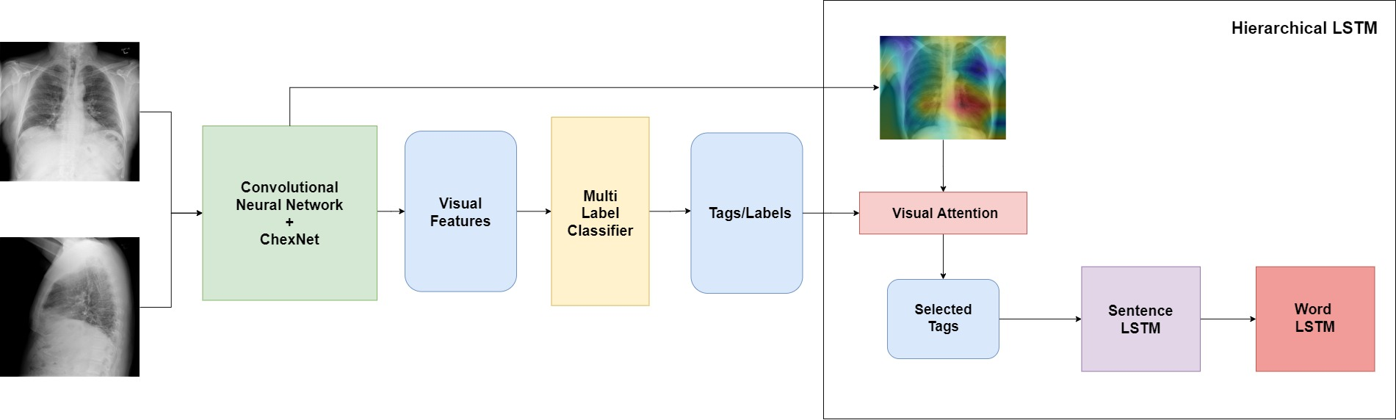
System Architecture

Slide 9
System Architecture – NLP Pipeline
NLP Pipeline – The findings, impressions and the indications obtained from the reports have to be preprocessed and properly cleaned to be used in the model. This involves the following steps:
Converting all characters into lowercase and removing contractions from the text e.g., won’t – will not, can’t – cannot.
Removing punctuation from text with the exception of full stop, as the findings from the reports may contain more than one sentences.
Removing smaller words and adverbs with the exception of “no” as it adds significant value. e.g., adverbs such as “there”, “then”.
Tokenization and addition of identifier tokens such as “_start” and “_end” tokens which are necessary in the text generation process.
Findings before the cleaning process | Findings after the cleaning process
No pleural effusion or pneumothorax. No acute bone abnormality. | _start no pleural effusion pneumothorax. no acute bone abnormality. _end

Slide 10
System Architecture - CNN
In order to extract the visual features of the image, we make use of convolutional neural networks. The CNN acts as the encoder in our model, and provides us a feature vector with the visual features of the image, which can be used to predict the tags for that particular X-ray. This is done by considering the problem as a multi-label classification task where the output layer provides you with the probability of a set number of tags. These predicted tags help us massively in text generation which is discussed in the next section.
However, the size of our dataset (7,470 images) is not enough to train a CNN properly. To remove this bottleneck, we have to use a transfer learning framework. Most transfer learning frameworks such as VGG16 or InceptionV3 are trained over generic image datasets which doesn’t serve our purpose.
Fortunately, ChexNet is a convolutional neural network especially trained on Chest X-ray images. It was trained over 1,12,120 images and contains 121 layers where the input is a chest X-ray image, and the output is the probability of 14 different diseases along with a localized heatmap which highlights the visual features of the chest x-ray image. However, we do not need to classify the image into one of those 14 categories, so we can remove the final classification layer. From a image of dimensions (224,224,3), we get a feature vector with a length of 1,024. This final feature vector will be passed along with the report to the decoder which is discussed in the next section.

Slide 11
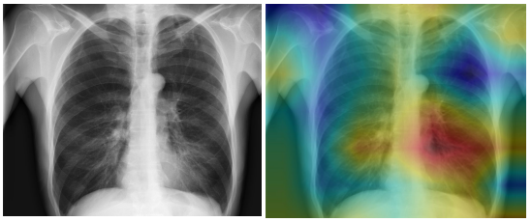
System Architecture - CNN
Chest X-ray image from the dataset before and after passing through the CNN

Slide 12

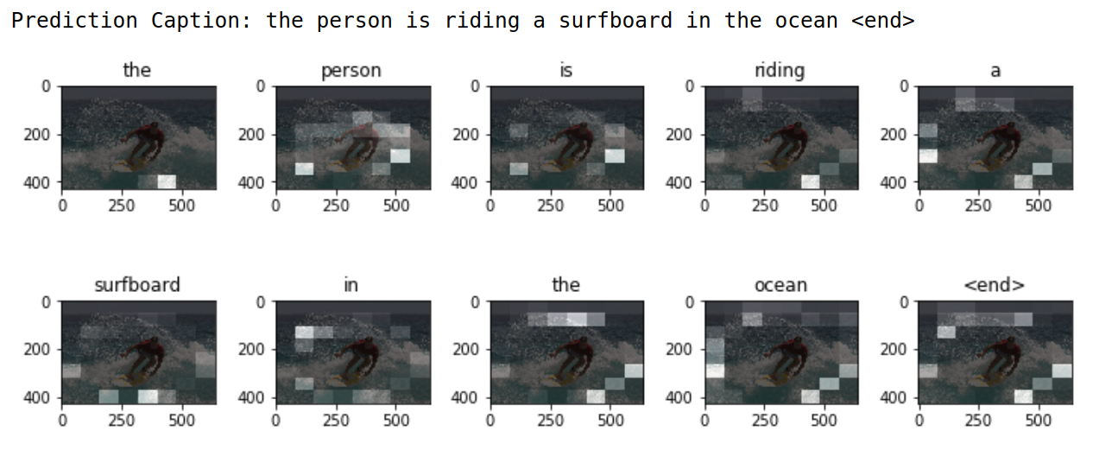
Visual Attention
https://www.tensorflow.org/tutorials/text/image_captioning

Slide 13
System Architecture – Hierarchical LSTMs
Hierarchical LSTMs [1] are specialized recurrent neural networks which are often used for text generation from images and video frames. It is built to consider both high-level language features from the training text and low-level visual features obtained from the processed image. Note that the keywords/tags obtained from the image are generated by the fully connected layer, which results in a loss of spatial information. To improve these results, an additional mechanism known as Attention is added.
When the visual features and the tags arrive at the decoder, the high-level spatial information provided by the localized heatmap help us to focus on the tags which are visually highlighted more, and yield better results. This new context vector with the embeddings of the selected tags is passed on to a sentence LSTM.
A Sentence LSTM will generate multiple sentences as suggestions to the provided words, using a technique known as beam search which predicts the probability distribution across the given vocabulary and returns the words which have the maximum probability to be subsequent words in the sentence. Beam search selects multiple alternatives for an input sequence, based on conditional probability and a parameter known as beam width.
When the sentence vector is successfully produced, it is passed on as a context vector to the Word LSTM. Word LSTM employs a greedy search mechanism, which selects a single candidate which is suitable for the input sequence in a time step. This improves the quality of the final sentence generated.

Slide 14
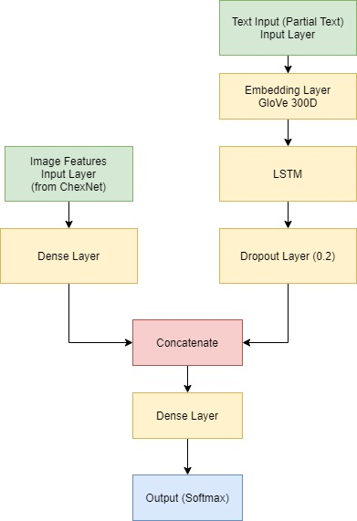
Merge Architecture (Decoder)

Slide 15
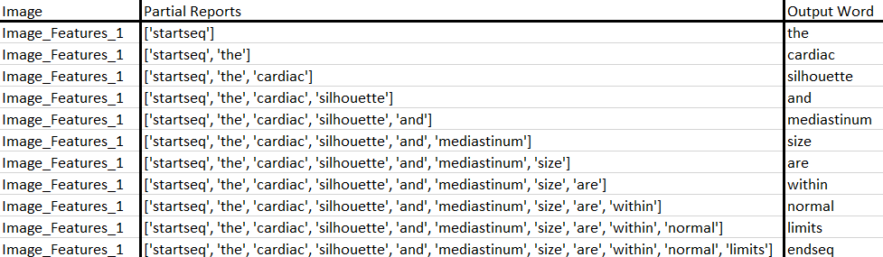
System Architecture – Hierarchical LSTMs
Word LSTM predicting the next word using greedy search

Slide 16
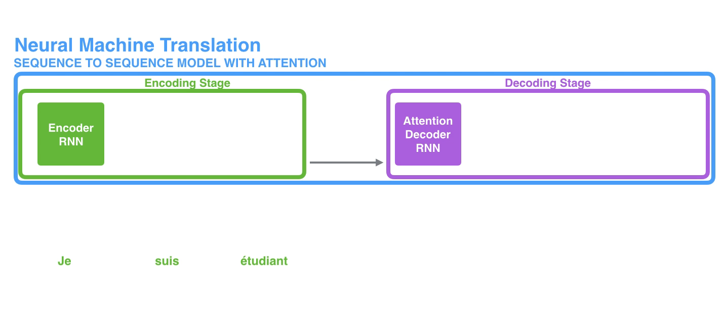
Attention Visualized
https://jalammar.github.io/visualizing-neural-machine-translation-mechanics-of-seq2seq-models-with-attention/

Slide 17
Challenges Faced and Addressed
Using the GloVe word embeddings has a certain disadvantage due to the lack of medical terms. The GloVe word embeddings are trained on a generic text corpus, which is not. For resolving this, BioWordVec can be used which are a type of new biomedical word embeddings.
The initial Simple Encoder-Decoder model, due to the lack of localized visual context, couldn’t provide accurate predictions. Most of the predictions generated by the simple Encoder-Decoder model are correct when the case is related to cardiopulmonary abnormality, but other tags are predicted wrong. This is solved by using a Global Attention Layer that was discussed before.

Slide 18
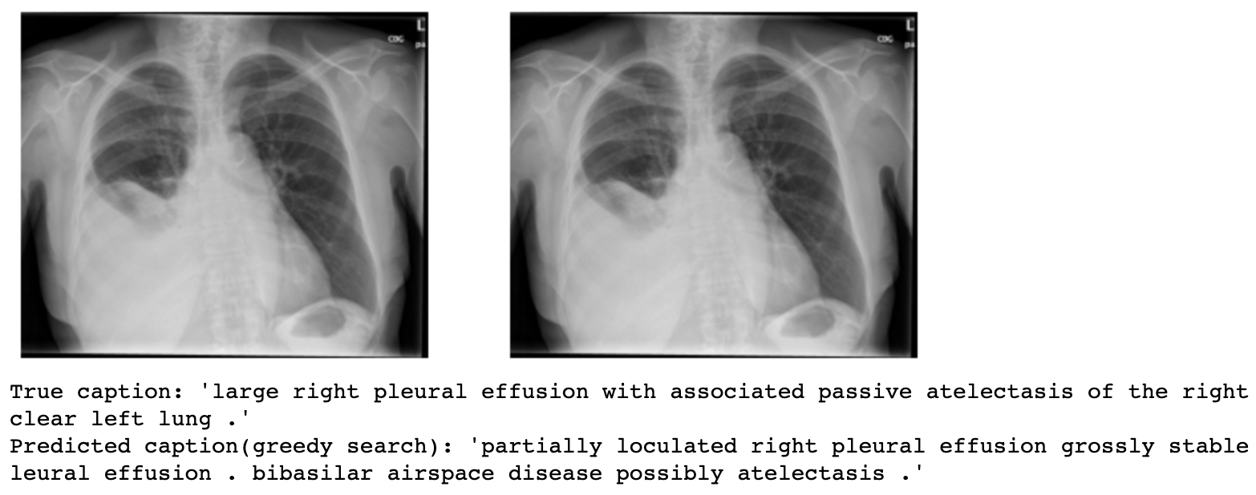
Correct Predictions

Slide 19
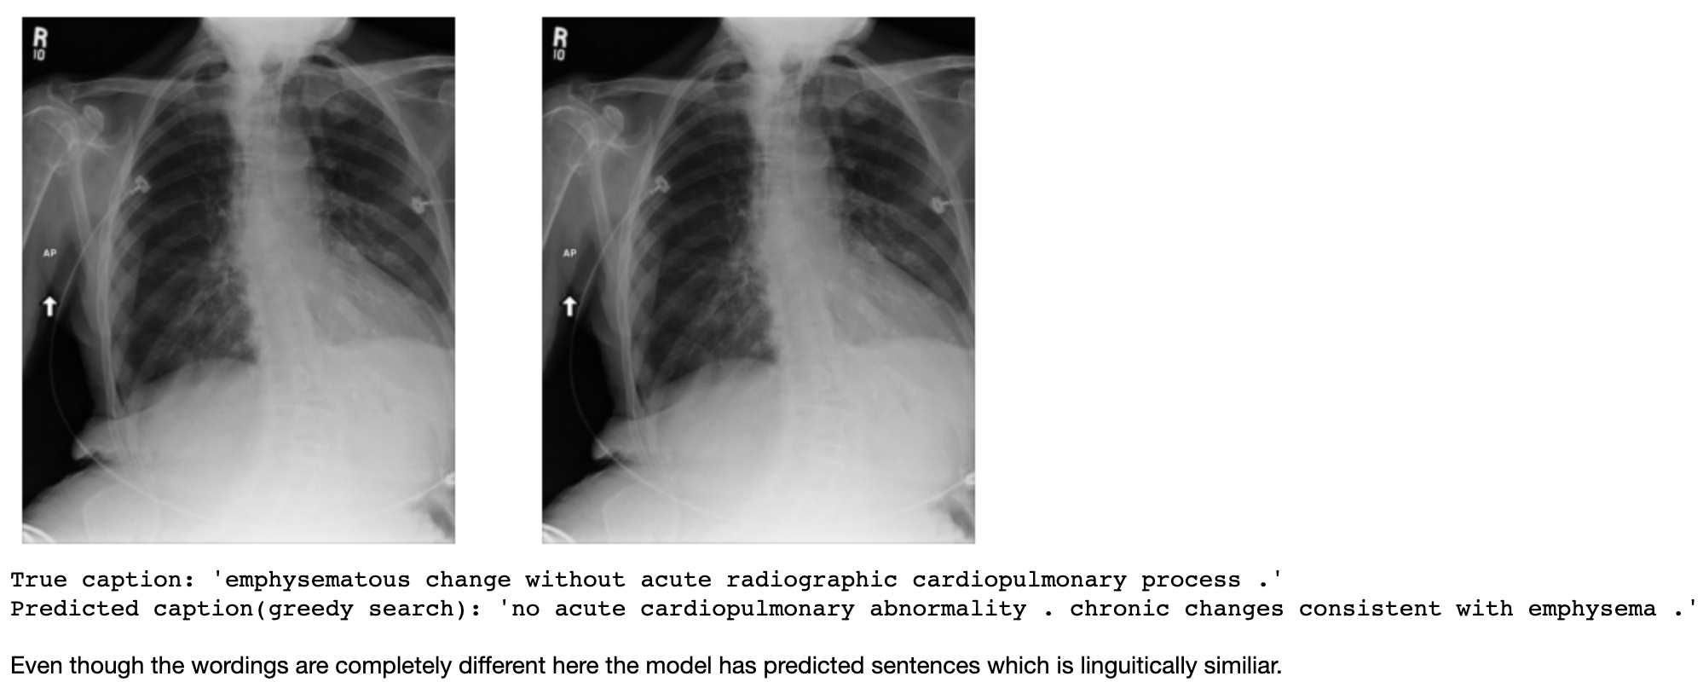
Correct Predictions

Slide 20
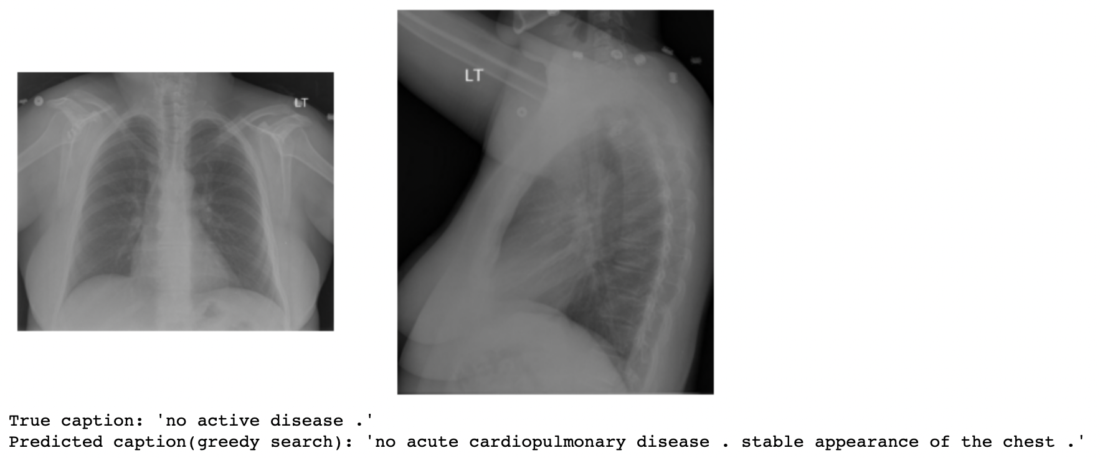
Incorrect Predictions

Slide 21
Comparative Result Analysis
BLEU Scores – The BLEU score (Bilingual Evaluation Understudy) is a popular metric used to compare models for text generation and image captioning. Given below are the BLEU scores for different cumulative N-grams i.e. (1,2,3,4).
BLEU-4 is the most popular method of comparison which is also known as Sentence BLEU score
Model | BLEU1 | BLEU2 | BLEU3 | BLEU4
Base Paper (Co-Attention) | 0.517 | 0.386 | 0.306 | 0.247
Simple Encoder-Decoder | 0.198 | 0.227 | 0.286 | 0.314
With Visual Attention | 0.213 | 0.258 | 0.325 | 0.381

Slide 22
Conclusion
The automated generation of medical reports on chest X-ray images is highly viable, using a multi-step approach which employs the best techniques offered by deep learning and NLP. Chest X-rays are one of the most popular diagnostic tools and this project can improve the speed and quality of diagnosis.
The CNN predicts the tags from the visual features and retains the spatial information in order to provide better context. The hierarchical LSTMs can decode the vector provided by the encoding layer in order to generate legible medical reports, which can be compared and evaluated using metrics such as BLEU and Meteor Scores.

Slide 23
References
[1] L. Gao, X. Li, J. Song, and H. T. Shen, “Hierarchical LSTMs with adaptive attention for visual captioning,” IEEE Trans. Pattern Anal. Mach. Intell., vol. 42, no. 5, pp. 1112–1131, 2019.
[2] D. Demner-Fushman et al., “Preparing a collection of radiology examinations for distribution and retrieval,” J. Am. Med. Informatics Assoc., vol. 23, no. 2, pp. 304–310, 2016.
[3] J. Devlin, M.-W. Chang, K. Lee, and K. Toutanova, “{BERT:} Pre-training of Deep Bidirectional Transformers for Language Understanding,” CoRR, vol. abs/1810.0, 2018.
[4] T. Wolf et al., “Transformers: State-of-the-art natural language processing,” in Proceedings of the 2020 Conference on Empirical Methods in Natural Language Processing: System Demonstrations, 2020, pp. 38–45.
[5] H.-C. Shin, K. Roberts, L. Lu, D. Demner-Fushman, J. Yao, and R. M. Summers, “Learning to Read Chest X-Rays: Recurrent Neural Cascade Model for Automated Image Annotation,” in 2016 IEEE Conference on Computer Vision and Pattern Recognition (CVPR), 2016, pp. 2497–2506.
[6] Q. You, H. Jin, Z. Wang, C. Fang, and J. Luo, “Image Captioning with Semantic Attention,” in 2016 IEEE Conference on Computer Vision and Pattern Recognition (CVPR), 2016, pp. 4651–4659.
[7] K. Xu et al., “Show, attend and tell: neural image caption generation with visual attention,” in Proceedings of the 32nd International Conference on International Conference on Machine Learning-Volume 37, 2015, pp. 2048–2057.
[8] B. Jing, P. Xie, and E. Xing, “On the Automatic Generation of Medical Imaging Reports,” in Proceedings of the 56th Annual Meeting of the Association for Computational Linguistics (Volume 1: Long Papers), 2018, pp. 2577–2586.

