Slide 1

Project Title:
Linker Implementation(pass1)
Guide:
Prof. Prameetha Pai
Prof. Dhara
Prof. Aparna
By:
Nishant 1DS19CS105
Omkar G Shet 1DS19CS106
P R Sai Rahul 1DS19CS107
Palguni R H 1DS19CS108
By:

Slide 2
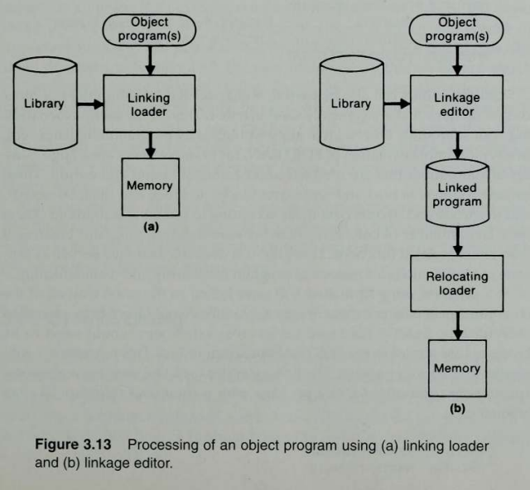
Why Linkers?
Linker is a program in a system which helps to link object modules of a program into a single object file. It performs the process of linking.
Linkers are also called as link editors.
Linking is a process of collecting and maintaining piece of code and data into a single file.
Benefits:
have less overhead than linking loaders
Resolution of external reference and library searching is performed only once.
Linkage editors perform linking operations before the program is loaded for execution
Suitable when a program is executed many times without being reassembled.
.exe,
.dll,
.txt,
.o

Slide 3
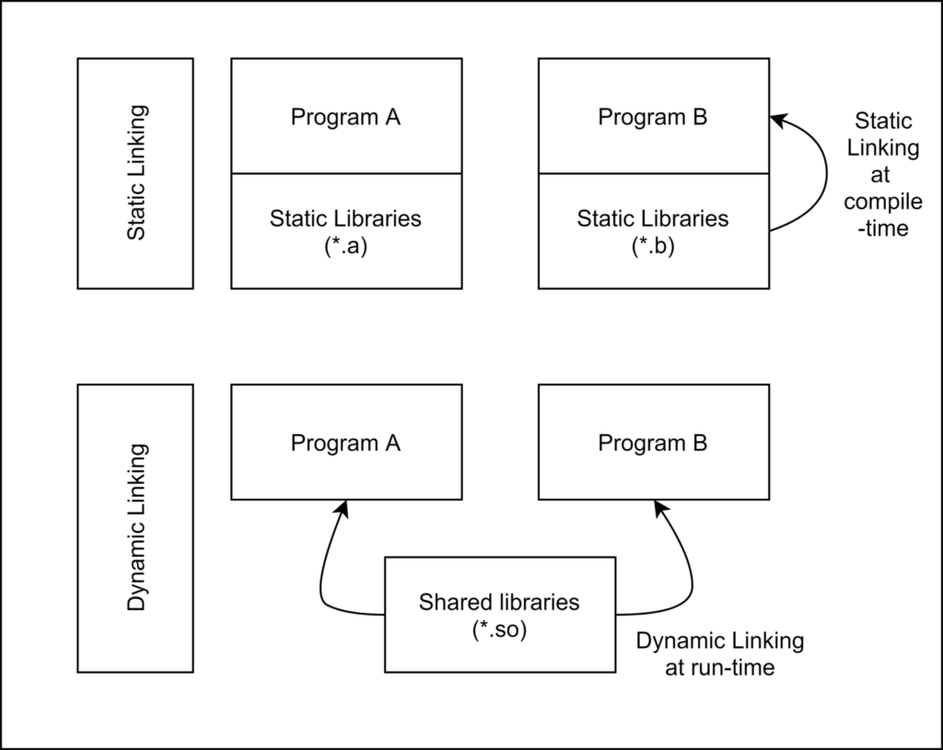
Types of Linkers
Static Linking
Dynamic linking

Slide 4
Static Linking
Static Linking – It is performed during the compilation of source program. Linking is performed before execution in static linking. It takes collection of relocatable object file and command-line arguments and generates a fully linked object file that can be loaded and run. Static linker performs two major tasks:
Symbol resolution – It associates each symbol reference with exactly one symbol definition .Every symbol has a predefined task.
Relocation – It relocates code and data section and modifies the symbol references to the relocated memory locations.
The linker copies all library routines used in the program into executable image. As a result, it requires more memory space. As it does not require the presence of library on the system when it is run, so it is faster and more portable. No failure chance and less error chance.

Slide 5
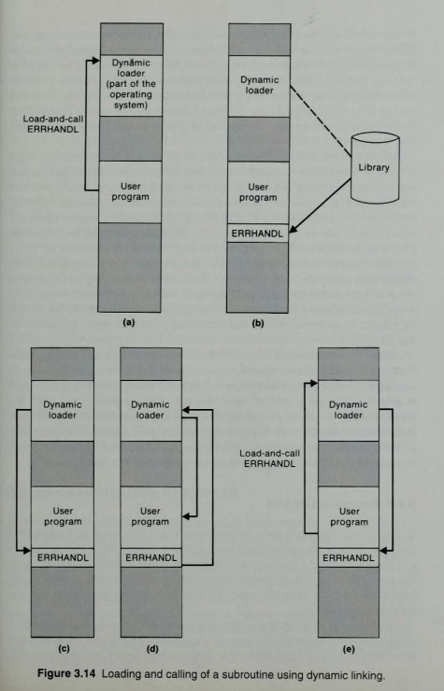
Dynamic Linking
Is performed at the run time, in which multiple programs can share a single copy of the library. It means, each module having the same object can share information of an object with other modules rather than linking the same object repeatedly into the library.
These dynamic link libraries are loaded at the time a program is executed; then, it performs a final linking. Also, a linker is not needed by the dynamic linking.
Although it needs less memory space, there are more chances of error and failure chances. In the linking, the needed shared library is held in virtual memory that helps to save random access memory. This linking fix the address at run time; also, it allows the users to reposition the code in order to smooth running of code. However, it cannot be relocatable all the code. There are two benefits of using the dynamic linking approach, which is given below:
In dynamic linking, the often-used libraries do not need to store in every single executable file; they only need to store in only one location that helps to save memory and disk space.
In the library function, if a bug is corrected with the help of replacing the library, all problems using it dynamically, after restarting them will get benefit from the correction. Otherwise, programs would have to be re-linked first if they include this function by static linking.
The dynamic linking also has some disadvantages that are as follows:
An incompatible updated library is known as "DLL hell" on the Windows platform. If the newer version is incorrectly not backward compatible, this library will break executables on the basis of the performance of the earlier form of the library.
A program used with the libraries might be certified in the form of documentation requirements, correctness, performance, and package, but if components can be replaced, they may not be certified.

Slide 6
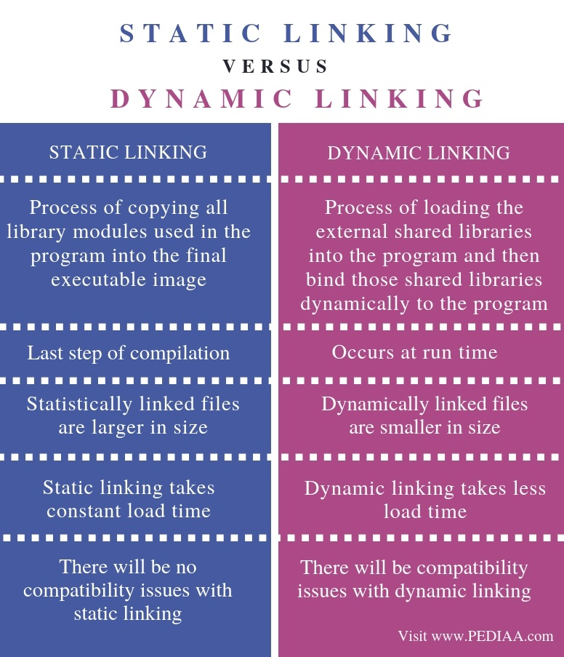

Slide 7
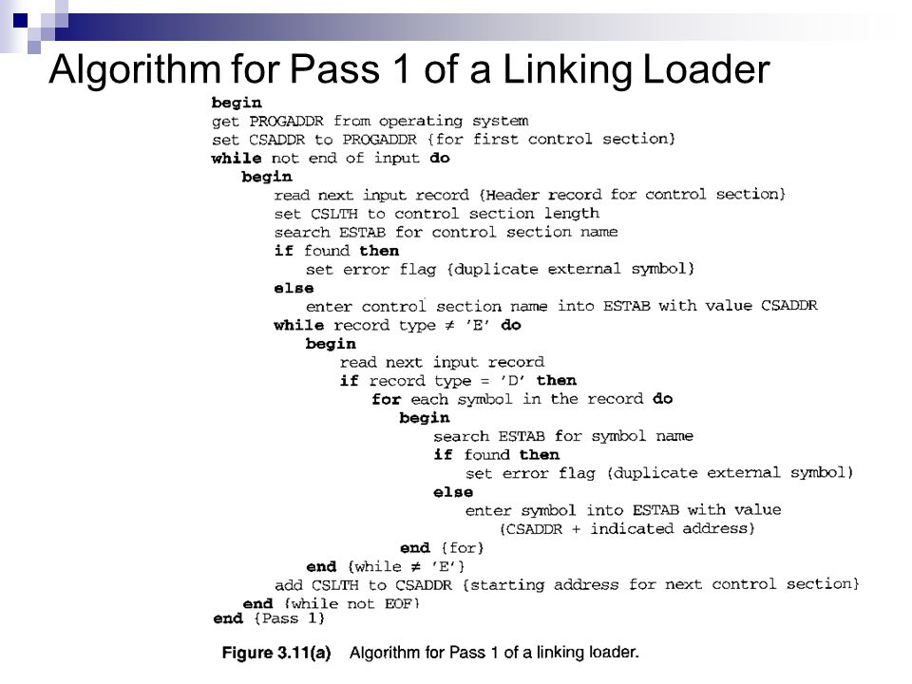

Slide 8
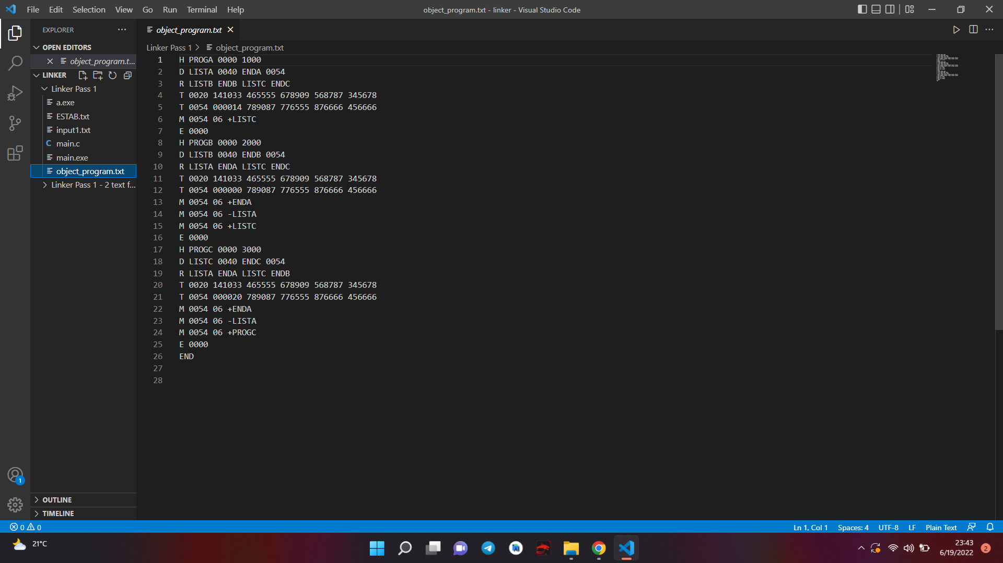
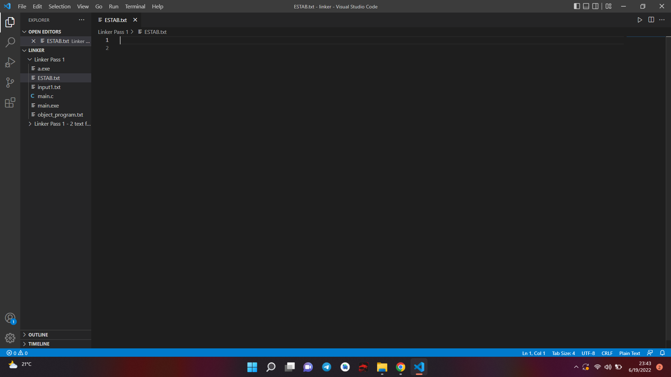
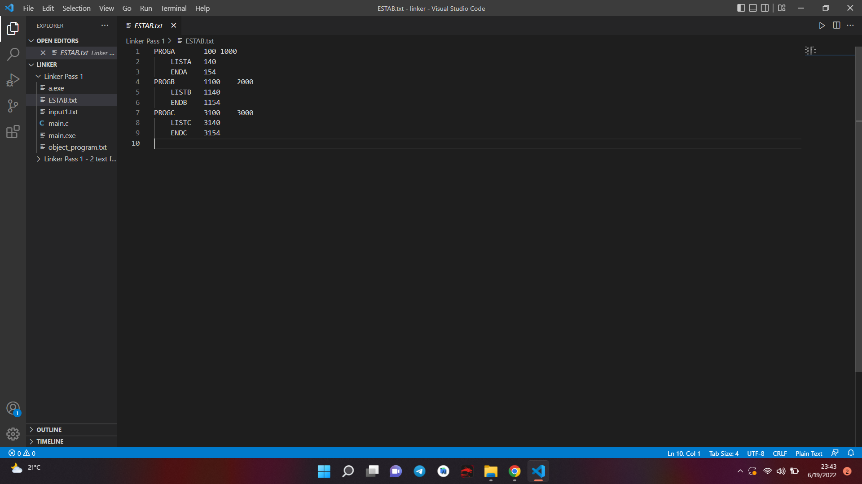
Linkers Implementation screenshots:
Object Code file
Linkers
ESTAB file

