Slide 1

Project Title:
Predictive Analysis of Diabetes in India
Guide: Prof.Chaitra
By:
P R Sai Rahul 1DS19CS107
S Jaishree 1DS19CS134
Sanjeev F Annigeri 1DS19CS142
Shreya sri A N 1DS19CS153

Slide 2
Overview:
In this project, we will be predicting that whether the patient has diabetes or not on the basis of the features we will provide to our machine learning model, and for that, we will be using the Pima Indians Diabetes Database.

Slide 3


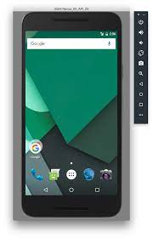
Platforms used:
>VS Code (dart,flutter,html,css,JS,Django
,MongoDB)
>CoLab
>Android Studio(emulator)

Slide 4
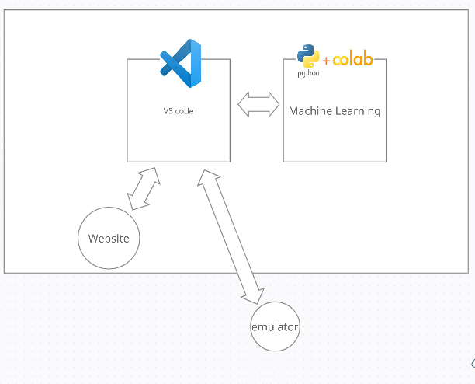
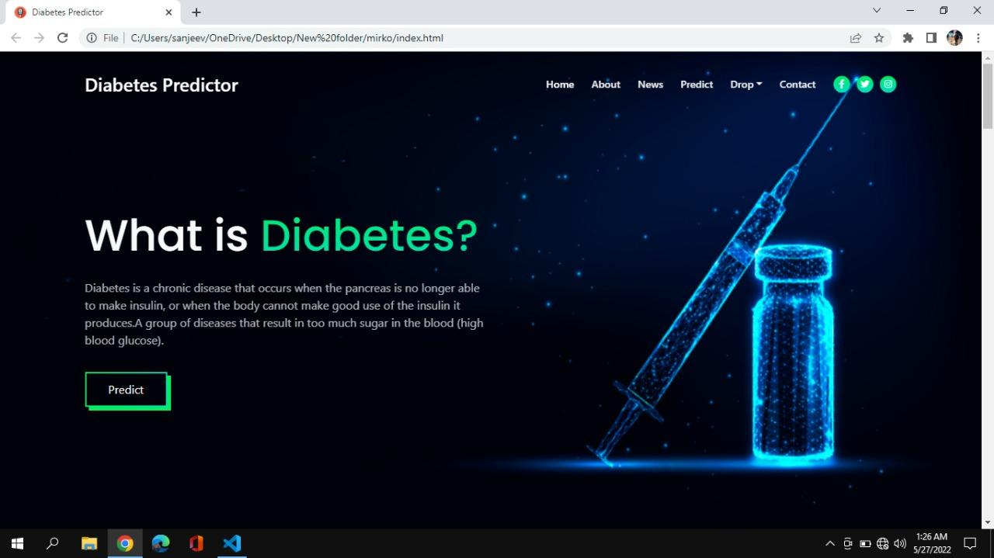
Design Flow
Deployment in cloud
(dart,flutter,html,css,JS,Django,,MongoDB)

