Slide 1


Dlstress.py

Slide 2

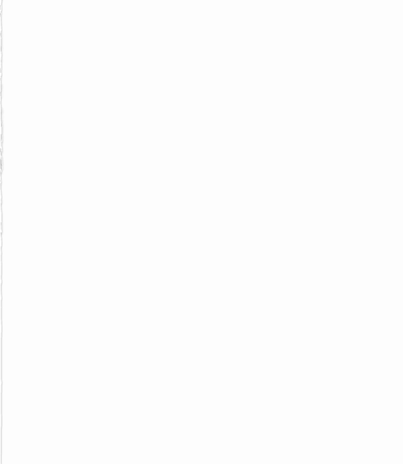
UnsupervisedLearning
Basically converting data that can used further.
Idx_train_mat and Idx_test_mat: stores the index of train and test
Import matlab file “data file” and extract x y and s matrix and convert them into numpy arrary.
Similarly extract test matixies, mean shape, weights, …. and convert it into numpy array.

Slide 3
ComputeVonMisesStress
Von Mises stress is a value used to determine if a given material will yield or fracture
The von Mises yield criterion states that if the von Mises stress of a material under load is equal or greater than the yield limit of the same material under simple tension then the material will yield.
We have given data in which first 5000 are s11 vector then next are s22 and then next are s12.

Slide 4


ComputeError
Its is basically computing error in our generated result with ground truth.
It returns mean absolute error and normalized MAE matrixies are intialised and then

Slide 5


ComputeError_peak
Its is basically computing error in our generated result with ground truth.
It returns gives absolute error and mean absolute error.

Slide 6
CreateModel_ShapeEncoding
Likewise in pytorch here we create a model which is used to encode shape matrix using PCA
CreateModel_StressDecoding
This is use to make non linear mapping using admax which perform supervised learning
It have two hidden layer each of 128 nodes
CreateModel_StressDecoding
This is use to encode stress matrix using Low Rank Approximation (unsupervised learning)

Slide 7
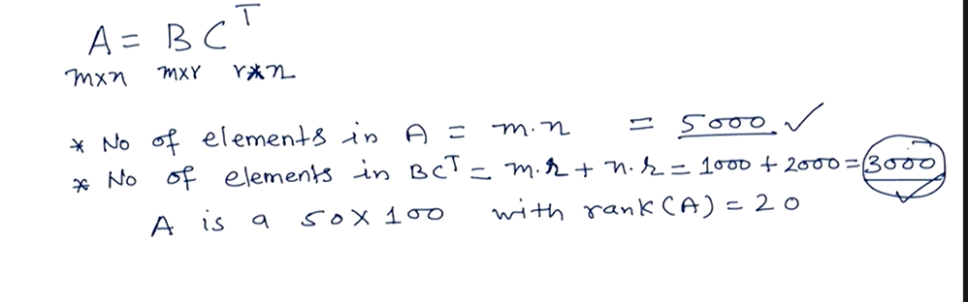
Low Rank Approximation
Motivation is reduce the size of matrix with kepping all data same. This reduce large data handing process and also reduce computational cost.

