Slide 1

Project
Intro
A deep learning approach to estimate
stress distribution
Future Work
Workflow
Teams
References
Input Cons

Slide 2
Abhilash Awasthi
Under the Guidance of:
Teammates
Intro
Teams
Future Work
Workflow
References
Input Cons
Shresth Somya
Vishal Kumar Saini
Yuvraj Verma
Rahul Saini
Ram Eknath Munde

Slide 3
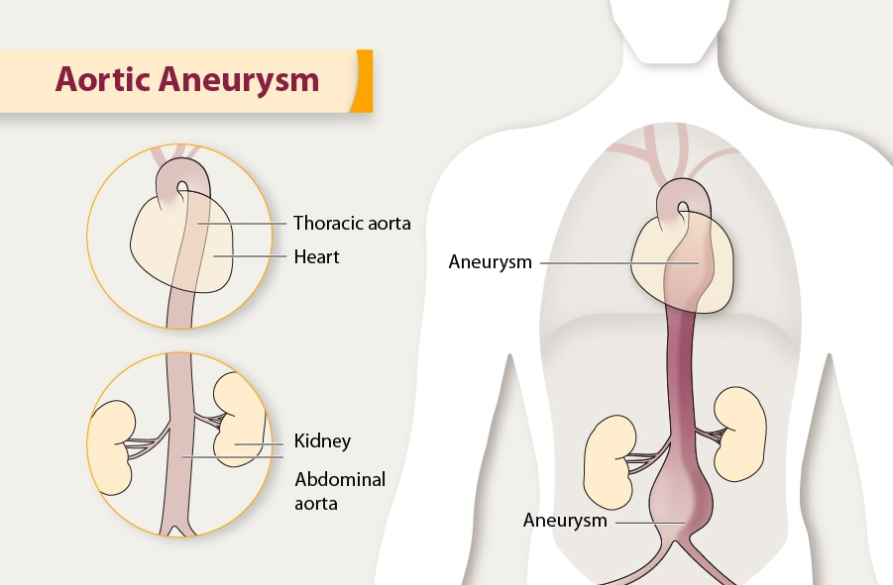
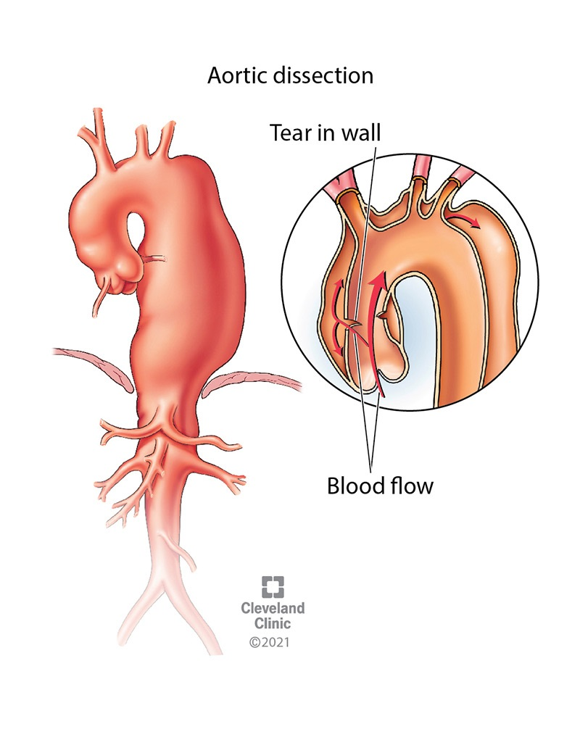
Intro
Future Work
Workflow
Teams
References
Input Cons
Purpose of stress analysis: Ascending aortic aneurysm (AsAA) rupture is believed to occur when the mechanical stress acting on the wall exceeds the strength of the wall tissue. Therefore, knowledge of the stress distribution in an intact AsAA wall could be useful in assessing its risk of rupture.

Slide 4
INPUT
Patient image data
Patient Characteristics
Manual segmentation and modelling
ML based segmentation and modelling
Finite Element Analysis (FEA)
ML based Solution
Intro
Future Work
Workflow
Teams
References
Input Cons
Manual FEA setup
ML-FE surrogate
FE simulation
OUTPUT
Stress/strain Distribution
Predicted Clinical Outcome

Slide 5
Shape Encoding
Stress decoding
Input:
Shape
Encoded Shape
Encoded Stress
Output:
Stress
Intro
Future Work
Workflow
Teams
References
Input Cons
Non – Linear Mapping

Slide 6







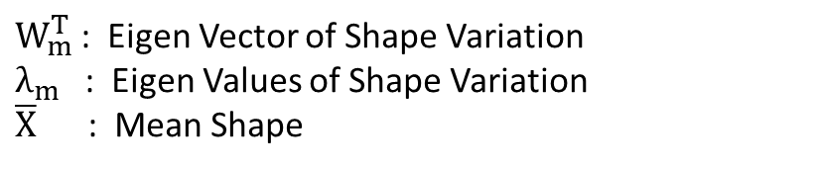




The Neural Network for Shape Encoding
$$x_{1}$$
$$y_{1}$$
$$z_{1}$$
$$α_{1}$$
Encoded shape
$$α_{2}$$
5000 Nodes of coordinates $\left(x_{i},y_{i},z_{i}\right)$
$$α_{3}$$
Intro
Future Work
Workflow
Teams
References
Input Cons
$$x_{5000}$$
$$y_{5000}$$
$$z_{5000}$$
$$α_{m}=\frac{W_{m}^{T}\left(X−\overline{X}\right)}{\sqrt{λ_{m}}}$$
Input size:
3 x 5000 x 729
$W_{m}^{T}$: Eigen Vector of Shape Variation
$λ_{m}$: Eigen Values of Shape Variation
$\overline{X}$ : Mean Shape

Slide 7















Non Linear Mapping from Shape to Stress
$$h_{1}^{1}$$
$$h_{1}^{2}$$
$$β_{1}$$
$$α_{1}$$
$$h_{2}^{1}$$
$$h_{2}^{2}$$
$$β_{2}$$
Encoded shape
Encoded stress
$$α_{2}$$
Intro
Future Work
Workflow
Teams
References
Input Cons
$$β_{63}$$
$$α_{3}$$
$$h_{127}^{1}$$
$$h_{127}^{2}$$
$$β_{64}$$
$$h_{128}^{1}$$
$$h_{128}^{2}$$
Multilayer Neural Network

Slide 8



















The Neural Network for Stress Encoding and Decoding
Stress Encoding
1 | 2 | 3 | 4 | 5
6 | 7 | 8 | 9 | 10
11 | 12 | 13 | 14 | 15
16 | 17 | 18 | 19 | 20
21 | 22 | 23 | 24 | 25
$$r_{1}^{1}$$
$$S_{1}^{1}$$
$$S^{1}$$
$$β_{1}$$
$$r_{256}^{1}$$
$$S_{600}^{1}$$
$$β_{2}$$
$$r_{1}^{2}$$
$$S_{1}^{2}$$
Intro
Future Work
Encoded stress
Workflow
Teams
References
Input Cons
$$S^{2}$$
$$r_{256}^{2}$$
$$S_{600}^{2}$$
$$β_{63}$$
$$β_{64}$$
$$r_{1}^{25}$$
$$S_{1}^{25}$$
Divided Aortic walls into 25 region with 200 Nodes
$$S^{25}$$
$$r_{256}^{25}$$
$$S_{600}^{25}$$
Stress Decoding

Slide 9
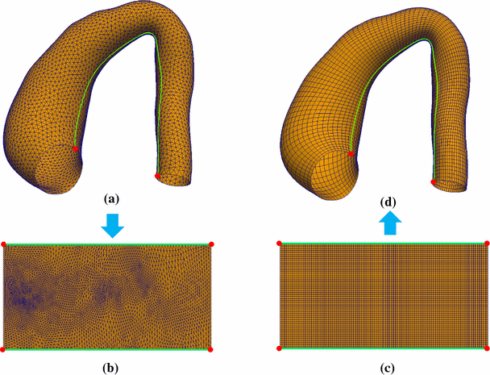
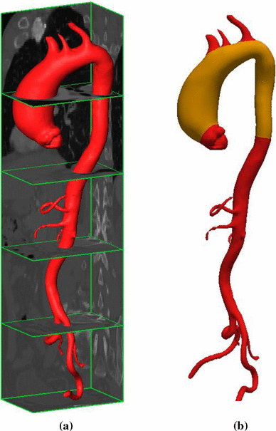

25 Shapes from CT images
Remeshing
Intro
Future Work
Workflow
Teams
References
Construction of Input Shape Data
Input Cons
Alignment
Generalized Procrustes Analysis
$$J\left(s,R,t\right)=\sum_{k=1}^{K}{\sum_{n=1}^{N}{{\left|\left|\overline{x_{n}}−sRx_{n}^{\left(k\right)}−t\right|\right|}^{2}}}$$
Perform PCA using SVD and generated the 729 different samples.
Input

Slide 10
Will perform the unsupervised learning, i.e., shape encoding and stress encoding and decoding in MATLAB and will call the function in Python to implement it. (May perform whole thing in python)
Will create the model for supervised learning, i.e., non-linear mapping, with PyTorch Library in Python.
Visualize our Stress model through ParaView.
Work on calculating the accuracies of the model.
Intro
References
Future Work
Workflow
Teams
Input Cons

Slide 11
Liang, L., Liu, M., Martin, C. and Sun, W., 2018. A deep learning approach to estimate stress distribution: a fast and accurate surrogate of finite-element analysis. Journal of The Royal Society Interface, 15(138), p.20170844.
Liang, L., Liu, M., Martin, C., Elefteriades, J.A. and Sun, W., 2017. A machine learning approach to investigate the relationship between shape features and numerically predicted risk of ascending aortic aneurysm. Biomechanics and modeling in mechanobiology, 16(5), pp.1519-1533.
Seshu, P., 2003. Textbook of finite element analysis. PHI Learning Pvt. Ltd..
Intro
References
Workflow
Teams
Future Work
Input Cons

Slide 12
THANK YOU

Slide 13
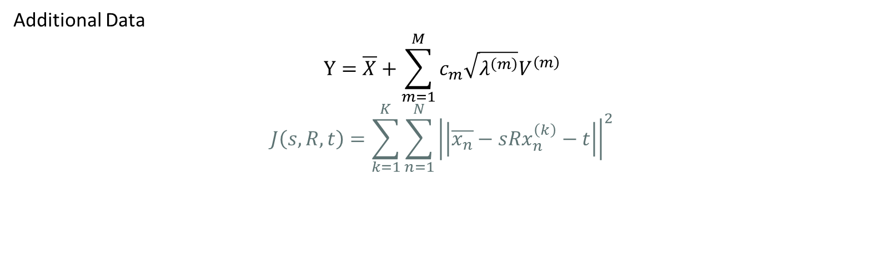
Additional Data
$$Y=\overline{X}+\sum_{m=1}^{M}{c_{m}\sqrt{λ^{\left(m\right)}}V^{\left(m\right)}}$$
$$J\left(s,R,t\right)=\sum_{k=1}^{K}{\sum_{n=1}^{N}{{\left|\left|\overline{x_{n}}−sRx_{n}^{\left(k\right)}−t\right|\right|}^{2}}}$$

