Slide 1
APL-405 PROJECT
Presentation on FEA

Slide 2
FEA and FEM
FEA –Finite element analysis (FEA) is the process of simulating the behavior of a part or assembly under given conditions so that it can be assessed using the finite element method (FEM).
To understand FEA, we have to understand the concept of FEM.
FEM - Finite Element Method is a method of solving stress-strain relation problems in mechanics. In this method we solves problem by splitting the body into a number of much smaller elements those are connected at nodes.
This splitting process is called discretisation and the collection of nodes is called the mesh. Discretisation is done because applying equilibrium conditions to the entire body is much harder than to the finite discrete but simple elements.

Slide 3
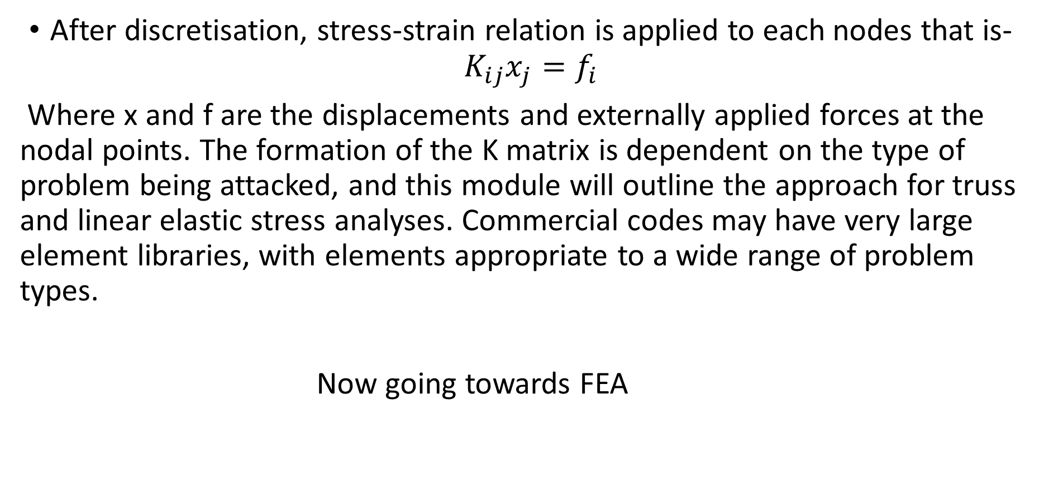
After discretisation, stress-strain relation is applied to each nodes that is-$K_{ij}x_{j}=f_{i}$
Where x and f are the displacements and externally applied forces at the nodal points. The formation of the K matrix is dependent on the type of problem being attacked, and this module will outline the approach for truss and linear elastic stress analyses. Commercial codes may have very large element libraries, with elements appropriate to a wide range of problem types.
Now going towards FEA

Slide 4
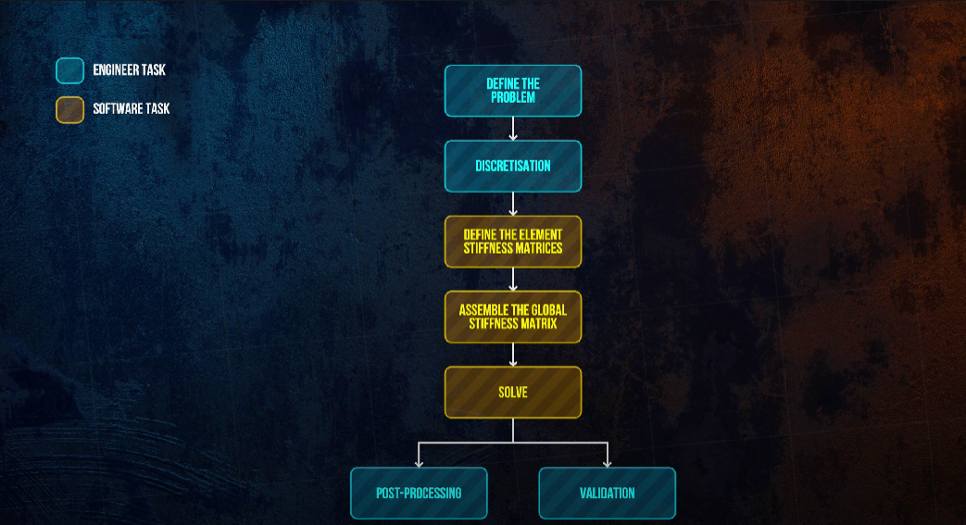

Slide 5
Define the problem – Init, we examine the problem , understand how fea is applied, which type of stiffness matrix is used, element’ shape, types of loads and boundary conditions.
Discretisation – Construct a model in that given body or structure is divided into the elements of desired shape (say triangle or square) and these elements are connected at nodes, those nodes have some fixed displacements. Note down the nodes (or their displacements) which will work as input in the analysis step.
Define the element stiffness matrix(K) – This matrix vary according to type of problem, type of shape of element chosen and type of method being used to solve the problem.

Slide 6
Some methods are
1). Direct method
2). Variational method
3). Method of weight residuals
Assemble the global stiffness matrix – The element stiffness matrices are now assembled into a global stiffness matrix based on element connectivity. Now, this matrix will define how the complete body will respond to any applied load and using boundary conditions we can get displacement or stress at each node.
Solve – After getting global matrix we can solve for any other variable at any desirable node.

Slide 7
Validation – It is done by testing data to check the accuracy of the FEA simulator.
Postprocessing – It just how we want our output to show.
- Thank you
-Vishal Kumar Saini
202ME10984

