Slide 1

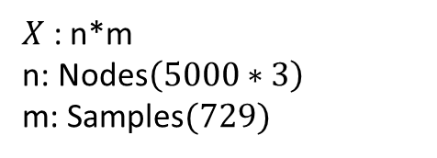


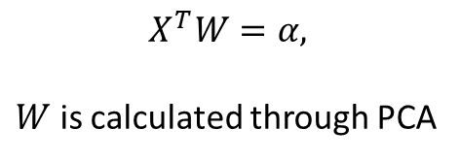








Shape Encoding
$$x_{1}$$
$$y_{1}$$
$$z_{1}$$
$$α_{1}$$
Encoded shape
5000 Nodes of coordinates $\left(x_{i},y_{i},z_{i}\right)$
$$α_{2}$$
$$X^{T}W=α,$$
$W$ is calculated through PCA
$$α_{3}$$
$$x_{5000}$$
$$y_{5000}$$
$$z_{5000}$$
$$W=\frac{U_{3}}{S_{3}}$$
Input size:
3 x 5000 x 729
$X$ : n*m
n: Nodes$\left(5000∗3\right)$
m: Samples$(729)$

Slide 2
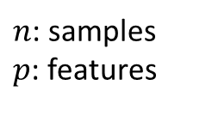
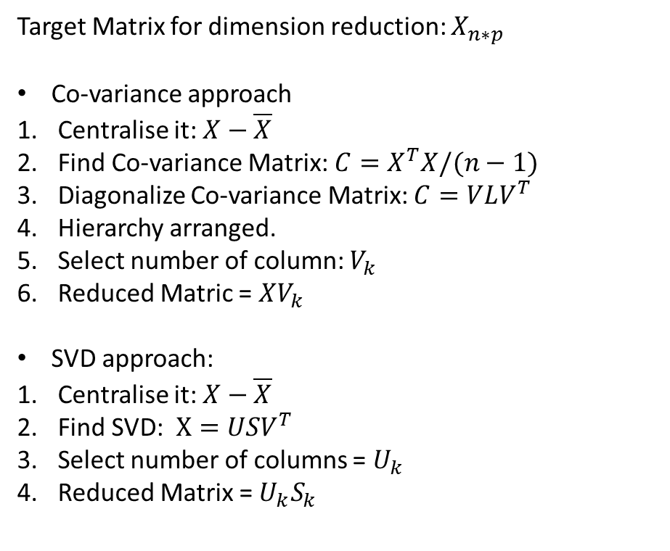
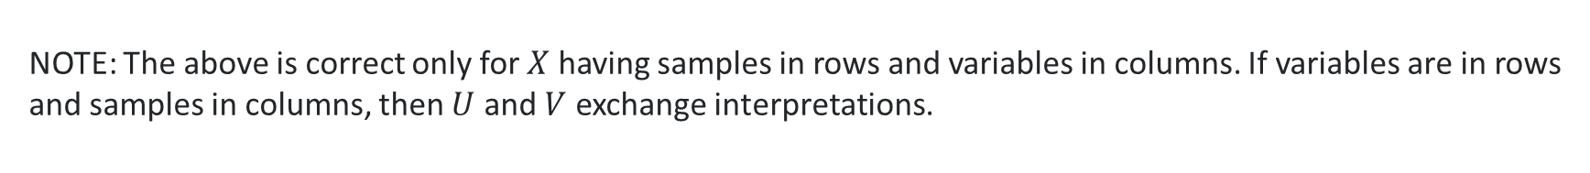
PCA Working step
$n$: samples
$p$: features
Target Matrix for dimension reduction: $X_{n∗p}$
Co-variance approach
Centralise it: $X−\overline{X}$
Find Co-variance Matrix: ${C=X}^{T}X/(n−1)$
Diagonalize Co-variance Matrix: $C=VLV^{T}$
Hierarchy arranged.
Select number of column: $V_{k}$
Reduced Matric = $XV_{k}$
SVD approach:
Centralise it: $X−\overline{X}$
Find SVD: $X=USV^{T}$
Select number of columns = $U_{k}$
Reduced Matrix = ${U_{k}S}_{k}$
NOTE: The above is correct only for $X$ having samples in rows and variables in columns. If variables are in rows and samples in columns, then $U$ and $V$ exchange interpretations.

Slide 3
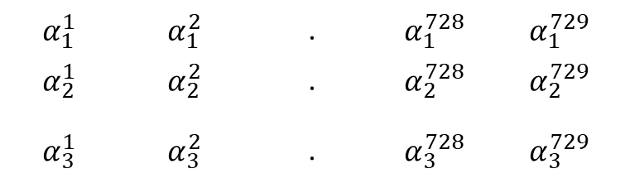
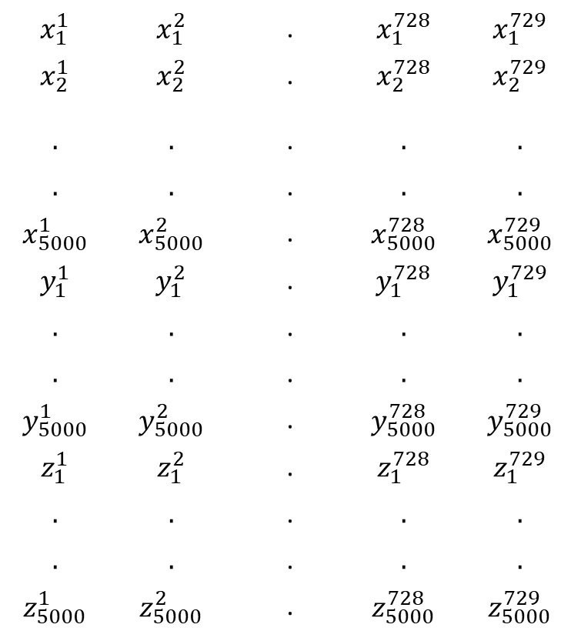
Columns: Patient
Rows: Nodes
Performed PCA through SVD.
$$x_{1}^{1}$$ | $$x_{1}^{2}$$ | . | $$x_{1}^{728}$$ | $$x_{1}^{729}$$
$$x_{2}^{1}$$ | $$x_{2}^{2}$$ | . | $$x_{2}^{728}$$ | $$x_{2}^{729}$$
$$.$$ | $$.$$ | . | $$.$$ | $$.$$
$$.$$ | $$.$$ | . | $$.$$ | $$.$$
$$x_{5000}^{1}$$ | $$x_{5000}^{2}$$ | . | $$x_{5000}^{728}$$ | $$x_{5000}^{729}$$
$$y_{1}^{1}$$ | $$y_{1}^{2}$$ | . | $$y_{1}^{728}$$ | $$y_{1}^{729}$$
$$.$$ | $$.$$ | . | $$.$$ | $$.$$
$$.$$ | $$.$$ | . | $$.$$ | $$.$$
$$y_{5000}^{1}$$ | $$y_{5000}^{2}$$ | . | $$y_{5000}^{728}$$ | $$y_{5000}^{729}$$
$$z_{1}^{1}$$ | $$z_{1}^{2}$$ | . | $$z_{1}^{728}$$ | $$z_{1}^{729}$$
$$.$$ | $$.$$ | . | $$.$$ | $$.$$
$$.$$ | $$.$$ | . | $$.$$ | $$.$$
$$z_{5000}^{1}$$ | $$z_{5000}^{2}$$ | . | $$z_{5000}^{728}$$ | $$z_{5000}^{729}$$
PCA
$$α_{1}^{1}$$ | $$α_{1}^{2}$$ | . | $$α_{1}^{728}$$ | $$α_{1}^{729}$$
$$α_{2}^{1}$$ | $$α_{2}^{2}$$ | . | $$α_{2}^{728}$$ | $$α_{2}^{729}$$
$$α_{3}^{1}$$ | $$α_{3}^{2}$$ | . | $$α_{3}^{728}$$ | $$α_{3}^{729}$$

Slide 4















Non-Linear Mapping Of Shape to Stress
$$h_{1}^{1}$$
$$h_{1}^{2}$$
$$β_{1}$$
$$α_{1}$$
$$h_{2}^{1}$$
$$h_{2}^{2}$$
$$β_{2}$$
Encoded shape
Encoded stress
Hidden layers: 2
Neurons: 128 each
Activation func.: ReLU
Output Layer has 64 neurons
$$α_{2}$$
$$β_{63}$$
$$α_{3}$$
$$h_{127}^{1}$$
$$h_{127}^{2}$$
$$β_{64}$$
$$h_{128}^{1}$$
$$h_{128}^{2}$$
Multilayer Neural Network

Slide 5



















Stress Decoding:
Stress Encoding
1 | 2 | 3 | 4 | 5
6 | 7 | 8 | 9 | 10
11 | 12 | 13 | 14 | 15
16 | 17 | 18 | 19 | 20
21 | 22 | 23 | 24 | 25
$$r_{1}^{1}$$
$$S_{1}^{1}$$
$$S^{1}$$
$$β_{1}$$
$$r_{256}^{1}$$
$$S_{600}^{1}$$
$$β_{2}$$
$$r_{1}^{2}$$
$$S_{1}^{2}$$
Encoded stress
Encoding: CNN
Decoding: transposed-CNN
$$S^{2}$$
$$r_{256}^{2}$$
$$S_{600}^{2}$$
$$β_{63}$$
$$β_{64}$$
$$r_{1}^{25}$$
$$S_{1}^{25}$$
Divided Aortic walls into 25 region with 200 Nodes
$$S^{25}$$
$$r_{256}^{25}$$
$$S_{600}^{25}$$
Stress Decoding

Slide 6
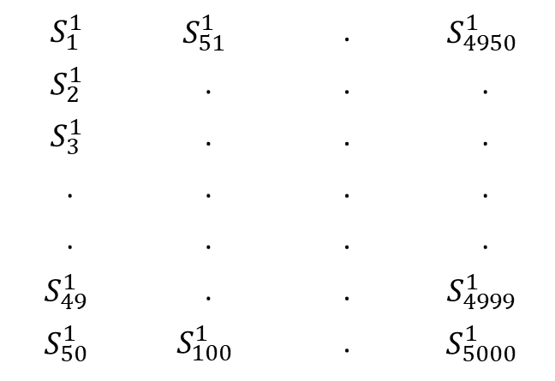
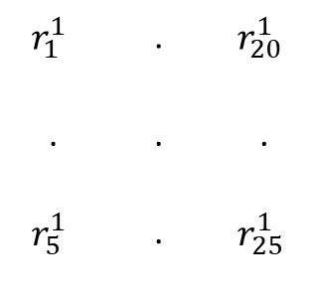


CNN Working
3
$$S_{1}^{3}$$ | $$S_{51}^{3}$$ | . | $$S_{4950}^{3}$$
256
$$S_{1}^{2}$$ | $$S_{51}^{2}$$ | . | $$S_{4950}^{2}$$
$$S_{1}^{1}$$ | $$S_{51}^{1}$$ | . | $$S_{4950}^{1}$$
$$S_{2}^{1}$$ | . | . | .
$$S_{3}^{1}$$ | . | . | .
. | . | . | .
. | . | . | .
$$S_{49}^{1}$$ | . | . | $$S_{4999}^{1}$$
$$S_{50}^{1}$$ | $$S_{100}^{1}$$ | . | $$S_{5000}^{1}$$
CNN
$$r_{1}^{1}$$ | . | $$r_{20}^{1}$$
. | . | .
$$r_{5}^{1}$$ | . | $$r_{25}^{1}$$
Weight: 256x3x10x20
Stride: 10x20
Padding: 0

Slide 7

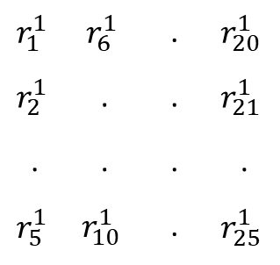
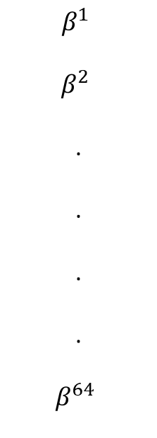
Layer Contd.
$$β^{1}$$
$$β^{2}$$
.
.
.
.
$$β^{64}$$
256
64
CNN
Flatten
$$β^{1}$$
$$r_{1}^{1}$$ | $$r_{6}^{1}$$ | . | $$r_{20}^{1}$$
$$r_{2}^{1}$$ | . | . | $$r_{21}^{1}$$
. | . | . | .
$$r_{5}^{1}$$ | $$r_{10}^{1}$$ | . | $$r_{25}^{1}$$
Weight: 64x256x5x5
Stride: 1x1
Padding: 0

Slide 8
INPUT
KERNEL
1 | 0 | 2
0 | 3 | 1
2 | 3 | 1
Transposed-CNN
0 | 1
2 | 3
0 | 0 | 0
0 | 0 | 0
0 | 0 | 0
 |  | 1 | 0 | 2
 |  | 0 | 3 | 1
 |  | 2 | 4 | 1
0 | 0 | 1 | 0 | 2
0 | 0 | 0 | 3 | 1
2 | 0 | 9 | 4 | 7
0 | 6 | 2 | 9 | 3
4 | 6 | 8 | 9 | 3
2 | 0 | 4
0 | 6 | 2
4 | 6 | 2
 |  | 3 | 0 | 6
 |  | 0 | 9 | 3
 |  | 6 | 9 | 3
Kernel: 3x3
Stride: 2x2
Padding:0

Slide 9
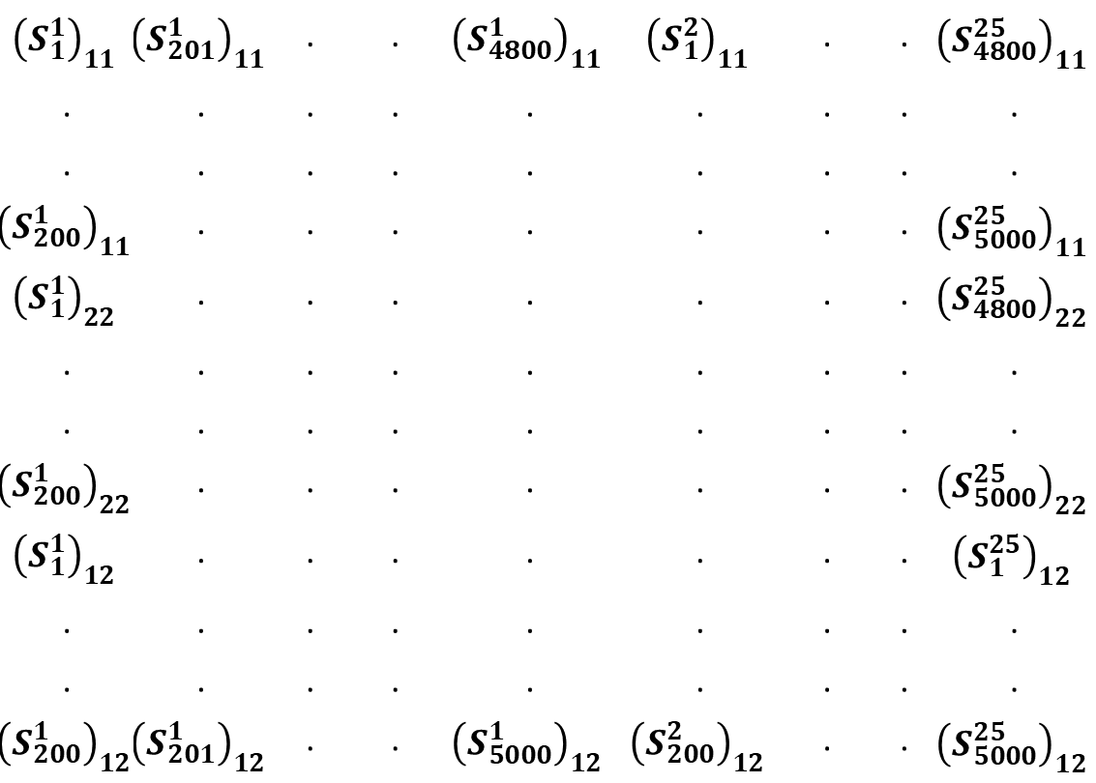
Weights Of CNN
Rearrange Stress
$${\left(S_{1}^{1}\right)}_{11}$$ | $${\left(S_{201}^{1}\right)}_{11}$$ | . | . | $${\left(S_{4800}^{1}\right)}_{11}$$ | $${\left(S_{1}^{2}\right)}_{11}$$ | . | . | $${\left(S_{4800}^{25}\right)}_{11}$$
. | . | . | . | . | . | . | . | .
. | . | . | . | . | . | . | . | .
$${\left(S_{200}^{1}\right)}_{11}$$ | . | . | . | . | . | . | . | $${\left(S_{5000}^{25}\right)}_{11}$$
$${\left(S_{1}^{1}\right)}_{22}$$ | . | . | . | . | . | . | . | $${\left(S_{4800}^{25}\right)}_{22}$$
. | . | . | . | . | . | . | . | .
. | . | . | . | . | . | . | . | .
$${\left(S_{200}^{1}\right)}_{22}$$ | . | . | . | . | . | . | . | $${\left(S_{5000}^{25}\right)}_{22}$$
$${\left(S_{1}^{1}\right)}_{12}$$ | . | . | . | . | . | . | . | $${\left(S_{1}^{25}\right)}_{12}$$
. | . | . | . | . | . | . | . | .
. | . | . | . | . | . | . | . | .
$${\left(S_{200}^{1}\right)}_{12}$$ | $${\left(S_{201}^{1}\right)}_{12}$$ | . | . | $${\left(S_{5000}^{1}\right)}_{12}$$ | $${\left(S_{200}^{2}\right)}_{12}$$ | . | . | $${\left(S_{5000}^{25}\right)}_{12}$$
Rearrange stress
Centralize
Find co-variance Matrix
Find eigen Vector
Choose 256 column
Find the CNN layer
Find its co-variance
Find eigen Vector
Choose 64 column
These chosen are weights of respective layers

Slide 10
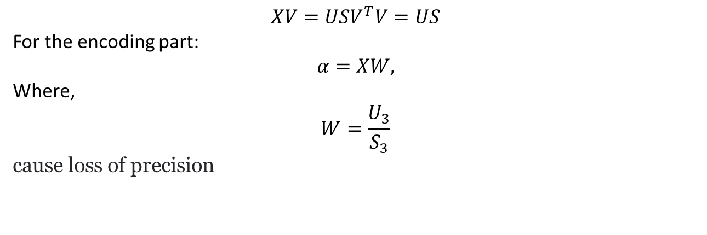
Additional data
For SSM: https://www.youtube.com/watch?v=NNvqhB8p8ZY&ab_channel=MaterialiseMedical
$$XV=USV^{T}V=US$$
For the encoding part:
$$α=XW,$$
Where,
$$W=\frac{U_{3}}{S_{3}}$$
cause loss of precision

