Slide 1
HR_Analytics
Submission by: Rahul Saini

Slide 2
Abstract
An employee is an asset to the company. They define the future and present of the company. So, it is obvious that a company invest a huge attention, money and care for its employees to make them not leave. People Analytics is simply the way of giving answer to why employees leave the employers through the data. In this project we try to predict whether on the present conditions if an employee leaves the company or not.

Slide 3
Problem Solving Approach
At First, we try to do some Exploratory Data Analysis on the given dataset , tries to find some interdependencies of the columns using correlation. Then it is supposed that the Average_Speed could be a useful columns for higher rating, therefore creating that using speed distance formula.
Then After, we will be building a Classification Model for our problem and try to have as much accuracy as we can. For this we will be testing both Logistic Regression and Random Forest Classifier Libraries.

Slide 4
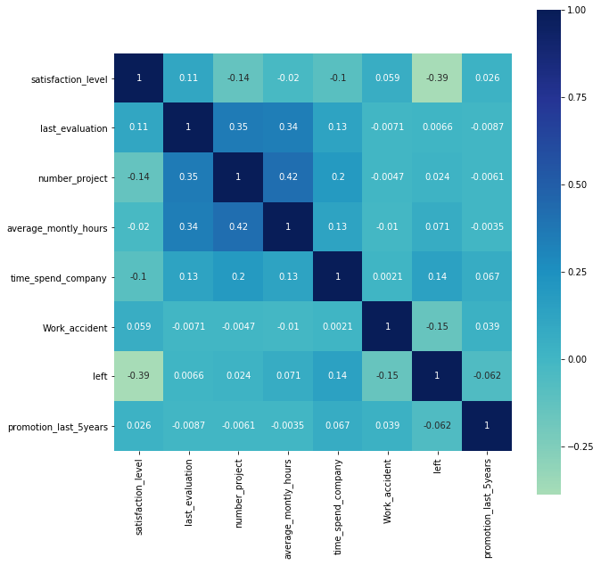
Exploratory Data Analysis
Using Correlation we tries to find the inter relation between the independent variables and target variable. Therefore selecting our Independent Variables for the modeling.
Then after univariate analysis we get some strong insights of the data.

Slide 5
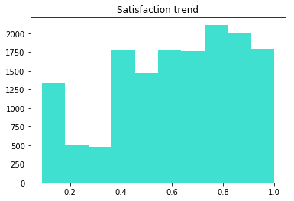
Analysis of independent variables
We have find that there is strong relation between some independent variables like Satisfaction Trend , Salary , last_evaluation , time_spend_company etc. and Target variable left.
Our next step was to convert categorical columns into Integer so as to do our modeling.

Slide 6
Logistic Regression
Now as we all know that this is a classification problem, Therefore building the Logistic Model for the problem.
from sklearn.linear_model import LogisticRegression
model = LogisticRegression(random_state = 0)
model.fit(x_train,y_train)
model.score(x_train,y_train)
After this model our accuracy score was around 76% , But since it is not optimised therefore building a Random Forest Classification model.

Slide 7
Random Forest Model
Since our accuracy score with the Logistic Regression is not quite satisfying therefore using Random Forest with optimised Factors to have a bit better accuracy score.
from sklearn.ensemble import RandomForestClassifier
model_random = RandomForestClassifier(n_estimators=6, random_state=0,max_depth = 15)
Now, the accuracy of the model is around 88% which is perfect for a prediction model, hence finalizing this model.

Slide 8
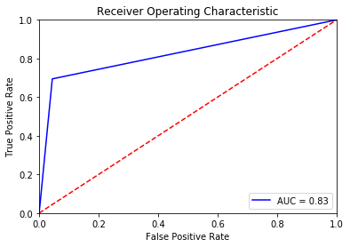
ROC Curve
A receiver operating characteristic curve, or ROC curve, is a graphical plot that illustrates the diagnostic ability of a binary classifier system as its discrimination threshold is varied. The ROC curve is created by plotting the true positive rate against the false positive rate at various threshold settings.

Slide 9
Thank You!!

