Slide 1
Project Presentation of CO-OP Project at Industry (Module-2) (22CS421)
On
DIGITAL IDENTITY WITHOUT EXPOSURE: A PRIVACY PRESERVING DECENTRALIZED APPROACH
Rahul - 2210992126
Ishanesh Srivastava - 2210991685
Supervised By
Ashish Kumar
Department of Computer Science and Engineering,
Chitkara University, Punjab

Slide 2
Abstract
Digital identity systems are essential for accessing online services, but traditional centralized approaches expose users to risks like data breaches and privacy loss. The proposed system introduces a privacy-preserving decentralized digital identity framework that enables secure authentication without revealing sensitive information. It uses Decentralized Identifiers (DIDs), Verifiable Credentials (VCs), and selective disclosure to ensure minimal data sharing. Blockchain technology provides a tamper-proof and transparent system, eliminating single points of failure. The system includes User, Issuer, Verifier, and a Decentralized Ledger to manage identity creation and verification. This approach enhances security, privacy, and user control, making it suitable for applications like banking, healthcare, and e-governance.

Slide 3
Introduction
Digital identity is essential for accessing modern online services like banking, healthcare, and e-governance.
Most existing identity systems are centralized, which creates risks like data breaches and privacy loss.
Users often have to share more personal information than necessary during verification.
Centralized systems act as a single point of failure, making them vulnerable to cyber-attacks.
Decentralized identity gives users control over their own data and improves privacy.
This project proposes a secure, privacy-preserving system using selective disclosure and verifiable credentials.
3

Slide 4
Problem Statement
Traditional digital identity systems rely on centralized storage, making them highly vulnerable to cyber-attacks and data breaches.
Users are forced to share excessive personal information even for simple verification processes.
Lack of user control over personal data leads to privacy violations and misuse of sensitive information.
Centralized systems create a single point of failure, risking large-scale identity exposure if compromised.
Existing systems are prone to identity-based attacks such as phishing, impersonation, and credential reuse.
Poor interoperability and lack of transparency reduce trust and make identity management inefficient.
4

Slide 5
Objectives
Development of a decentralized digital identity system that removes dependency on centralized authorities.
Protection of user privacy through selective disclosure and minimal sharing of personal data.
Providing users full control over storage, access, and sharing of their identity information.
Implementation of secure and reliable verification using advanced cryptographic techniques.
Reduction of risks such as data breaches, identity theft, and unauthorized access.
Ensuring scalability and interoperability for use across domains like banking, healthcare, and e-governance.
5

Slide 6
Related Work
Centralized Identity Systems
Store user identity data in centralized databases managed by authorities
Widely used in banking, healthcare, and e-governance systems
Easy to implement and manage for authentication purposes
Limitation: Single point of failure and high risk of data breaches
Decentralized Identity & Blockchain Solutions
Use blockchain to remove dependency on central authorities and Technologies include Decentralized Identifiers and VCs
Limitation: High complexity, scalability challenges, and performance overhead
Privacy-Preserving Authentication Techniques ○ Zero-Knowledge Proofs (ZKPs) enable verification without revealing actual data ○ Improve privacy and reduce unnecessary data exposure ○ Limitation: Computationally expensive and difficult to implement
6

Slide 7
System Architecture & Methodology
User → Issuer → DID Registry (Blockchain) → Verifiable Credentials → Verifier → Authentication (Selective Disclosure) Modules:
User: Registers, creates decentralized identity, and stores credentials securely.
Issuer: Verifies user information and issues verifiable credentials.
DID Registry (Blockchain): Stores decentralized identifiers and public keys securely.
Verifiable Credentials: Digitally signed credentials owned and controlled by the user.
Verifier: Requests and validates credentials without accessing full identity data.
Authentication (Selective Disclosure): Shares only required information for verification while preserving privacy.
7

Slide 8
System Architecture & Methodology
Phase 1: Credential Issuance
User generates a Decentralized Identifier (DID) on the blockchain.
Trusted issuer validates user information and signs credentials.
Verifiable credentials stored encrypted on user's device.
Phase 2: Selective Disclosure
User selects minimum required attributes for a service request.
Cryptographic signatures ensure integrity of shared attributes.
Short-term or time-stamped credentials used to minimize exposure.
Phase 3: Decentralized Verification
Verifier validates credentials using Zero-Knowledge Proofs.
Blockchain ledger confirms authenticity without accessing personal data.
Access granted to service provider upon successful verification.
8

Slide 9
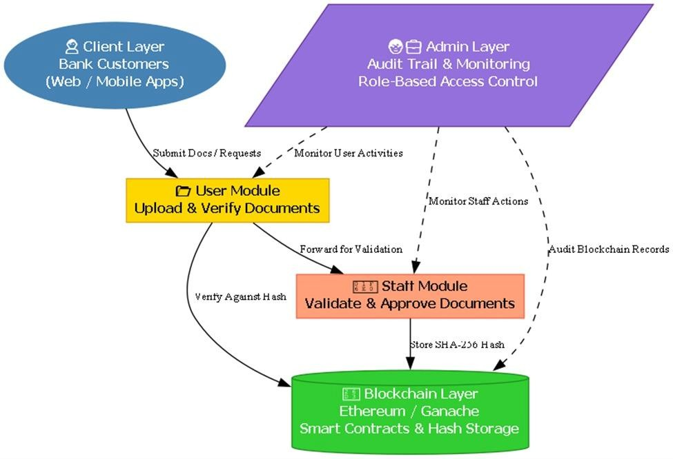
Architecture
9

Slide 10
Conclusion & Future Work
Conclusion
Proposed a decentralized digital identity system to overcome limitations of centralized models.
Enhanced user privacy through selective disclosure and minimal data sharing.
Improved security by eliminating single points of failure using blockchain technology.
Provided users full control over their identity data and authentication process.
Reduced risks of data breaches, identity theft, and unauthorized access.
Future Work
Improve system performance by optimizing cryptographic operations for faster authentication.
Improve system performance by optimizing cryptographic operations for faster authentication.
Enable cross-chain interoperability for use across multiple blockchain networks.
Develop user-friendly mobile and web interfaces for better adoption.
Enhance scalability to support large-scale real-world deployments.
10

Slide 11
References
[1] I. Sedki, A. Hamou-Lhadj et al., “An Effective Approach for Parsing Large Log Files,” Concordia University.
[2] P. He, J. Zhu, Z. Zheng, M. R. Lyu, “Drain: An Online Log Parsing Approach with Fixed Depth Tree,” IEEE ICWS 2017, pp. 33-40.
[3] “Big Data Analytics with Hadoop,” International Journal of Engineering Research & Technology (IJERT).
[4] H. Annangi, “Security Log Analysis Using Hadoop,” Master’s thesis, St. Cloud State University, MN, 2017.
[5] G. Aydin and I. R. Hallac, “Distributed log analysis on the cloud using MapReduce,” Tehnički vjesnik, vol. 23, no. 4, pp. 1011-1016, 2016.
11

Slide 12
Thank You
12

