Slide 1
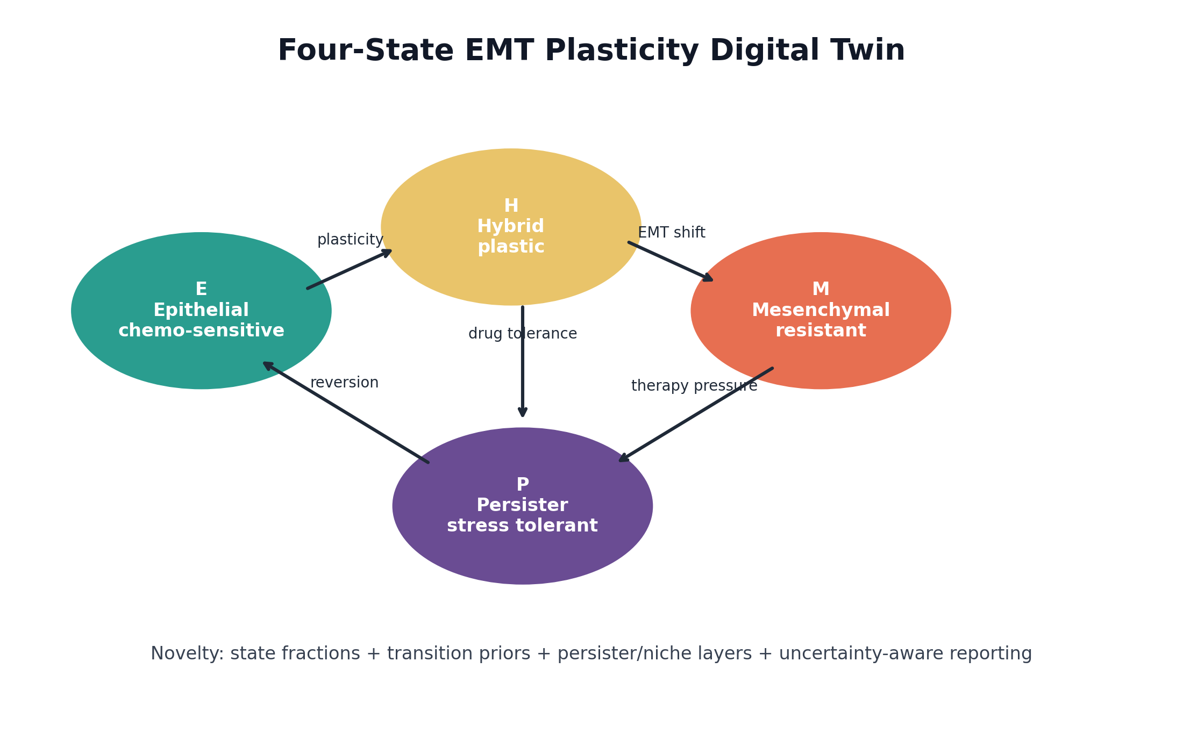
NOVELTY POSITIONING
Digital Twin of EMT Plasticity Under Therapy
How this TNBC NAC project differs from current literature, digital-twin reports, and EMT/persister resources
Thesis
Novelty is not one isolated algorithm. It is the integration of dynamic EMT/persister state biology, curated public TNBC NAC labels, cross-platform validation, and clinician-safe reporting.
Novelty package built from locked project outputs and verified comparator literature

Slide 2
TNBC EMT DIGITAL TWIN
Current Landscape: Many Pieces, Few Integrated Workflows
The literature covers endpoints, biology, imaging twins, and governance, but usually in separate silos.
Clinical endpoint literature
EMP and persister biology
MRI-based TNBC twins
Oncology DT/QSP reviews
pCR, residual disease, and RCB explain why response matters, but not how surviving cells adapt.
Reviews define EMT plasticity and drug-tolerant persister concepts, often without a TNBC NAC validation workflow.
Closest comparator: strong for imaging-calibrated tumor-growth response, less focused on transcriptomic EMT/persister states.
Useful credibility and simulation frameworks, but broad and rarely label-curated TNBC NAC state pipelines.
Gap: A governed transcriptomic state twin that explains therapy-induced EMT/persister biology under TNBC NAC.
Comparators: pCR/RCB literature; EMP/DTP reviews; MRI-based TNBC NAC DTs; QSP/IO and oncology DT reviews

Slide 3
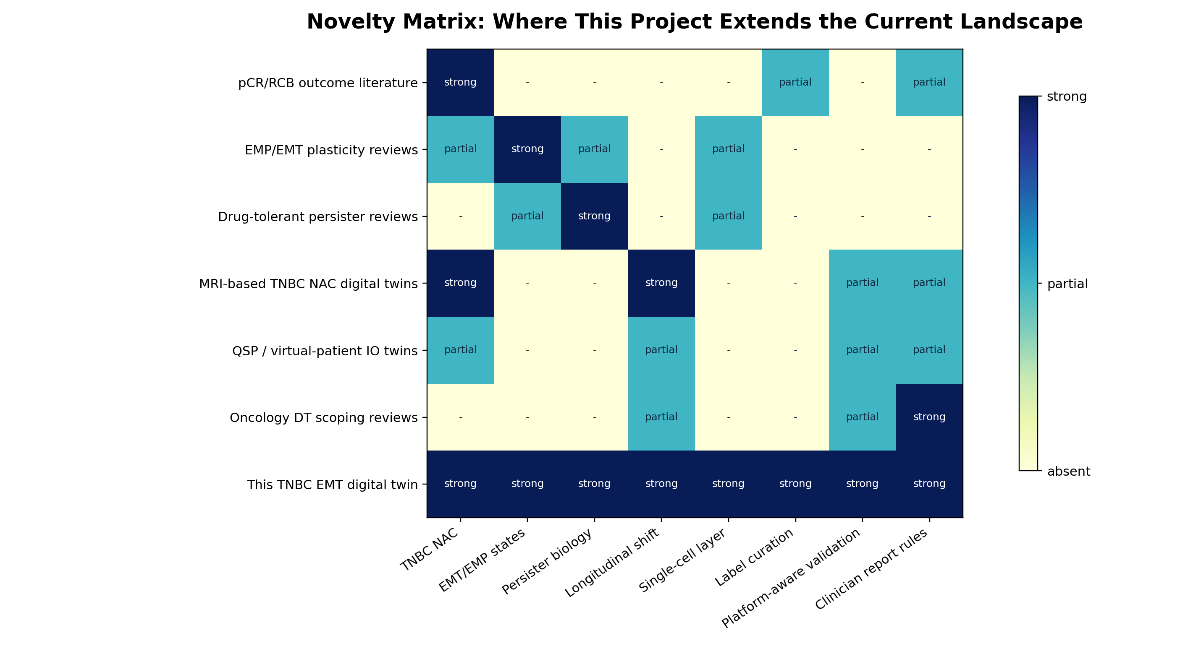
TNBC EMT DIGITAL TWIN
Novelty Matrix
This project’s distinctiveness is the complete row: state biology, validation, and governance together.
Scale: absent, partial, strong coverage. Matrix is qualitative positioning, not a claim of superiority.

Slide 4
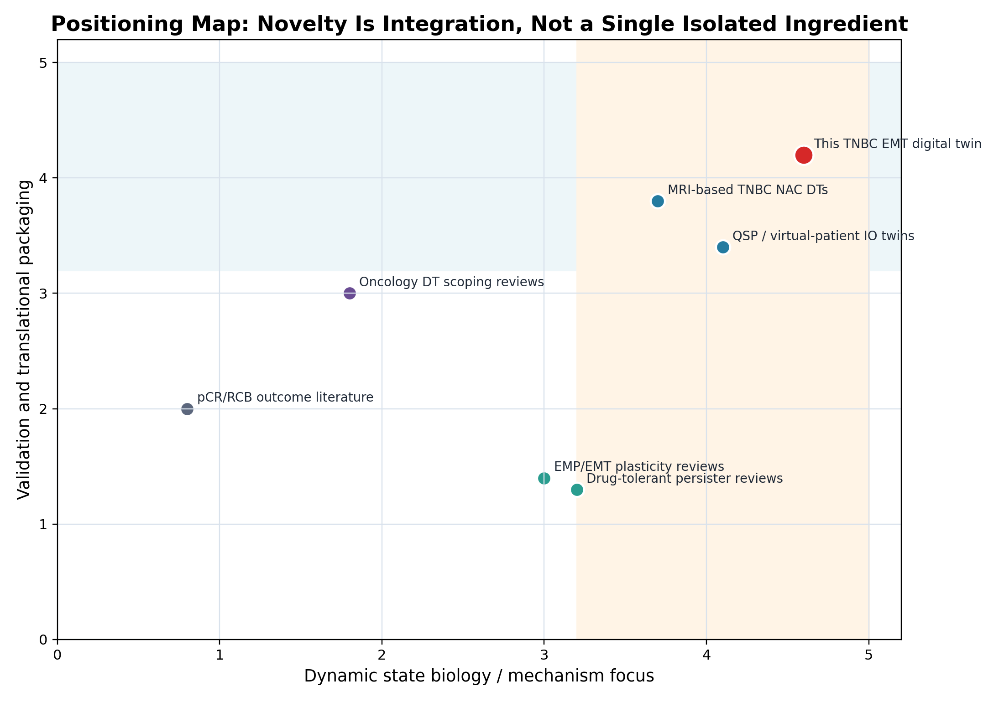
TNBC EMT DIGITAL TWIN
Where the Project Sits
Closest to TNBC digital-twin work, but shifted toward transcriptomic state biology and report governance.
Interpretation
MRI-based TNBC twins are the closest cousin. This project complements them by explaining molecular state trajectories: E, H, M, P, persister/niche programs, label uncertainty, and platform shift.
Research prototype: not clinical decision support

Slide 5
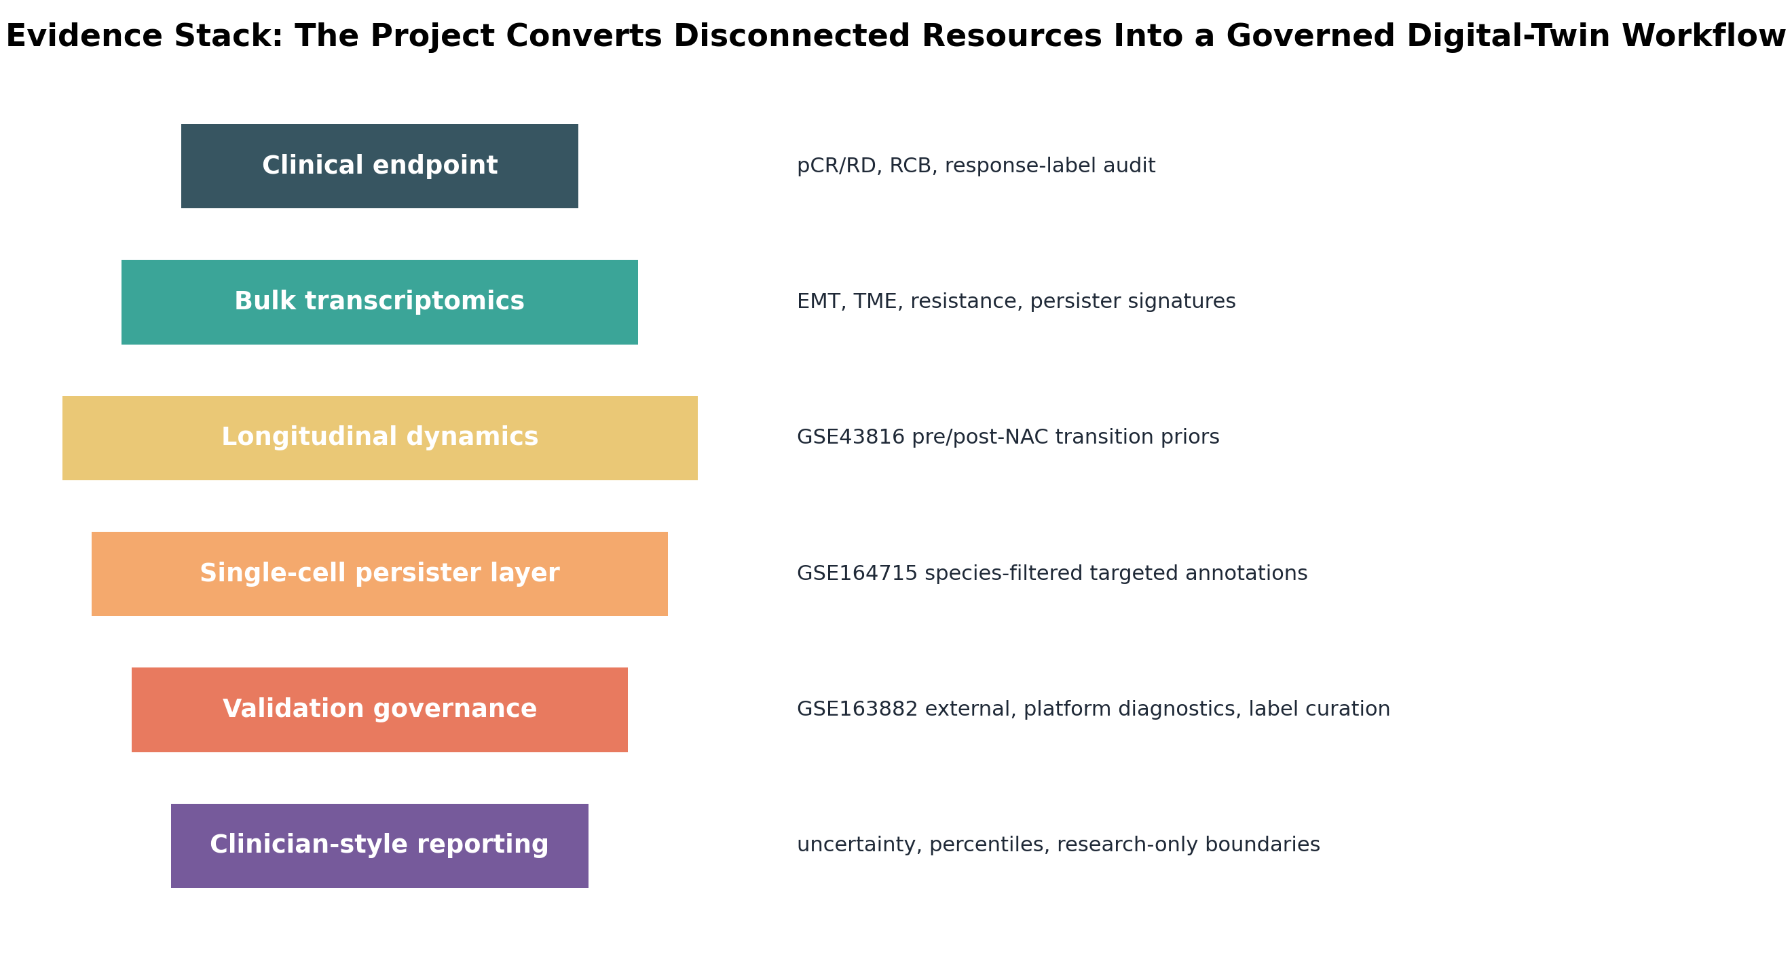
TNBC EMT DIGITAL TWIN
Evidence Stack
The project converts disconnected public resources into a governed digital-twin workflow.
Stack layers: endpoint curation, bulk signatures, longitudinal dynamics, scRNA persister layer, validation governance, clinician-style reporting

Slide 6
TNBC EMT DIGITAL TWIN
Similar, But Not the Same
The project reuses trusted ideas but recombines them around a different scientific question.
MRI-based TNBC NAC digital twins
EMP / DTP reviews
Similar: patient-specific NAC twins.
Different: this project is transcriptomic EMT/persister-state centered, not imaging growth centered.
Similar: same biology of plasticity and survival.
Different: this project operationalizes biology in scored TNBC NAC cohorts.
QSP / IO virtual patients
pCR / RCB literature
Similar: mechanistic simulation philosophy.
Different: this project uses public TNBC NAC transcriptomics, label curation, and report governance.
Similar: same endpoint motivation.
Different: this project models survival-state mechanisms, not endpoint alone.
Novelty claim: complementary to current work, not a replacement for it.
Research prototype: not clinical decision support

Slide 7
TNBC EMT DIGITAL TWIN
Eight Novel Contributions
These are the defensible novelty claims for a report, viva, proposal, or manuscript introduction.
TNBC NAC-specific but state-centered, not only endpoint-centered.
EMT modeled as dynamic E/H/M/P state space.
Persister separated into tumor-cell, stress-tolerance, and niche layers.
Transition priors calibrated from paired pre/post-NAC TNBC samples.
Public response labels audited and curated before sensitivity modeling.
Same-platform and cross-platform validation kept separate.
Single-cell ambiguity preserved instead of overconfident cell labels.
Clinician-style reporting forbids treatment recommendations and foregrounds uncertainty.
Research prototype: not clinical decision support

Slide 8
TNBC EMT DIGITAL TWIN
Why Clinicians Should Care
The project is not a prescriber; it is a research-grade explanation layer for residual-risk biology.
Molecular review prompt
Uncertainty first
Post-NAC research triage
Shows whether residual-risk biology appears hypoxic, AXL/TAM-high, YAP/TAZ-high, stromal-supported, immune-contextual, or persister-enriched.
Reports cohort percentiles, bootstrap bands, platform shifts, and label caveats before interpretation.
Helps prioritize specimens for deeper profiling, spatial assays, single-cell work, or trial hypothesis generation.
Clinical boundary: no treatment recommendation, no individual survival claim, no clinical deployment without prospective validation.
Research prototype: not clinical decision support

Slide 9
TNBC EMT DIGITAL TWIN
Why Researchers Should Care
It creates a reusable scaffold for asking better residual-disease questions.
Benchmark EMT, TME, resistance, and persister signatures across public TNBC NAC cohorts.
Test how endpoint definitions change model behavior.
Compare raw, percentile, z-score, and quantile cross-platform calibration.
Connect bulk response models with longitudinal therapy shifts and single-cell persister biology.
Use ambiguity as data: unresolved compartments become follow-up targets, not hidden errors.
External validation: combined state + TME features outperform EMT-only.
Research prototype: not clinical decision support

Slide 10
TNBC EMT DIGITAL TWIN
Creative Roadmap
The next-generation version becomes a multimodal residual-disease twin.
Time-lapse
Spatial
Perturbation
early on-treatment velocity
niche distance and immune exclusion
AXL/TAM, TGF-beta, hypoxia, ferroptosis
Explant
Trial enrichment
Uncertainty UI
organoid/PDX calibration
residual-disease subgroups
confidence before claims
Roadmap is prospective: all clinical use requires locked assays and prospective validation

Slide 11
TNBC EMT DIGITAL TWIN
Takeaway
Novelty is a governed bridge from endpoint prediction to state-aware residual biology.
Similar to current work:
Different from current work:
Uses accepted pCR/RD/RCB clinical logic.
Centers transcriptomic E/H/M/P state dynamics in TNBC NAC.
Builds on EMT plasticity and persister biology.
Includes label curation, platform-aware validation, and scRNA ambiguity review.
Shares digital-twin goals of simulation, validation, and decision support.
Outputs clinician-style research reports with hard safety boundaries.
Final claim
A computationally complete research prototype for EMT/persister-state interpretation, not a clinically deployed treatment-selection model.
Main deck sources are listed in the novelty positioning report.

