Slide 1
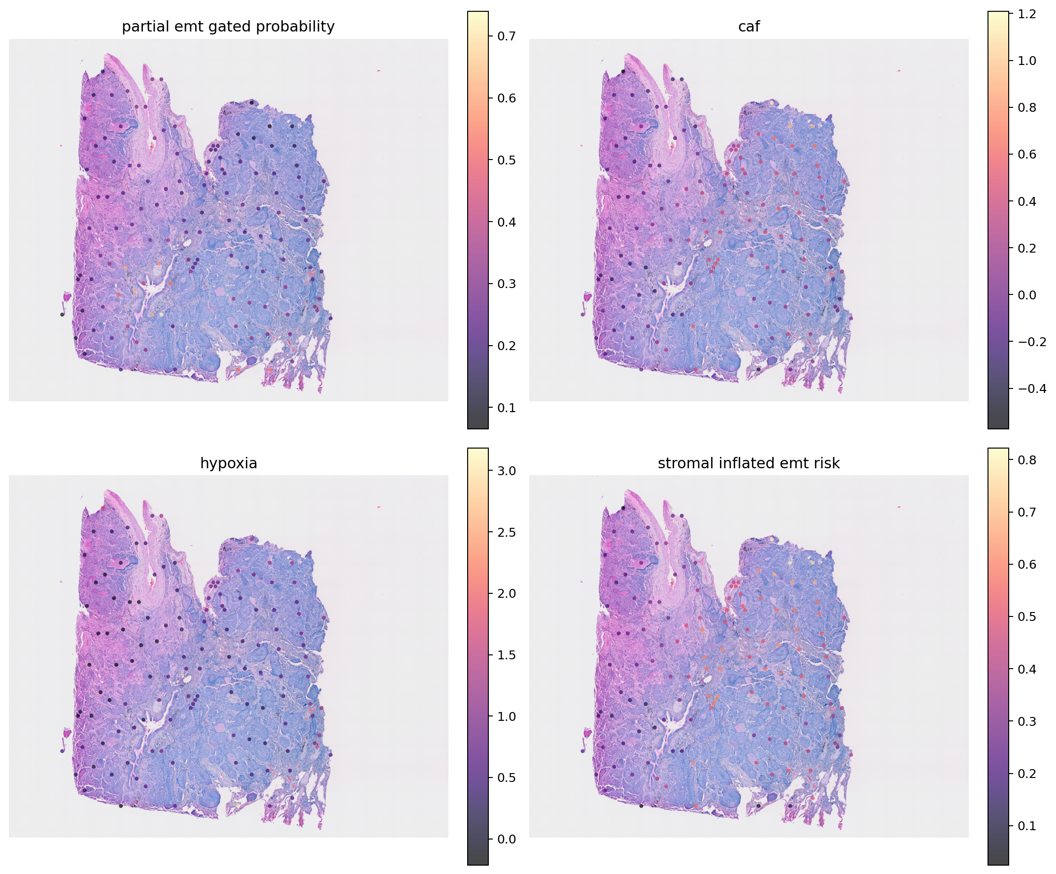
EMT-ViSTA
Virtual spatial staining of epithelial-mesenchymal plasticity from routine H&E
A risk-aware, uncertainty-aware research pipeline
Real public spatial data • Lung and colorectal holdouts • Honest negative baselines
Notes:
Open with the project promise, then immediately frame it as a research and assay-triage system rather than a diagnostic product.
[Sources]
- Local project output: data/processed/emt_virtual_spatial_staining_v1/resnet50/maps/CytAssist_FFPE_Human_Lung_Squamous_Cell_Carcinoma_he_overlay.png
- Dong A, Blanpain C. Nature Reviews Cancer (2026). https://www.nature.com/articles/s41568-025-00873-0

Slide 2
The molecular question is spatial, but the routine slide is not
Routine H&E
Spatial transcriptomics
• Ubiquitous in pathology
• Shows architecture and morphology
• Cheap enough for large cohorts
• Does not directly measure RNA programs
?
• Measures spatial molecular programs
• Resolves CAF, TAM and hypoxia niches
• Costly and not routine
• Provides supervision for virtual staining
Can morphology nominate where these programs are active?
02
Notes:
Explain the translation gap: H&E is routine, while spatial RNA is informative but expensive. The model tries to transfer supervised molecular information to routine morphology.
[Sources]
- HEST-1k. NeurIPS Datasets and Benchmarks (2024). https://proceedings.neurips.cc/paper_files/paper/2024/file/60a899cc31f763be0bde781a75e04458-Paper-Datasets_and_Benchmarks_Track.pdf
- STPath. npj Digital Medicine (2025). https://www.nature.com/articles/s41746-025-02020-3

Slide 3
The hypothesis is useful only if it survives contamination controls
Central hypothesis
Multi-scale H&E morphology contains enough signal to predict spatial epithelial-mesenchymal plasticity and its microenvironment, provided stromal admixture and uncertainty are modeled explicitly.
Q1
Can H&E predict epithelial, mesenchymal and partial-EMT programs?
Q2
Can it separate malignant plasticity from CAF-rich spot mixing?
Q3
Do local tissue neighborhoods improve prediction?
Q4
Does uncertainty identify predictions that should be rejected?
03
Notes:
State the hypothesis as a falsifiable proposition. The distinctive part is not H&E-to-score regression alone; it is separating malignant plasticity from stromal admixture and refusing uncertain predictions.
[Sources]
- Local protocol: docs/emt_virtual_spatial_staining/detailed_project_plan.md
- Thompson EW et al. Nature Reviews Clinical Oncology (2025). https://www.nature.com/articles/s41571-025-01058-2

Slide 4
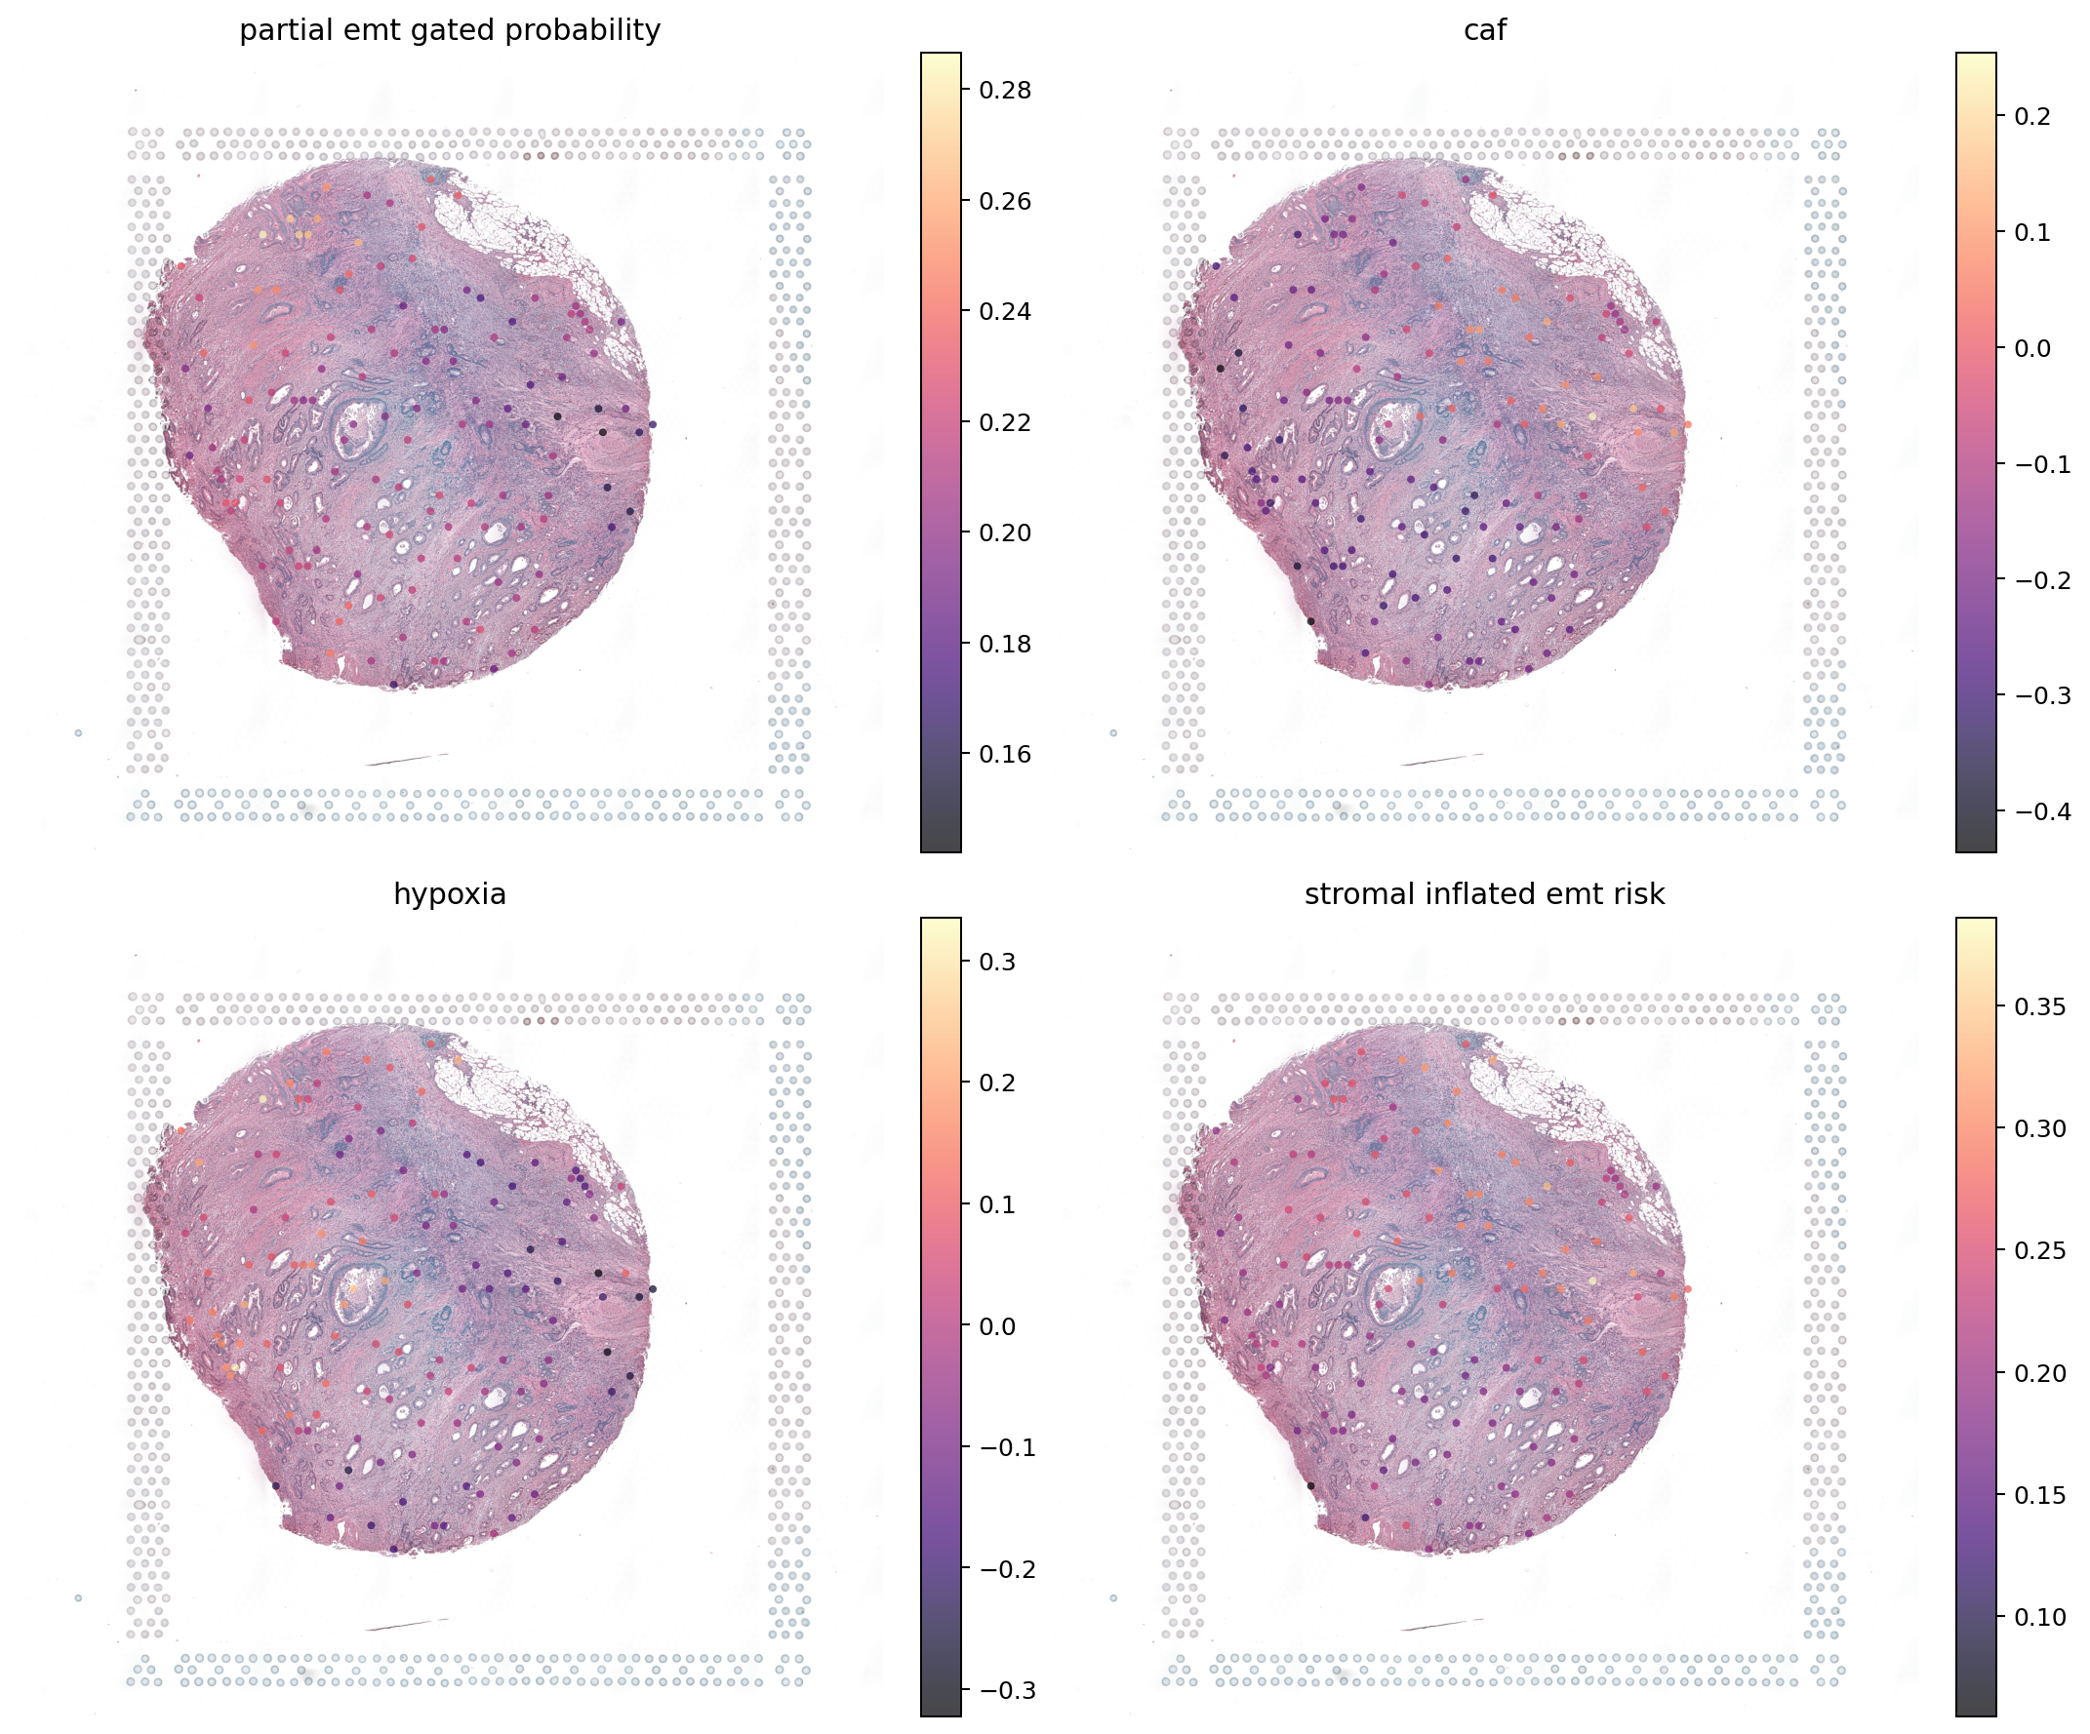
Stromal signal can mimic tumour EMT
The confounder
A Visium spot can mix malignant epithelial cells with fibroblasts, macrophages and ECM. That mixture can mimic partial EMT without proving tumour-cell plasticity.
EMT-ViSTA response
• Require epithelial + mesenchymal co-activity
• Predict stromal inflation separately
• Gate candidate partial EMT by malignant evidence
• Abstain when confidence is inadequate
04
Notes:
This is the core biological safety slide. Describe spot mixing and why an EMT score must be interpreted alongside epithelial evidence, CAF signals and stromal risk.
[Sources]
- Local output: data/processed/emt_virtual_spatial_staining_v1/resnet50/maps/Visium_FFPE_Human_Intestinal_Cancer_he_overlay.png
- Dong A, Blanpain C. Nature Reviews Cancer (2026). https://www.nature.com/articles/s41568-025-00873-0

Slide 5
Five public cohorts created a real cross-cancer technical test
Dataset-level separation prevents neighboring spots from leaking across train and test.
5
16,862
6,518
aligned public cancer datasets
molecularly scored spatial spots
held-out lung + colorectal spots
TRAIN Breast + prostate
VALIDATE Ovarian
TEST Lung squamous + colorectal
05
Notes:
Clarify that these are dataset-level technical holdouts, not independent multi-patient clinical cohorts. The split is still stronger than random spot splitting because it avoids local leakage.
[Sources]
- Local manifest: data/processed/emt_virtual_spatial_staining_v1/training_pair_manifest.json
- Local report: docs/emt_virtual_spatial_staining/implementation_report.md

Slide 6
Molecular supervision becomes uncertainty-aware maps
1
2
3
4
5
6
Pair H&E + spatial RNA
Score EMT + TME
Extract center + context
Add spatial neighbors
Fit multitask ensemble
Gate, abstain, export
Every stage produces inspectable TSV, JSON, image or GeoJSON outputs.
06
Notes:
Walk left to right. Emphasize that the workflow is reproducible and modular: labels, embeddings, model, evaluation and exports can be run independently.
[Sources]
- Local pipeline: scripts/run_emt_vista_pipeline.py
- Local package: src/emt_virtual_spatial_staining/

Slide 7
Each method targets a specific failure mode
Biological validity
Generalization
Trustworthiness
Malignant-gated partial EMT
Separate CAF/TAM/ECM outputs
Stromal false-positive test
Dataset-level holdouts
Center + context scales
Handcrafted and ImageNet controls
Bootstrap uncertainty
Calibration and selective risk
Explicit abstention
The method is designed to fail visibly before it can overclaim.
07
Notes:
Connect each method to a risk: stromal mixing, domain shift and false confidence. This is a useful interview slide because it explains why the methodology matters, not just what tools were used.
[Sources]
- Local methods: docs/emt_virtual_spatial_staining/research_article_draft.md
- Towards robust foundation models for digital pathology. Nature Communications (2026). https://www.nature.com/articles/s41467-026-73923-2

Slide 8
The v1 model stays interpretable before going deep
Center tile
224 × 224
Bootstrap PCA + ridge
Mean = prediction
Spread = uncertainty
Image representation
Handcrafted / ResNet / Phikon
Spatial neighbor
mean features
Context tile
448 × 448
Why not start with a giant neural network? A transparent baseline reveals leakage, stain bias and weak labels before model complexity hides them.
08
Notes:
Explain PCA plus ridge as an engineering baseline, not the final architecture. It tests whether the data contain a transferable signal before moving to GNNs or multimodal Transformers.
[Sources]
- Local implementation: src/emt_virtual_spatial_staining/modeling.py
- Phikon-v2. https://arxiv.org/abs/2409.09173
- Bioptimus H-Optimus. https://www.bioptimus.com/h-optimus

Slide 9
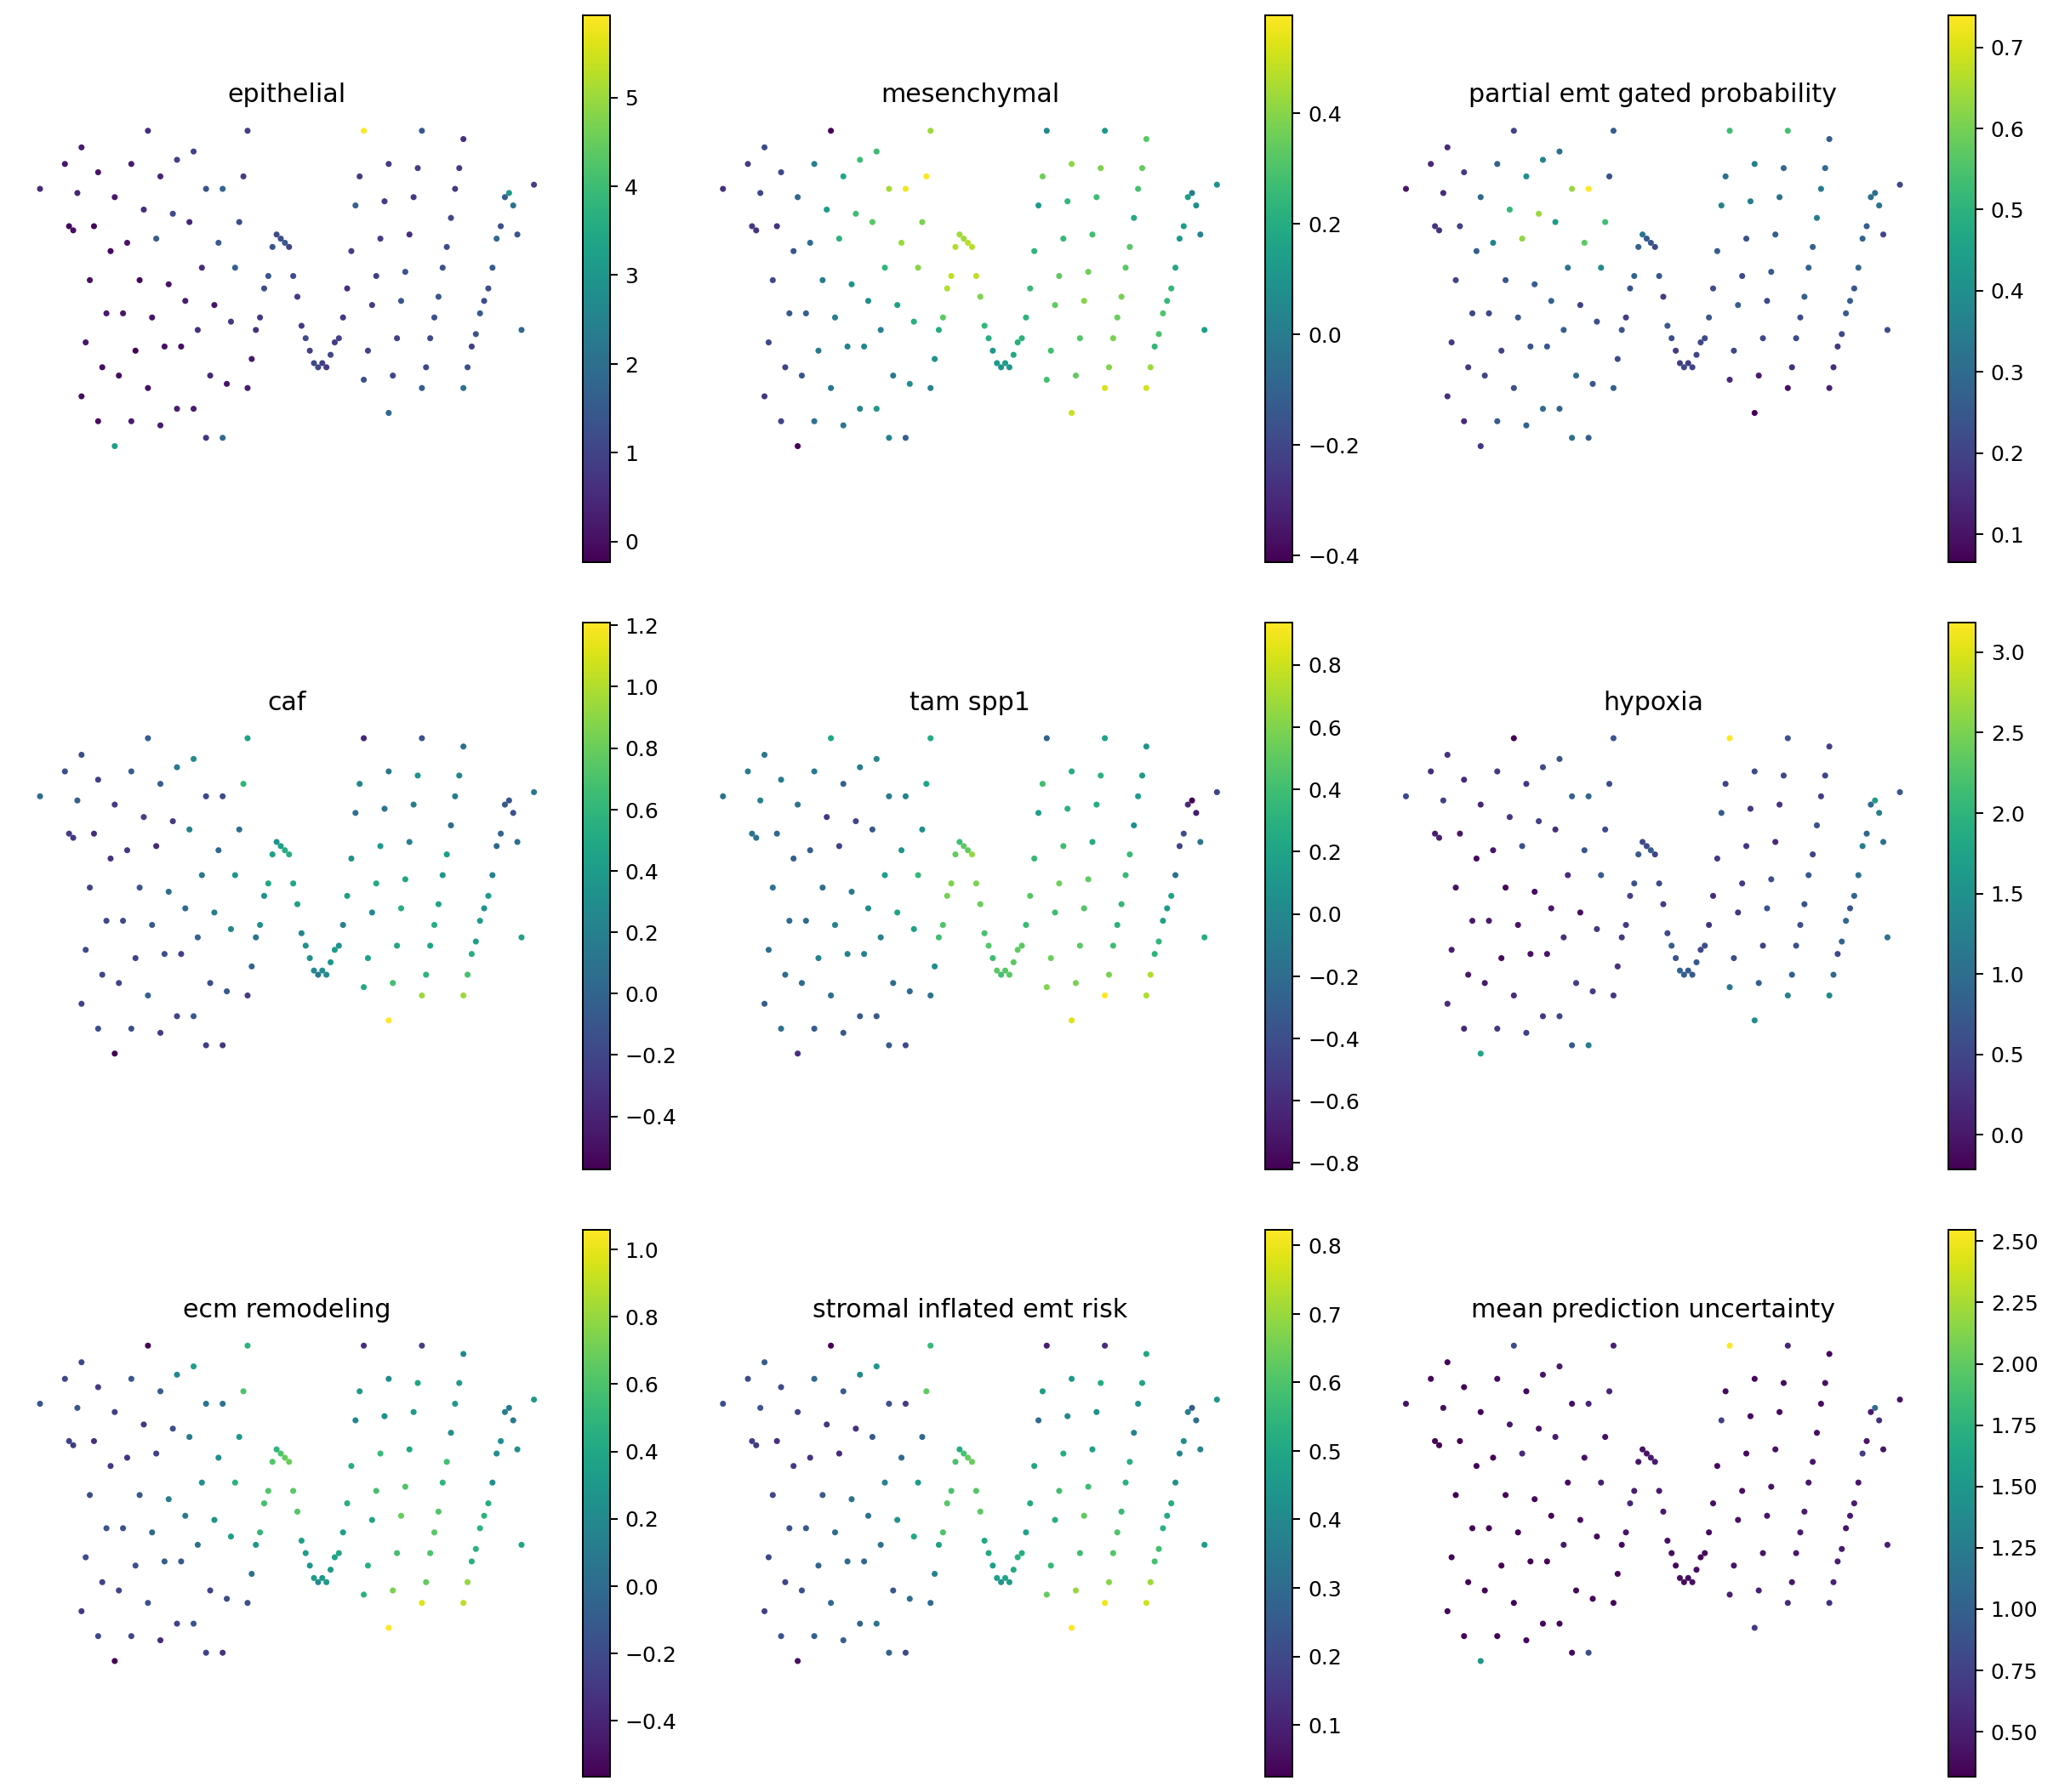
The output is a reviewable hypothesis map, not a hidden score
Each spot carries
• Eight program predictions
• Prediction uncertainty
• Malignant partial-EMT gate
• Stromal-inflation risk
• Abstain / review status
• GeoJSON hotspot export
Interpret together: signal + contamination + uncertainty + morphology
09
Notes:
Describe the outputs as spatial review tools. A high partial-EMT probability means morphology resembles training regions under the label definition; it does not prove gene expression.
[Sources]
- Local output: data/processed/emt_virtual_spatial_staining_v1/resnet50/maps/CytAssist_FFPE_Human_Lung_Squamous_Cell_Carcinoma_virtual_stains.png
- Local interpretation rule: docs/emt_virtual_spatial_staining/README.md

Slide 10
Held-out data rejected both image controls
Predefined gate = 0.35
Result
Neither representation generalized adequately to held-out lung and colorectal spots.
Useful signal
The handcrafted epithelial program reached 0.310, below the 0.35 gate. Pure-stroma false-positive control passed.
10
Notes:
Pause here. The correct finding is that the controls failed. This protects the project from turning attractive maps into unsupported molecular claims.
[Sources]
- Local benchmark: docs/emt_virtual_spatial_staining/backend_benchmark_summary.tsv
- Local gates: data/processed/emt_virtual_spatial_staining_v1/resnet50/emt_vista_go_no_go.tsv

Slide 11
A failed performance gate is a scientific result, not a software failure
What the run establishes
What the run does not establish
• End-to-end paired-data pipeline works
• Lung and CRC stay outside model fitting
• Uncertainty and safety metrics are reported
• Maps align correctly with H&E
• Weak baselines are honestly rejected
• H&E directly measures EMT
• Hotspots are true invasive fronts
• Performance transfers across patients
• The method is clinically actionable
• A negative baseline disproves the concept
Conclusion: the framework is ready for a stronger experiment; the biomarker is not ready for use.
11
Notes:
Use this slide to demonstrate research maturity. Separate engineering completion from biological validation and clinical readiness.
[Sources]
- Local implementation report: docs/emt_virtual_spatial_staining/implementation_report.md
- Local research article draft: docs/emt_virtual_spatial_staining/research_article_draft.md

Slide 12
Lung and colorectal slides expose different morphology domains
Lung squamous
Colorectal / intestinal
12
Notes:
Point out domain differences in tissue architecture and stain distribution. Cross-cancer holdout performance is intentionally hard and may require cancer-specific heads or larger heterogeneous training cohorts.
[Sources]
- Local lung output: data/processed/emt_virtual_spatial_staining_v1/resnet50/maps/CytAssist_FFPE_Human_Lung_Squamous_Cell_Carcinoma_he_overlay.png
- Local colorectal output: data/processed/emt_virtual_spatial_staining_v1/resnet50/maps/Visium_FFPE_Human_Intestinal_Cancer_he_overlay.png

Slide 13
The project is strong as a research platform and limited as a biomarker
Advantages
Limitations
• Uses routine H&E and public paired data
• Targets biologically coherent programs
• Explicitly models stromal contamination
• Produces uncertainty and abstention
• Reproducible modular GitHub workflow
• Negative results remain visible
• Small number of slides and patients
• Spatial spots remain mixed compartments
• CPU benchmarks sample spots
• Foundation model not benchmarked at scale
• No blinded pathologist labels
• No external institution or prospective endpoint
13
Notes:
Present the trade-off clearly. The advantages justify continued research; the limitations define the next experiments and prevent clinical overclaiming.
[Sources]
- Local student report: docs/emt_virtual_spatial_staining/student_project_report.md

Slide 14
Four design choices make EMT-ViSTA more than expression regression
01
Risk-aware partial EMT
02
Spatial morphology
Joint epithelial/mesenchymal evidence plus a separate stromal-risk output.
Center, context and neighborhood representations model tissue organization.
03
Selective prediction
04
Predefined falsification
Calibration, ensemble spread and abstention define when the model should remain silent.
Release gates are fixed before interpretation, so a visually attractive map cannot override failed evidence.
14
Notes:
These are the project highlights to use in an interview. They communicate novelty without claiming state-of-the-art predictive accuracy.
[Sources]
- Local interview guide: docs/emt_virtual_spatial_staining/interview_and_viva_guide.md

Slide 15
The next study must move from slides to patients
Now
Next
Then
Decisive
Full-scale Phikon / H-Optimus
Compartment-resolved labels
Patient-level validation
External institution
Run all spots on CUDA; compare under the same frozen gates.
Matched scRNA deconvolution plus two-pathologist region annotations.
Leave-patient-out lung and CRC cohorts with confidence intervals.
Untouched scanner, center and technology; prospective assay-triage endpoint.
Success means passing frozen external-validation gates, not reaching 100% software completion.
15
Notes:
This is the execution roadmap. Emphasize patient-level units, pathology annotation and external centers as the real validation unlocks.
[Sources]
- HEST-1k repository. https://github.com/mahmoodlab/hest
- Local project plan: docs/emt_virtual_spatial_staining/detailed_project_plan.md

Slide 16
Interview pitch: a trustworthy virtual stain abstains
30-second pitch
Remember
I built EMT-ViSTA, a multimodal pipeline that learns spatial EMT and tumour-microenvironment programs from routine H&E using paired spatial transcriptomics. Its novelty is contamination-aware partial-EMT prediction with uncertainty and abstention. The first lung and colorectal holdouts rejected simple image baselines, which gave us an honest roadmap toward pathology-foundation, patient-level and pathologist-validated studies.
• Problem before tools
• Why each control matters
• Results without spin
• Limits define next experiments
• Maps nominate; assays validate
The strongest answer is not ‘the model worked.’ It is ‘the study design prevented us from claiming that it did.’
16
Notes:
Close by resolving the opening tension. The project is valuable because it creates a rigorous bridge from routine pathology to spatial hypotheses while preserving the right to abstain.
[Sources]
- Local interview guide: docs/emt_virtual_spatial_staining/interview_and_viva_guide.md
- Local implementation report: docs/emt_virtual_spatial_staining/implementation_report.md

